Slide 1
Thinking Strategically, MBSE using UAF: A Tale of 2 SAR Models

Slide 2
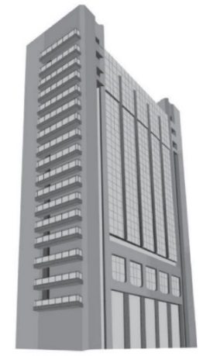
We need a Strategic Approach to MBSE
Grady Booch’s Taxonomy of Approaches
Dog House
My House
City Block
Advanced Requirements
Quality Materials
Advanced tools
Advanced Skills
-Builders, architects and
electricians
-Communication/ coordination
-Monitoring the plans
Complex processes
Massively Increased scale and complexity
-Legal/Permits/Codes
-Diverse Stakeholders
Volatile requirements
Integrated processes
IMS/Configuration Mgmt
Advanced materials
Integrated tools
Enterprise Skills
Planners, Architects, Zoning Commission…etc.
Communication/coordination
Basic Requirements
Basic Materials
Basic tools
Basic building skills.
-Basic hand-to-eye
co-ordination
“Systems, units and forces must be able to provide and
accept data, information, materiel and services to and from
other systems, units and forces…” DoDD 5000.01
¹ Booch G., Rumbaugh J., Jacobson I. The Unified Modeling Language User Guide. 2nd edn. Addison-Wesley:Boston, MA; 2005

Slide 3
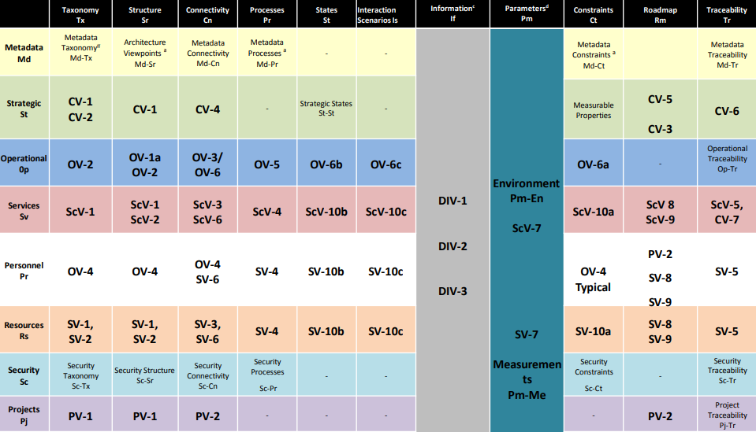
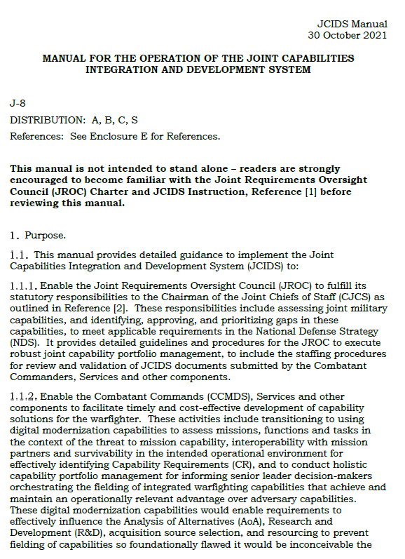
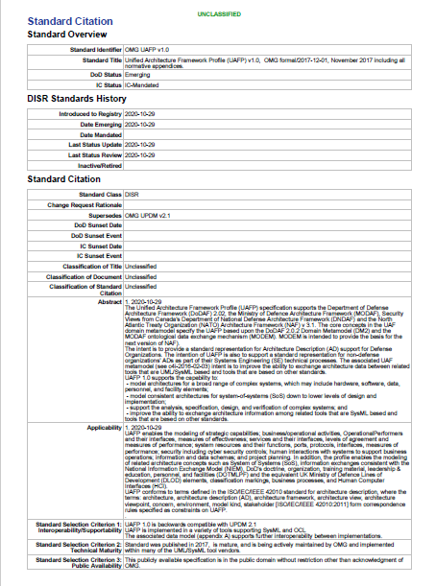
UAF Meets JCIDS Requirements
DISR UPDM2.1 Mandate 3/14/2012
Retired Oct 2020
UAF Grid Maps to DODAF Viewpoints
-Includes Security and Personnel Views
DoDAF 2.0 Compliance Mandate 5/20/2009
JCIDS Manual 30 Oct 2021
UAF – Current Architecture Standard
JCIDS still requires interoperability analysis evidence be provided in DoDAF Described Artifacts

Slide 4
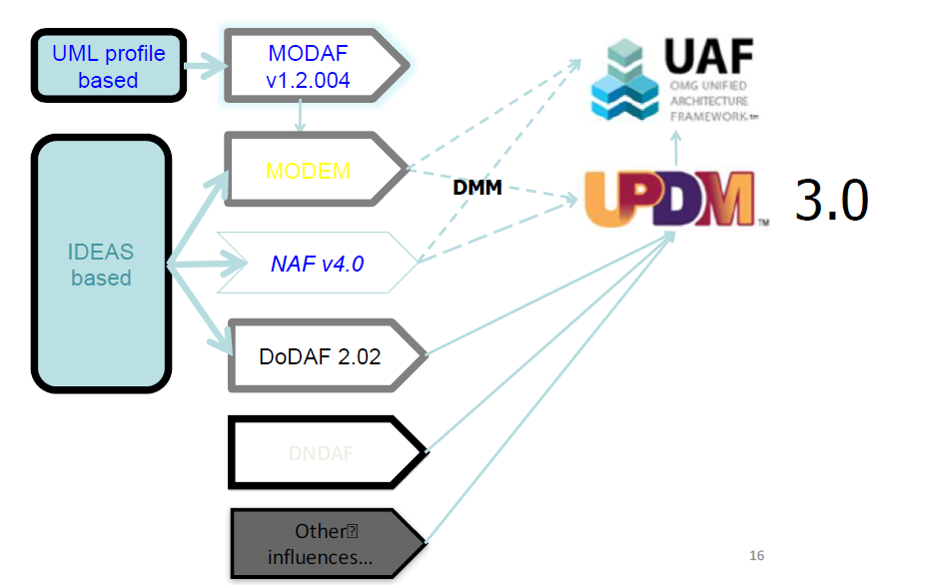
UAF Supports Joint/Multinational Integration
AND Digital Engineering
Ministry of Defence Architecture Framework
MODEM
2.1
MODAF Ontological Data Exchange Model
NATO Architecture Framework
DNDAF
Canadian Department of Defense,DND/CF, Architecture Framework

Slide 5
Authoritative System Representations
UAF Strategic Views
Strategic Architecture
Goals
Conceptual Architecture
(and associated behaviors)
System (Logical) Architecture
(and associated behaviors)
Developed by Government;
Owned by
Government
UAF Operational Views
UAF Resource/Service Views
Physical Architecture
(and associated behaviors)
Developed by Contractor;
Delivered to Government
SysML or UAF Resource/Service Views
Unclassified
PEO MS Digital Enterprise Team
-- Complexity is the Simplest Thing we do All Day

Slide 6
Search and Rescue Mission
Great work is being done to further the DE vision
Problem: System Specific – generally not shareable
Solution: OMG / Public Domain SAR Concept -Sharable
Problem: Example SAR models from vendors describe only how the diagrams should look in DoDAF -Not how to use UAF in an SE / DE application
Solution: The community could create and share models and methodology approaches to meeting both the JCIDS and SE needs of the acquisition community using the SAR construct
…so on to the 2 SAR models

