Slide 1
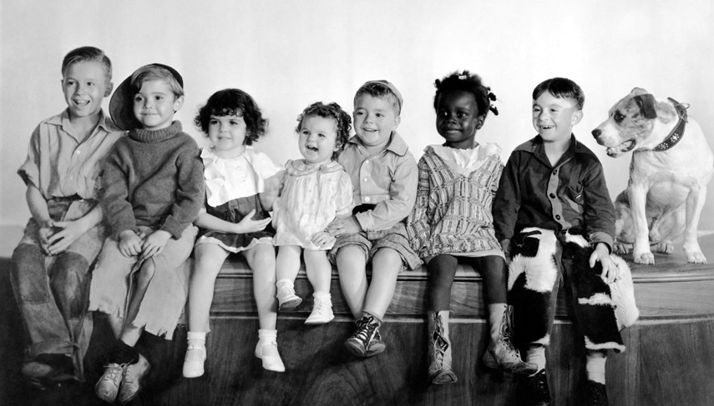

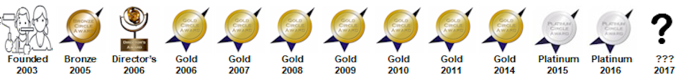
Bob
Regina
Erik
(in drag)
ENCHANTMENT CHAPTER 2003++
Francis
Curt
Murray
Notes:
Chapter Banner Loop for Holiday December 8, 2017 Social

Slide 2
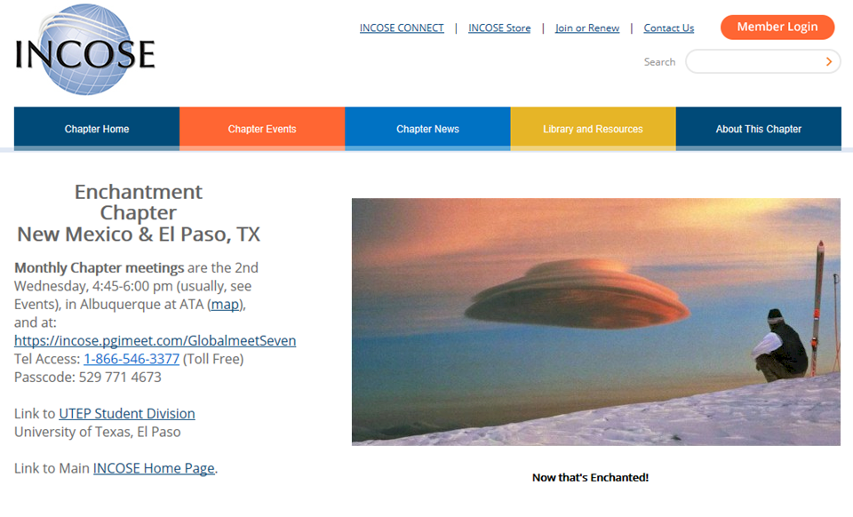
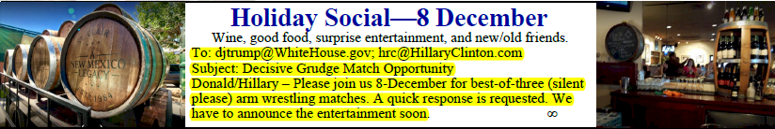
www.incose.org/enchantment

Slide 3
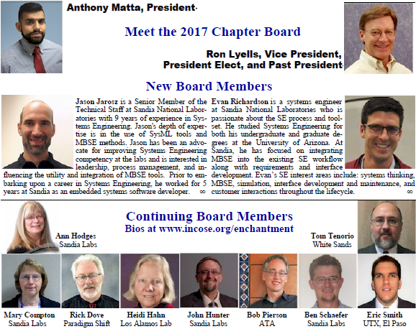

Slide 4
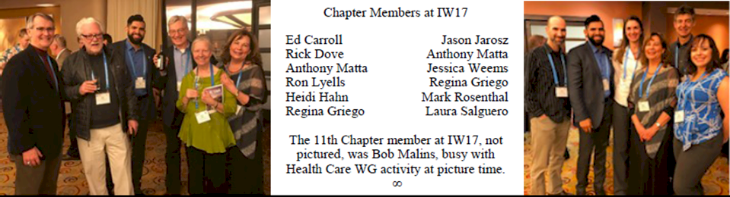
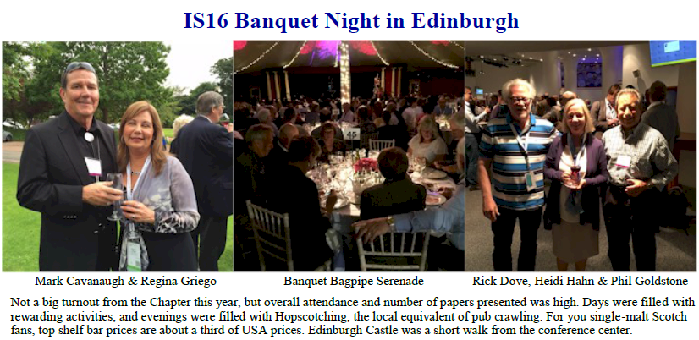
Chapter Members at IW17

Slide 5
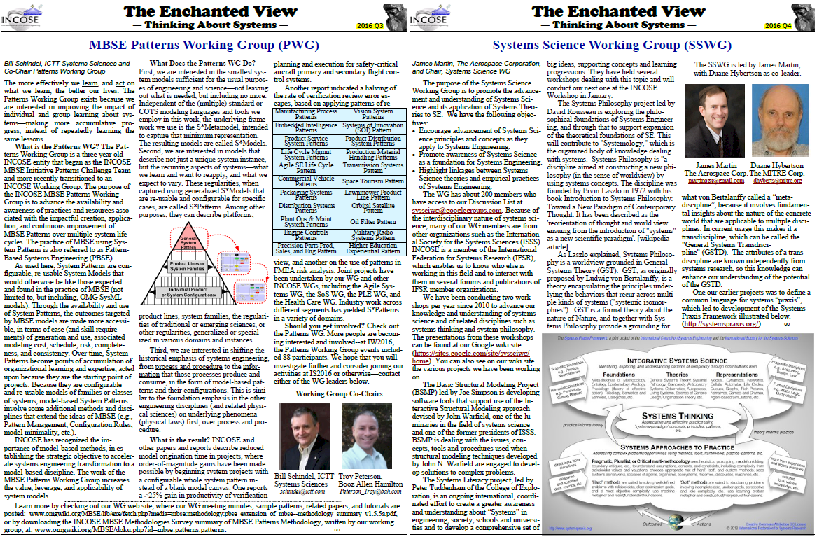
Working Group Feature in Every Newsletter

Slide 6
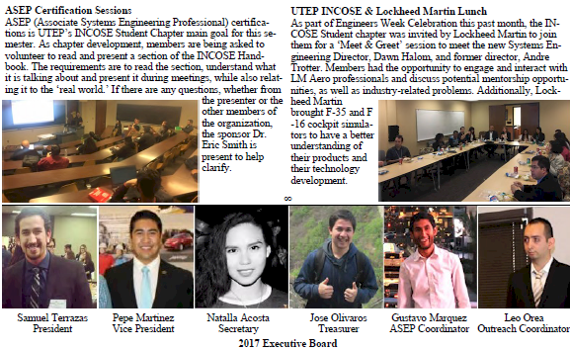
UTEP Student Division

Slide 7
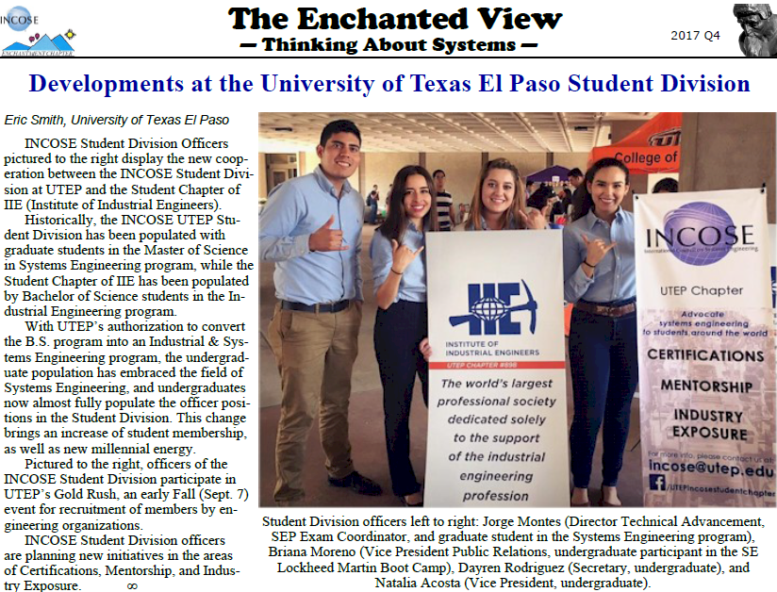

Slide 8
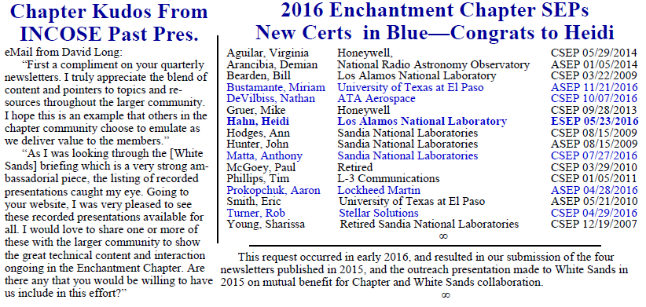

Slide 9
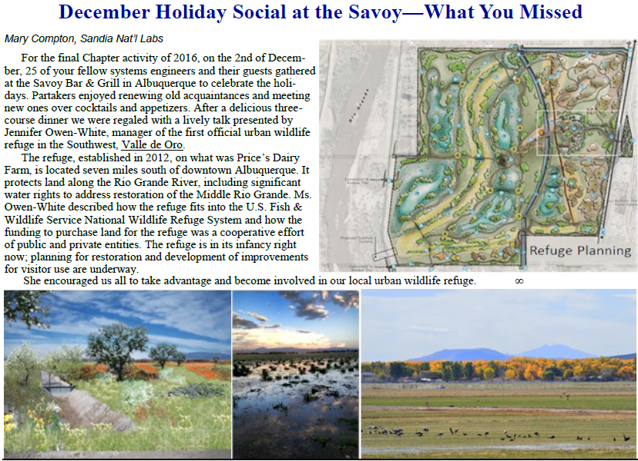
December 2016 Holiday Social at the Savoy – Valle de Oro

Slide 10
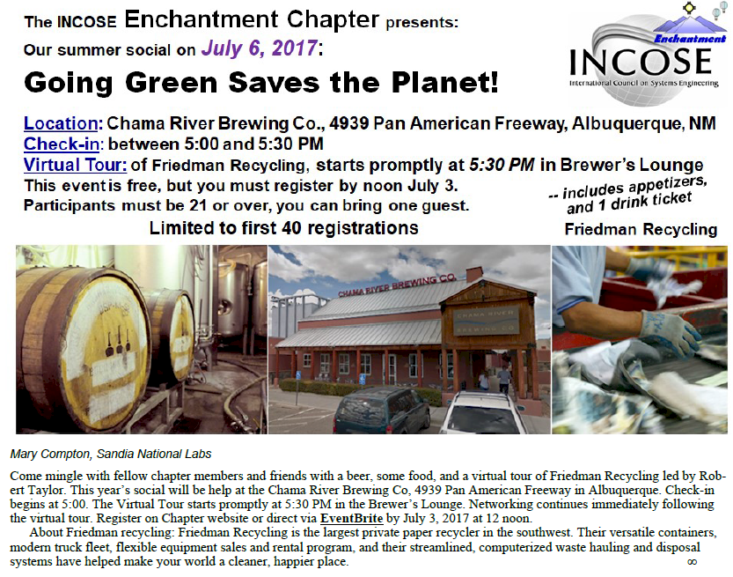

Slide 11
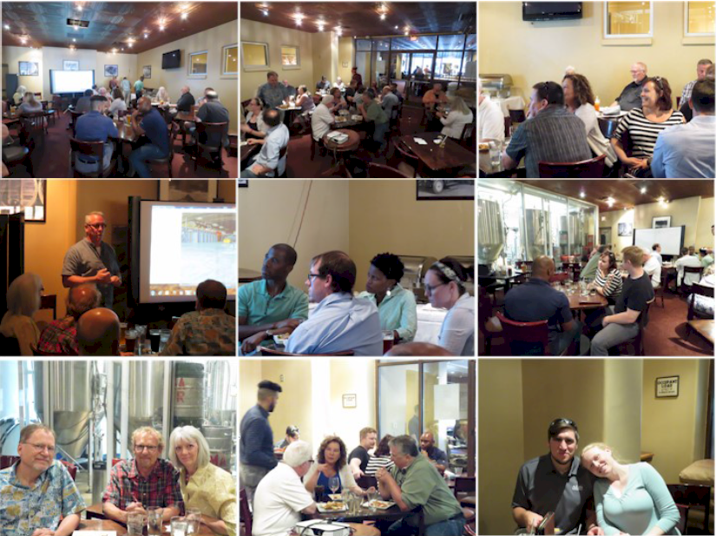

Slide 12
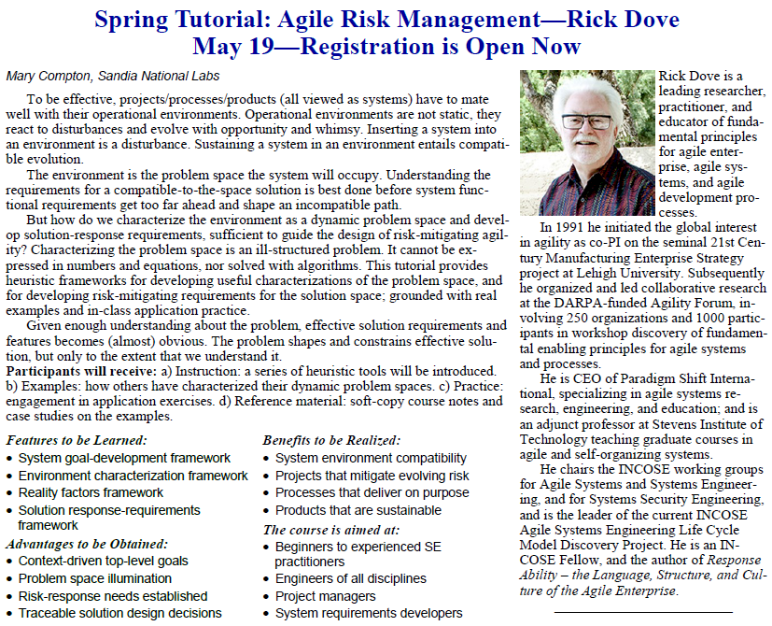

Slide 13
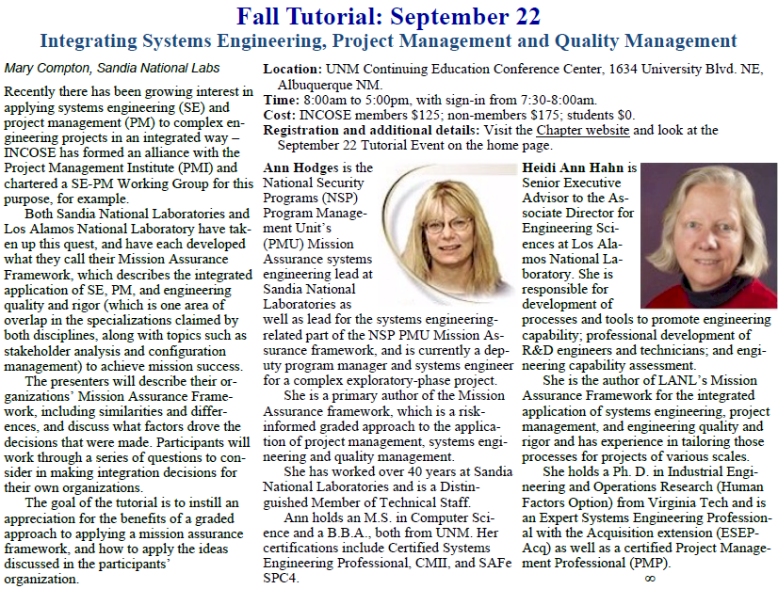

Slide 14
Enchantment Chapter - 2017 Meeting Archive
Dec 8, 2017 John Hunter producing, Mary Compton speaking, Sandia National Labs
Holiday Social Flyer - Lions, Zebras, and Giraffes, Oh My!
Nov 9, 2017 Cihan Dagli, Missouri University of Science & Technology
Architecting Cyber Physical Systems, Recording not available.
Oct 11, 2017 Donna Rhodes, Massachusetts Institute of Technology
Why is Human-Model Interactivity Important to Model-Centric Systems Engineering? Recording
Sep 13, 2017 Len Troncale, California State Polytechnic University
Beyond Biomimicry to Systems Mimicry, Recording
Aug 9, 2017 Rick Dove, Paradigm Shift International
Agile Systems and Processes 106 – Risk Management and Mitigation, Recording
July 6, 2017 Mary Compton producing and Robert Taylor speaking, Friedman Recycling
Summer Social Event at Chama River Brewing Company – Flyer
June 14, 2017 Regina Griego, Sandia National Labs
Defining “System” – a Comprehensive Approach, IS17 Paper, Recording
May 10, 2017 Dawn Schaible, NASA
Developing the Next Generation of Systems Engineering Leaders, Recording
April 12, 2017 Bill Schindel, ICTT System Sciences
ASME Work in Computational Model V&V Standardization, Recording
March 8, 2017 Alan Benson, California Department of Transportation
Integration of Agile Principles into the Systems Engineering Lifecycle Model, Recording
February 8, 2017 Mark Blackburn, Stevens Institute of Technology
Transforming Systems Engineering to Model-Centric Systems Engineering, Recording
January 11, 2017 Heidi Hahn, Los Alamos National Laboratory
A Mission Assurance Framework for R and D Organizations, Recording

Slide 15

We pioneered the Systems Summit Concept
in Socorro at New Mexico Tech in 2016
with an Encore in 2017 – Will it Happen Again?

Slide 16
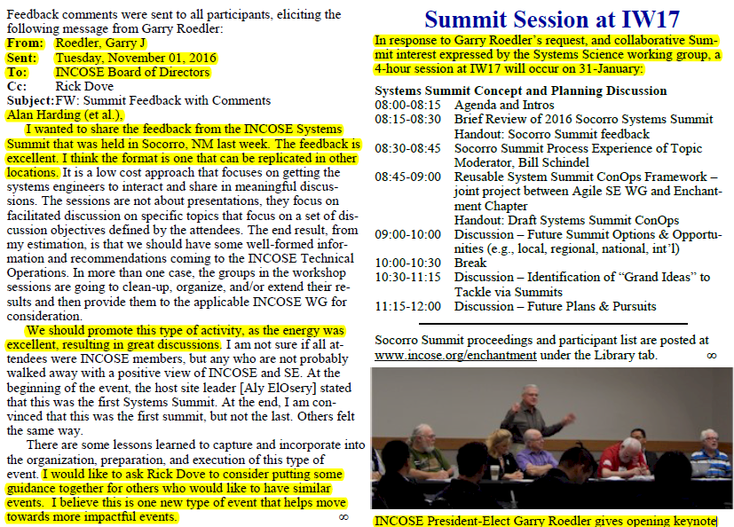

Slide 17
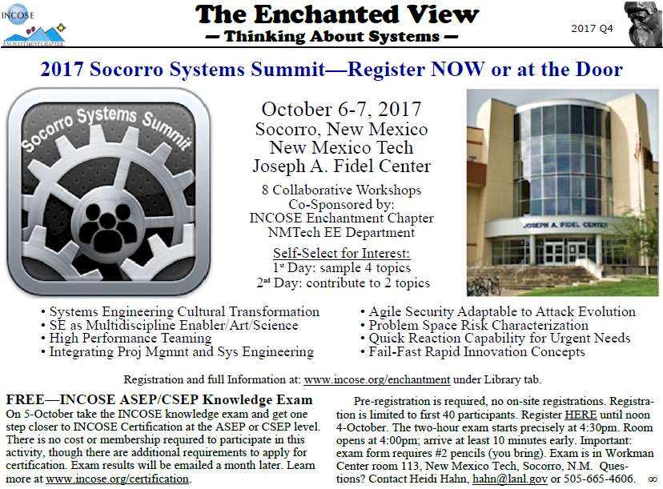

Slide 18
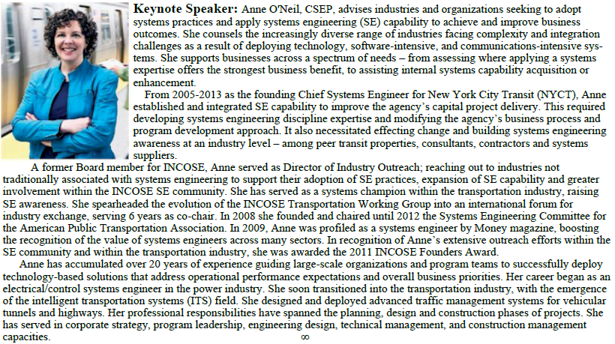

Slide 19
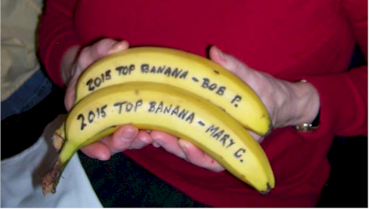
Chapter Recognizes Outstanding Performers

Slide 20
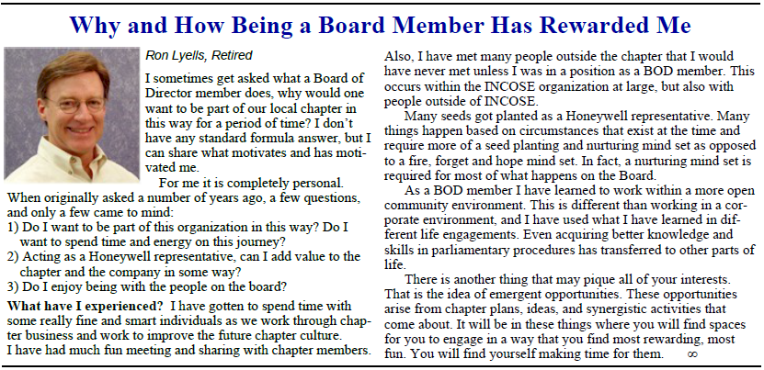
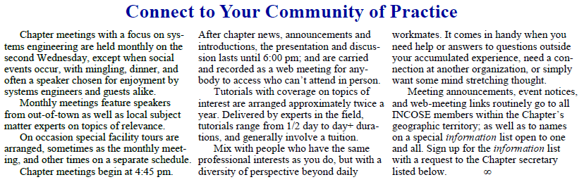

Slide 21
Director’s Value-Based Personal Engagement
Annual 4-hour strategic planning retreat – with President’s straw-man in advance.
Eleven 1-hour BOD meetings: pre-lim agenda, final agenda, pre-reading facilitates tight-schedule adherence for timely BOD decisions.
Proper by laws and BOD meetings: Robert’s Rules.
Timely BOD minutes with traceable decisions and actions.
BOD recruitment: for diversity, valued professional development, engagement.
Budget and treasury quarterly reviews: operate at break even, maintain reserve.
Member communications: effective and kept to a minimum.
Criteria-based meeting speaker/topic selections: not who’s available, but who’s appropriate.
Criteria-based tutorial leader/topic selections: not who’s available, but who’s appropriate.
Tutorial production: two days/year, affordable, supported effectively.
Social event production: subsidized, dinner, attractive location/event, networking, recruitment, planned, supported, and implemented effectively.
Regional event production: member engagement and professional development, planned, supported and implemented effectively.
Newsletter: public face of the Chapter, value to members, and recruitment tool.
Web site: public face of the Chapter, value to members, and recruitment tool.

Slide 22
2017 Enchantment Chapter Strategic Plan
VALUES
Serving members
Excellence
Integrity
Responsibilities
Goal 1: Director of Outreach
Goal 2: Director of Professional Development
Goal 3: VP, President Elect
Goal 4: President
VISION
Be the professional organization that is the regional focal point
for the SE Community of Practice.
MISSION
Provide professional development value to members.
STRATEGIES
Grow synergistic involvement with regional organizations.
Implement member professional development opportunities & engagement.
Cultivate member-attracting appreciation of Chapter performance.
HISTORY
Established 2003
Bronze Award 2005
Director’s Award 2006
Gold Award 2006, 2007, 2008, 2009, 2010, 2011, 2014
Platinum Award 2015, 2016
Reputation GOAL 1
Recognized as the
Regional Voice-of-SE
OBJECTIVE
Need: Awareness in the community of INCOSE and Chapter as valued resources.
Intent: Effective member and Chapter involvement with regional organizations.
OPERATIONAL ACTIVITIES
Ascertain appropriate regional interests.
Facilitate regional interaction.
Provide regional interaction.
Develop value proposition for chapter and target regional interactions.
Reputation GOAL 2
THE Go-To Place for
Professional Development
OBJECTIVE
Need: Local resource for meaningful SE professional development.
Intent: Exposure to SME’s in the theory and practice of leading SE concepts.
OPERATIONAL ACTIVITIES
Ascertain member interests.
Provide in-demand talks/tutorials.
Facilitate member active engagement.
Facilitate INCOSE WG involvement.
Facilitate SEP certification.
Reputation GOAL 3
Member-Rewarding
Activities
OBJECTIVE
Need: Opportunities for active engagement with Chapter resources.
Intent: Member-attracting projects and workshops that engage Chapter members.
OPERATIONAL ACTIVITIES
Ascertain member interests.
Provide facilitated member active-engagement.
Facilitate INCOSE WG involvement.
Reputation GOAL 4
Reliable and Effective
Chapter
OBJECTIVE
Need: Chapter strategic and operational effectiveness.
Intent: Development and execution of goal-achieving
Strategic and Operational Plans.
OPERATIONAL ACTIVITIES
Planning at Strategic and Operational levels.
Review execution effectiveness of all goals

Slide 23
Circle Awards
Went after Circle awards initially as “good-chapter” guidance.
But in 2012/13 we thought:
Award criteria had no affect on what the Chapter actually did.
What got done was only because somebody wanted to do it,
not because someone else thought it ought to be done.
What got done was good accomplishment for Chapter mission.
Felt it was micro management by INCOSE Central with misplaced values,
many categories of insufficient interest to engage quality leadership.
We used it simply to get a trophy???
Conclusion: A lot of work and frustration for no real value.
Now we think differently, and use the award criteria for purpose:
Makes us reflect on what was actually done, and appreciate who’s engaged.
Provides ideas for consideration.
Good VP prep and thought stimulation for upcoming Presidential year.
VP is responsible for submission, with assistance BOD-wide.
President has prior experience, assists heavily, and owns the award as legacy.

Slide 24
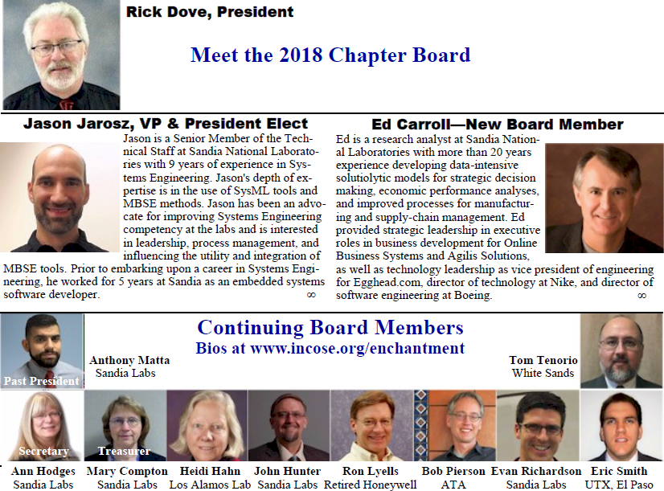

Slide 25
