Slide 1


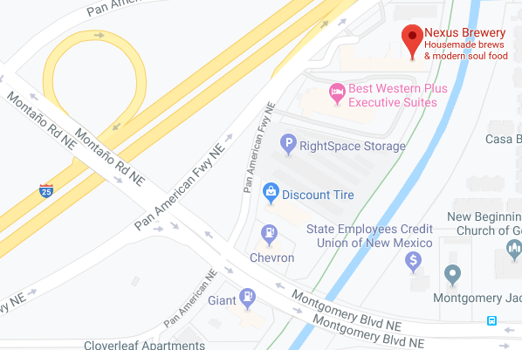
The INCOSE Enchantment Chapter presents:
2019 2nd Annual Systems Engineering Challenge Event
Network with your fellow SE professionals to explore SE challenges submitted by Chapter members – collaboratively discuss the nature of the challenge, brainstorm suggestions to overcome issues & amplify positive aspects.
Where: Nexus Brewery, 4730 Pan American Fwy NE, Albuquerque, NM 87109
When: Wednesday, September 11, 2019, 5:30pm – 7:15pm Check in @ 5:30pm, networking 5:30pm – 6:15pm, discussion 6:15pm – 7:15pm, and optional dinner (on your own) 7:15pm – 9:00pm
Submit your challenge idea to Ann Hodges by COB September 6. In your submission, include the verbiage you want shared for the challenge and how you want to be identified (anonymous is fine).
Admission: Free, register via EventBrite by September 10, 2019 at 5 pm. Event includes free appetizers and 1 drink of your choice (fine microbrewed beer or other) from Nexus.
**Event limited to 35 guests! Must be 21 to consume alcohol**
Follow the Enchantment Chapter on Social Media
Nexus Brewery location:
https://twitter.com/EnchantIncose
https://www.linkedin.com/company/incoseenchantment

