Slide 1

Welcome!
INCOSE Enchantment Chapter Monthly Meeting
We’re glad you’re here.

Slide 2

We respectfully request:
Mute your audio when you are not speaking
*6 toggle or in GlobalMeet left-side, your name
Discussion and questions are encouraged!
Put questions in the chat box or unmute yourself to speak up.

Slide 3
Meeting Materials
Slide presentations can be downloaded prior to start of the meeting from the Meeting Materials page of our website:
https://www.incose.org/incose-member-resources/chapters-groups/ChapterSites/enchantment/resources/meeting-materials
If recording is authorized by speaker, the video will be posted at the link above within 24 hours.

Slide 4
SEP Training
CSEP Courses by Certification Training International:
  CTI currently is offering online course offerings, see
  https://certificationtraining-int.com/incose-sep-exam-prep-course/
  Our chapter has two SEP mentors:
  Ann Hodges alhodge@sandia.gov
  Heidi Hahn drsquirt@outlook.com

Slide 5
Upcoming meetings
September 8, 2021: Brian Kennedy, Leveraging Set-Based Practices to Enable Efficient Concurrency in Large Systems and Systems-of-Systems Engineering
October 13, 2021: Jim Armstrong – “Kitchens”
November 10, 2021: Jennifer Russell – “Smart Cities” (tentative)

Slide 6

Introductions
Please type your name, position, and organization in the Chat window
Photo by Adam Solomon on Unsplash

Slide 7
Survey
The link for the online survey for this meeting is
www.surveymonkey.com/r/2021_08_MeetingEval
Your feedback is important!

Slide 8
Enchantment Chapter Monthly Meeting
WBS Integration with an Effective Schedule
Abstract: This presentation addresses the following questions:
How a WBS fits into the big picture of planning and managing a project
Why the WBS should form the foundation for project schedule development and elaboration
The hierarchical structure of a WBS
WBS nodes vs. project activities
Managing and relating WBS data within a project schedule
Download recording from the Library at www.incose.org/enchantment
NOTE: This meeting will be recorded

Slide 9
Speaker Bio
Patrick Foley is a highly experienced project controls data specialist who has built and supervised the deployment of complex project data management platforms. His business and technical qualifications span more than 30 years. He is employed by PM Tec Inc. and currently on contract to Sandia Laboratories. As a scheduling expert he has functioned as a team lead, team member, and subject matter expert in schedule controls for projects requiring broad institutional implementation as well as projects requiring detailed unit operation process improvement. He is a scheduling expert in both Microsoft Project and Primavera P6. He is also an accomplished VBA code writer and database designer/engineer. As an active volunteer with the local PMI (Rio Grande) Chapter, he has delivered PMP prep course material for the chapter and conducted scheduler boot camp training at Sandia Labs.
Mr. Foley is a certified Project Management Professional (PMP) and holds an M.A. in Information and Communication Studies from California State University and a B.S. in International Business from the University of Colorado, Boulder.

Slide 10
The Work Breakdown Structure or “WBS”
Patrick Foley
8/11/2021

Slide 11
Topic Organization
WBS Defined
Organization of the WBS
WBS as a Scope Statement
Detail activities as they relate to the WBS
WBS in the context of a project and activity derivation
Numbering the WBS
The PWBS & CWBS
WBS is an attribute in a schedule database
WBS as it relates to Earned Value

Slide 12
The WORK in the Work Breakdown Structure (WBS)
12
The WBS is a parcel containing descriptors of ALL of the WORK required to execute a specific project.
1
Pyramid
Notes:
Time: 1 min
Emphasize: difference between WBS and network/schedule
Detail tasks should NOT be in the WBS,
If they are, they would be found at the “atomic” or lowest level within a branch of the WBS
Remove them to the schedule if you can

Slide 13
WBS is “Broken Down”
13
WBS is broken down into a collection of smaller, manageable parcels
Enables the organization of work, resource assignment and costs
Parcels are usually organized by component.
1
Pyramid
1.1
Foundation
1.2
Walls
1.3
Burial Chamber
1.4
Treasure
Notes:
Time: 1 min
Emphasize: difference between WBS and network/schedule
Detail tasks should NOT be in the WBS,
If they are, they would be found at the “atomic” or lowest level within a branch of the WBS
Remove them to the schedule if you can

Slide 14
Work Breakdown Structures (WBS) - Graphically
The WBS is a hierarchical breakdown of project effort into lower level units of work (e.g. Work Packages) by deliverable product, existing procedures or process, etc.
There is NO precedence logic or durations within the WBS. It is NOT a logical network/schedule.
It represents the foundation of the Earned Value Management environment (Cost/Control Accounts) AND the “parents” of schedule activities.
14
1
Pyramid
1.1
Foundation
1.2
Walls
1.3
Burial
Chamber
1.4
Treasure
1.1.1
Survey
1.1.2
Leveling
1.1.3
Grading
1.2.1
North Wall
1.2.2
South Wall
1.2.3
East Wall
1.2.4
West Wall
1.3.1
Pharaoh
1.3.2
Pharaohess Chamber
1.4.1
Floor
1.4.2
Ceiling
1.4.3
Walls
1.2.2.1
Secret
Entrance
1.2.4.1
Entrance
1.3.1.1
Floor
1.3.2.1
Floor
1.4.3.1
Secret
Entrance
1.2.2.2
Trap Door
1.2.4.2
Booby Trap
1.3.1.2
Ceiling
1.3.2.2
Ceiling
1.4.3.1
Entrance
1.2.4.3
Arming Mechan.
1.3.1.3
Walls
1.3.2.3
Walls
1.4.3.2
Booby Trap
1.3.1.3.1
Entrance
1.3.2.3.1
Entrance
1.4.3.3
Arming Mechan.
Notes:
Time: 2 min
The WBS is NOT a network!

Slide 15



WBS in the “Triple Constraint” of Project Management
15
SCHEDULE
GOOD,
FAST or CHEAP?
RESOURCES
The WBS chart is a GRAPHICAL DEPICTION of a project scope statement
Changes to one will affect the others.
You can only optimize two at a time!
SCOPE
Modifications to the WBS
are likely to impact SCHEDULE
and/or RESOURCE requirements
This Photo by Unknown Author is licensed under CC BY-SA-NC

Slide 16
Basic Schedule development/elaboration
16
WBS
Activity List
Activity
Precedence
Duration
Estimates
Assign
Resources
Develop Project Work Breakdown Structure (WBS)
Decompose WBS into activity list
Determine Activity Precedence
Estimate activity durations
Assign Resources
Notes:
Time: 2 min
Once you have ACTIVITIES, MILESTONES, PRECEDENCE and DURATIONS you have a basic schedule and it begins to take on a life of its own.
The process is rarely this “clean”, just do your best to keep the ideal process in mind

Slide 17
WBS Within the Big Picture of a Project
17
Notes:
Time: 1 min
This is a highly DETAILED conceptual project flow;
Emphasize the schedule development and schedule management elements

Slide 18
Numbering the WBS
While there is no specific rule on what type of numbering system to use in a WBS, the pharaoh’s manager chose to use a simple hierarchical numbering system on each node
18
1
Pyramid
1.1
Foundation
1.2
Walls
1.3
Burial
Chamber
1.4
Treasure Chamber
1.1.1
Survey
1.1.2
Leveling
1.1.3
Grading
1.2.1
North Wall
1.2.2
South Wall
1.2.3
East Wall
1.2.4
West Wall
1.3.1
Pharaoh
1.3.2
Pharaohess Chamber
1.4.1
Floor
1.4.2
Ceiling
1.4.3
Walls
1.2.2.1
Secret
Entrance
1.2.4.1
Entrance
1.3.1.1
Floor
1.3.2.1
Floor
1.4.3.1
Secret
Entrance
1.2.2.2
Trap Door
1.2.4.2
Booby Trap
1.3.1.2
Ceiling
1.3.2.2
Ceiling
1.4.3.1
Entrance
1.2.4.3
Arming Mechan.
1.3.1.3
Walls
1.3.2.3
Walls
1.4.3.2
Booby Trap
You may have organizational standards or requirements for numbering your WBS (i.e. DOD is “MIL-STD-881C”)
1.3.1.3.1
Entrance
1.3.2.3.1
Entrance
1.4.3.3
Arming Mechan.
1.3.1.3.2
Booby Trap
1.3.2.3.2
Booby Trap

Slide 19
Control Accounts & Work Packages in the WBS
Lowest Level Nodes in the WBS = Work Packages
Nodes just above Work Packages = Control Accounts
19
1
Pyramid
1.1
Foundation
1.2
Walls
1.3
Burial
Chamber
1.4
Treasure
1.1.1
Survey
1.1.2
Leveling
1.1.3
Grading
1.2.1
North Wall
1.2.2
South Wall
1.2.3
East Wall
1.2.4
West Wall
1.3.1
Pharaoh
1.3.2
Pharaohess Chamber
1.4.1
Floor
1.4.2
Ceiling
1.4.3
Walls
1.2.2.1
Secret
Entrance
1.2.4.1
Entrance
1.3.1.1
Floor
1.3.2.1
Floor
1.4.3.1
Secret
Entrance
1.2.2.2
Trap Door
1.2.4.2
Booby Trap
1.3.1.2
Ceiling
1.3.2.2
Ceiling
1.4.3.1
Entrance
1.2.4.3
Arming Mechan.
1.3.1.3
Walls
1.3.2.3
Walls
1.4.3.2
Booby Trap
1.3.1.3.1
Entrance
1.3.2.3.1
Entrance
1.4.3.3
Arming Mechan.
Notes:
Time: 2 min
The WBS is NOT a network!

Slide 20
Detail Activities as they relate to the WBS
20
Lowest-level WBS containers (Work Packages) are broken down into schedule activities. Detail activities in a project schedule represent a DECOMPOSITION of the lowest level nodes in the WBS into specific activities.
1
Pyramid
1.1
Foundation
1.2
Walls
1.3
Burial
Chamber
1.4
Treasure
The SURVEY “Work Package”
1.1.1
Survey
1.1.2
Leveling
The LEVELING “Work Package”
Hire Surveyor
Calibrate
Measure
Record
Stake out
Rake down
Water down
If an activity cannot be found in the WBS, it should not be in your schedule
Notes:
Time: 2 min
Emphasize: difference between WBS and network/schedule
Detail tasks should NOT be in the WBS,
If they are, they would be found at the “atomic” or lowest level within a branch of the WBS
Remove them to the schedule if you can

Slide 21
WBS / PWBS / CWBS
WBS = Work Breakdown Structure
  PWBS = Program Work Breakdown Structure
  CWBS = Contract Work Breakdown Structure (> Level 3)
21
1
Pyramid
PWBS
1.1
Foundation
1.2
Walls
1.3
Burial
Chamber
1.4
Treasure Chamber
1.1.1
Survey
1.1.2
Leveling
1.1.3
Grading
1.2.1
North Wall
1.2.2
South Wall
1.2.3
East Wall
1.2.4
West Wall
1.3.1
Pharaoh
1.3.2
Pharaohess Chamber
1.4.1
Floor
1.4.2
Ceiling
1.4.3
Walls
1.2.2.1
Secret
Entrance
1.2.4.1
Entrance
1.3.1.1
Floor
1.3.2.1
Floor
1.4.3.1
Secret
Entrance
1.2.2.2
Trap Door
1.2.4.2
Booby Trap
1.3.1.2
Ceiling
1.3.2.2
Ceiling
1.4.3.1
Entrance
CWBS
1.2.4.3
Arming Mechan.
1.3.1.3
Walls
1.3.2.3
Walls
1.4.3.2
Booby Trap
1.3.1.3.1
Entrance
1.3.2.3.1
Entrance
1.4.3.3
Arming Mechan.
1.3.1.3.2
Booby Trap
1.3.2.3.2
Booby Trap

Slide 22
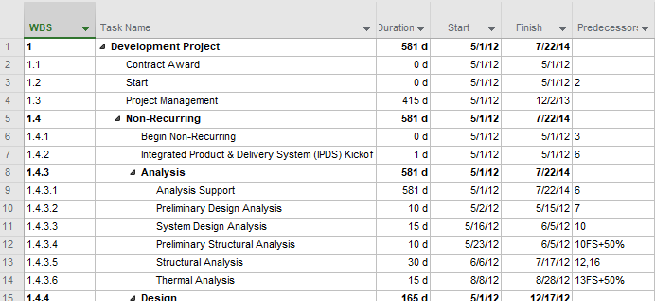
A Project Schedule is a Database
22
Schedule management programs are databases having tables, records and fields integrated with an elegant calculator
The WBS FIELD is one of numerous attributes in a table of your activities
FIELD / Attribute
TABLE
RECORD
This Photo by Unknown Author is licensed under CC BY-SA
Notes:
Time: 3 min

Slide 23
WBS in the Context of Earned Value Management
Basic Terms
23
WBS Work Breakdown Structure
OBS Organization Breakdown Structure
BAC Budget at Complete
PV Planned Value (BCWS)
EV Earned Value (BCWP)
AC Actual Cost (ACWP)
Formulas
CPI Cost Performance Index (EV/AC)
CV Cost Variance (EV - AC)
SPI Schedule Performance Index (EV/PV)
SV Schedule Variance (EV - PV)
TCPI To Complete Performance Index (BAC-EV)/(BAC-AC)
ETC Estimate to Complete (EAC - AC)
EAC Estimate at Complete (BAC/CPI)
IEAC Independent EAC (various)
VAC Variance at Complete (BAC – EAC)

Slide 24
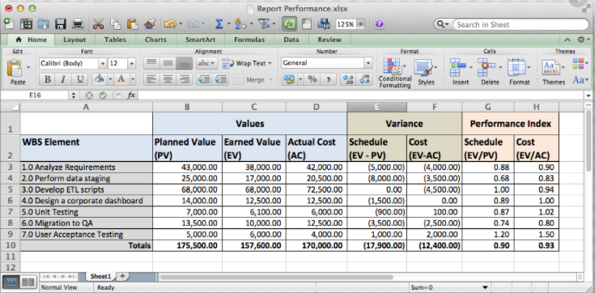
WBS in the Context of Earned Value Management
24

Slide 25


25
?
Questions
+
+
+
This Photo by Unknown Author is licensed under CC BY
Notes:
Time: 10 min

