Slide 1
A Few Words First
Audio Connection –Please mute phone (*6 toggle) –or your GM left-side name
Phone connections may be muted during presentation. Put questions in chat box.
Upcoming Meetings:
September 9: Fall Social – watch for details!
September 17-19: Western States Regional Conference
CSEP Courses by Certification Training International:
  Course details(with more locations and dates)
  Upcoming Course Schedule (somewhat nearby):
  2020 Sep 28-Oct 2 | Austin, TX
  CTI currently is offering online course offerings, see https://certificationtraining-int.com/incose-sep-exam-prep-course/
  Chapter SEP mentors: Ann Hodges alhodge@sandia.gov and Heidi Hahn drsquirt@outlook.com
And now - introductions

Slide 2
Enchantment Chapter Monthly Meeting
4:45pm – 6:00pm MT
A Next-Generation Model-Based Enterprise Maturity Index
Abstract: For any transition journey, one needs a vision for your organization to get started; one needs plans, for your organization to finish; and one needs an index for your organization to define a path for success. This paper introduces the next generation Model-Based Enterprise (MBE) Maturity Index that helps define and normalize the transition from a document-centric, drawing-based business to a part-centric, digital, model-based enterprise. The aim of this paper is to share NNSA’s efforts related to MBE and thus help increase the pace of progress in industry.
Download recording from the Library at www.incose.org/enchantment
NOTE: This meeting will be recorded

Slide 3
Speaker Bio
Sarah Hale has worked as mechanical engineer at Sandia National Laboratories for nine years. She earned a BS from Oklahoma State and a MS from Georgia Tech, both in Mechanical Engineering. She spent eight years as a finite element analyst on the Modeling and Simulation Team and joined the Model Based Enterprise team after noticing that analysis models are frustratingly disconnected from CAD models. As an MBE architect, she works to find ways to connect and reuse all types of models. In her free time, she enjoys volunteering with her church and Girl Scouts.

Slide 4
Today’s Presentation
Things to think about
How can this be applied in your work environment?
What did you hear that will influence your thinking?
What is your take away from this presentation?

Slide 5
A Next-Generation
Model-Based Enterprise Maturity Index
Curtis Brown
Lead Mechanical Engineer, Kansas City National Security Campus (KCNSC)
Sarah Hale
Senior Mechanical Engineer, Sandia National Laboratories (SNL)
Jeffrey Winter
Consultant to National Nuclear Security Administration (NNSA)
Sandia National Laboratories is a multimission laboratory managed and operated by National Technology and Engineering Solutions of Sandia, LLC, a wholly owned subsidiary of Honeywell International, Inc., for the U.S. Department of Energy’s National Nuclear Security Administration under contract DE-NA0003525. SAND2020-2545 C
The Department of Energy’s Kansas City National Security Campus is operated and managed by Honeywell Federal Manufacturing & Technologies, LLC under contract number DE-NA0002839

Slide 6
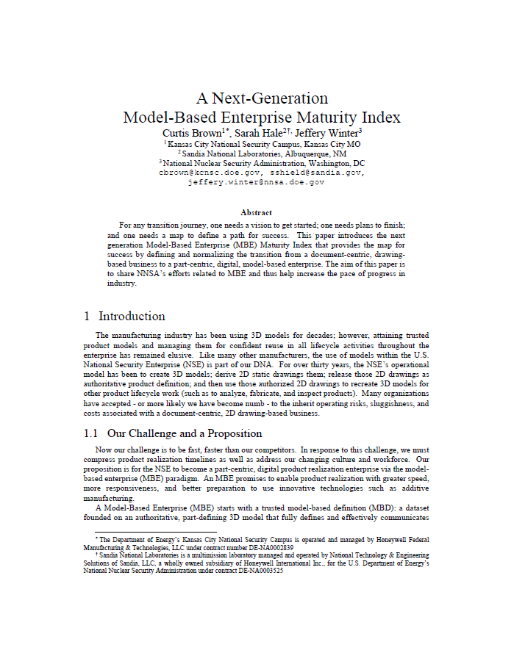
Purpose
Discuss our journey in developing an MBE Maturity Index for the NSE.
Contribute ideas and approaches to industry; Propose this version to industry
Gather feedback for continuous improvement

Slide 7
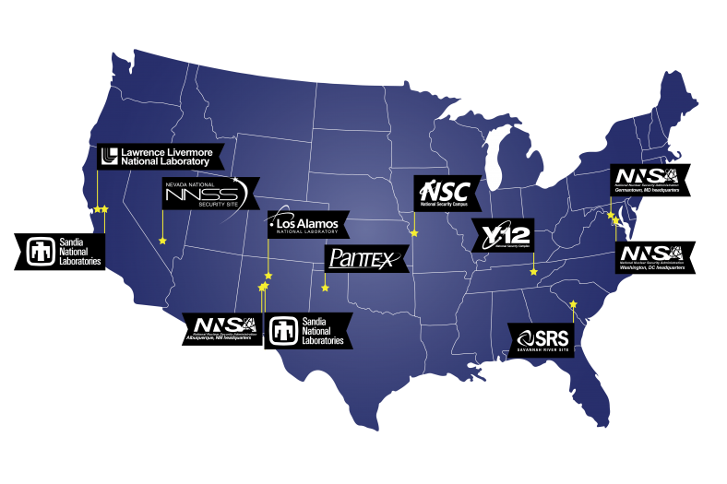
NNSA’s Nuclear Security Enterprise
NNSA is a semi-autonomous agency within the U.S. Department of Energy.
Maintains/enhances safety, security, and effectiveness of the U.S. nuclear weapons stockpile (+more).
Nuclear Security Enterprise (NSE) = NNSA HQ + Management and Operating contractors (M&O) at national labs and plants.
Refer to Backup slides about KCNSC and SNL
Kansas City

Slide 8
The Challenge
Challenge: World is changing
  Keep pace with industry
  Compress Development Timelines
    “We must recapture the ability of our nation to go fast, faster than all potential adversaries, in order to maintain an effective deterrent.” – General John E. Hyten, Commander of U.S. Strategic Command Testimony to Senate Committee on Armed Services, February 26, 2019.
  Workforce and Culture: Attract and retain
  NSE is necessarily adverse to risk and change (safety, security, performance, verification)
Proposition: become a Part-Centric, Model-Based Enterprise (MBE)
  MBE enables end-to-end Digital Product Realization
  Potential for greater speed, responsiveness, & innovation
Model Based Enterprise (MBE) -- An organization that uses digital models and associated datasets as the foundation for the product lifecycle.

Slide 9
Why is an Index Important?
To successfully become an MBE, an organization needs …
  a vision to get started
  A means to drive action for the vision and a basis for action
    ← MBE Maturity Index is the means
  a plan to achieve success.
MBE Maturity Index -- A rubric that an organization uses to assess itself as a model-based enterprise.
  Allows teams / organizations to assess & guide their digital transformation.
  Shows an incremental progression towards becoming more digital, better integrated, better informed, and more automated.
  Common point of reference for communication, planning, and execution.
  Identifies distinctive successes along an organization’s MBE transition.

Slide 10
Evolution, Features, Status of NSE’s MBE Maturity Index
  Foundations:
    1st Generation: MBE Maturity Capability Levels
      DOD - US Mantech – 2010; Roy Wittenburg, Mark Nielsen, Raphael Nascimento
    2nd Generation: MBE Level Assessment Worksheet
      DOD – US Army; Roy Wittenburg, Rich Eckenrode, RECON-Services
  Features of NSE’s MBE Maturity Index
    Scoring Matrix (rubric)
    Implemented as Excel spreadsheet w/ MBE Lexicon
    Structure Extended with Categories, Topics, & Facets (discreteness)
    Vertical and horizontal consistency and continuity
    Assesses target (future) and as-is (current state) for any given set of activities
    As-Is assessment reviewed at three different as-is ratings: Capability (tools), Readiness (processes), Adoption (people)
    Built for the NSE, but normalized for any Digital Product Realization Enterprise
    Embeds notions of trust
    Feedback loop with Lexicon

Slide 11
Initial Lifecycle Scope of NSE’s MBE Maturity Index
Current Maturity Index Coverage
Primary Concept &
Product Requirements
Customer
Requirements
Authorized
Design
Delivered
Product
Disposed
Product
Conceive Product
Design Product
Produce
Product
Service
Product
Manage Product & Process Data
Enterprise Enabling

Slide 12
Maturity Levels on Columns
Each level conveys a consistent theme
  L1 is probably where many are at right now
  L2 validates the models being used
  L3 begins to achieve an MBE state
  L4 represents a complete MBE
  L5 is best practice
  L6 extends capabilities
Level Name | Drawing-Centric | Drawing Model-Centric | Validated Model-Centric | Formalized Model-Based Definition | Trusted Model-Based Definition | Integrated Model-Based Enterprise | Extended Model-Based Enterprise
Level Identifier | L0 | L1 | L2 | L3 | L4 | L5 | L6
Level Theme | 2D Drawings Only; Disconnected | 2D Drawings & STEP Derived from 3D Models; Drawings Managed, Disconnected from Models | 2D Drawings & Equivalent Derivatives from Validated 3D Models; Drawings Managed, Disconnected from Models | 3D Models with Semantic PMI Added; Producing 3D Interactive Viewable (3DIV) Managed as Part-Centric | Digital Model-Based Definition (MBD) , Certified & Authorized; Managed & Sourced as Part-Centric | Enterprise Integrated from Trusted Digital Product Definition Dataset; Process Data Managed with Part-Centric | Enterprise Extended with Optimized Capabilities and Extended Partners
Authorized Definition | 2D Drawing | 2D Drawing | 2D Drawings w/ Support Models | Drawings w/ Support MBD | 3D MBD w/ Support Drawing | 3D MBD Dataset | 3D MBD Dataset
Artifact Management | File-Sharing | Document-Centric PDM | Document-Centric PDM | Part-Centric PDM | Part-Centric Lifecycle PDM | Enterprise Part-Centric PDM | Extended Part-Centric PDM
Notes:
Currently the NSE performs as a L1; ROI Goal is L4 (Selected W87-1 PRTs Demonstrated with MAPR-4Ds pilot); Demonstrating Goal L3 (Selected W80-4 PRTs; remaining of W87-1); A longer term achievable goal is L5;
Need your help to enable the NSE to mature as a MBE

Slide 13
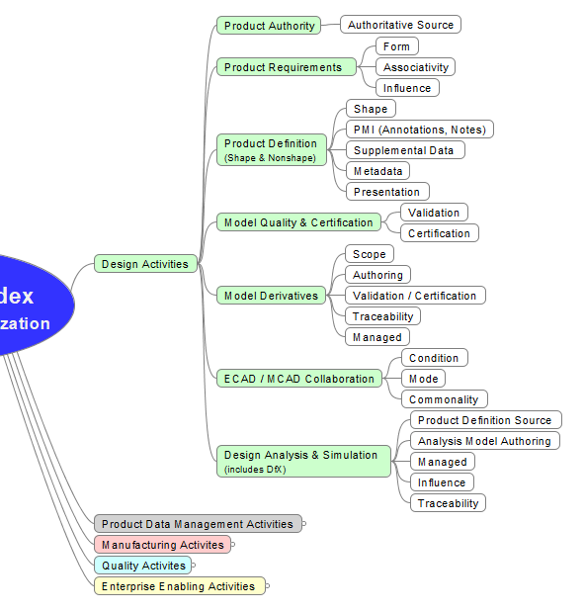
Hierarchy of Activities on Rows
Categories (C#), As-is and Target scores calculated roll-ups of topics
Topics (C#), Assess Targets; As-is scores calculated rollup-ups of facets
Facets (F#), Assess As-is assertions and describes a progression toward a more mature state for an activity
MBE Activities
Example: C1;T1;F1

Slide 14
Category C1
C1: Design Activities |  | Activities involved in developing a design for product definition or other lifecycle activity. |  | 2D Drawings used for all activities | 2D Drawings derived from models | 2D Drawings and other derivatives from Validated Model | Semantic PMI included with model | Certified, Authorized MBD | MBD Dataset made useable for all lifecycle activities within enterprise | MBD Dataset made useable for all lifecycle activities
 | T1: Product Authority
 | T2: Product Requirements
 | T3: Product Definition Representation
 | T4: Model Quality & Certification
 | T5: Model Derivatives
 | T6: ECAD/MCAD Collaboration
 | T7: Design Analysis & Simulation (includes DfX)

Slide 15
Category C2
C2: Product Data Management Activities |  | Activities that relate product lifecycle data to product definition. |  | File-Sharing Directory | Document-Centric PDM | Document-Centric PDM; Disconnected with Models | Part-Centric PDM; Product Related Disciplines | Part-Centric PDM; Product & Process Related Disciplines | Digitally "One" Part-Centric PDM within Enterprise | Extended digital exchange part-centric PLM with trusted suppliers
 | T1: Data Management Authority
 | T2: Data Management Approach
 | T3: Product Definition Management
 | T4: Process Data Management
 | T5: Bill of Materials (BOM) Management
 | T6: Common Digital Libraries
 | T7: Data Records

Slide 16
Category C3
C3: Manufacturing Activities |  | Activities involved in making a product. |  | 2D Drawings used for all manufacturing related activities | Manufacturing via 2D drawings supported by disconnected derivative (e.g. STEP) or recreated models | Manufacturing via validated derivative models along with 2D Drawings | Manufacturing via validated derivative models supported by 3DIVs. | Digital manufacturing via trusted MBD. | Digital manufacturing via smart derivative models. | Automated manufacturing processes extended to trusted partners via smart derivative models.
 | T1: Manufacturing Process Definition
 | T2: Tooling Definition & Realization
 | T3: Manufacturing Process Instructions
 | T4: Manufacturing Code Generation
 | T5: Manufacturing Analysis & Simulation
 | T6: Manufacturing Operations
 | T7: Product Procurement

Slide 17
Category C4
C4: Quality Activities |  | Activities involved in manufacturing verification, part inspection, and product acceptance. |  | 2D Drawings used for Verification, Inspection, Testing, & Acceptance Activities | Verification & Acceptance preformed from 2D drawings with disconnected derivative (e.g. STEP) or recreated models. | Verification & Acceptance preformed from 2D drawings with validated derivative models. | Verification & acceptance performed from 3DIVs with certified derivative models. | Digital Verification, Inspection & Acceptance via trusted MBD. | Digital metrology via smart derivative models with product characteristics | Automated metrology processes, extended to trusted partners via smart derivative models
 | T1: Quality Process Definition
 | T2: Quality Product Characteristics & BoC
 | T3: Quality Process Instructions
 | T4: Inspection Code Generation
 | T5: Quality Results Management & Analysis
 | T6: Test Equipment Definition & Realization
 | T7: Inspection Operations

Slide 18
Category C5
C5: Enterprise Enabling Activities |  | Activities that enable an enterprise to act as a MBE, do not directly add value to a product’s lifecycle. |  | Non-existent MBE | MBE Awareness | Reactive MBE | Repeatable MBE | Digital MBE | Integrated MBE | Optimized MBE
 | T1: Product Work Collaboration
 | T2: MBE Governance
 | T3: MBE People
 | T5: MBE Technology
 | T6: MBE Information Assurance
 | T7: MBE Financials

Slide 19
Structure of the NSE’s MBE Maturity Index
Maturity Levels on Columns
Context is Organization Under Assessment (OUA)
Assess against a target date
Scoring Area
Activities on rows
Establish bounding conditions for OUA
Assertions at intersections

Slide 20
How to Use the Index for Assessment
Prepare
  Identify and establish the bounds for your Organization Under Assessment (OUA).
    Portion of lifecycle
    Departments
    Security environment
    Product line
    Functional area
  Determine meaningful target date (e.g., some milestone).
  Select activities to assess.
Assess and Score
  Note. As you fill in, spreadsheet automatically calculates scores.
  For each Facet, identify an As-is (current) level.
  Start at L0 and work your way to the right. Or, work backwards from L6. Find the best match.
  For each Topic, identify a Target (future) level.
  Examine your scores and refine as you go.

Slide 21
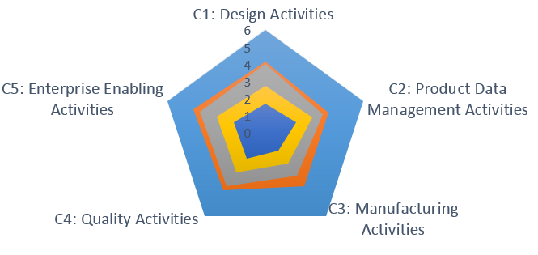
How to View the Results from the Assessment
Scores are shown graphically in ‘RADAR’ charts.
  High-level showing all categories
  One for each category, showing topics
Identifies MBE capability/readiness/adoption gaps
Informs and provides focus for your organization’s MBE roadmap or action plan.
Drives Action!

Slide 22

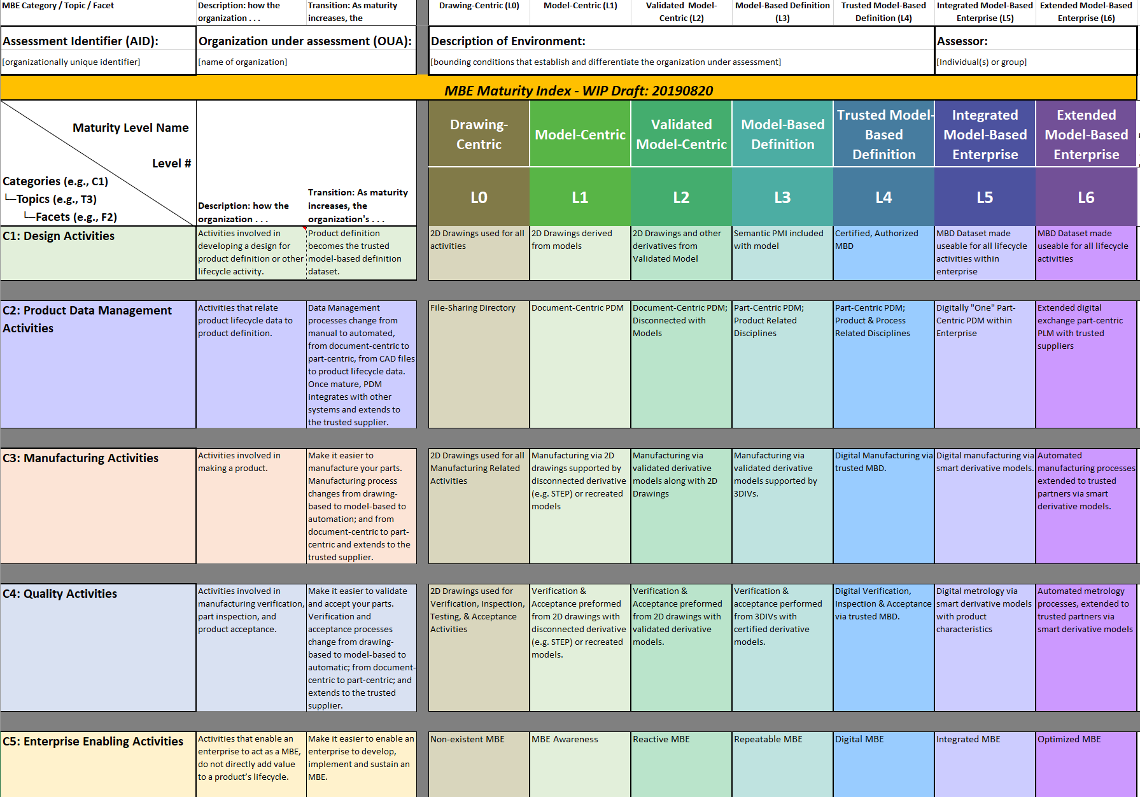
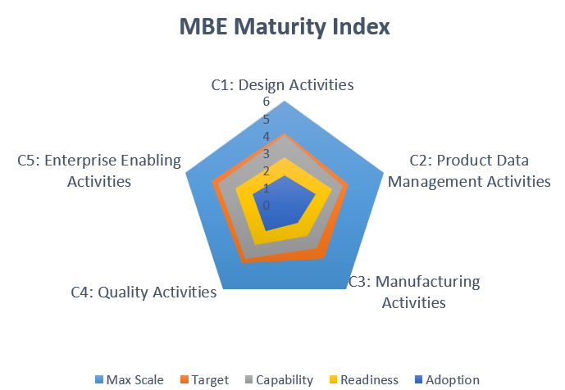
MBE Index is Central to Broader Planning Context
Helps cast a vison for your organization
to get started
Helps your organization find an actionable path for success
VISION
Identifies MBE capability/readiness/adoption gaps within your organization
INDEX
Provides focus for developing an MBE implementation plan
ASSESSMENT
Allows organizations to tailor a MBE roadmap
ROADMAP
Notes:
Outcomes from a MBE Maturity Index assessment:
Identifies MBE capability/readiness/adoption gaps
Allows your organization to tailor a MBE roadmap
from where your organization currently is and
where it wants to be at some future date or event.
Provides focus for developing an MBE implementation plan.

Slide 23
Value Statement for a Controlled MBE Lexicon
MBE practitioners need a reliable lexicon
  Common vocabulary of terms and phrases used in a domain
  Validated terms and concepts in context
  Managed with Thesaurus
…for collaboration …
  Precision (remove ambiguity)
  Ease (I understand you)
… as a foundation for developing MBE practices…
  More confidently (no more meandering)
  More rapidly (less paralysis and contention resolution)
  More collaboratively (move forward together)
…that are
  More assuredly integrated
  Achieve common goals

Slide 24
Lexicon Tab in the Index
Integral to development of the Index
  Included as a worksheet (tab) in the same workbook as the Index
  Feedback loop: Prompts Index and takes prompts from Index
  Defines terms particular to the Index
  Really, inseparable from Index
Normalized for Model-Based Enterprise
Workbook provides Term, Definition and opportunities for customization:
  ‘Specialization’ refines the definition to an organization’s needs
  ‘Organization comments’ helps the community continue to improve the lexicon

Slide 25
Transition to MBE Requires Trust by Management and Practitioners
MBE is a paradigm shift: a fundamental change in approach or underlying assumptions
The transition to an MBE requires trust in your models and the associated digital data sets. The aims of digital engineering, digital enterprise, MBE, automation, etc. are unachievable without comprehensive trust in the models.
This is especially true in the NSE, where change in the Product Realization Process is antithetical.
To that end, the MBE Index emphasizes the notion of trust. Indeed, it weaves concepts related to trust throughout its assertions. Those assertions are founded on the following ‘Trust Framework’ that applies to a model, dataset, or any other artifact.

Slide 26
NSE’s MBE Trust Framework
Trusted: Regarded with confidence, and concurrently being certified, authorized, and authenticated.
    Authenticated: Proven to be genuine as issued by its originator.
    Signed: Authenticity of originator cannot be repudiated.
    Traceable: The ability to find the authoritative source of a given fact
  Authorized: Approved by an authority for use in a lifecycle activity.
    Certified: Guaranteed to conform to protocols.
      Validated: Assured to satisfy intent.
      Verified: Assured to satisfy requirements.
      Versioned: Successive revisions are stored and sequentially identified.
Factors that increased confidence:
Required: Mandated by some authority.
Specified: Defined to minimally-sufficient detail.
Recorded: Permanently documented for future reference.
Certified
Authenticated
Authorized
Trusted

Slide 27
Index Development
KCNSC Baseline -> NSE’s MBE Committee Index Task Team -> NSE Release
  Winter 2019 - 4 day face to face kickoff
    3-4 hour long follow-on meetings per week
  Spring & Summer 2019 - Draft releases for peer review
    Weekly meetings to compile and incorporate peer comments
  Fall 2019 - Release with peer review comments
    Beta Testing projects
  Spring 2020 Present to NIST MBE Summit
    Expand scope
Current Implementations:
  NNSA Model-Based Enterprise Transition – Initiative (MBET-I)
    Program Manager Organizational Tool
  Ongoing Beta Testing at internal and external sites
  Initiated use at NSE Sites for planning and assessments
  Introduced to ASME MBE Standards Committee
    Terms subcommittee leadership
  DOE Representatives From:
  Kansas City National Security Campus
  Lawrence Berkley Laboratory
  Lawrence Livermore National Laboratory
  Los Alamos National Laboratory
  National Nuclear Security Administration
  Naval Nuclear Laboratory
  Sandia National Laboratory
  Savannah River
Peer Reviews from Industry Peers

Slide 28
Status and Way-forward
Work in Progress
Continue to solicit peer review and to obtain focus area validation & improvements.
Beta Testing: Conduct real and simulated assessments to confirm the content.
Prepare training curriculum.
Publish for NNSA, US Industry, and other government reuses.
Consider additional categories:
  C0: System Engineering Activity and
  C6: Service Activity
Refine the functional areas of electrical design and production support.
Continue to update as needed.
Consider more useable format for the assessment.

Slide 29
Where can you get the latest WIP Index?
KCNSC’s Web Exchange File Manager
https://fmt.kcnsc.doe.gov/kcpfm/kcpfm_short.cgi?box=/.Dst9EMRmxucstVHi&path=/&cmd=list
Or via TinyURL
https://tinyurl.com/NSE-MBE-Maturity-Index

Slide 30
Backup

Slide 31
Thank you!
C. Brown, M. Caruthers, D. Cox, P. Crane, D. Francis, M. Reece, G. Vernon; Kansas City National Security Campus (KCNSC)
G Brandt, K. Campbell, S. Hale, B. Scott, D Vortolomei; Sandia National Laboratories (SNL)
R. Kuhns, J. Winter; National Nuclear Security Administration (NNSA)
D. Carne, J. Gonzales, N. Moya; Los Alamos National Laboratories (LANL)
J. Schaufler; Savanah River Site (SRS)
W. Hutcheson; Lawrence Berkeley Laboratories (LNL)
R. Bagwell, S. Burns; Lawrence Livermore National Laboratories (LLNL)
J. Selby, N. Weister; Navy Nuclear Laboratories (NNL)
R. Gelotte; Action Engineering
R. Nascimento; ITI
M. Nielsen; TechAzul

Slide 32
Agenda
Purpose
About NNSA and the National Security Enterprise (NSE)
The Challenge
MBE to meet the challenge
Importance of an MBE Maturity Index
Evolution and Features of NSE’s Index
Structure and Scope
Overview of Content
How to Use
Planning Context
MBE Lexicon
Trust Framework
Level of Effort
Status and path forward
Where you can get it

Slide 33
NSE’s MBE Maturity Index Working Group
DOE Representatives from:
  Kansas City National Security Campus
  Lawrence Berkley Laboratory
  Lawrence Livermore National Laboratory
  Los Alamos National Laboratory
  National Nuclear Security Administration
  Naval Nuclear Laboratory
  Sandia National Laboratory
  Savannah River
Peer Reviews from:
  NNSA’s Cross-Site Model-Based Working Group
  NNSA Subject Matter Experts
  Selected Industry Peers
  Previous Index Authors

Slide 34
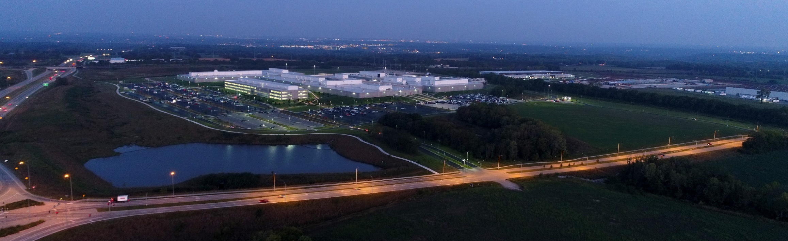
Kansas City National Security Campus (KCNSC)
Quick View
A multi-mission engineering and manufacturing enterprise delivering trusted national security products and government services
Department of Energy leased facility
DOE National Nuclear Security Administration (NNSA) and DOE-IN oversight
Managed & operated by Honeywell
Established in 1949 as Kansas City Plant
~4,800 employees
$1.8B annual federal budget
Locations
Botts Campus: 1.5M sq. ft. in 4 main buildings, including a 350K sq. ft. SCIF
KCNSC South
KCNSC West
KCNSC North
KCNSC East
Albuquerque, NM: offices, 130k sq. ft. fabrication shop and vehicle depot facility

Slide 35


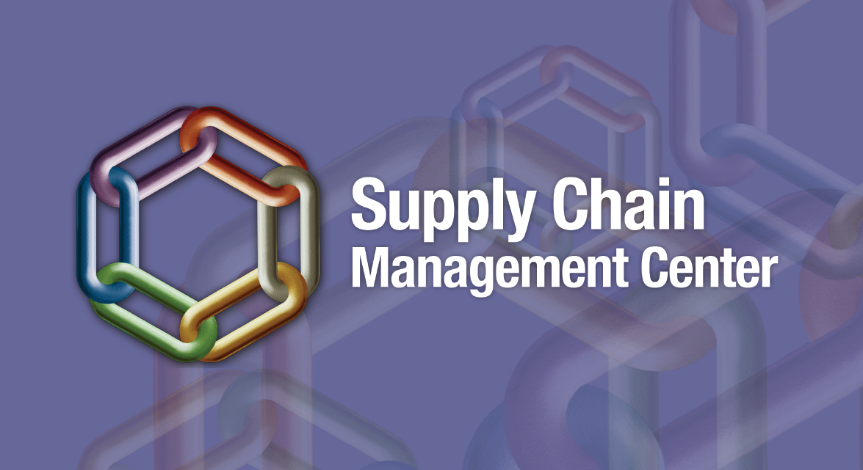




KCNSC’s Mission
To support national security objectives by providing exceptional solutions,
managed operations and targeted services through talented people.
STOCKPILE STEWARDSHIP
STRATEGIC
PARTNERSHIP PROGRAM
SUPPLY CHAIN MANAGEMENT CENTER
  MANUFACTURING
  ENGINEERING
  SCIENCE & TECHNOLOGY
WORKFORCE

Slide 36
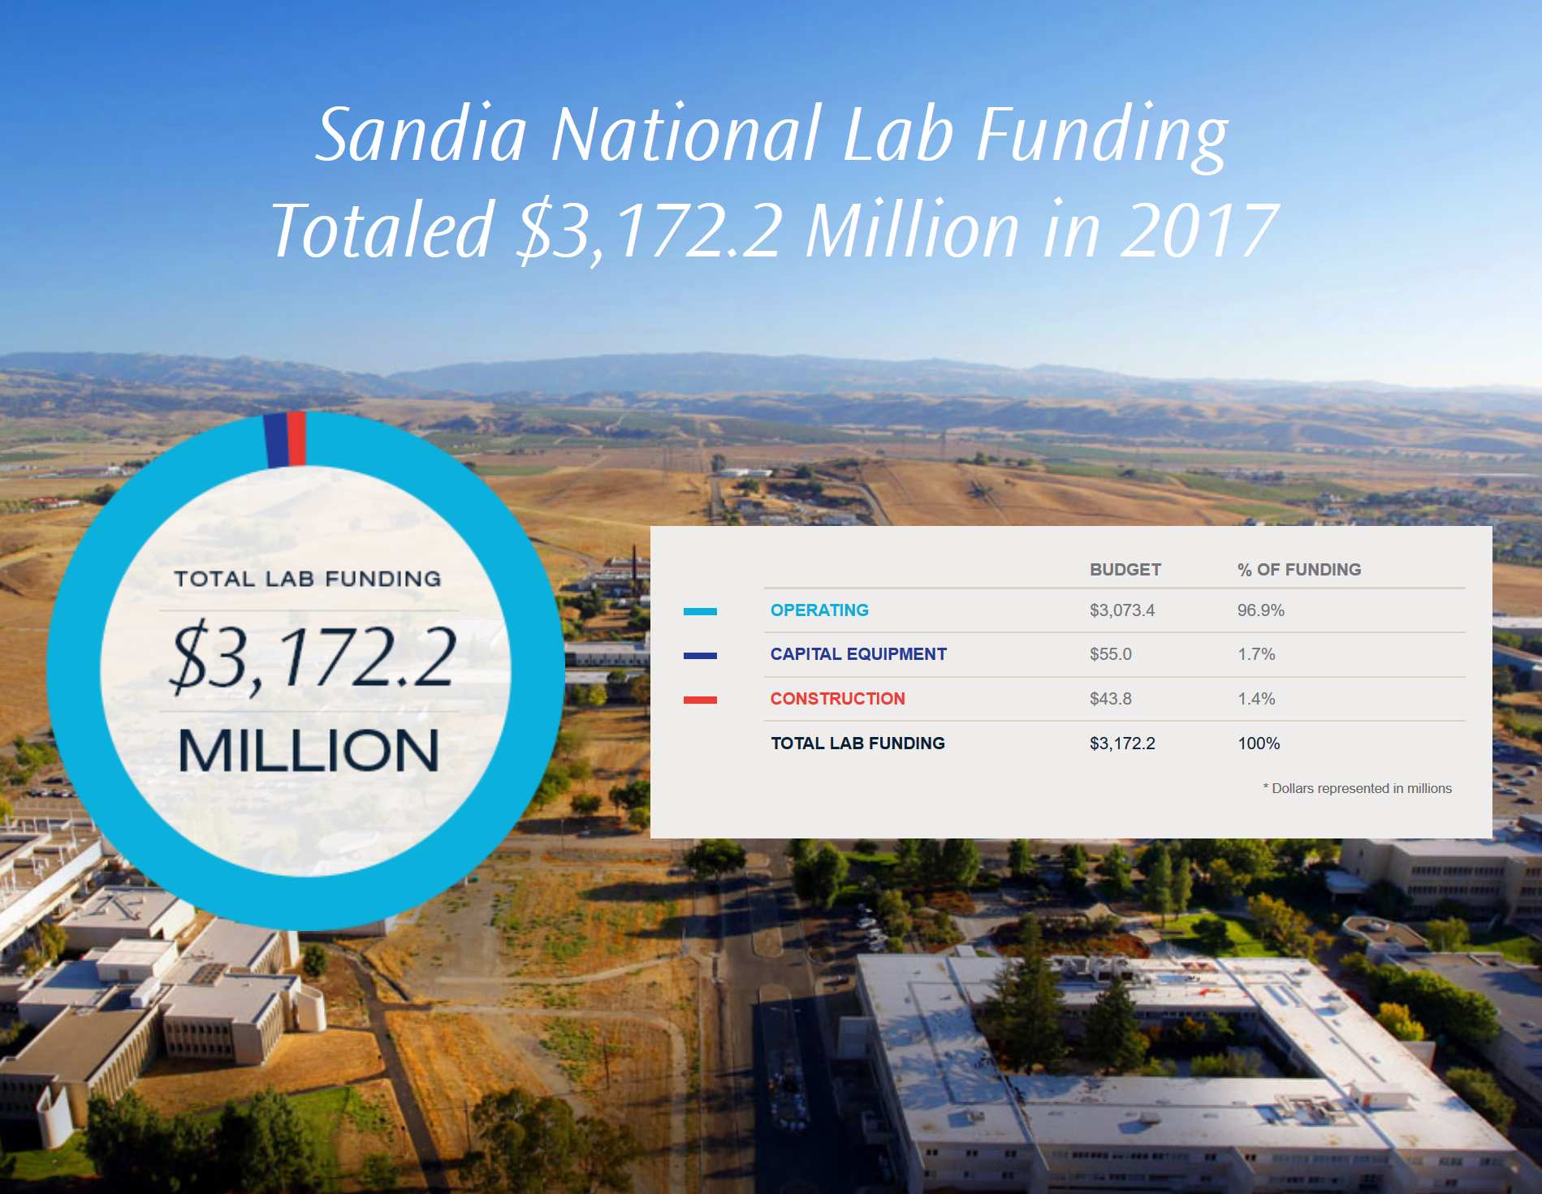
Sandia National Laboratories
Sandia develops advanced technologies to ensure global peace.
As a multidisciplinary national laboratory and federally funded research and development center (FFRDC), Sandia accomplishes tasks that are integral to the mission and operation of our sponsoring agencies by
anticipating and resolving emerging national security challenges
innovating and discovering new technologies to strengthen the nation’s technological superiority
creating value through products and services that solve important national security challenges
informing the national debate where technology policy is critical to preserving security and freedom throughout our world
Managed and Operated by National Technology & Engineering Solutions
Sandia National Laboratories is a multimission laboratory managed and operated by National Technology and Engineering Solutions of Sandia, LLC, a wholly owned subsidiary of Honeywell International, Inc., for the U.S. Department of Energy’s National Nuclear Security Administration under contract DE-NA0003525.

Slide 37
Today’s Presentation
Things to think about
How can this be applied in your work environment?
What did you hear that will influence your thinking?
What is your take away from this presentation?

Slide 38
Please
The link for the online survey for this meeting is
www.surveymonkey.com/r/2020_08_MeetingEval
Look in GlobalMeet chat box for cut & paste link
Slide presentation can be downloaded now/anytime from:
The library page at: www.incose.org/enchantment

