Slide 1
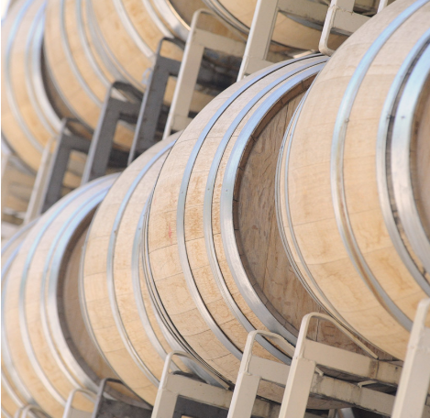
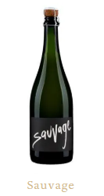
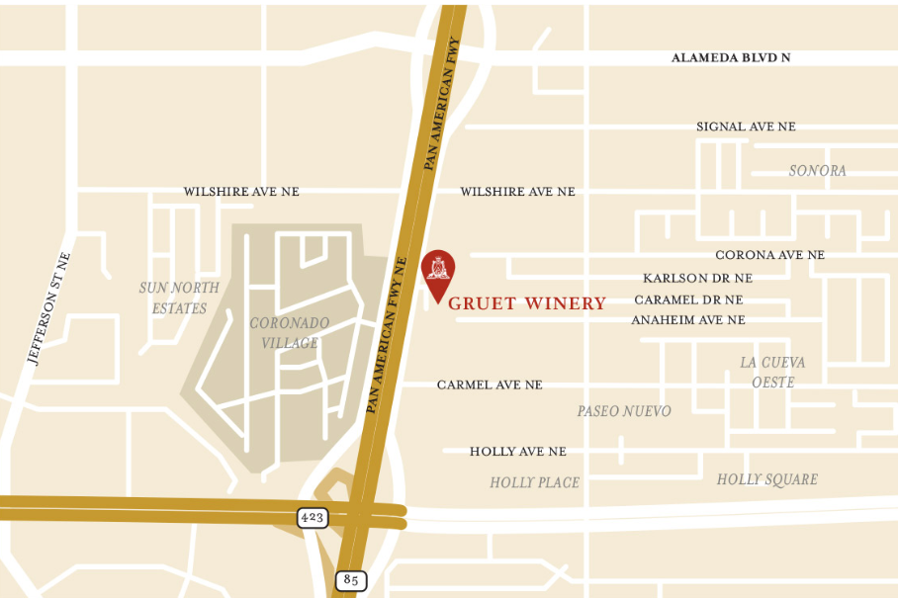

The INCOSE Enchantment Chapter presents:
Our 2022 Spring Social Event!
We are so excited about getting together again in person! Come mingle with fellow chapter members & friends with wine & some food at the Gruet Winery!
Where: Gruet Winery Barrel Room/Upper Patio, 8400 Pan American Freeway N.E., ABQ, NM
When: Thursday, May 26, 2022, 5:30 – 7:30 PM
Admission: $10 per person, payable via cash or check at the event
Register via EventBrite by May 25, 2022 at 5 pm.
--- includes appetizer buffet
**Guests welcome! INCOSE membership not required. Event limited to 40 guests!**
***Must be 21 or over to consume wine.***
Gruet’s location
Follow the Enchantment Chapter on Social Media
https://twitter.com/EnchantIncose
https://www.linkedin.com/company/incoseenchantment

