Slide 1


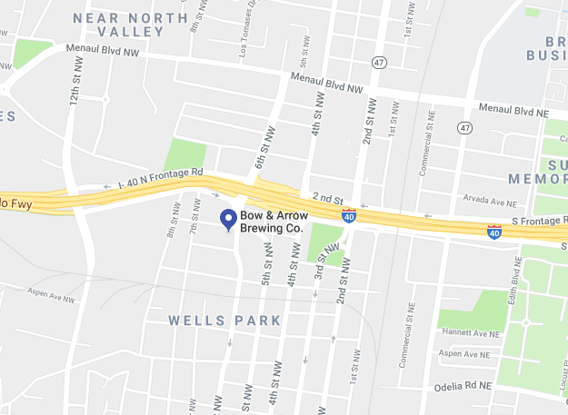


The INCOSE Enchantment Chapter presents:
2019 Summer Social Event-Local Brews & BBQ!
INCOSE veterans and newcomers please join your fellow chapter members and friends with locally brewed beer and BBQ in the loft of Bow and Arrow Brewery located near downtown ABQ.
Where: Bow & Arrow Brewing Company, 608 McKnight Ave NW ABQ, NM 87102
When: Friday, August 9, 2019, 5:00 – 7:00 PM
Admission: $10/person payable via cash or check at the event Register via EventBrite by August 7, 2019 at 5 pm. Event includes food from Kimo’s Hawaiian BBQ! Guests are welcome.
**Event limited to 50 guests! Must be 21 to consume alcohol**
Bow & Arrow location:
Follow the Enchantment Chapter on Social Media
https://twitter.com/EnchantIncose
https://www.linkedin.com/company/incoseenchantment

