Slide 1
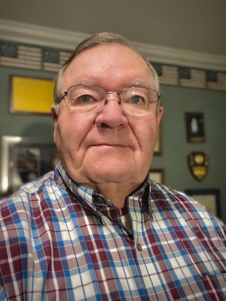
INCOSE Chicagoland Spring Tutorial 2022
Lifecycle Concepts and Needs Definition Group Project
Instructor – Lou Wheatcraft
Delivered Virtually, via Zoom in 3 consecutive weeks in May
Session 1: Project Kickoff: 07 May, 8:00 AM – 12:00 PM CDT
Session 2: Project Q&A: 12 May, 4:00 PM – 7:00 PM CDT
Session 3: Project Presentations: 21 May, 8:00 AM – 12:00 PM CDT
In this seminar, you will learn
Identify the need for, and benefits of, defining lifecycle concepts and needs prior to defining the design input requirements
Describe the major activities and resulting knowledge and artifacts involved in defining lifecycle concepts and needs
Understand the importance of validating and baselining the integrated set of needs before transforming them into the set of design input requirements
Register online: https://incose-chicagoland-spring-2022-seminar.eventbrite.com
It is recommended to register prior to May 7th to allow time to do the prework!
Prework materials will be available April 7th.

Slide 2
INCOSE Chicagoland Spring Tutorial 2022
Lifecycle Concepts and Needs Definition Group Project
Instructor – Lou Wheatcraft
Dates: Saturday May 7th, Thursday May 12th, & Saturday 21st
Delivered Virtually, via Zoom
Attendees will earn 10 PDUs for the tutorial
Certificates will be provided.
Eventbrite ticket sales are open! Tutorial pricing starts at $50 (tbd).
Order now for Early Bird pricing, including
Special offer for the INCOSE Chicagoland Chapter membership drive:
Purchase a one-year INCOSE membership and receive discounted tutorial admission.
Register online: https://incose-chicagoland-spring-2022-seminar.eventbrite.com
It is recommended to register prior to May 7th to allow time to do the prework!
Prework materials will be available April 7th.

