Slide 1
General Session
RESILIENT SYSTEMS WORKING GROUP (RSWG)
Ken Cureton (Chair) Kenneth.Cureton@incose.net
John Brtis (Co-Chair) jbrtis@johnsbrtis.com
General Session
Triana 2 – SATURDAY February 1, 16:00-17:00 GMT+1
For more information: https://www.incose.org/communities/working-groups-initiatives/resilient-systems
THIS SESSION IS BEING RECORDED

Slide 2
General Session
Agenda Item for Saturday 1-February-2025 (1.0 hour)
1600-1615: BRIEF Participant Introductions
Around the “Virtual Room”
Please include the proper spelling of your name and e-mail address in the Chat panel
1615-1630: What is the Mission of the RSWG?
How We Define Resilience & “The Resilience Elevator Speech”
Location & Types of RSWG Work Products (SEBoK, etc.)
Resilience Webinar (Virtual: October 2024)
1630-1645: Summary of Planned RSWG Products
SEBoK Cycle 12 ( by March 2025)
Document: How to Justify Resilience
Document: Things that Frustrate Resilience
Resilience Primer
1645-1700: Questions & Answers

Slide 3
General Session
Agenda Item for Saturday 1-February-2025 (1.0 hour)
1615-1630: What is the Mission of the RSWG?
Primary purpose: further understanding and achieving resilience in engineered systems & provide a clear description of principles of resilience in INCOSE publications & outreach materials
Also to develop, promote, and advance Systems Engineering methods, tools, and techniques for resilience of Engineered Systems and System of Systems— for example, in the INCOSE Systems Engineering Body of Knowledge (SEBoK) and Systems Engineering Handbook (SEH)
Not focused on Natural Resilient Systems or Human/Social Resilient Systems (valuable disciplines of their own right)
However, these disciplines influence engineered systems, and there may be a synergistic interaction with those disciplines and many other quality characteristics

Slide 4
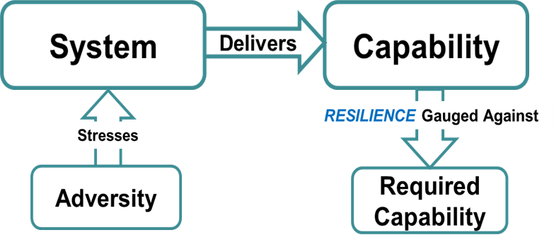
General Session
Agenda Item for Saturday 1-February-2025 (1.0 hour)
1615-1630: How We Define Resilience
Definition recommended by the RSWG: Resilience is the Ability to Provide Required Capability when facing Adversity
Fundamental Resilience Objectives:
Avoid: eliminate or reduce exposure to adversity
Withstand: resist capability degradation when subjected to adversity
Recover: replenish lost capability after degradation

Slide 5
General Session
Agenda Item for Saturday 1-February-2025 (1.0 hour)
1615-1630: How We Define Resilience (continued)
Typical Means of Achieving Resilience Objectives:
Adapt, Anticipate, Constrain, Continue (continuity), Degrade Gracefully, Disaggregate, Evolve, Fortify, Manage Complexity, Preserve Integrity, Prepare, Prevent, Re-architect, Redeploy, Monitor, Tolerate, Transform, Understand
These typically lead to FUNCTIONAL REQUIREMENTS for Resilience
Many Architecture, Design, and Operational Techniques to Achieve Resilience Objectives-- all detailed in the Systems Engineering Handbook v5 & the Systems Engineering Body of Knowledge (SEBoK)
These typically lead to DESIGN REQUIREMENTS for Resilience

Slide 6
General Session
Agenda Item for Saturday 1-February-2025 (1.0 hour)
1615-1630: “The Resilience Elevator Speech”
Systems are made up of parts that are brought together to do something useful.
Creating effective systems is not simple!
Systems engineering is the science of creating effective systems.
And if you need a system you can count on in rough situations, the systems engineer will apply design techniques known to make the system resilient.
So, if you are developing a system, you need to identify the challenges it could face and decide how resilient you need the system to be.

Slide 7
General Session
Saturday 1-February-2025(1.0 hour)
1615-1630: What is the Mission of the RSWG?
Location & Types of RSWG Work Products
Regular (typically weekly) virtual telecons (see Viva Engage for announcements and agendas
Monthly TED-like Talk Presentations
IW meetings
IS Papers & Presentations
Systems Engineering Handbook v5 guidance for engineered resilient systems (see https://www.wiley.com/en-ie/INCOSE+Systems+Engineering+Handbook%2C+5th+Edition-p-9781119814290 )
Systems Engineering Body of Knowledge (SEBoK) content for engineered resilient systems (see https://sebokwiki.org/wiki/System_Resilience and https://sebokwiki.org/wiki/Resilience_Modeling )
Peer review of Papers and Dissertations that include aspects of engineered resilient systems (includes creation of per-reviewed papers)
Liaison with other groups, e.g. IEEE, ISO/IEC, etc.

Slide 8
General Session
Saturday 1-February-2025(1.0 hour)
1615-1630: Summary of Planned RSWG Products
SEBoK Cycle 12 ( by May 2025)
Update “Systems Resilience” section with new References and updates to Resilience Taxonomy
Update “Resilience Modeling” section with more references for System Dynamics and Resilience Contracts to support MBSE and Digital Engineering efforts
Resilience Webinar (Virtual: mid-2025)
Half-day duration
Presentations are flexible and can be formal or informal
See https://www.skit.com/RSWG for prior webinar
Document: How to Justify Resilience
Document: Things that Frustrate Resilience
Resilience Primer (see next slide)

Slide 9
General Session
Saturday 1-February-2025(1.0 hour)
1615-1630: Summary of Planned RSWG Products
Resilience Primer Outline (part 1 of 2)
What is Resilience?
Elevator Speech: What is Resilience, Who needs it and the Value Proposition
Types of Adversities to be Considered
Potential Resilience Stakeholders
Purpose of primer: “How To” Achieve it
Perspectives on Resilience
Resilience is in the organization
Resilience is about dealing with failure (tends to be an extension of quality characteristics: safety, reliability in particular)
Resilience is about system context appropriate response to adversity
Resilience Taxonomy (Objectives, Techniques, & Mapping to SE Life Cycle)
Taxonomy Layer 1 and Layer 2 and brief introduction to Layer 3
Life Cycle of Resilience Engineering
SE Processes for Resilience– How To
Links to SEHv5 & SEBoK
Methodology for applying Resilience Techniques

Slide 10
General Session
Agenda Item for Saturday 1-February-2025 (1.0 hour)
1615-1630: Summary of Planned RSWG Products
Resilience Primer Outline (part 2 of 2)
Identifying the Right Level of Resilience
Assessing intrinsic resilience?
How much additional resilience is required?
How much is not affordable?
Developing Resilience Requirements
Modeling Resilience (includes Timeline references and Strategies)
Architectural, Design, and Operational Techniques for Achieving Resilience
Taxonomy Layer 3 & Synergy amongst the Techniques
Resilience Heuristics
Related Quality Characteristics & Risk
Summary
Case Studies (see SEHv5 for Exemplar Case Studies)
One Cyber, One Physical, One Organizational, One Human Survival
References

Slide 11
General Session
Agenda Item for Saturday 1-February-2025 (1.0 hour)
1645-1700: Questions & Answers

