Slide 1
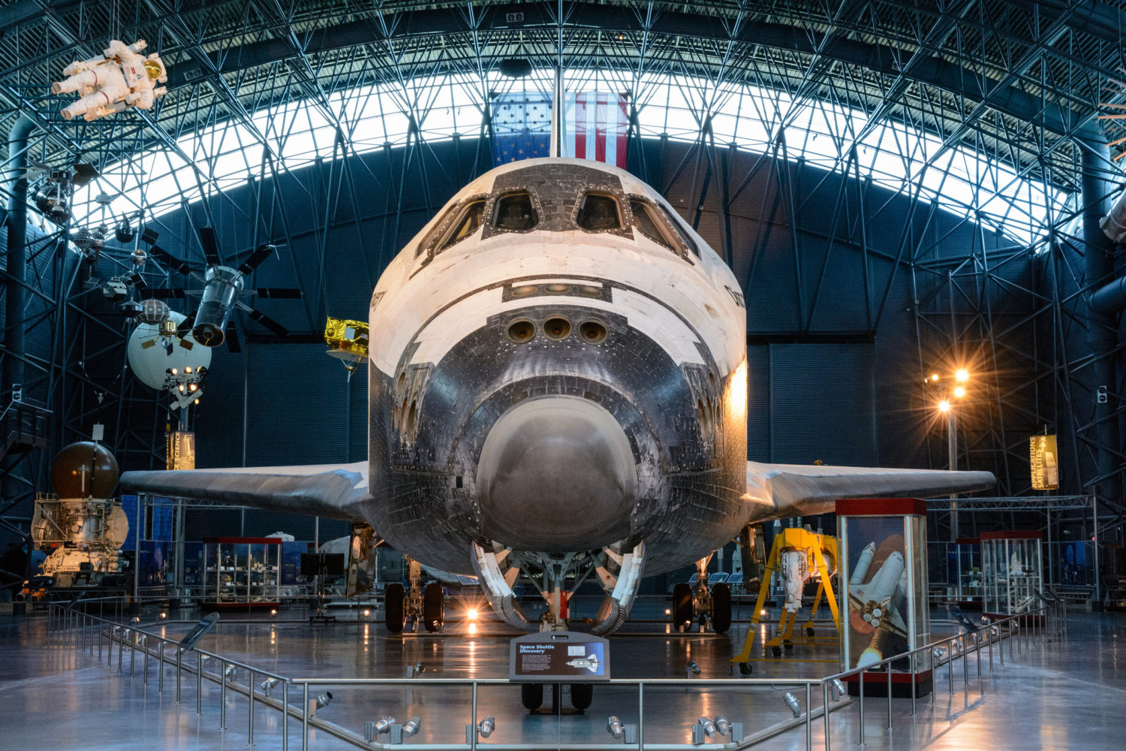
Q1 2024 Membership Networking Event
Docent-led Tour of Udvar-Hazy Center Smithsonian National Air and Space Museum in Chantilly, VA
Saturday March 2nd
10 AM – 12 PM
A maximum of 60 registrants may attend the event. Please register using the Google Form.
Guests are welcome to attend with an INCOSE WMA member.

