Slide 1
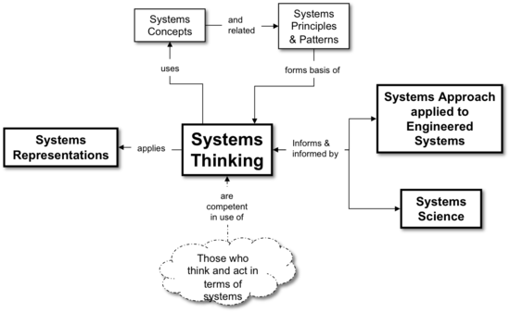

Systems Thinking:
A Foundation for Product Development
Presentation to INCOSE Heartland Chapter
Rick Hefner, PhD
rhefner@caltech.edu

Slide 2
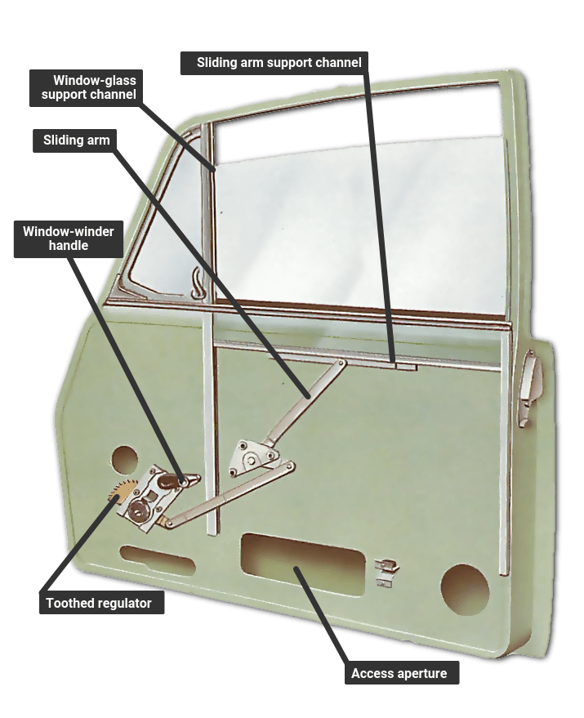
You are the subsystem design engineer responsible for an automotive power window mechanism
Your boss says “we need to improve the design by reducing cost and weight”
What do you do?

Slide 3
What is a System?
An integrated set of elements, subsystems, or assemblies that accomplish a defined purpose; these elements include products hardware, software and firmware), processes, people, information, techniques, facilities, services and other support elements [INCOSE Systems Engineering Handbook]
System
Boundary
Procedures
Personnel
Facilities
System
Hardware
Software
Materials
Services
Data
Operational
Environment
Notes:
Reminder of the definition of system or system-of-interest. In order to be clear on the what is included in our SoI, we have to define a system boundary. Everyone outside that boundary is part of the environment.
The other concept is the purpose (or mission) or which the system is being designed and built. Often this is to solve a customer’s or user’s problem. Might be nice to cite an example here.

Slide 4
System Terminology
INCOSE Systems Engineering Handbook

Slide 5
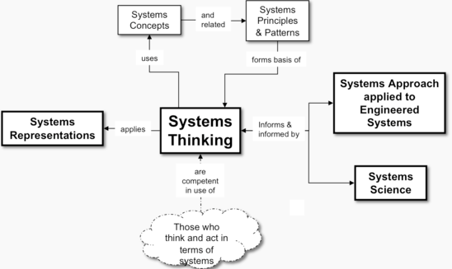
Systems Thinking
Systems thinking is concerned with understanding or intervening in problem situations, based on the principles and concepts of the systems paradigm [INCOSE SE Body of Knowledge – sebokwiki.org]
Systems thinking
considers the
similarities between
systems from different
domains in terms of
a set of common
systems concepts,
principles and patterns
INCOSE Systems Engineering Handbook

Slide 6
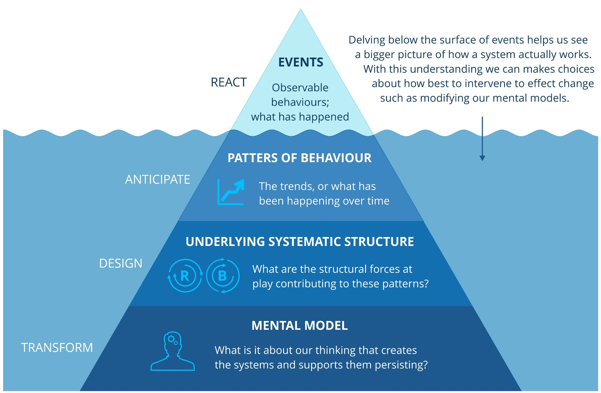
Systems Thinking Iceberg

Slide 7

Systems Thinking in Product Development
Car
Engine subsystem
Fuel subsystem
Exhaust subsystem
Cooling subsystem
Lubrication subsystem
Electrical subsystem
Trans-mission subsystem
Chassis subsystem
Wheels
Tires
Brakes
Suspension
Body
For the team designing the suspension: What are the impacts of our design decisions on the overall properties of the car? (handling, gas mileage, ride quality, weight, …)
Could we model the car properties to better drive design decisions (or at least evaluate their impacts)?
Notes:
RH: Will replace with a better example

Slide 8
Systems Principles (1 of 2)
INCOSE SE Body of Knowledge – sebokwiki.org
Abstraction | A focus on essential characteristics is important in problem solving because it allows problem solvers to ignore the nonessential, thus simplifying the problem.
Boundary | A boundary or membrane separates the system from the external world. It serves to concentrate interactions inside the system while allowing exchange with external systems.
Change | Change is necessary for growth and adaptation, and should be accepted and planned for as part of the natural order of things rather than something to be ignored, avoided, or prohibited.
Dualism | Recognize dualities and consider how they are, or can be, harmonized in the context of a larger whole.
Encapsulation | Hide internal parts and their interactions from the external environment.
Equifinality | In open systems, the same final state may be reached from different initial conditions and in different ways (Bertalanffy 1968). This principle can be exploited, especially in systems of purposeful agents.
Holism | A system should be considered as a single entity, a whole, not just as a set of parts.
Interaction | The properties, capabilities, and behavior of a system are derived from its parts, from interactions between those parts, and from interactions with other systems.
Layer Hierarchy | The evolution of complex systems is facilitated by their hierarchical structure (including stable intermediate forms) and the understanding of complex systems is facilitated by their hierarchical description.
Leverage | Achieve maximum leverage (Hybertson 2009). Because of the power versus generality tradeoff, leverage can be achieved by a complete solution (power) for a narrow class of problems, or by a partial solution for a broad class of problems (generality).
Modularity | Unrelated parts of the system should be separated, and related parts of the system should be grouped together.

Slide 9
Systems Principles (2 of 2)
INCOSE SE Body of Knowledge – sebokwiki.org
Network | The network is a fundamental topology for systems that forms the basis of togetherness, connection, and dynamic interaction of parts that yield the behavior of complex systems.
Parsimony | One should choose the simplest explanation of a phenomenon, the one that requires the fewest assumptions. This applies not only to choosing a design, but also to operations and requirements.
Regularity | Systems science should find and capture regularities in systems, because those regularities promote systems understanding and facilitate systems practice.
Relations | A system is characterized by its relations: the interconnections between the elements. Feedback is a type of relation. The set of relations defines the network of the system.
Separation of Concerns | A larger problem is more effectively solved when decomposed into a set of smaller problems or concerns.
Similarity/ Difference | Both the similarities and differences in systems should be recognized and accepted for what they are. Avoid forcing one size fits all, and avoid treating everything as entirely unique.
Stability/ Change | Things change at different rates, and entities or concepts at the stable end of the spectrum can and should be used to provide a guiding context for rapidly changing entities at the volatile end of the spectrum (Hybertson 2009). The study of complex adaptive systems can give guidance to system behavior and design in changing environments.
Synthesis | Systems can be created by choosing (conceiving, designing, selecting) the right parts, bringing them together to interact in the right way, and in orchestrating those interactions to create requisite properties of the whole, such that it performs with optimum effectiveness in its operational environment, so solving the problem that prompted its creation”
View | Multiple views, each based on a system aspect or concern, are essential to understand a complex system or problem situation. One critical view is how concern relates to properties of the whole.

Slide 10
Conceptagon Framework
A systems thinking tool for analyzing complex systems
Forms a framework for thinking about the dimensions of a systems
Each area is a new
lens or perspective
for describing one dimension of a system
‘The conceptagon: a framework for systems thinking and systems practice," in IEEE International Conference on Systems, Man and Cybernetics (SMC 2009) San Antonio, TX, 2009, pp. 3299 – 3304
‘Federal Aviation Administration NextGen: Applying Systems Thinking in Practice’, Proc. of the 2011 6th International Conference on System of Systems Engineering, Albuquerque, New Mexico, USA - June 27-30, 2011
Notes:
The Conceptagon characterizes a system in 7 areas and 3 concepts or a total of 21 dimensions. In can be used a framework to ensure you understand all critical aspects of a SoI

Slide 11
Systems Thinking
A holistic approach to analysis that focuses on the way that a system's constituent parts interrelate and how systems work over time and within the context of larger systems
Key concepts:
  Hierarchy – Systems are composed of smaller subsystems
  Complexity – Creates unknown (and sometimes undesirable) emergent behavior
  Emergent behavior – Properties of the system result from the both the components and their interactions

Slide 12
Hierarchy - System-of-Interest, System Element
ISO/IEC/IEEE 15288

Slide 13
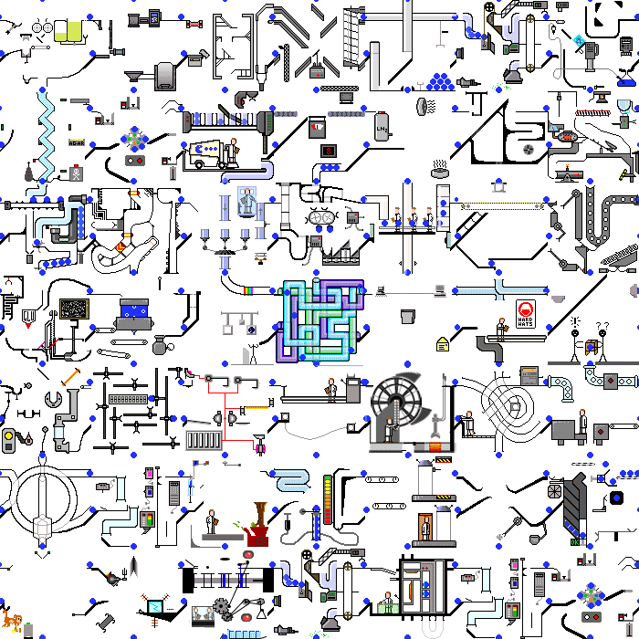
Complexity - What makes this system complex?
Notes:
Question to the group: What makes this system complex? (Detail, dynamic, connections, different structure/behavior of each element)
This animated if is on the website for them to copy and use.

Slide 14
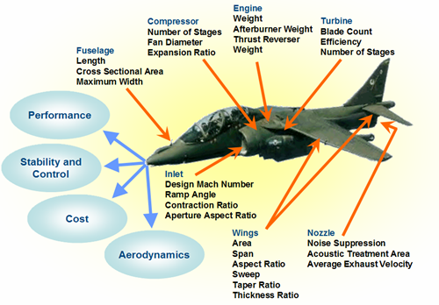
Emergent Behavior
Properties of the system result from both the components and their interactions

Slide 15

Discussion ‒ System Example
What is the hierarchy of systems?
What makes the system-of-interest complex?
What emergent behaviors (positive and negative) might we try to influence in the system design process?

Slide 16
Systems Engineering
An interdisciplinary approach encompassing the entire technical development effort to evolve and verify an integrated and life-cycle balanced set of system, people, product and process solutions that satisfy customer needs
Systems engineering encompasses:
Technical efforts related to the development, manufacturing, verification, deployment, operations, support, disposal of and user training for, system products and processes
Definition and management of the system configuration
Translation of the system definition into work breakdown structures
Development of information for management decision making
EIA 632, Systems Engineering

Slide 17
System Engineering Process
INCOSE Handbook and ISO/IEC/IEEE 15288
AGREEMENT PROCESSES
TECHNICAL MANAGEMENT PROCESSES
Acquisition
Project Planning
Project Assessment and Control
Decision Management
Risk Management
Supply
Configuration Management
Information Management
Measurement
Quality Assurance
ORGANIZATION PROJECT-ENABLING PROCESSES
TECHNICAL PROCESSES
Systems Analysis
Business or Mission Analysis
Transition
Disposal
Life Cycle Model Management
Stakeholder Needs & Requirements Definition
Operation
Maintenance
Infrastructure Management
Validation
Human Resource Management
System Requirements Definition
Verification
Quality Management
Architecture Definition
Integration
Knowledge Management
Design Definition
Implementation

Slide 18
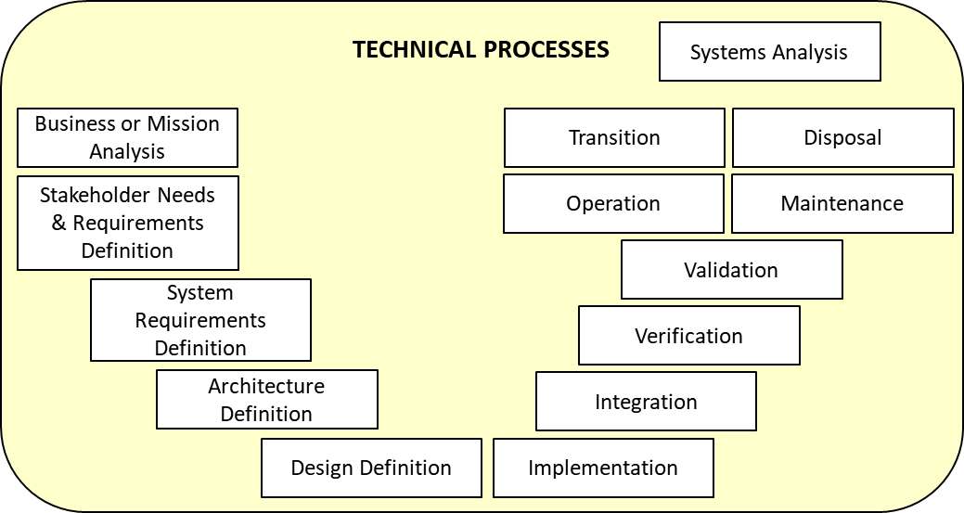
How Does Systems Thinking Change Traditional Product Development?
Systems thinkers consider the impact of their element in a broader context (typically two layers up in the hierarchy)
  Interfaces and interactions
  Emergent properties
  Impacts and effects
Systems thinkers recognize the impacts of early lifecycle decisions on later lifecycle activities
  More time is spent
  understanding the problem
  context without rushing into
  design (e.g., context diagrams,
  stakeholder analysis)
  More iteration among activities

Slide 19
Cycle of Stakeholder Needs
Cited in SEBoK. Permission granted by Singery'Com

Slide 20
Model-Based Systems Engineering (MBSE)
Model-Based Systems Engineering (MBSE) is the formalized application of modeling to support system requirements, design, analysis, verification and validation activities beginning in the conceptual design phase and continuing throughout development and later life cycle phases.
  - INCOSE SE Vision 2020 (INCOSE-TP-2004-004-02), Sept 2007
Helps to:
  Document system functions and requirements
  Assess the mission performance
  Estimate costs
  Evaluate tradeoffs
  Provide insights to improve performance, reduce risk, and manage costs

Slide 21
MBSE Domains
Ref: Vitech

Slide 22
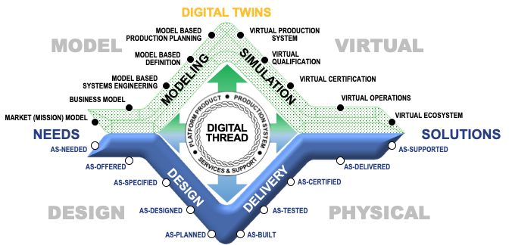
A Shift In Thinking

Slide 23
Model-Based Systems Engineering Trends
  MBSE is increasingly integrating technical, programmatic, and business concerns
    Model-based approaches will require broader and deeper collaboration among roles across the lifecycle
  Tool suites and virtualization capabilities are maturing
    Mastering the concepts and tools requires training and practice
  Model-based approaches will enable understanding of complex system behavior much earlier in the product life cycle
    Customers will expect a more collaborative approach to requirement definition and architecture selection

Slide 24
For Further Study
Caltech 5-day Systems Engineering Fundamentals Certificate Program
http://ctme.caltech.edu/programs-for-individuals/advanced-engineering-open/systems-engineering-
fundamentals-open
What is Systems Thinking?, INCOSE SEBOK
http://sebokwiki.org/wiki/What_is_Systems_Thinking?
Basic principles of systems thinking as applied to management and leadership, The Institute of Systemic Leadership
http://www.systemicleadershipinstitute.org/systemic-leadership/theories/basic-principles-of-systems-thinking-as-applied-to-management-and-leadership-2/
What are the General Principles Applicable to Systems?, D. Hitchins
https://connect.incose.org/Library/INSIGHTArchive/INSIGHT%20Library/vol-13-issue-1.pdf#search=%22What%20are%20the%20General%20Principles%20Applicable%20to%20Systems%22
How Systems Thinking Contributes to Systems Engineering, INCOSE UK
https://incoseonline.org.uk/Documents/zGuides/Z7_Systems_Thinking_WEB.pdf
Notes:
Systems Thinking: A Foundation for Model-Based Systems Engineering
Rick Hefner, Ph.D., Caltech Center for Technology and Management Education
Systems thinking is an approach to understanding a system by examining the interactions among its components and between the system and the external environment. Systems thinking is essential to proper systems engineering, because it provides a framework for understanding and influencing the system’s behavior. The ability to design systems relies on applying systems thinking rules to the definition of the system boundary, structure and interfaces to predict system performance.
This presentation will discuss the fundamental concepts, tools, and methods of systems thinking, and describe how their application distinguishes systems engineering from more traditional product development. Special emphasis will be paid to the connections between systems thinking and model-based systems engineering (MBSE).

