Slide 1
How Can Systems Engineers Influence Without Authority?
Presented to INCOSE Heartland Chapter – 6/10/2021
Tim Boyd
Caltech Center for Technology and Management Education
tim.boyd@alumni.caltech.edu

Slide 2
Influencing Through Collaboration
As a systems engineer, your ability to influence others is critical to your success
  Influence through trust, credibility, and respect... versus fear
  Listen with empathy without giving up your position
  Facilitate problem-solving in challenging situations
  Exercise personal power to positively impact your team
  Stay centered in conflicts to reduce tensions and set the stage for growth
A system engineer’s effectiveness is determined by how well they can influence others
This presentation describes tools and techniques to increase your competence in the areas of communication, influence, and people problem-solving
The focus is on the real-life challenges systems experience in the workplace
Notes:
How Systems Engineers Can Influence Without Authority?
Tim Boyd, Caltech Center for Technology and Management Education
A system engineer’s effectiveness is determined by how well they can influence others. This presentation is on tools and techniques to increase your competence in the areas of communication, influence, and people problem-solving. The focus is on the real-life challenges systems experience in the workplace.
You will learn to:
Influence through trust, credibility, and respect... versus fear
Listen with empathy without giving up your position
Facilitate problem-solving in challenging situations
Exercise personal power to positively impact your team
Stay centered in conflicts to reduce tensions and set the stage for growth

Slide 3
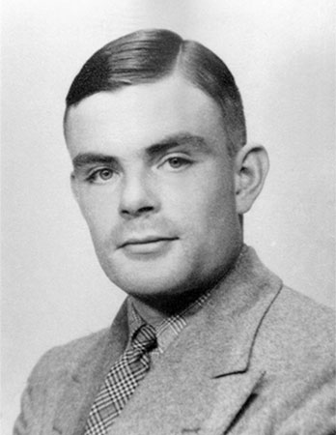
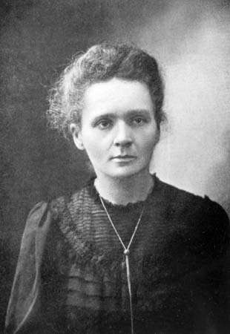
There Is No Formula …
But There Are Principles

Slide 4
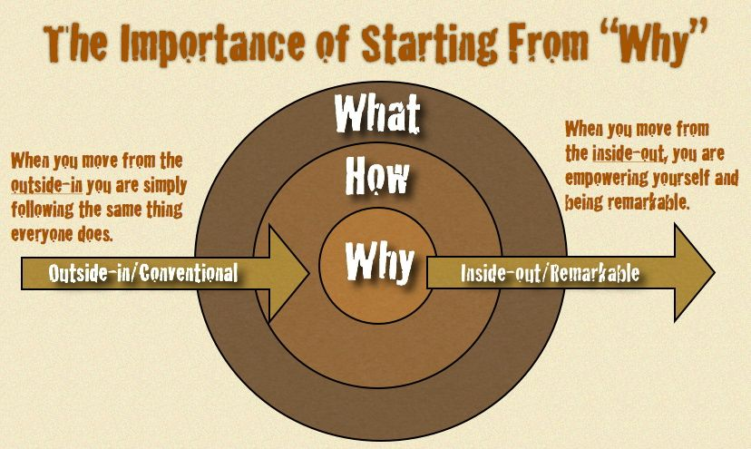
This is your journey… Understand your why
Why are you pursuing this journey of influence?

Slide 5
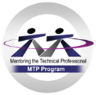

Influencing is Required No Matter Which Path You Choose
Boyd
-5
Approved For Public Release #17-2097; Unlimited Distribution, Dated 10/5/17

Slide 6
Systems Engineering and Influence
Functional Baseline
Established
Product Baseline Established
Contract
Award
SRR
PDR
CDR
TRR
MRR
IOC
FOC
Negotiating requirements, Measures of Effectiveness
Negotiating budget and schedule
Internal disconnects
Negotiating
fixes and
upgrades
Mission and
Requirements
Definition
Operations,
Maintenance and
Sustainment
Setting tradeoff criteria
Modeling
and Analysis
Verification
and Validation
Resolving verification problems
Presenting/reviewing designs
Architectural
Design and
Synthesis
System
Integration
Development and
Implementation
Handling late requirements changes

Slide 7
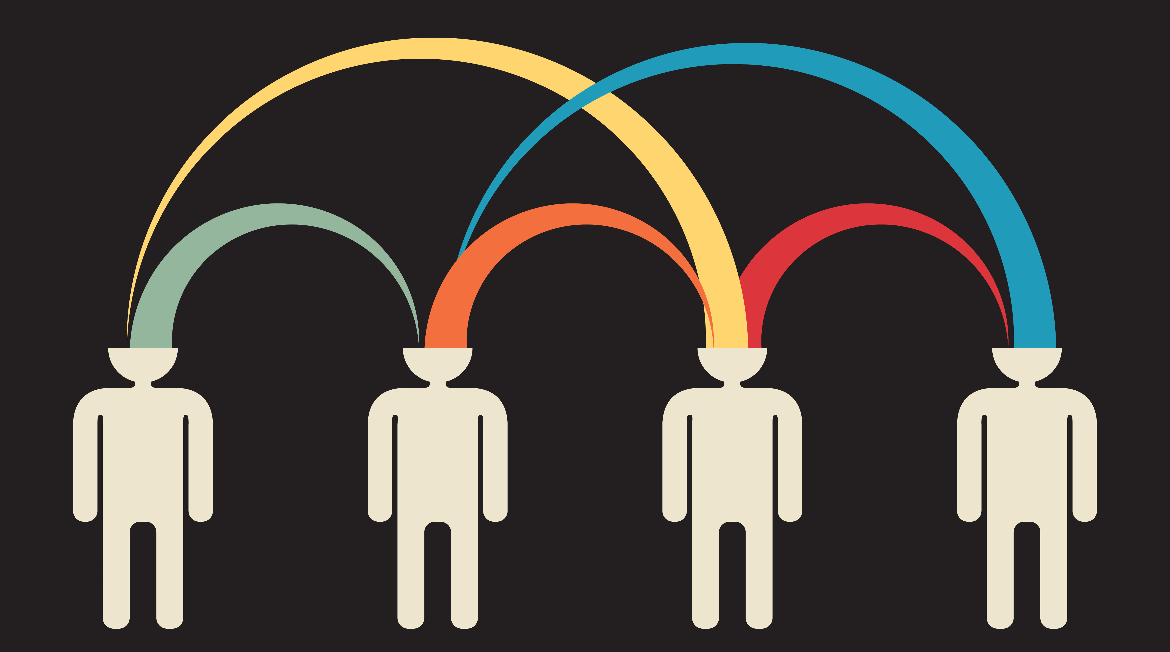
Foundations of Influence
Assessing Needs
  A dynamic process because different people have different needs, and their needs change over time
  We cannot influence unless we know both their needs and our needs
Brokering the Exchange
  We must communicate the vision so others can see why the change is beneficial
  We must request change without attacking and alienating others

Slide 8

Reciprocity (Social Exchange Theory)
People are willing to competently care for our needs when they trust that we will competently care for their needs in return
We take risks to make our needs known, which makes us vulnerable to others
Circularly, we must risk caring for someone else’s needs in hopes they will also care for ours

Slide 9
Cohen-Bradford Influence Model
Identify relevant currencies: yours, theirs
Dealing with relationships
Influence through give and take
Diagnose the world of the other person
Assume all are potential allies
Clarify your goals and priorities
Allen R. Cohen and David L. Bradford “Influence Without Authority”

Slide 10
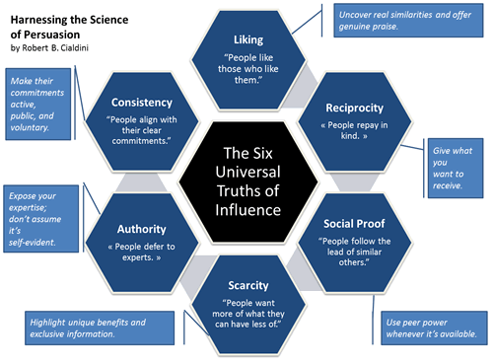

Slide 11
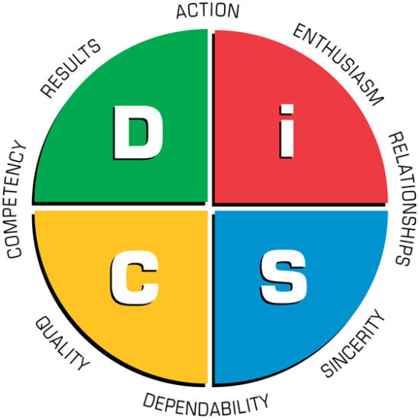
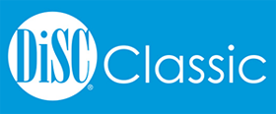
DISC for Understanding Behavioral Preferences
Dominance: Direct, decisive, independent and to the point; bottom line and results oriented; often strong-willed, enjoy challenges and immediate results
Influence: Optimistic, social and out going; enjoy being on teams, sharing openly, entertaining and motivating others
Steadiness: Team players, cooperative and supportive of others; prefer being in the background, working in a stable environment; often good listeners and prefer to avoid conflict and change
Conscientiousness: Cautious and concerned; focused on quality, details and accuracy

Slide 12
Each Personality Type has a Preferred Influence Style
But your ability to influence is dictated by how well you use all the styles!
Dominance
Conscientiousness
Influence
Steadiness
Authority
Problem Solving
Influence
Communication
Cooperation

Slide 13
Sources of Authority (Power) in Organizations
Structural
Position the person holds within the organization
Reward
Ability to reward (e.g., pay raises, promotions, resources, work assignments)
Coercive
Ability to punish (demotion, loss of privileges)
Expert
Referent
Recognized knowledge, skills or abilities
Liked, admired or respected
Pfeffer, Jeffrey (1994). Managing with power: Politics and influence in organizations, Boston: Harvard Business School Press

Slide 14

Ways to Enhance Your Authority
Maintain awareness of what's going on
Develop transferrable skills
Develop a strong personal brand image
Enhance your reputation
Build good working relationships
Focus on what you can change

Slide 15
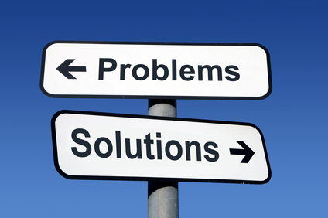
Identifying The Problem – Ask The Right Questions
Problem:
  Define the problem
  Five Whys method
Scope:
  How important is this problem?
  How deep does it go?
Consequence:
  What are the consequences of solving/not solving this problem?
  What is the impact on my organization or myself?
  What’s the worst that can happen?
Reward:
  Is this problem worth solving?

Slide 16

Ways to Enhance Your Problem-Solving Skills
Transparent communication
Break down silos
Cultivate open-minded people
Understand everyone’s interests
Build a solid foundational strategy
Chip away at the mountain
Be conscious of capacity and timing

Slide 17
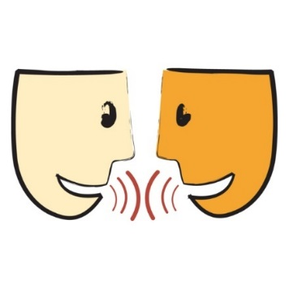



How Do We Communicate?
Verbal
Visual
Written
Non-Verbal

Slide 18

Goal: Creating a Pool of Shared Meaning

Slide 19
Communication Tips
Dominance
Influence
Steadiness
Conscientiousness
  Offer solutions
  Display reasoning
  Provide concise data
  Present options
  Include most current/profitable trends
  Get to the point quickly
  Prepare to be challenged
  Recommend action plan
  Provide timely compliments and genuine appreciation
  Be optimistic and provide positive comments
  Acknowledge their feelings when possible
  Focus on their role in the “big picture” rather than detail
  Include in brainstorm sessions
  Offer new ideas and ask their opinion
  Keep a fast lively pace
  Allow time for them to describe and explain
  Incorporate their alliances when discussing solutions
  Show how idea minimizes risk
  Show step – by – step reasoning for plan
  Acknowledge their support and follow-through
  Demonstrate a sincere interest in them
  Review project outline and instructions in person and in writing
  Contribute to a relaxing and friendly atmosphere
  Give them advice and assurance
  Focus on common interests
  Provide information and ask their opinion
  Tell them “why” and “how”
  Show reasoning with pros and cons
  Provide tangible data
  Provide detailed explanation and documentation
  Expect them to request time to research before deciding
  Provide questions prior to discussion
  Acknowledge their contributions
  Know all information before meeting
  Ask for classification and assistance

Slide 20
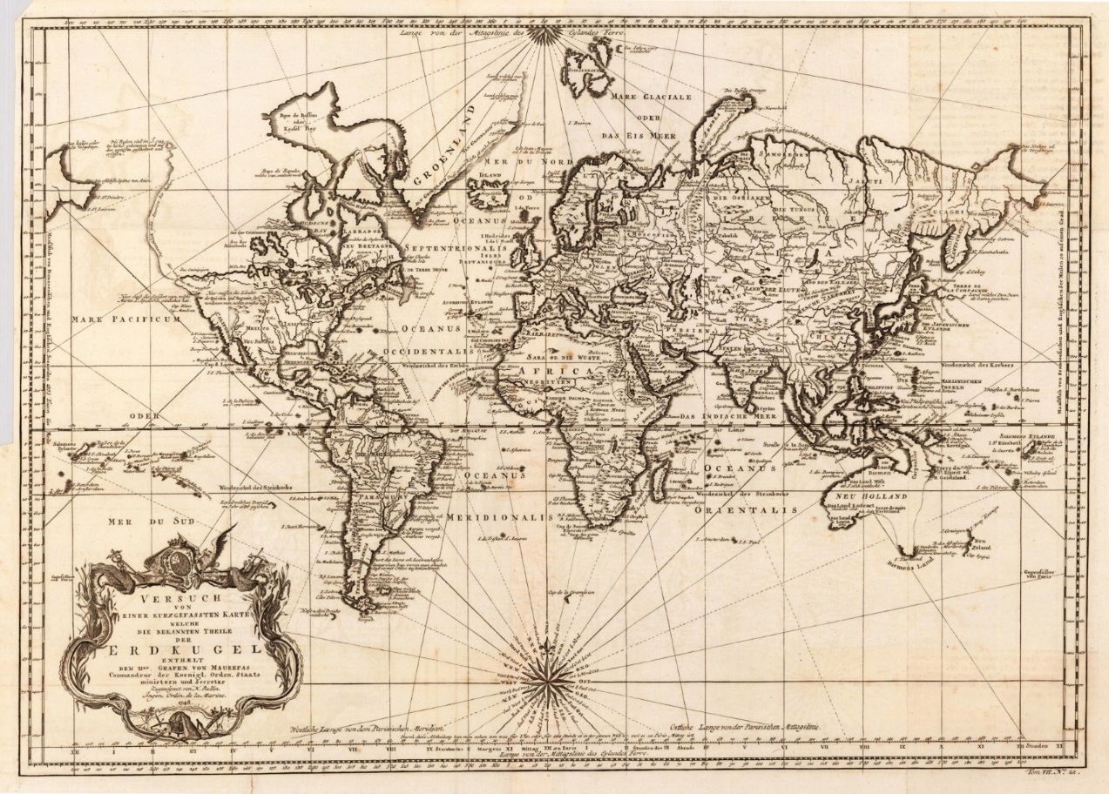
A Shrinking World
In early 1700s, the fastest communications were via horseback or sailing ship
  Business issues were addressed locally or through representatives
  Cultural considerations, though important, were not pressing
Today, communications are “instantaneous”
  Cultures and collaboration have not evolved at the same rate as communications

Slide 21
Cooperation in High Performance Teams
The purpose of teamwork is synergy – combined efforts yielding greater value than the collection of individual efforts
  Common meaningful purpose
Get the Job Done
Synergy = Combined Efforts Exceed Individual Efforts
  Commitment to working together
  Complementary competencies and attributes
Work Effectively Together
  Alignment on team
  approach and processes
  Collective and supportive accountability

Slide 22
The Tools of Cooperation and Change
Clayton Christensen, Matt Marx, Howard H. Stevenson

Slide 23
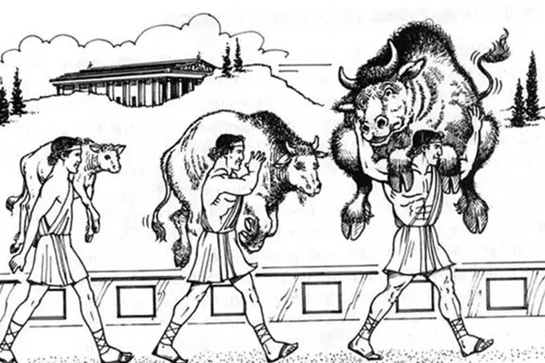
Building Your Systems Engineering Influence Takes Time
Will take multiple iterations to streamline
Requires collaboration and cooperation from all teams
Requires strong leadership and trust to effectively execute the Why
Gather enough experience to understand all aspects of SE
Leverage key subject matter expertise around you to increase influence
Where do you think you are today?

Slide 24
For More Information
List of references provided at https://ctme.caltech.edu/influencing-references
Public on-demand course Managing without Authority:
https://ctme.caltech.edu/leadership
ELEVATED – A monthly seminar on leadership topics https:/ctme.caltech.edu/elevated

Slide 25
Tim Boyd - Biography
Tim Boyd specializes in systems engineering, project management and organizational leadership development. He has technical experience in a wide variety of mission areas including space, air and ground systems as well as the systems engineering life cycle.
Mr. Boyd currently is the deputy ground element system engineering lead for an established space program. In this execution phase, Tim is leading the design, development and upgrades of critical capabilities that support multiple mission areas.
He has a diverse background and has previous experience in a multitude of roles: regional ops manager, systems engineering lead, project manager, cyber strategy analyst, business development, technical team lead and cost account manager.
Tim holds multiple certifications in various technical and non-technical domains and is credited with over 60 technical publications, trade secrets and technology awards in aerospace engineering and human capital development.

