Slide 1
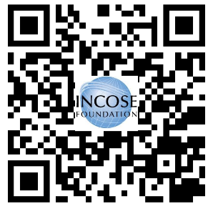
Call for Doctoral Award Applications:
INCOSE Foundation/Stevens Institute
All universities welcome! Deadline 9-01-2025, for Doctoral Research that will advance the state of knowledge in systems engineering and integration.
$5K cash, plaque and formal recognition at Feb. 2026 Annual INCOSE IW, Torrance, CA.
Email completed forms to Foundation@incose.net
Apply today! Required forms:
Stevens Doctoral Award Application
Stevens Doctoral Award Recommendation

