Slide 1
Chapter Leader Training
Video Recorded at IS 2014
Unit 2
The International Council on Systems Engineering
Revision 2.0
30 June 2014
Prepared by the Keys to Effective Chapters, part of the Chapters Shared Services Committee of the INCOSE Sectors

Slide 2
Certification: The Systems Engineering Professional (SEP) Program
An Introduction

Slide 3
The INCOSE SEP Program Purpose and Benefits
The INCOSE SEP program has been developed as the highest quality independent assessment of system engineering professionals benefiting:
Systems engineering community:
  Creates the standard to identify and develop systems engineering professionals
  Establishes a formal, recognized body of knowledge for the systems engineering community
System engineering professionals:
  Prepares the recipient to work across the extended enterprise with a common language and foundation
  Provides a portable standard of recognition for attainment of knowledge, education, and experience
Organizations/institutions:
  A universal, industry-approved measure of a professional’s knowledge –achieved through the independent evaluation of relevant tasks, projects, and programs
INCOSE’s certification program continues to grow due to the increasing recognition of its value to professionals, to organizations/ institutions, and to the overall systems engineering community

Slide 4
14 SE Functional Areas
Recognized for Experience
SE Technical Areas
  Requirements Engineering
  Design Development
  System Integration
  Qualification, Verification, and Validation
SE Management Areas
  Technical Planning
  Technical Effort Assessment
  Risk and Opportunity Management
  Baseline Control
SE Support Areas
  Specialty Engineering
  Process Definition
  Training
  Tool Support
  Quality Assurance
Plus “Other”
  To allow for the variety of SE across domains
  Applicants should describe what they are claiming as other experience
Successful candidates must have balanced experience across multiple areas

Slide 5



Systems Engineering
Professional Certification
INCOSE established a multi-level Systems Engineering Professional (SEP) Certification Program to recognize systems engineers, regardless of where they may be in their career:
  Entry to early career: Associate SEP (ASEP)
  Mid-level: Certified SEP (CSEP)
  Senior: Expert SEP (ESEP)
INCOSE Certification provides a formal method for recognizing the knowledge and experience of systems engineers
Notes:
Systems Engineering Professional Certification
The International Council on Systems Engineering has established a multi-level Professional SEP Certification Program to provide a formal method for recognizing the knowledge and experience of systems engineers, regardless of where they may be in their career.
What is certification?
Certification is a formal process whereby a community of knowledgeable, experienced, and skilled representatives of an organization, such as INCOSE, provides confirmation of an individual's competency (demonstrated knowledge, education, and experience) in a specified profession or occupational specialty provides formal recognition that a person has achieved competency in specified areas (demonstrated by education, experience, and knowledge). Certification differs from licensing in that licenses are permissions granted by a government entity for a person to practice within its regulatory boundaries. Certification also differs from a "certificate" that documents the successful completion of a training or education program.
Certification Value to YOU as a Systems Engineer
Formally recognizes your Systems Engineering capabilities
It is a discriminator that can aid in obtaining your next job
Can provide a competitive advantage in your career
Provides a portable Systems Engineering designation that is recognized across industry
Furthers your professional development as a systems engineer
Demonstrates your commitment to continuing professional development. Participation in continuing education indicates your commitment to personal development
Certification Value to YOUR ORGANIZATION
Formally recognizes the Systems Engineering capabilities of your people
Certified systems engineers can be a selling point and a discriminator for your proposals
Can be used as part of the hiring and promotion process
It encourages employee participation in continuing education
Provides an independent internal and external assessment
It is a tool for promoting professional competence

Slide 6
What’s Next
What is INCOSE
Admin Office Functions/Resources– Barclay Brown
Technical Operations
Chapters
Chapter Officer Roles & Responsibilities
Chapter Achievement Program
Resources and Products
Events

Slide 7
INCOSE Admin Office Functions and Resources are provided by:
Holly Witte
Christine Kowalski
Carol Berardino
Amy Wang
Carrie Lopez
Alexandra Kowalski

Slide 8
Topics
GlobalMeet Resource for webinar and remote meeting participation
EOY Financial Reporting: Templates/Due Dates
Chapter INCOSE Promotional Items

Slide 9
GlobalMeet
GlobalMeet Resource
INCOSE Shared Resources Request Site: https://connect.incose.org/resources/default.aspx

Slide 10
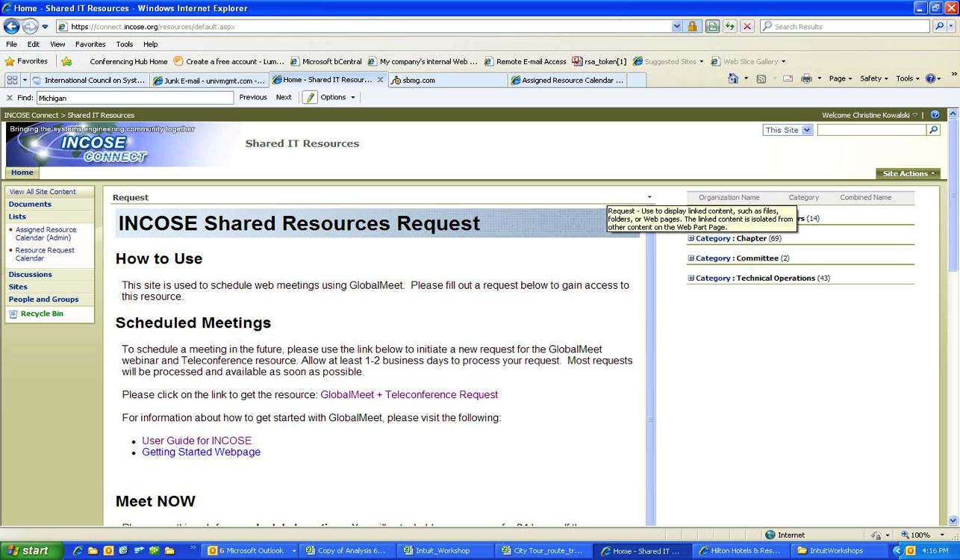
GlobalMeet
Be sure to review the User Guide and Getting Started Webpage links in the How to Use Scheduled Meetings

Slide 11
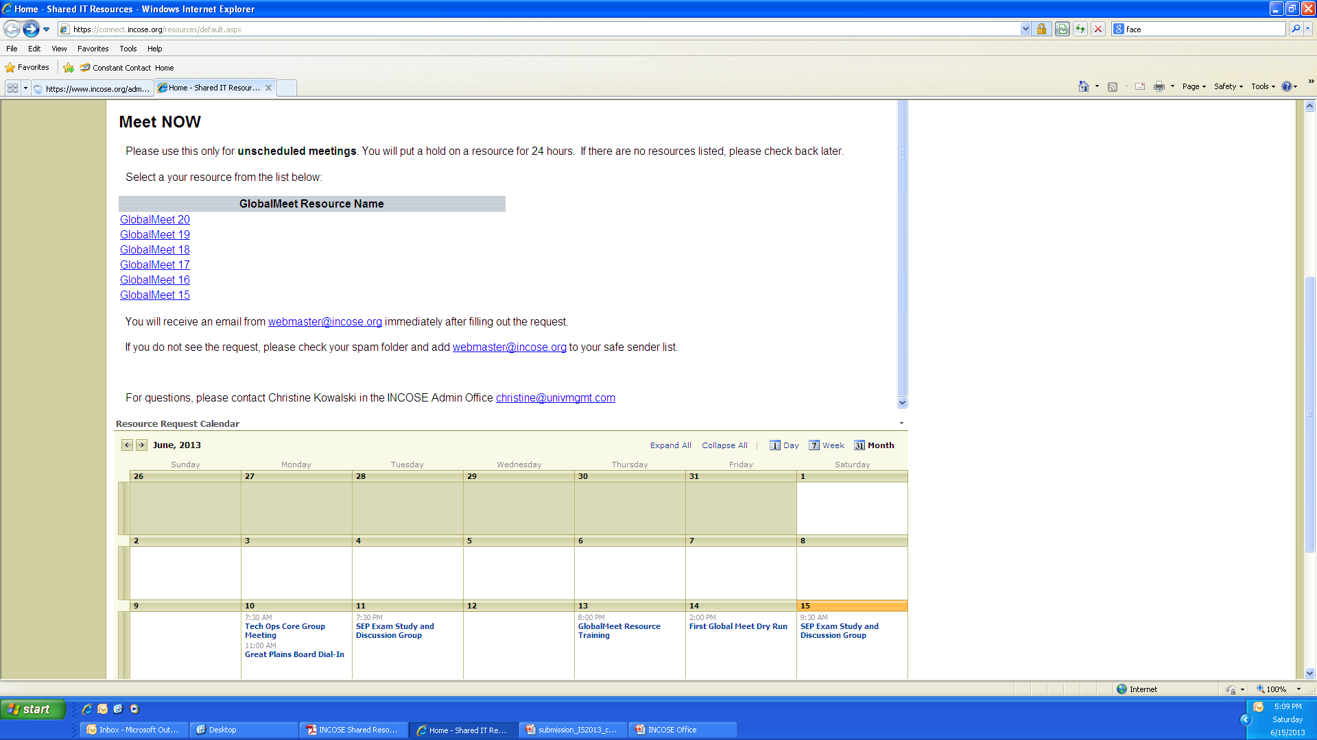
GlobalMeet
Meet NOW – for unscheduled meetings only.

Slide 12
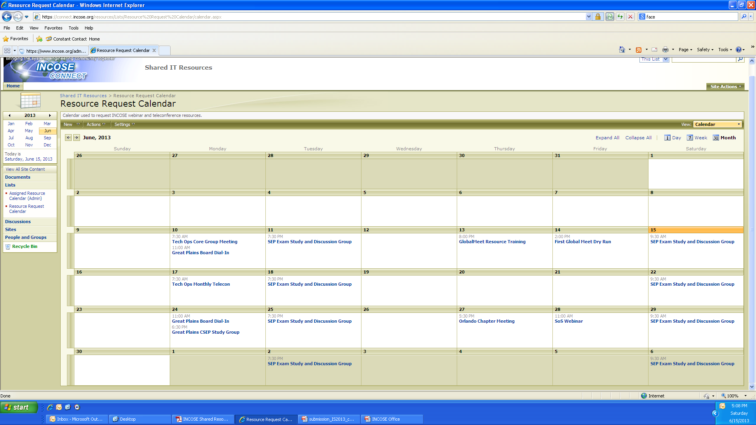
GlobalMeet
Calendar where Requests populate when submitted.

Slide 13
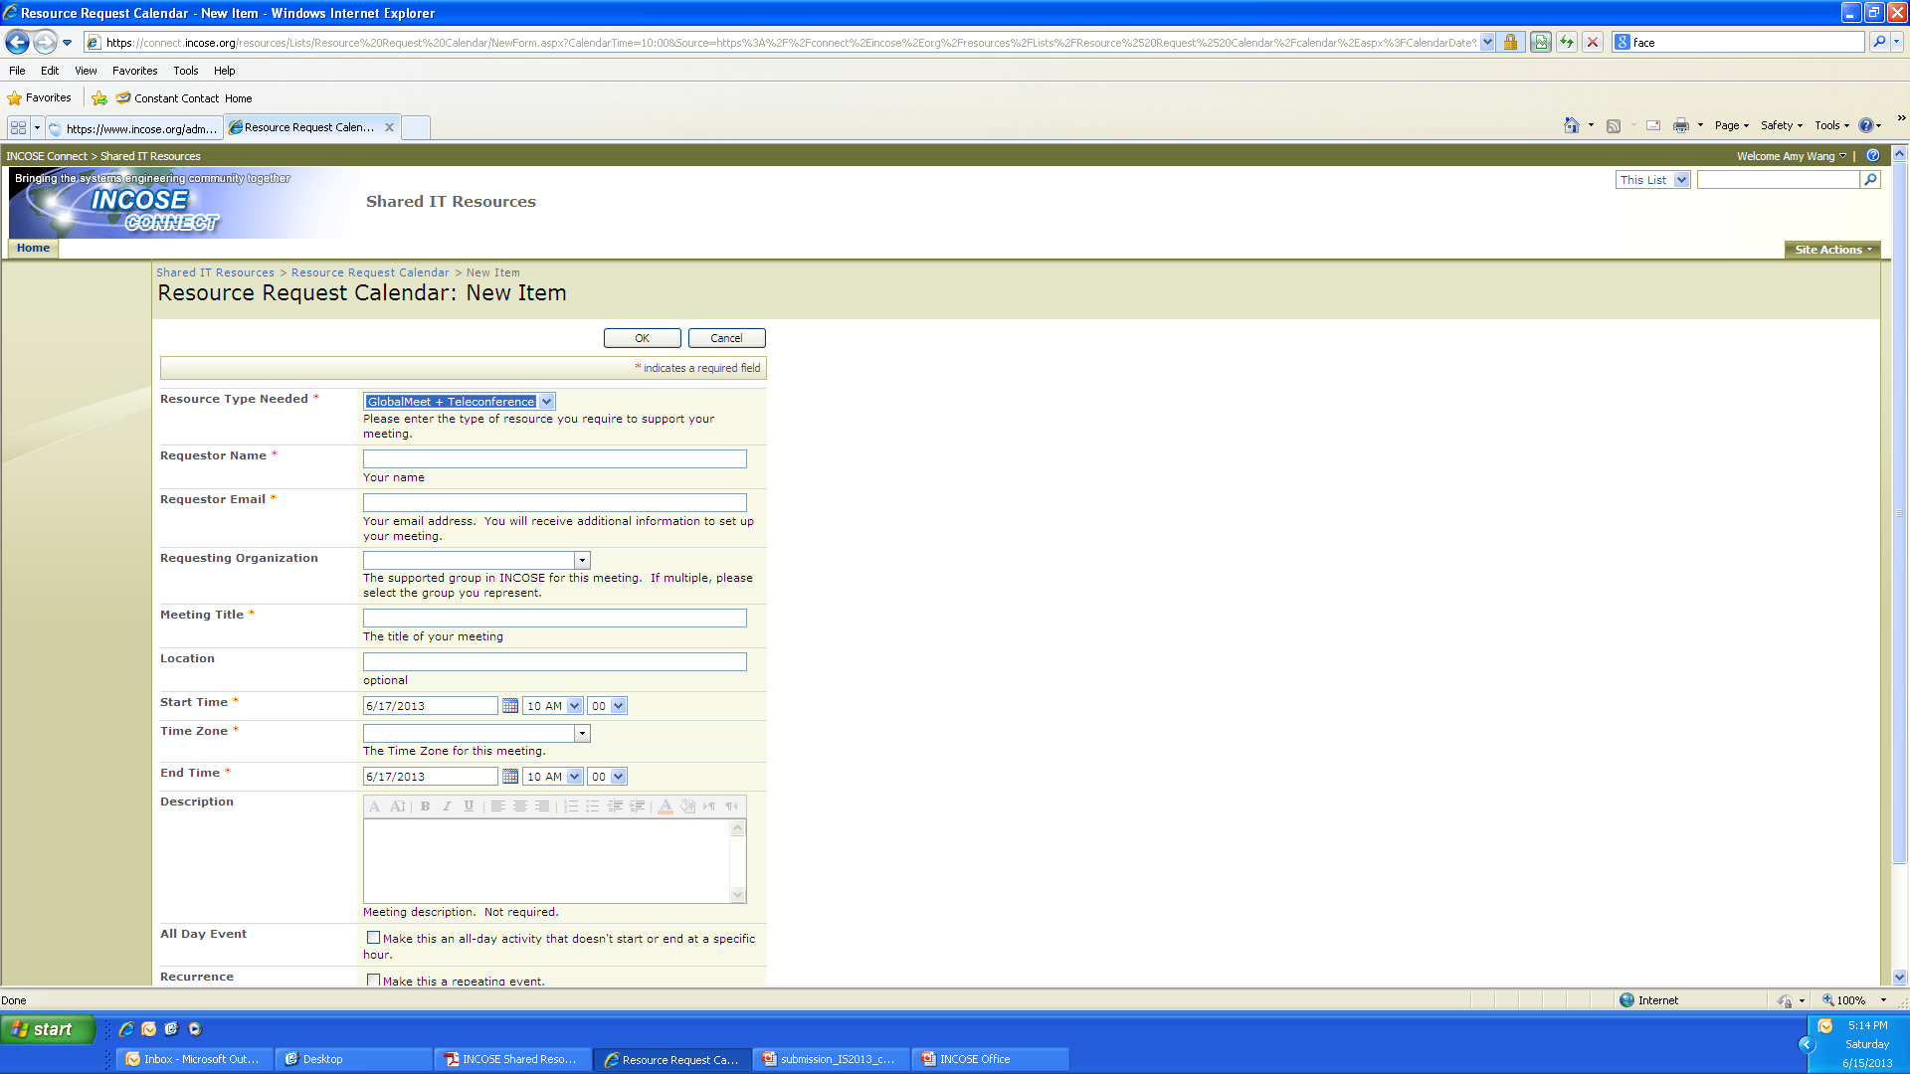
GlobalMeet
Select the GlobalMeet & Teleconference Request Hyperlink to access request form:

Slide 14
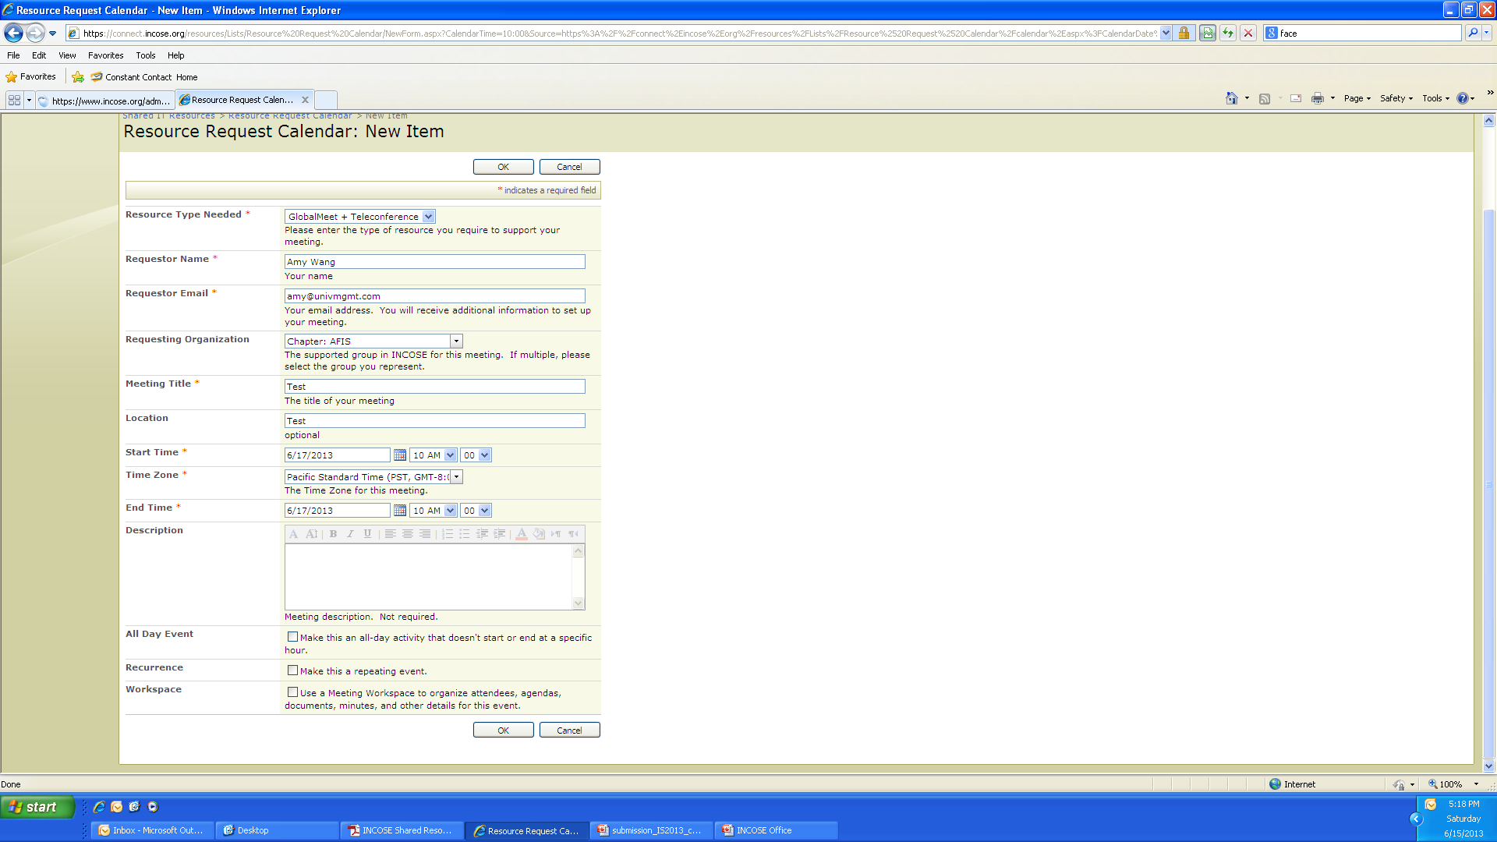
GlobalMeet
Complete the request form and submit (OK button)

Slide 15
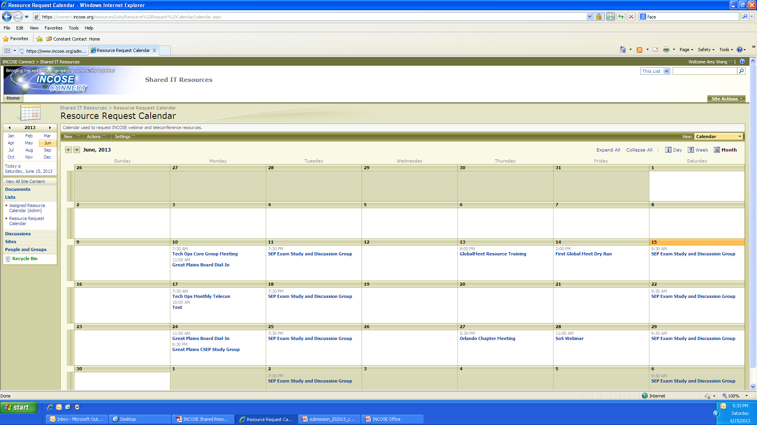
GlobalMeet
Request has populated the Request Calendar

Slide 16
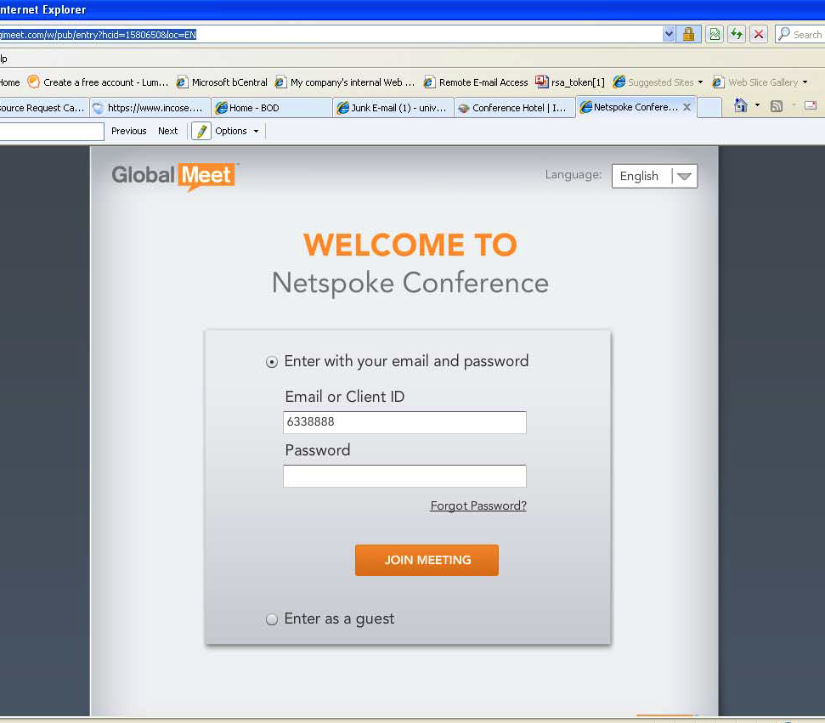
GlobalMeet Audio
Copy the web address and enter the Client ID and password in order to test / use your resource account. Attendees will sign in as Guests.
Please be sure to test the platform on the computer you will be using. Some organizations may have computers locked down where you cannot download the executable file which allows you to use the Screen Share of your desktop. You will need to have your IT department open your
computer and provide rights to do the download.

Slide 17
End of Year Chapter Financial Reporting
All chapters must have their financial reports emailed by February 15, 2015 to receive their chapter shares in March.
NOTE: US Chapter Shares are disbursed half in March and half in September for the dues shares from 1, March 2014 – 31, August 2014 (Or subject year)
INCOSE must have the completed financial reports as the chapter finances are included in our 990 tax report to the IRS. If you have any questions please contact info@incose.org
The report templates for US/Non US Chapters are in Connect on the Chapter homepage https://connect.incose.org/mb/chapters/default.aspx in the folder called “Financial Reports – Template” Please be sure to email a copy of your Chapter bank statement reflecting the December 31, 2014 (Or Subject year) balance. If you have any questions, please don’t hesitate to contact our office.
Chapters Main POC: Amy, info@incose.org

Slide 18
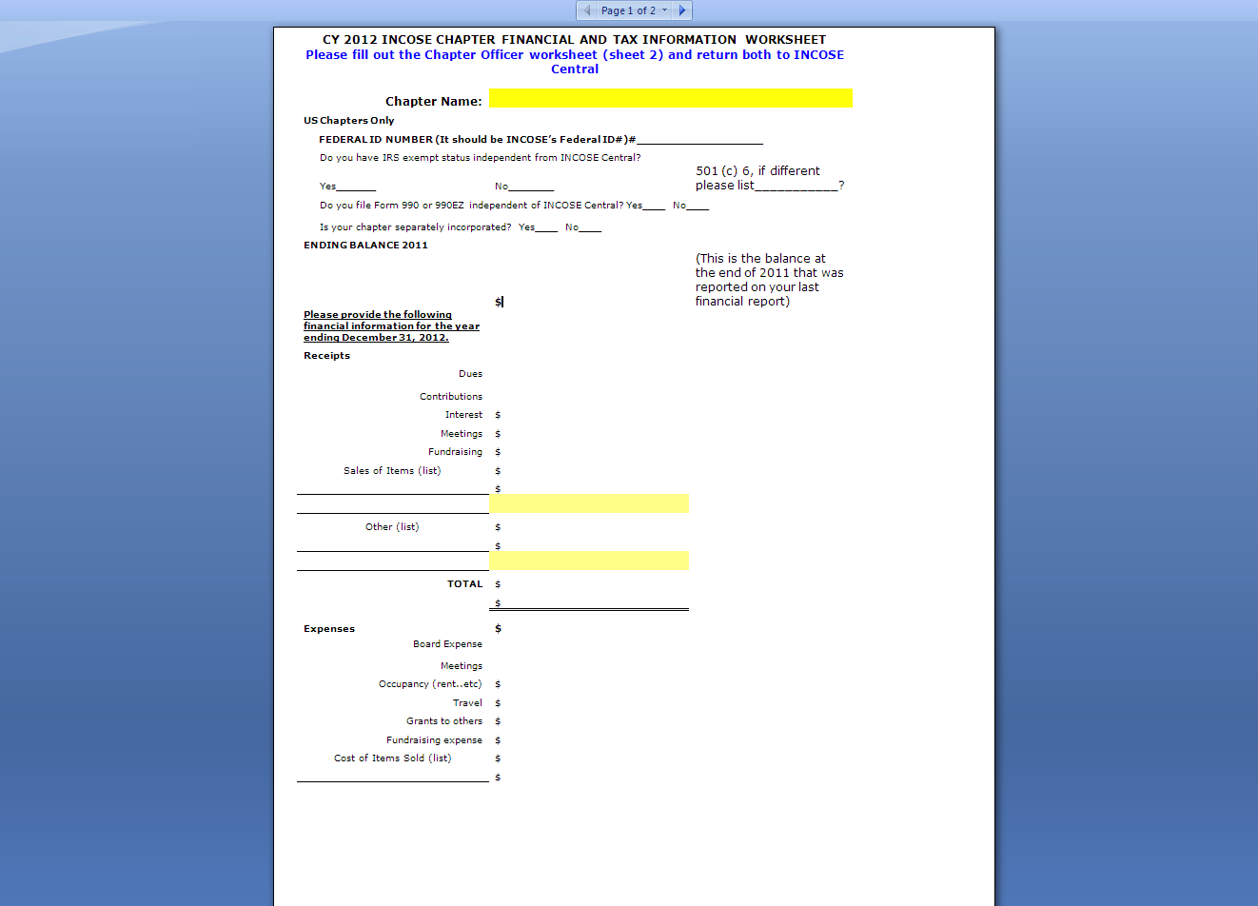
End of Year Chapter Financial Reporting
Direct Link to Form on INCOSE Connect: https://connect.incose.org/default.aspx?RootFolder=%2fShared%20Documents%2fChapter%20Templates&FolderCTID=&View=%7b832EA538%2dB92E%2d4C14%2dACEA%2d39DE80A815EE%7d

Slide 19
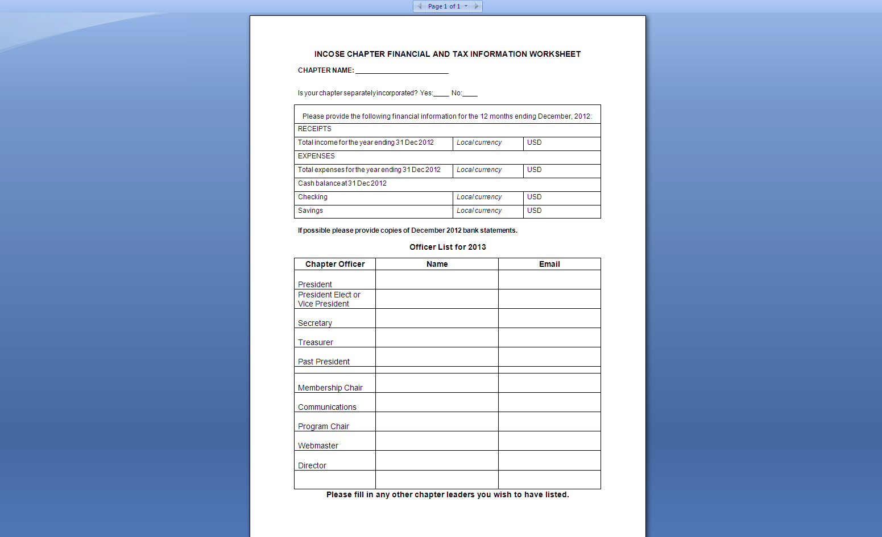
End of Year Non-US Chapter Financial Reporting
Direct Link to Form on INCOSE Connect: https://connect.incose.org/default.aspx?RootFolder=%2fShared%20Documents%2fChapter%20Templates&FolderCTID=&View=%7b832EA538%2dB92E%2d4C14%2dACEA%2d39DE80A815EE%7d

Slide 20
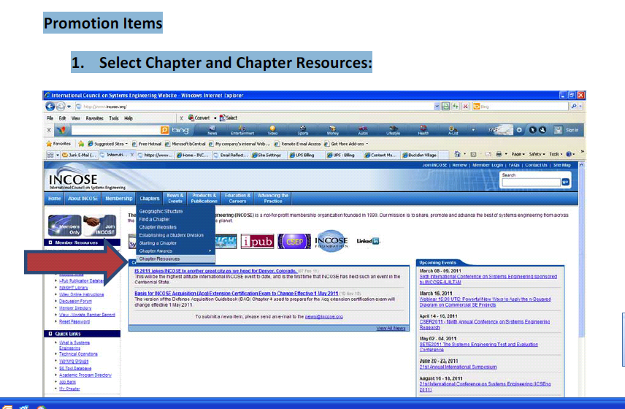
Promotional Items for Chapters

Slide 21
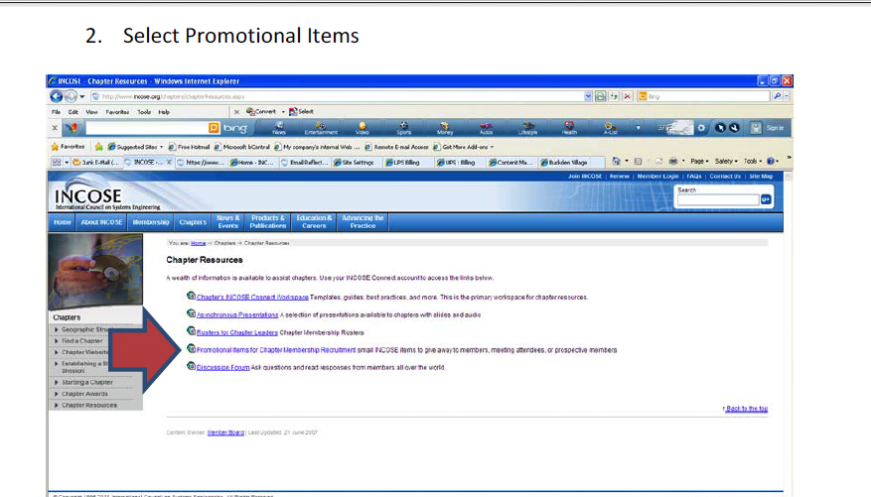
Promotional Items Ordering

Slide 22
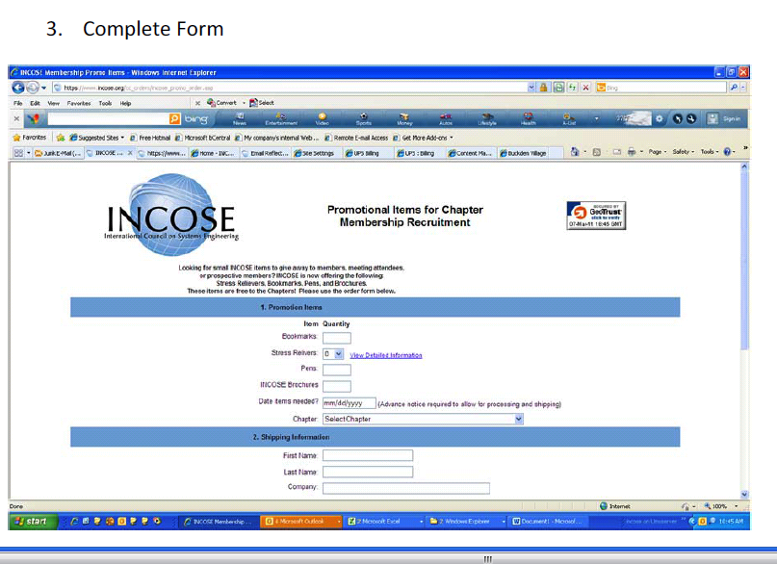
Promotional Items Order Form

Slide 23
What’s Next
What is INCOSE
Admin Office Functions/Resources
Technical Operations – Bill Miller Technical Operations Director
Chapters
Chapter Officer Roles & Responsibilities
Chapter Achievement Program
Resources and Products
Events

Slide 24
Initiative: Influencing & Harmonizing Standards
ISO/IEC JTC1 SC7 WG04 - SE Tools Editor
ISO/IEC JTC1 SC7 WG07 - 24748 -- Sys. Eng. Management Editor
ISO/IEC JTC1 SC7 WG07 - 24748 -- Systems Integration Editor
ISO/IEC JTC1 SC7 WG07 - 24748 -- Sys. Eng. Management Editor
ISO/IEC JTC1 SC7 WG07 - Requirements Editor
ISO/IEC JTC1 SC7 WG07 - System Life Cycle
ISO/IEC JTC1 SC7 WG20 - Certification Editor
ISO/IEC JTC1 SC7 WG20 - Certification Editor
ISO/IEC JTC1 SC7 WG24 – Life Cycle for Very Small Entities
ISO/IEC JTC1 SC7 WG42 – Architecture
ISO/IEC JTC1 SC27 - IT Security Techniques
ISO TC184 SC5 Object Process Methodology (OPM)
IEEE 15288.1 and IEEE 15288.2 – US DoD Extensions to 15288
Object Management Group (OMG) – SysML
NIST – NIS SP 800-160 System Security Engineering
ISO – International Organization for Standardization
IEC – International Electrotechnical Committee
JTC 1 – Joint Technical Committee 1
TR –Technical Report
CD – Committee Draft
NWIP – New Work Item Proposal
NIST – National Institute of Standards and Technology
NIS – Network Information System
SP – Special Publication

Slide 25
Initiative: Model-Based Systems Engineering
Reduced cycle times
System of systems
interoperability
Design optimization across broad trade space
Cross domain effects based analysis
MBSE Capability
Extending Maturity and Capability
Institutionalized
MBSE across
Academia/Industry
Distributed & secure model repositories
crossing multiple domains
Defined MBSE theory, ontology, and formalisms
Well Defined MBSE
Refer to activities in
the following areas:
Maturity
Architecture model integrated
with Simulation, Analysis, and Visualization
Planning & Support
Research
Standards Development
Processes, Practices, & Methods
Tools & Technology Enhancements
Outreach, Training & Education
Matured MBSE methods and metrics,
Integrated System/HW/SW models
Ad Hoc MBSE
Document Centric
Emerging MBSE standards
2010
2010
2020
2025
http://www.omgwiki.org/MBSE/doku.php

Slide 26
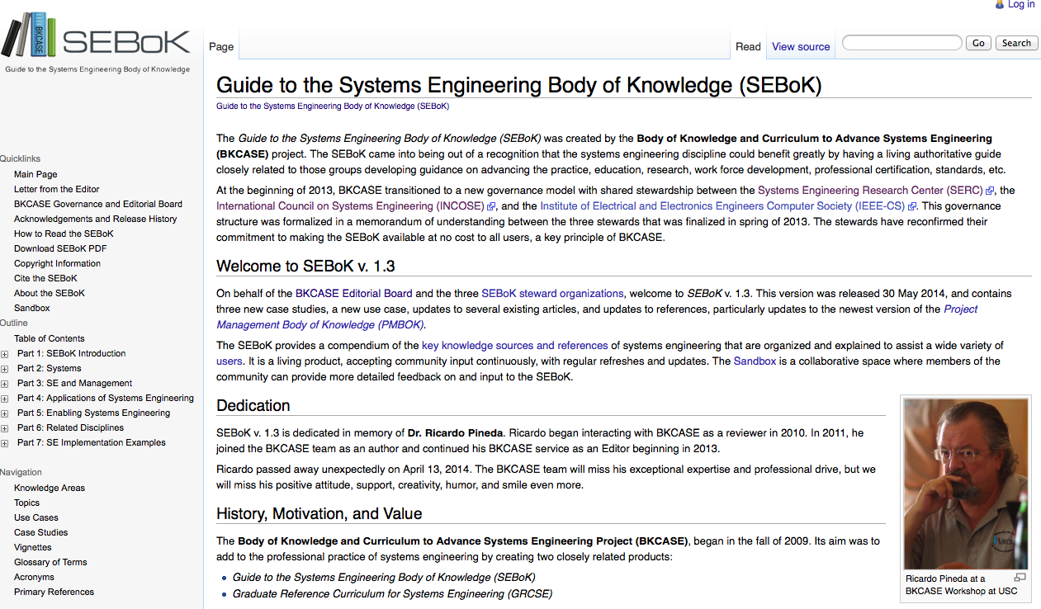
Initiative: BKCASE
http://www.sebokwiki.org/wiki/Guide_to_the_Systems_Engineering_Body_of_Knowledge_(SEBoK)

Slide 27
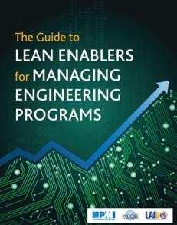
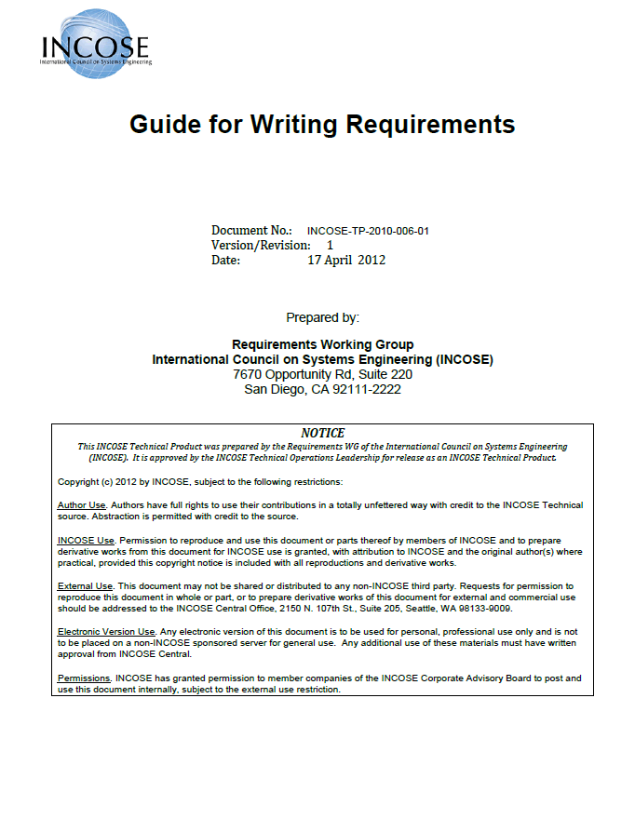
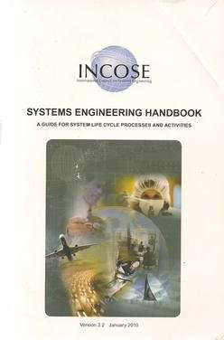
Technical Working Groups
~ 50 different working groups in our Technical Operations organization
The technical heart of INCOSE supported by many national and local working groups
Focused on solving relevant problems and creating products for global use
Notes:
SE Handbook
Book: The Guide to Lean Enablers for Managing Engineering Program
First document which bridges SE, PM and Lean
Available for download on MIT website

Slide 28
Working Groups
Affordability
Agile SE
Anti-Terrorism International
Architecture
Automotive
Autonomous System Test & Validation
Biomedical & Healthcare
Competency
Complex Systems
Decision Analysis
Defense Systems
GEOSS
Human Systems Integration
INCOSE-PMI Alliance
Infrastructure
In-Service Systems
Intelligent Enterprises
Knowledge Management
Lean Systems Engineering
Life Cycle Management
Measurement
Model Based Conceptual Design
Motor Sports
Natural Systems
Net-Centric Operations
Object-Oriented SE Method
Power and Energy Systems
Process Improvement
Product Lines
Reliability Engineering
Requirements
Resilient Systems
Risk Management
Space Systems
System of Systems
Systems Science
Systems Security Engineering
Tools Database
Tools Integration & Interoperability
Training
Transportation
Very Small & Medium Enterprises
For more information or the complete list, visit http://www.incose.org
follow Home>Advancing the Practice>Technical Operations
Notes:
SE Handbook
Book: The Guide to Lean Enablers for Managing Engineering Program
First document which bridges SE, PM and Lean
Available for download on MIT website

Slide 29
Supporting Top CAB Needs
SE Professional Development
  Competency WG (Don Gelosh, Chair)
Agile/Expedited Methods
  Agile WG (Rick Dove, Chair)
Effective Trade Studies
  Decision Analysis WG (Frank Salvatore, Chair)
  System of Systems WG (Judith Dahmann, Co-Chair)
Product Lines, Reuse
  Product Line WG (Gerard Auvray)

Slide 30
What’s Next
What is INCOSE
Admin Office Functions/Resources
Technical Operations
Chapters – Barclay Brown
Chapter Officer Roles & Responsibilities
Chapter Achievement Program
Resources and Products
Events

