Slide 1
Chapter Leader Training
Video Recorded at IS 2014
UNIT 3
The International Council on Systems Engineering
Revision 2.0
30 June 2014
Prepared by the Keys to Effective Chapters, part of the Chapters Shared Services Committee of the INCOSE Sectors

Slide 2
Agenda
Chapter Officer Training as divided up for video segments
  Unit 1
    What is INCOSE – David Long
  Unit 2
    Certification/Admin Office Functions/Resources – Barclay Brown
    Technical Operations – Bill Miller
  Unit 3
    Chapters – Barclay Brown
    Chapter Officer Roles & Responsibilities – Barclay Brown
  Unit 4
    Chapter Excellence Program- Don Boyer
  Unit 5
    Resources and Products - Barclay Brown
    Events – Barclay

Slide 3
What’s Next
What is INCOSE
Admin Office Functions/Resources
Technical Operations
Chapters – Barclay Brown
Chapter Officer Roles & Responsibilities
Chapter Achievement Program
Resources and Products
Events

Slide 4

Are Chapters relevant
in an online world?
... Perhaps “nothing could be more necessary”
(The Last Samurai)

Slide 5

Chapters are about who you know, and who you can get to know
INCOSE is about who you know and who you can get to know

Slide 6
Mission of Chapters
Local chapters play an essential role in the achievement of INCOSE’s goals and objectives:
  Organize professional and social programs that facilitate continuous professional development and networking
  Conduct membership recruitment and retention initiatives
  Support technical activities to advance the state and art of systems engineering practice, education and research
  Market INCOSE as the international authoritative body on systems engineering
  Increase the visibility of INCOSE and the systems engineering profession

Slide 7



Chapters, Local and National
Facilitate professional networking and information exchange
Host local activities
  Meetings
  Tutorials, workshops, mini-conferences and vendor fairs
  Contributions to working groups and projects
Disseminate announcements and news
Develop local initiatives such as
  Tutorials and handbooks
  SE certification support programs
  Activities with other professional organizations

Slide 8
Critical Success Factors for Chapters
Continuous recruiting of leadership team
Chapter officer training
Leadership teamwork
Chapter planning
Mentoring by Sector Leadership
These are leading indicators predictive of sustained performance

Slide 9
Why Chapters?
Facilitate professional networking and information exchange
Plan local activities
  Meetings (many are monthly)
  Tutorials, workshops, mini-conferences and vendor fairs
  Contributions to working groups and projects
Disseminate announcements and news
Develop local initiatives such as
  Tutorials and handbooks
  SE certificate programs
  Local Working Groups
  Activities with other professional organizations

Slide 10
Chapters Have Responsibilities
Operate in accordance with INCOSE bylaws CHP-100
  http://www.incose.org/about/docs/Policy_CHP-100.pdf
  Financial reporting – a legal requirement
Create programs for “local” membership
Hold chapter elections annually, update officer information on Connect
  https://www.incose.org/membersOnly/search/chapterRosterAccess.cfm
  and inform the central office info@incose.org and webmaster webmaster@incose.org
Hold regular meetings of the Chapter officers/directors (at least quarterly) and document results with minutes
Create/maintain bylaws and other governance documents – send revised bylaws to info@incose.org

Slide 11
Chapters Have Responsibilities (2)
Maintain archives of activities and financial status
Create communications internal to the chapter
Participate in communications with other chapters
Communicate with the Sector Directors via Regional Representatives/Sector Director Assistants by phone and at IW and IS
Maintain awareness and align with INCOSE strategic directions, policies and procedures, technical products

Slide 12
What About Financial Responsibilities?
Annual reporting supports tax filing
All chapters must report by 28 Feb
Non-USA also report on fiscal year basis
Forms maintained on chapters resource page
Also submit bank account statements
Assets of chapter are not the reason for reporting
Simple accounting
Open account using INCOSE Tax-ID (EIN) after chartering (INCOSE name only, not Chapter name)
Use Prudent-Man principle: Don't speculate, ensure income and protect capital
Treasurer role has responsibility for these activities
Chapters responsible for any ‘local’ tax requirements, e.g. related to
Income from events, or non-USA national obligations

Slide 13
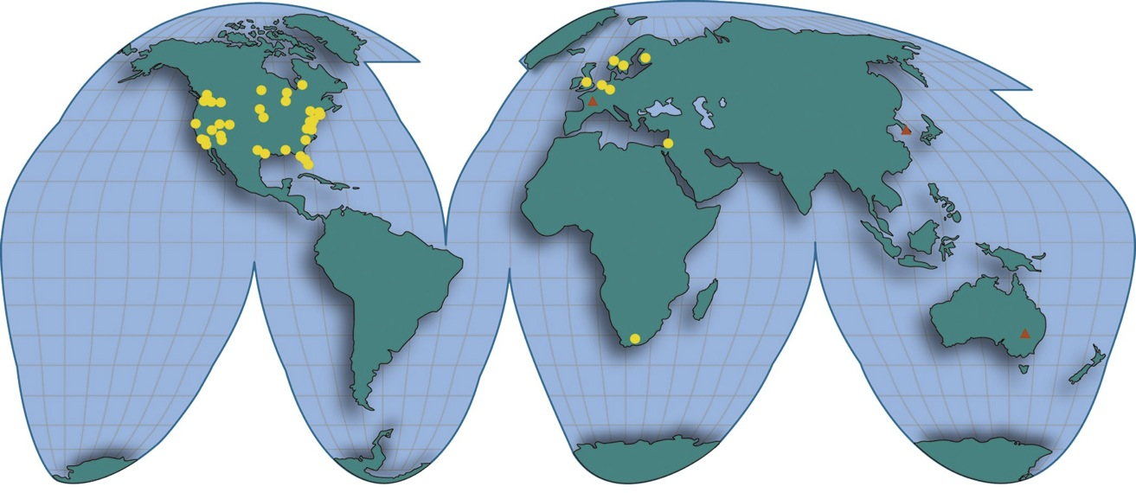
INCOSE Chapters Around the World
Chapters
Startups
2013

Slide 14
What’s Next
What is INCOSE
Admin Office Functions/Resources
Technical Operations
Chapters
Chapter Officer Roles & Responsibilities – Barclay Brown
Chapter Achievement Program
Resources and Products
Events

Slide 15


Chapter Officers/Leadership Team
Serving on the Chapter Leadership Team is a privilege as well as a responsibility
Your chapter’s success will be directly related to your commitment and teamwork
Chapter leadership provides valuable “real world” developmental experience, superior in many ways to a business degree
Chapter leadership provides opportunities to enhance and accelerate your career
NOT

Slide 16
Chapter Officers/Leadership Team
The following is required by the INCOSE Bylaws as a minimum organization
  President
  President Elect (for the following year)/ Vice President
  Secretary/Treasurer
Some chapters find 2 year terms very helpful
Other roles many chapters find helpful, (sometimes combined)
  Separate Treasurer
  Programs (chapter meetings, events)
  Development or Training (tutorials)
  Technical Director
  Membership (ambassadors, recruiting, retention)
  Communications (newsletter, website)
  Ad hoc committees, e.g. for elections and governance updates
  Liaison with CAB and other companies
  Additional Directors

Slide 17
Planning Responsibilities - President
Lead chapter planning by the Leadership Team soon after elections, then periodic review/update
  Needs to be a team effort (consider inviting non-board members from the general membership)
  Use of the Chapter Planning Workbook & Template is recommended
  The strategic portion provides long range guidance
    Maintain alignment with INCOSE Vision, Mission, Goals and Strategic Initiatives
    Consider a Strengths, Weaknesses, Opportunities, Threats assessment (SWOT) as a first step; conduct a gap analysis
    Strategic components include Vision, Mission, Goals, Strategy that are mostly unchanged year-to-year, providing continuity

Slide 18
Planning Responsibilities (2) - President
The second part of chapter planning focuses on the operational plans, also addressed in the Chapter Plans Workbook and Template
  Guided by, aligned with chapter’s Strategic Planning
  Include plans for activities and actions throughout the year such as attendance at IW and IS, work with other chapters or non-INCOSE entities, etc. (see Chapter Plans Workbook and Circle Awards criteria for ideas)
  Include plans/subplans
    Membership (recruiting and retention)
    Communications including website and publicity
    Ambassador/Promoter (companies, academia, other societies)
    Promotion of IW, IS, Certification, etc.
    Leadership succession planning

Slide 19
Other Typical Responsibilities - President
Vote with other Chapter Presidents to elect Sector Directors
Provide leadership to the profession, the Chapter Board and the membership.
Plan and chair Board and chapter meetings.
Manage all aspects of the chapter, whether internal, within INCOSE or external. Represent the chapter to INCOSE, and work with other chapter officers to ensure the interests of the chapter and INCOSE are properly represented.
Use Circle Awards criteria as metrics to evaluate progress
Identify, encourage, and mentor prospective chapter leaders
Conduct elections for the following year and ensure new list of officers is updated in Connect and submitted by January 31.
Mentor elected officers by setting expectations and offering guidance with issues that arise.
Vice President(s), Secretary, and Treasurer report to the President.

Slide 20
President’s Sample Check List
January (this year)
1/31 Set up Chapter Budget
1/31 Set up proposed meeting dates
1/31 Complete Officer Training presentation & discussion
1/31 Set up Board Meeting dates
1/31 Meet w/Board & discuss plans
1/31 Ensure Evidence uploaded for Circle Award
February
2/28 Send out Treasurer's Report
March
3/15 Complete Chapter Plans including Strategic,
Operations, Communications, Member Recruiting/Retention, Ambassador/Promoter
3/15 Ensure Evidence uploaded for Circle Award
July
7/31 Develop List of Officer Candidates
7/31 Review all components of Chapter Plans
7/31 Ensure Evidence uploaded for Circle Awards
September
9/30 Publish Officer Candidate Bios
9/30 Develop Chapter Survey
October
10/31 Hold Elections
10/31 Transmit Member Survey
10/31 Ensure Evidence uploaded for Circle Awards
November
11/30 Transmit Election results to INCOSE
11/30 Analyze Member Survey
11/30 Publish Member Survey results/analysis to guide next year’s planning
11/30 Officer Training presentation & discussion
December
12/15 Recognize Board and Chapter Members
12/15 Ensure Evidence uploaded for Circle Awards
January (next year)
1/4 Ensure All Evidence uploaded for Circle Awards
1/4 Certify and Send in Circle Awards Spreadsheet

Slide 21
Past President Suggested Tasks
Chair a chapter awards committee for Board/Member recognition
Assist President in leadership succession planning
NOT recommended to oversee the chapter’s Circle Awards – this should be done by the President Elect in preparation for role as President
Volunteer to be considered as a reviewer for the Circle Awards Committee
Volunteer to assist with the Keys to Effective Chapters Committee

Slide 22
Typical Responsibilities – President-Elect
Stand in when the President is not present
Oversee the Chapter Circle Award on-going evaluation, data collection and submittal
  Upload Circle Award evidence throughout the year to the Circle Award website (e.g. plans, newsletters, Board meeting minutes, activity announcements, etc.)
  Use to evaluate chapter’s progress in serving members, supporting INCOSE goals and promoting System Engineering
In smaller chapters may take on other responsibilities such as programs or membership.
Identify, encourage, and mentor prospective chapter leaders
Help mentor members of the leadership team by setting expectations and offering guidance with issues that arise

Slide 23
Typical Responsibilities – Vice President
There may be one or more Vice Presidents, depending on chapter size and plans
Assigned responsibilities may be for one or more areas
  Chapter Development – speakers for chapter meetings, tutorials
  Membership – recruiting, retention/renewal
  Ambassador/Promoters, CAB
  Communications (where not assigned to Secretary) – event promotions, newsletters, website
Identify, encourage, and mentor prospective chapter leaders

Slide 24
Typical Responsibilities – Secretary/Treasurer
May be separate offices for larger chapters
Record minutes of chapter and Leadership Team/ Board meetings
Oversee the communications such as website and newsletters
Help mentor members to develop in the chapter and encourage participation on the Leadership Team
Ensure chapter is responsible in all fiscal matters
Prepare the annual budget
Administer chapter income and payments with appropriate approval
Report income and expenses regularly at Board meetings
Ensure the chapter annual financial report is submitted to INCOSE main office by February 28

