Slide 1
Chapter Leader Training
Video Recorded at IS 2014
UNIT 1
The International Council on Systems Engineering
Revision 2.0
30 June 2014
Prepared by the Keys to Effective Chapters, part of the Chapters Shared Services Committee of the INCOSE Sectors

Slide 2
Agenda
Chapter Officer Training as divided up for video segments
  Unit 1
    What is INCOSE – David Long
  Unit 2
    Certification/Admin Office Functions/Resources – Barclay Brown
    Technical Operations – Bill Miller
  Unit 3
    Chapters – Barclay Brown
    Chapter Officer Roles & Responsibilities – Barclay Brown
  Unit 4
    Chapter Excellence Program- Don Boyer
  Unit 5
    Resources and Products - Barclay Brown
    Events – Barclay

Slide 3

Your Interest in Chapter Leadership Is a Brilliant Move on Your Part
Unique opportunities for deeper involvement in INCOSE, the premier systems engineering society
Allows you to contribute to the development of fellow chapter members
Involves you in promoting systems engineering in your community
Provides invaluable experience in leadership and organizational development to accelerate your career growth

Slide 4
Secrets of Successful Chapter Leadership
Develop as a strong team member, assisting & encouraging others
Learn and grow from the opportunities to develop valuable personal skills (for your chapter and your career)
  Strategic and Operational planning
  Organizing meetings and events
  Effective presenting & persuading
  Building personal relations to influence & motivate others
Practice good self-management – meet commitments
Plug into the INCOSE vast knowledge networks of officers from other chapters, and technical operations
Leverage the myriad of available resources from INCOSE

Slide 5
What We Are Planning to Cover
What is INCOSE – David Long, INCOSE President
Admin Office Functions/Resources
Technical Operations
Chapters
Chapter Officer Roles & Responsibilities
Chapter Excellence Program
Resources and Products
Events

Slide 6
We believe the systems perspective is essential to developing solutions for problems with a meaningful degree of complexity.
We believe the interesting things are often found in the gaps – between disciplines, between technologies, between components.
We believe the true challenges of today and tomorrow are systems challenges and that without the systems perspective, we cannot address these challenges effectively, efficiently, and free from unintended consequences.

Slide 7
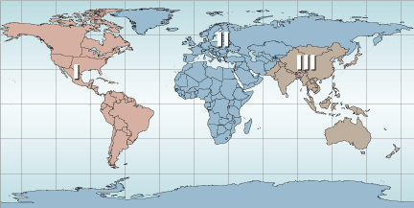
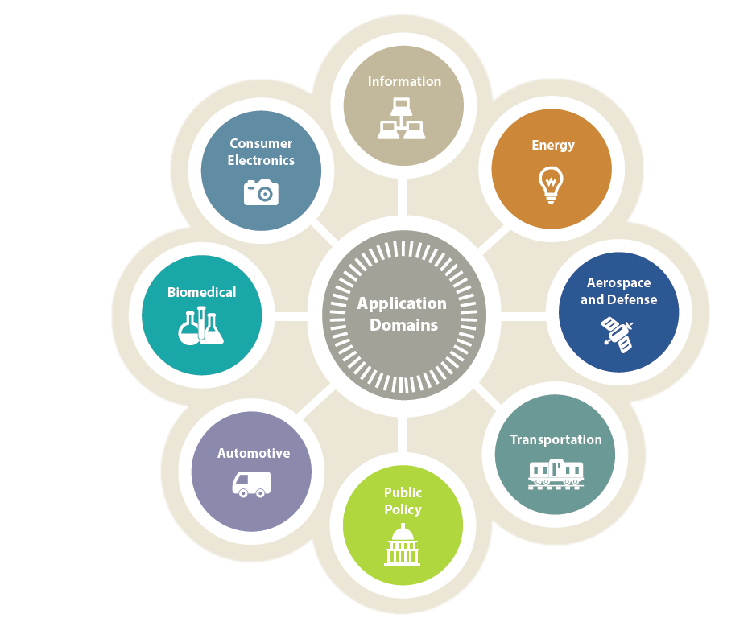
We connect systems practitioners around the world – across organizational boundaries, domain boundaries, and national boundaries.
We create, advance, and broker information on systems approaches to help the broader community address complex challenges.
We champion the systems perspective and the unique value of systems engineering and those who apply it.

Slide 8
67
58
74
10016
47
21
Notes:
Who is INCOSE?
We are 10016 members
In 58 countries
In 67 chapters
74 CAB members
21 academic council members
47 working groups

Slide 9
INCOSE: Who We Are
A not-for-profit membership organization founded in 1990 and dedicated to systems engineering
Over 10,000 members in government, industry, and academia
  Spanning aerospace & defense, transportation, health care, energy, and beyond
  67 local/national chapters and members in 58 countries
Our Mission: To share, promote and advance the best of systems engineering from across the globe for the benefit of humanity and the planet
Learn more at www.incose.org

Slide 10
INCOSE Goals to Advance the Profession
To provide a focal point for dissemination of systems engineering knowledge
To promote international collaboration in systems engineering practice, education, and research
To assure the establishment of competitive, scalable professional standards in the practice of systems
To improve the professional status of all persons engaged in the practice of systems engineering
To encourage governmental and industrial support for research and educational programs that will improve the systems engineering process and its practice

Slide 11
In INCOSE, We Value:
Systems Thinking – thinking and acting to apply systems approaches to address complex challenges and thus to realise successful sustainable solutions.
Pioneering and Innovation – taking opportunities ourselves or with partners to evolve systems approaches to meet future challenges.
Learning and Development – life-long learning with a changing world through education and continuing professional development, covering both technical and leadership competencies.
Respect, Diversity, Collaboration – building and maintaining respectful relationships internally and externally in order to enable effective collaboration across the diverse community.
Individuals – the importance of people, their intellect and influencing skill, to support complex decisions and to deliver enduring change.
Volunteerism – volunteers and staff working together to achieve our objectives and to deliver benefit to our members, individuals and society.

Slide 12
Our Five Year Objectives
Growth: INCOSE doubles its membership and embraces the healthcare, mobility, and energy business sectors
Alliances: INCOSE amplifies its ability to achieve its mission through diverse alliances
Education: INCOSE curricular recommendations are widely adopted around the world, raising the quality of engineering education
Products: INCOSE produces and brokers the most impactful systems engineering information in the world
Forums: INCOSE produces and supports the most impactful systems engineering forums in the world
Competency: INCOSE teams with industry to raise systems engineering competency across their supply chains
Transformation: INCOSE accelerates the transformation of systems engineering to a model-based discipline

Slide 13

Benefits of Membership
Network with 10,000 multi-national systems engineering professionals, individually, in a local chapter and in Working Groups
Quality presentations on SE topics of interest in chapter meetings, regional meetings, international workshops and symposia, webinars
Opportunities for career enhancing leadership training & experience
Receive INSIGHT, quarterly publication published digitally
Receive Systems Engineering, the Journal of INCOSE, online access
Exclusive access to INCOSE Connect, the collaborative space for INCOSE
Contribute to product creation through INCOSE working groups
Collaborate with experts and practitioners
Download INCOSE products and resources free from web
Lowest prices on INCOSE publications, e.g. SE Handbook

Slide 14
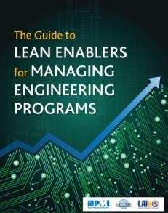
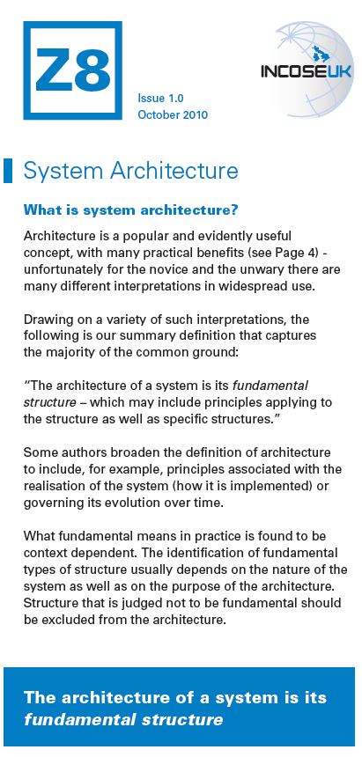
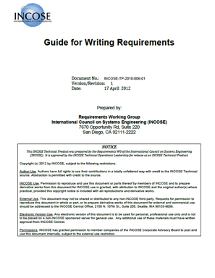
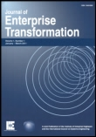
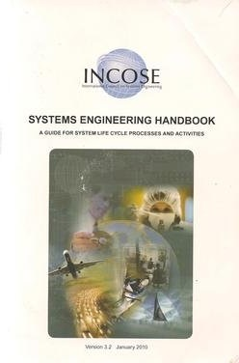




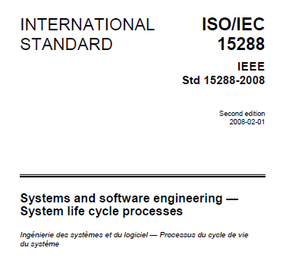



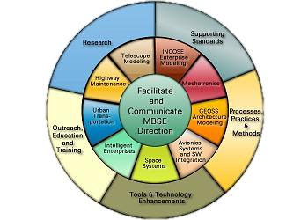


Notes:
Pictorial supplement enhancing previous slide on Benefits of Membership
Expanded on under Resources section later in presentation
Products
Developed locally, developed internationally
Produced alone and in partnership
Harmonization
Publications
Events
Major initiatives
At the local, national, sector, and international levels

Slide 15
INCOSE: The Organization
A Brief Overview of our Major Components

Slide 16
INCOSE Simplified
In the simplest terms, INCOSE consists of two primary operational entities
Chapters
Technical Operations
Board Of Directors/
Central
Office
Overseen and supported by
Overall leadership (Board of Directors)
Administrative support (Central Office)
Of course it is not that simple, but it is a good place to start
Chapters
Technical
Operations

Slide 17
INCOSE Simplified
Chapters
Primary gateway for new members
Provides local, year-round “home-room” support
A primary conduit for distribution of technical information to members and their companies
Technical Operations
Draws members from chapters for events and mostly virtual technical work groups
Advances the technical and operational aspects of systems engineering
In actuality they are symbiotic with mutual dependencies and each entity sharing some of the other’s functions

Slide 18
First – Oversight and Coordination

Slide 19

INCOSE Structure Provides Support for Key Areas of Operation
Incorporated as nonprofit technical society in January 1992
Started in August 1990 by 35 senior technical managers
Board of Directors
Corporate Advisory Board/
Academic Council
Executive Committee
Administrative Office
Sector Directors
Committees
Technical Operations, including over 40 technical Working Groups
Chapters

Slide 20
INCOSE Organizational Structure
Board of Directors
Corporate Advisory Board / Academic Council
Industry
Government
Academia
Sector Directors
Individuals
Chapters
Chapter & Members
Shared Services
Committee
  Chapter Awards
  Keys to Effective Chapters
  Student Divisions
Technical Operations
Technical Products / Data
Working Groups
Certification Program Office
ASEP
CSEP
ESEP
Notes:
20

Slide 21
Executive Committee & Board of Directors Provide Overall Direction
President
President-Elect
Secretary
Treasurer
Technical Director
Director for Communications
Director for International Growth
Director for Commercial Outreach
Director for Strategy
Director for Academic Matters
Director for IT
Corporate Advisory Board Chair (Elected by CAB Organizations)
Sector Directors (Elected by Chapter Presidents)
Elected
Appointed Director
Elected At-Large Directors
Picture directory: http://www.incose.org/about/leaders.aspx?id=bod

Slide 22

Sector Directors are the “Voice of the Chapter and Members” Within INCOSE
Elected representatives from each Sector I, II, III
Represents the chapters and their members
Resource, support for local chapters
Sector Directors’ focus:
Promote INCOSE goals to external organizations
within their Sector
Conduit between the BoD, Chapters &
Working Groups
Oversee Chapter & Members
Shared Services Committee
Oversee activities that support all members

Slide 23


Corporate Advisory Board (CAB) Provides “The Voice of the Corporate Customer” for INCOSE
Acts as a conduit between INCOSE and sponsoring corporations for information exchange, key corporate systems engineering-related issues, and access to corporate executive management
Provides guidance on overall INCOSE direction, focus, and priorities
Provides an priority needs list and assessment of how well INCOSE is meeting those needs based on status inputs from the BoD and the Technical Board
Provides advice and direction for Technical
Working Groups
Provides additional resources for INCOSE

Slide 24
INCOSE Administrative Office
Provides Support
Universal Management Services, LLC
  7670 Opportunity Road, Suite 220
  San Diego, CA 92111
  858-541-1725
  info@incose.org
Provides executive management services
Serves as single point-of-contact for inquiries
Manages membership database
Publication and Product sales
Certification administration
“Got a question? Contact the INCOSE Office”

Slide 25
Quick Reference

