Slide 1
Chapter Leader Training
Video Recorded at IS 2014
UNIT 5
The International Council on Systems Engineering
Revision 2.0
30 June 2014
Prepared by the Keys to Effective Chapters, part of the Chapters Shared Services Committee of the INCOSE Sectors

Slide 2
Agenda
Chapter Officer Training as divided up for video segments
  Unit 1
    What is INCOSE – David Long
  Unit 2
    Certification/Admin Office Functions/Resources – Barclay Brown
    Technical Operations – Bill Miller
  Unit 3
    Chapters – Barclay Brown
    Chapter Officer Roles & Responsibilities – Barclay Brown
  Unit 4
    Chapter Excellence Program- Don Boyer
  Unit 5
    Resources and Products - Barclay Brown
    Events – Barclay

Slide 3
What’s Next
What is INCOSE
Admin Office Functions/Resources
Technical Operations
Chapters
Chapter Officer Roles & Responsibilities
Chapter Achievement Program
Resources and Products – Barclay Brown
Events

Slide 4
Chapter Resource Links Available on Connect & INCOSE Home Page
(Connect Major Update in 2015)
A wealth of information is available to assist chapters.
  Keys to Effective Chapters Wiki (http://keys-to-effective-ch.wikispaces.com)- Chapter Leader Training, best practices, and more.
    Access to Veteran Officers - Ask questions and share information with officers all over the world - ChapterKeys@incose.org
Use your INCOSE Connect account to access the links below.
INCOSE home page/Chapters/Chapter Resources (drop down) includes the following resources:
  Asynchronous Presentations - A selection of presentations available to chapters with slides and audio (under INCOSE home page/Chapters/Chapter Resources drop down)
  Promotional Items for Chapter Membership Recruitment - Attractive brochures and small INCOSE items to give away to prospective members.

Slide 5
Publications & Products Promote Systems Engineering with Members and Companies
INSIGHT, quarterly publication
Systems Engineering – The Journal of INCOSE
Journal of Enterprise Transformation
Annual Proceedings – i-Pub (from the symposia, regional events)
Products from Working Groups
  Free to the public on the Web (www.incose.org)
    Tools Database (under review)
    Technical resource center
  From the Members Area (log-on and password assigned automatically upon joining or use Member Resources Link: https://connect.incose.org/products/default.aspx)
    REGAL: Requirements Engineering Guide for All
    Systems Engineering Handbook
    Many others available at this link or on the Working Groups’ sites
  Some are also available for purchase in print form through INCOSE

Slide 6
INSIGHT, the Newsletter of INCOSE
Published four times per year
60+ pages
Special theme in each issue. 2014-15 themes include:
  Agile Systems Engineering: Active Management of Unpredictable Risk
  2014 International Symposium Coverage: Las Vegas, Nevada
  Model-Based Conceptual Design: Engineering the Problem Space Resilient Systems Model-Based Systems Engineering
  Transformational System Engineering

Slide 7
Systems Engineering
Dr. Olivier de Weck (MIT), Editor-in-Chief
Refereed journal
Published quarterly by John Wiley & Sons
Access the Journal on line
  Current and past issues
  Full text in PDF
  Registration Key obtained by following instructions in the Members Area of the web
Instructions for authors found in INSIGHT and the INCOSE website

Slide 8
Journal of Enterprise Transformation
Published in collaboration with IIE
Ricardo Valerdi is INCOSE co-editor
Published by Taylor & Francis
Quarterly
Deeply discounted subscriptions available to members – gives both online access and hard copy journal

Slide 9
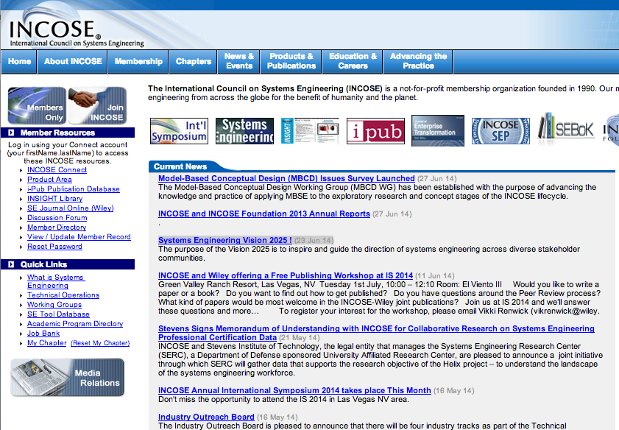
Member Resource Area: www.incose.org

Slide 10

http://www.incose.org
INCOSE Web resources also include:
  News of interest (INCOSE and SE)
  Calendar of upcoming events
  SE Primer
  Links to Working Groups’ information
  SE Certification information
  SE Tools database
  Technical Resource Center documents
  INCOSE organization descriptions and leadership directory
  Technical Operations overview
  Long range plans, policies and by-laws

Slide 11
https:/connect.incose.org – Changing in 2015
Members Area (member name and password protected)
  Technical Products are in the Product Area on Connect (https://connect.incose.org/products). Some examples:
    SE Measurement Primer
    Tech Measurement Guide
    Systems Engineering Handbook
    Systems Engineering Technical Vision
    SE Capability Assessment Model
    Webinars
  Latest issue of INSIGHT
  Access to the Journals
  i-Pub publications database
  SE Wiki
  Member directory
  Chapter membership records (access limited to chapter officers)

Slide 12
Updating Chapter Officers and Member Records
Updating Chapter Officers:
Go to https://www.incose.org/membersOnly/search/chapterRoster.cfm
then click the link after:
“To update your chapter leadership in the database click here.”
You must be listed as the President or a chapter leader to have the authority to access this page. If you can’t access the link above, then contact your Sector Director or INCOSE HQ at info@incose.org.
Updating a Member Record:
Go to www.incose.org
On the left side of screen under “Member Resources”
Click the link titled “View / Update Member Record”
Enter the updated information and remember to save
If you’re not logged in, you might be prompted to enter your username and password

Slide 13
Resources for Leadership Team
Your Sector Director and their assistants
Keys to Effective Chapters Wiki site
Chapter Circle Awards Connect site
Chapter real-time membership roster database
GlobalMeet web meeting capability provided by INCOSE
Chapter public website hosting by INCOSE
Connect chapter website with document storage, discussion board, etc.; separate pages for leadership team
Chapter presentations from Working Groups and Committees – a great, untapped resource

Slide 14
What’s Next
What is INCOSE
Admin Office Functions/Resources
Technical Operations
Chapters
Chapter Officer Roles & Responsibilities
Chapter Achievement Program
Resources and Products
Events – Barclay Brown

Slide 15
GlobalMeet Resource
GlobalMeet replaces LiveMeeting for all online INCOSE Meetings
Used for chapter meetings and events
Web meetings with 2-way audio / video
Telephone conference calls (with or without web meeting)
To reserve meeting:
https://connect.incose.org/resources/default.aspx
See Chapter Leader INCOSE Admin Office Training for more information on GlobalMeet

Slide 16

Activities Are Key to Involved Chapters and Members
Regular meetings of local chapters
Annual International Symposium in summer
Annual International Workshop at the end of January/first of February
Technical Working Groups – member participation; chapter presentations
Regional conferences
Extensive professional networking
Collaboration with other Societies
Involvement in the local community

Slide 17
Previous International Workshops
2014 International Workshop in Torrance, CA, USA
2013 International Workshop in Jacksonville, FL, USA
2012 International Workshop in Jacksonville, FL, USA
2011 International Workshop in Phoenix AZ, USA
2010 International Workshop in Mesa AZ, USA
2009 International Workshop in San Francisco CA, USA
2008 International Workshop in Albuquerque NM, USA
2007 International Workshop in Albuquerque NM, USA

Slide 18
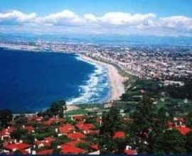
2015 International Workshop
2015 International Workshop planned for Torrance, CA (near Los Angeles)
24 - 27 January 2015
Installation of the INCOSE officers
Annual report to the membership on results and plans for the coming year
Working sessions for Working Groups, technical and administrative committees

Slide 19
Previous International Symposia
2013 International Symposia in Philadelphia, PA, USA
2012 International Symposia in Rome
2011 International Symposia in Denver CO, USA
2010 International Symposia in Chicago IL, USA
2009 International Symposia in Singapore
2008 International Symposia in The Netherlands
2007 International Symposia in San Diego, CA, USA

Slide 20
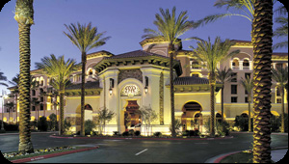
2014 International Symposia
2014 International Symposium in Las Vegas
  June 28 - July 3
  Technical papers, panels, tutorials, exhibits, plus many opportunities to collaborate with experts and practitioners from diverse domains
  Chapter leadership meetings, new member orientation, some working group meetings

Slide 21

2015 International Symposia
INCOSE 25th Anniversary
2015 International Symposium in Seattle
  June 28 - July 3
  Technical papers, panels, tutorials, exhibits, plus many opportunities to collaborate with experts and practitioners from diverse domains
  Chapter leadership meetings, new member orientation, some working group meetings

Slide 22



Regional Conferences Are More
Up-Close and Personal
28 – 30 Jul 2014. EnergyTech 2014 and AIAA Propulsion and Energy Forum (Cleveland, OH, USA)
7-9 Oct 2014. APCOSEC 2014 (Qingdao, China)
10-11 Oct 2014. 8th Annual Great Lakes Regional Conference (Chicago, IL, USA)
27-30 Oct 2014. EMEASEC 2014 (Cape Town, South Africa)
18-19 Nov 2014. INCOSE UK Conference 2014 (Tedford, UK)
Check the INCOSE events calendar and your Region for upcoming conferences http://www.incose.org/newsevents/events/index.aspx

Slide 23

Your Expectations
What do you want from INCOSE?
How can INCOSE best serve you in your new role?

