Slide 1
TechOps Overview and more!
Chris Hoffman , Technical Director

Slide 2
Agenda
1
2
3
4
TechOps Overview
Working Groups & Initiatives
INCOSE Products
Q&A

Slide 3
TechOps Overview
TechOps includes all members involved in TechOps activities (Working Groups, Initiatives & the governance of each)
Primary objective is to advance world-class systems engineering through activities that relate to all facets of systems engineering across all sectors of application

Slide 4
Tech Ops Working Group Structure
Application Domain
Application Domain
Application Domain
Application Domain
Application Domain
Application Domain
Application Domain
Tech Ops governance and Interfaces
(Technical Director, Deputy, Assistant Dir,,
Interfaces to Chapter WGs, CAB, IOB, Academia )
Transformational Enablers (dedicated to the transformational activities)
Analytic Enablers (Covering the cross-cutting, Specialty Engineering and analytic capabilities)
Process Enablers (based on ISO15288:2015 processes)

Slide 5
Leadership Team – Governance
*Change from IW2020
Technical Director, Christopher Hoffman*
Deputy Technical Director, Olivier Dessoude*
Please CC Olivier in all communication to the Technical Director
Assistant Director for Technical Review, TJ Ferrell*
Deputy Assistant Director, Krystal Porter*
Assistant Director for Technical Information, Masood Ahmed
Deputy Assistant Director, Lori Zipes
Assistant Director for Technical Events, Paul White*
Deputy Assistant Director, Nehal Patel*
Assistant Director for Working Group Integration, Eric Burgers
Assistant Director for Internal Operations, Bill Scheible*
https://www.incose.org/incose-member-resources/working-groups

Slide 6
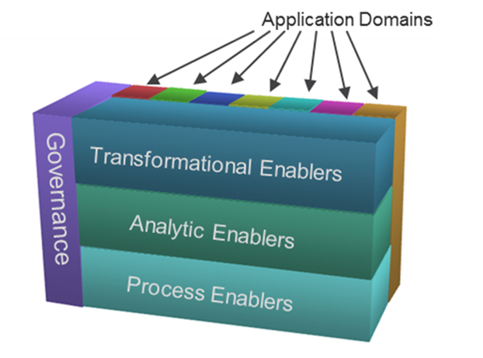
Leadership Team – WGs & Initiatives
*Change from IW2020
Assistant Director for Transformational Enablers, Phyllis Marbach*
Assistant Director for Analytic Enablers, Jimmie McEver
Assistant Director for Process Enablers, Bob Swarz
Assistant Director for Application Domains, Carl Landrum
Assistant Director for MBSE Initiative, Mark Sampson
Assistant Director for Smart Cities Initiative, Jennifer Russell, Marcel van den Ven
Assistant Director for Value Proposition Initiative, Juan Amenabar, Ken Harmon
Assistant Director for Standards Development Department, Richard Martin*
Deputy Assistant Director, Daniel Siegl*
https://www.incose.org/incose-member-resources/working-groups

Slide 7
WG Lifecycle
WG can be initiated by INCOSE members or be a spin-off from a Chapter WG or an Initiative
Periodic updates of the Charter are typically generated by the WG and approved by the Technical Director. WG may be initiated based on activities of INCOSE Initiatives (like MBSE) that are eligible to transform to a WG
WG may be dormant or inactive for a while, before being revitalized or retired.
WG have 4 stages: ‘Initiation’, ‘Active’, ‘Dormant’ and ‘Retired’.
Guidance from the Board is to stick to a single naming for Working Group activities (don’t consider names for teams that are more like discussion groups)
Transfor-mational
Processes
Domain
A
Analytic
WG revitalized
WG Product
WG Product
WG Initiation
-Setup Charter, Attract WG members
WG Active
- Have regular meetings, Create WG products, Update WG Charter & Quad Charts
WG dormant (inactive)
Charter (updates) approved
WG Retired

Slide 8
Initiatives
Application Domains
A dedicated cross-section can be made for each Initiative or Special Project
For Governance, the ADs or Initiative or Project Leader will support all inter-WG coordination.
Provides a network based rather than a top- down based connectivity
Also Chapter WGs or representatives of external organizations like IEEE may be involved in the initiative.
Transformational Enablers
Governance
Analytic Enablers
Chapter WG
Domain
G
Domain
F
Process Enablers
Domain
D
Domain
A
C
Transformational
Analytic
Governance
Process
Example Cross-section for an Initiative

Slide 9
https://www.incose.org/incose-member-resources/working-groups

Slide 10
Working Groups & Initiatives by Domains
Analytic Enablers | Application Domains | Process Enablers | Transformational | Other Groups & Initiatives
Competency Complex Systems Decision Analysis Human Systems Integration Natural Systems Product Line Engineering Resilient Systems System of Systems System Safety Systems Security Engineering Training | Automotive Critical Infrastructure Protection and Recovery (includes Anti-Terrorism International) Defense Systems Financial Services Healthcare Infrastructure Oil and Gas Power & Energy Systems Space Systems Telecommunications Transportation | Architecture Configuration Management Enterprise Systems Integration, Verification & Validation Measurement PM-SE Integration Requirements Risk Management Systems Engineering Quality Management | Agile Systems & Systems Engineering Artificial Intelligence Systems Digital Engineering Information Exchange Knowledge Management & Ontologies Lean Systems Engineering MBSE Patterns Model-Based Conceptual Design Object-Oriented Systems Engineering Method Process Improvement SE in Early-Stage Research & Development Small Business Systems Engineering Social Systems Soft Skills Systems Engineering Tools Database Systems and Software Interface Systems Science Tools Integration & Model Lifecycle Management | Empowering Women Leaders in SE MBSE Initiative Smart Cities Initiative Value Proposition Initiative
Be ACTIVE in a Working Group or Initiative!

Slide 11
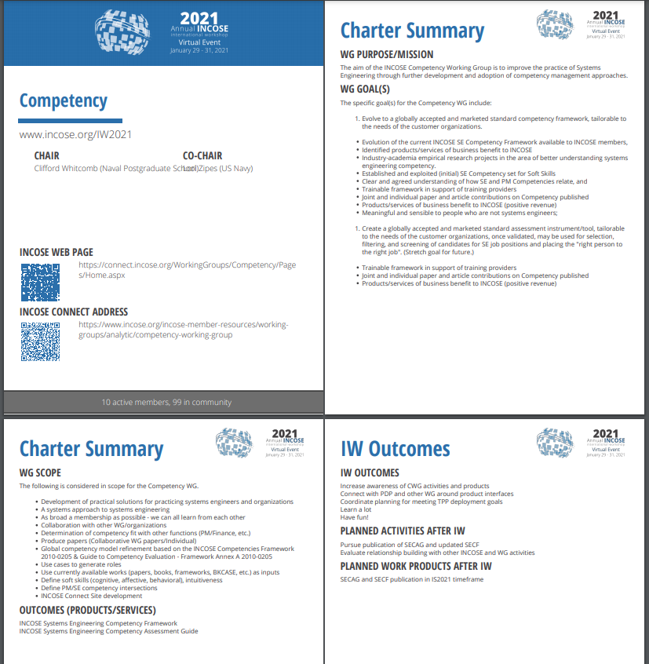
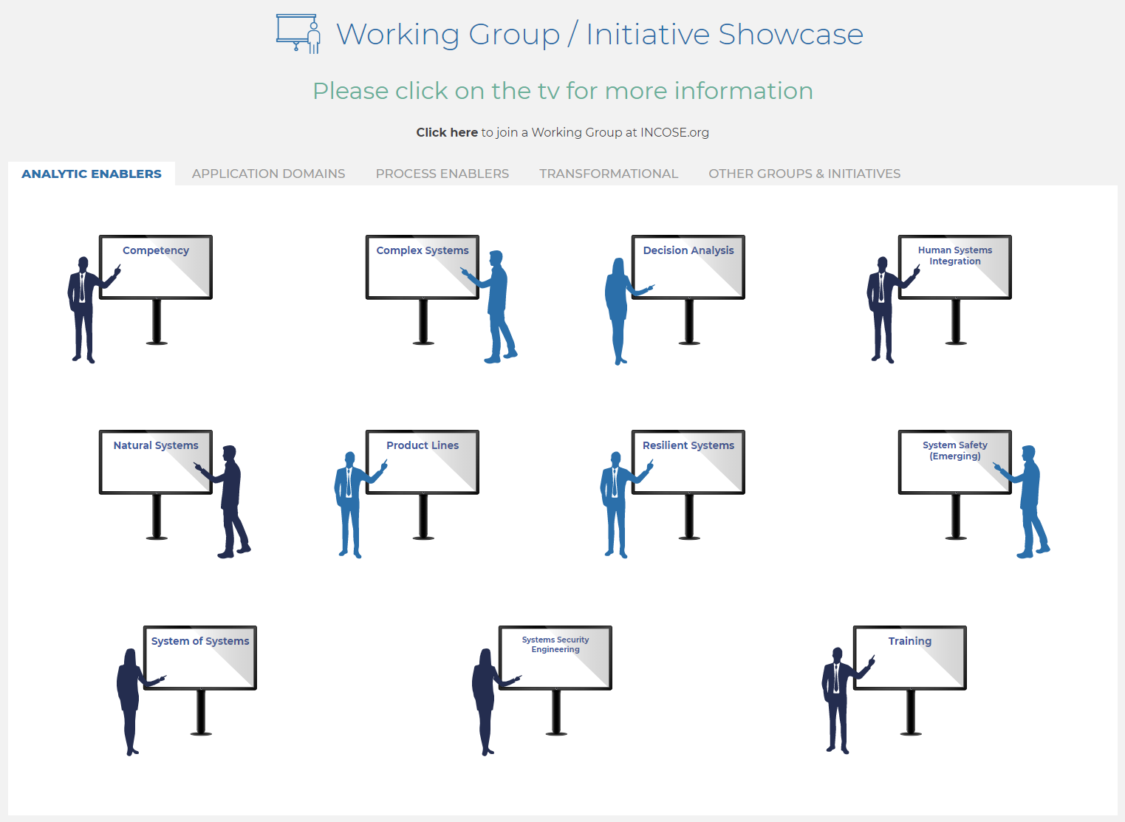
Visit our Working Groups & Initiatives!
Look for the Working Group Info Sheets from the Market Place to be posted on INCOSE.org!

Slide 12
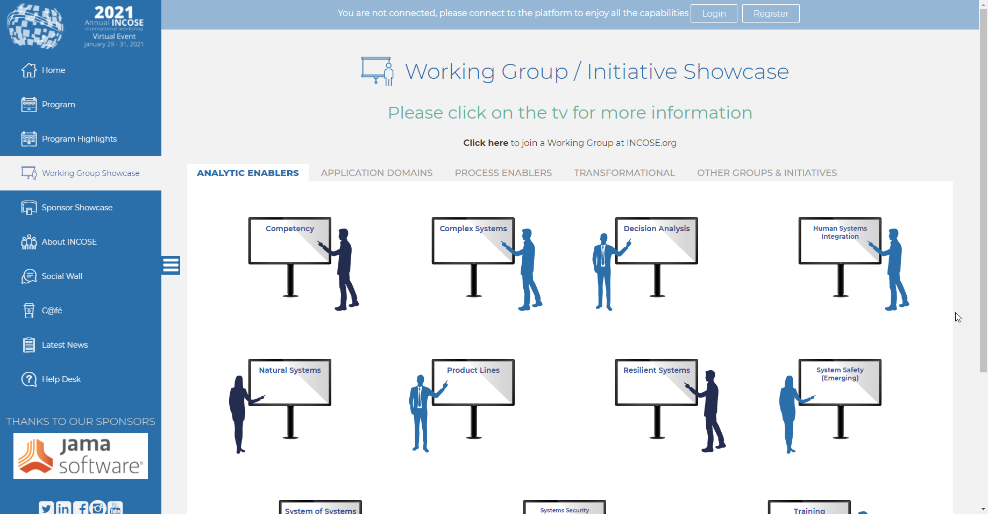
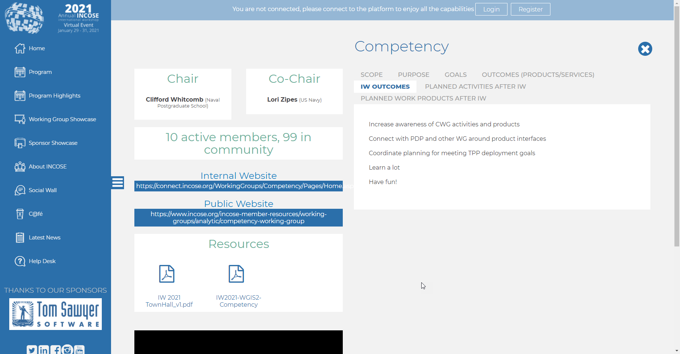
Working Group Showcase – Live Tour
https://conference.conflr.com/IW2021/WGshowcase
Accessible by anyone until Feb 15
Pages are likely going to be copied to INCOSE.org
Key info on each WG
Chairs / Co-Chairs
Scope / Purpose / Goals / Outcomes
IW Outcomes / Current year plans
Websites / PDFs / Videos

Slide 13
Technical Product Lifecycle
Technical Products come from anywhere with INCOSE, but typically through WGs (Process, Analytic, Transformational), Initiatives and/or Domains, or Special Projects
Some Technical Products are generated by a Chapter WG under the responsibility of the Chapter, These may get identified as an INCOSE product and undergo a formal review.
These products may consist of White papers, Books, Pamphlets, Presentations, Videos, etc.
- Products are initiated by the submission & approval of an easy to create Technical Product Plan
Products are released after team reviews, IP releases and/or formal review
Products are periodically assessed for potential retirement
Significant Content Update
IDEA!
Product Initiation
Submit Technical Product Plan (TPP)
Product Development
Have regular meetings with team
Create draft product
Review & Revise within team
- Formally agree on IP
Formally review for release/launch
Product Maintenance
Market, Advertise & Distribute
Configuration Management
Minor corrections & format changes
Reviews for retirement
Archive & Retirement
TPP Approved
Product Launch
Product corrected
Product Retired
and Archived

Slide 14
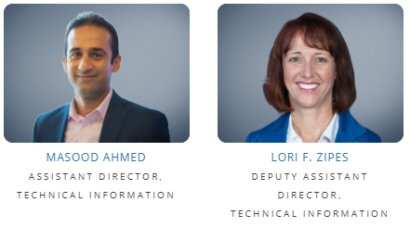
Online TPP (INCOSE CONNECT)
For Help – contact:
A TPP is a set of questions or sections of a product ‘charter’ to address basic needs and aspects of the planned product.

Slide 15
No shortage of opportunities…
Contribute to the Corporate Advisory Board (CAB) Needs
Contribute to the INCOSE Future of Systems Engineering (FuSE) Initiative
Contribute to the TechOps Initiatives
Contribute to the new version of the INCOSE Systems Engineering Handbook v5
Contribute to & Review impactful products such as SE Vision 2035, the SE Handbook, SEBoK, Professional Development Portal (PDP) and others.
…but don’t neglect the basics!

Slide 16
Join TechOps Leadership!
Deputy AstD Technical Information (IW2022)
AstD WG Integration (IW2022)
WG Chair / Co-Chair Rotations (~2 years)
Standards Development Department (especially in review & comment cycles)
"Work yourself out of a job"
Interested to help lead? How might we…? Reach out to technical-director@incose.org

