Slide 1
Chapter Leader Training Unit 2 - Certification - Technical Operations
Prepared by the US Sector and Keys to Effective Chapters
Revision 3.0
Presented on 20 January 2018

Slide 2
What We Are Planning to Cover
What is INCOSE
Certification
Technical Operations
Chapters
Chapter Officer Roles & Responsibilities
Chapter Excellence Program
Central Office Functions/Resources/Products
Events

Slide 3
Recognizing Systems Engineering Professionals
INCOSE provides independent assessment of system engineering professionals
Creating the standard to identify and develop systems engineering professionals
Establishing a formal, recognized body of knowledge for the systems engineering community
Multiple levels of certification cover increasing levels of knowledge, experience and leadership
Encouraging continued professional development
Recognizing leadership in systems engineering

Slide 4
Multiple Levels of Certification
ESEP focused on:
- LEADERSHIP
- SE ACCOMPLISHMENTS
- SIGNIFICANT SE EXPERIENCE
INCOSE ESEP
CSEP focused on:
- SE EXPERIENCE
- APPLIED SE KNOWLEDGE
INCOSE CSEP
ASEP focused on:
- SE KNOWLEDGE
INCOSE ASEP
SEP Candidates

Slide 5
How Chapters Support Certification
Inform individuals about certification
Help candidates fill out the certification application forms
Help candidates prepare for the knowledge exam
Host Certification exams
Recognize Systems Engineering Professionals at Chapter events
Publicize PDU opportunities

Slide 6
What We Are Planning to Cover
What is INCOSE
Certification
Technical Operations
Chapters
Chapter Officer Roles & Responsibilities
Chapter Excellence Program
Central Office Functions/Resources/Products
Events

Slide 7
Initiative: Influencing & Harmonizing Standards
ISO/IEC JTC1 SC7 WG04 - SE Tools Editor
ISO/IEC JTC1 SC7 WG07 - 24748 -- Sys. Eng. Management Editor
ISO/IEC JTC1 SC7 WG07 - 24748 -- Systems Integration Editor
ISO/IEC JTC1 SC7 WG07 - 24748 -- Sys. Eng. Management Editor
ISO/IEC JTC1 SC7 WG07 - Requirements Editor
ISO/IEC JTC1 SC7 WG07 - System Life Cycle
ISO/IEC JTC1 SC7 WG20 - Certification Editor
ISO/IEC JTC1 SC7 WG20 - Certification Editor
ISO/IEC JTC1 SC7 WG24 – Life Cycle for Very Small Entities
ISO/IEC JTC1 SC7 WG42 – Architecture
ISO/IEC JTC1 SC27 - IT Security Techniques
ISO TC184 SC5 Object Process Methodology (OPM)
IEEE 15288.1 and IEEE 15288.2 – US DoD Extensions to 15288
Object Management Group (OMG) – SysML
NIST – NIS SP 800-160 System Security Engineering
ISO – International Organization for Standardization IEC – International Electrotechnical Committee JTC 1 – Joint Technical Committee 1
TR –Technical Report CD – Committee Draft
NWIP – New Work Item Proposal
NIST – National Institute of Standards and Technology NIS – Network Information System
SP – Special Publication

Slide 8
Initiative: Model-Based Systems Engineering
Reduced cycle times
System of systems
interoperability
Design optimization across broad trade space
Cross domain effects based analysis
MBSE Capability
Extending Maturity and Capability
Institutionalized
MBSE across
Academia/Industry
Distributed & secure model repositories
crossing multiple domains
Defined MBSE theory, ontology, and formalisms
Well Defined MBSE
Refer to activities in
the following areas:
Maturity
Architecture model integrated
with Simulation, Analysis, and Visualization
Planning & Support
Research
Standards Development
Processes, Practices, & Methods
Tools & Technology Enhancements
Outreach, Training & Education
Matured MBSE methods and metrics,
Integrated System/HW/SW models
Ad Hoc MBSE
Document Centric
Emerging MBSE standards
2010
2010
2020
2025
http://www.omgwiki.org/MBSE/doku.php

Slide 9
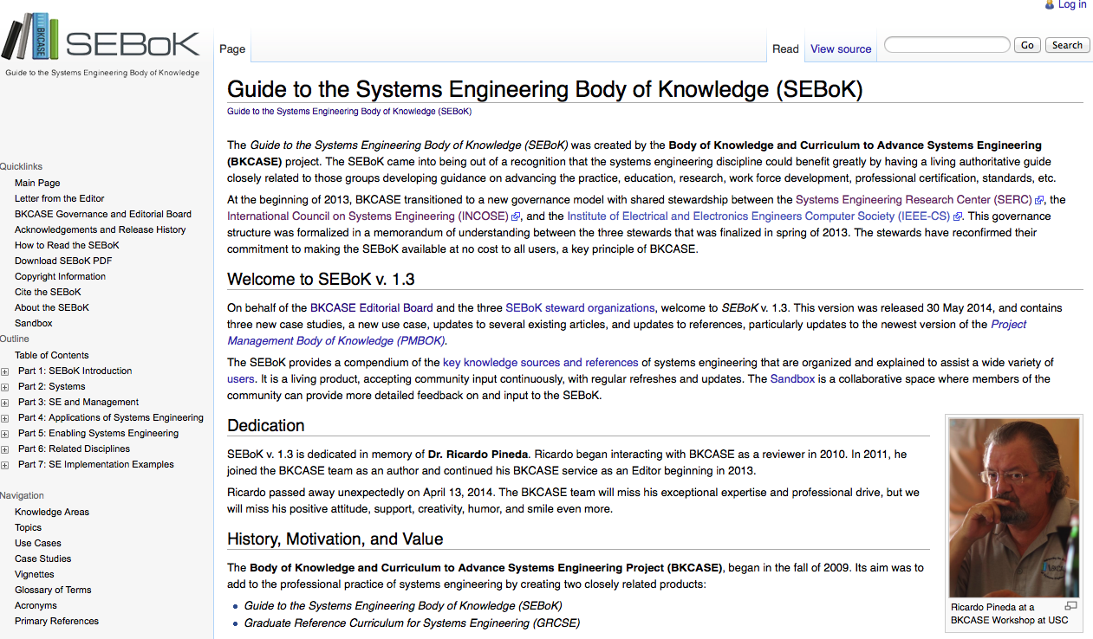
Initiative: BKCASE
http://www.sebokwiki.org/wiki/Guide_to_the_Systems_Engineering_Body_of_Knowledge_(SEBoK)

Slide 10
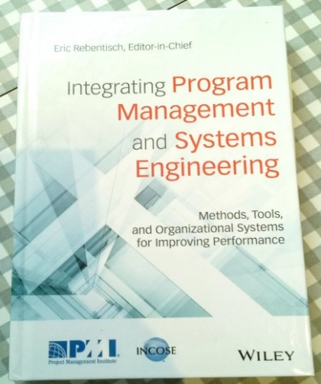
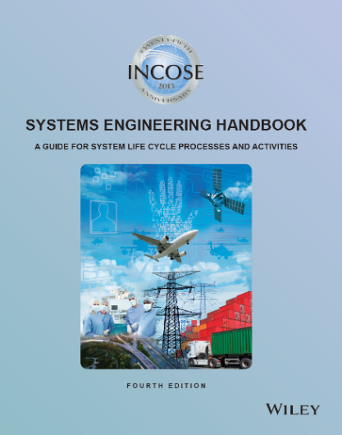
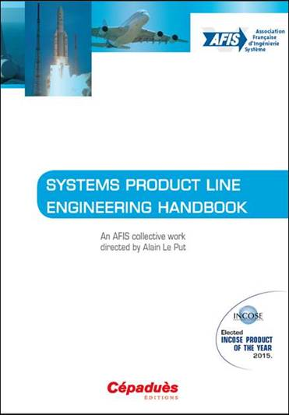
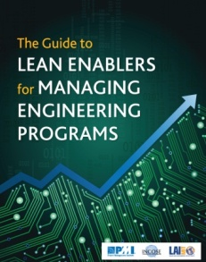
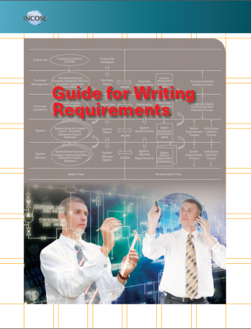
Technical Working Groups
~ 50 different working groups in our Technical Operations organization
The technical heart of INCOSE supported by many national and local working groups
Focused on solving relevant problems and creating products for global use
Notes:
SE Handbook
Book: The Guide to Lean Enablers for Managing Engineering Program
First document which bridges SE, PM and Lean
Available for download on MIT website

Slide 11
Working Groups
Affordability
Agile SE
Anti-Terrorism International
Architecture
Automotive
Autonomous System Test & Validation
Biomedical & Healthcare
Competency
Complex Systems
Decision Analysis
Defense Systems
GEOSS
Human Systems Integration
INCOSE-PMI Alliance
Infrastructure
In-Service Systems
Intelligent Enterprises
Knowledge Management
Lean Systems Engineering
Life Cycle Management
Measurement
Model Based Conceptual Design
Motor Sports
Natural Systems
Net-Centric Operations
Object-Oriented SE Method
Ontologies
PM-SE Integration
Power and Energy Systems
Process Improvement
Product Lines
Reliability Engineering
Requirements
Resilient Systems
Risk Management
Space Systems
System of Systems
Systems Science
Systems Security Engineering
Tools Database
Tools Integration & Interoperability
Training
Transportation
Very Small & Medium Enterprises
For more information or the complete list, visit http://www.incose.org
follow Home>Advancing the Practice>Technical Operations
Notes:
SE Handbook
Book: The Guide to Lean Enablers for Managing Engineering Program
First document which bridges SE, PM and Lean
Available for download on MIT website

Slide 12
Supporting Top CAB Needs
SE Professional Development
Competency WG (Don Gelosh, Chair)
Agile/Expedited Methods
Agile WG (Rick Dove, Chair)
Effective Trade Studies
Decision Analysis WG (Frank Salvatore, Chair)
System of Systems WG (Judith Dahmann, Co-Chair)
Product Lines, Reuse
Product Line WG (Hugo Chale Gongora, Chair)

