Slide 1
Chapter Leader Training
Unit 3 – Chapters and Officer Roles
Prepared by the US Sector
and Keys to Effective Chapters
Revision 3.0
Presented on January 20, 2018

Slide 2
What We Are Planning to Cover
What is INCOSE
Certification
Technical Operations
Chapters
Chapter Officer Roles & Responsibilities
Chapter Excellence Program
Central Office Functions/Resources/Products
Events

Slide 3

Are Chapters relevant
in an online world?
... Perhaps “nothing could be more necessary”
(The Last Samurai)

Slide 4

Chapters are about who you know, and who you can get to know
INCOSE is about who you know and who you can get to know

Slide 5
Mission of Chapters
Local chapters play essential roles supporting INCOSE’s goals and objectives:
  Organize professional and social programs that facilitate continuous professional development and networking
  Conduct membership recruitment and retention initiatives
  Support technical activities to advance the state and art of systems engineering practice, education and research
  Market INCOSE as the international authoritative body on systems engineering
  Increase the visibility of INCOSE and the systems engineering profession

Slide 6



Chapters, Local and National
Facilitate professional networking and information exchange
Host local activities
  Meetings
  Tutorials, workshops, mini-conferences and vendor fairs
  Contributions to working groups and projects
Disseminate announcements and news
Develop local initiatives such as
  Tutorials and handbooks
  SE certification support programs
  Activities with other professional organizations

Slide 7
Critical Success Factors for Chapters
Continuous recruiting and development of leadership team
Chapter officer training
Leadership teamwork
Chapter planning
Mentoring by Sector Leadership
These are leading indicators predictive of sustained performance

Slide 8
Why Chapters?
Facilitate professional networking and information exchange
Plan local activities
  Meetings (many are monthly)
  Tutorials, workshops, mini-conferences and vendor fairs
  Contributions to working groups and projects
Disseminate announcements and news
Develop local initiatives such as
  Tutorials and handbooks
  SE certificate programs
  Local Working Groups
  Activities with other professional organizations

Slide 9
Chapters Have Responsibilities
Operate in accordance with INCOSE bylaws CHP-100 (https://www.incose.org/docs/default-source/policiesbylaws/chp-100.pdf?sfvrsn=12
Governance
  Have a President, President Elect or VP, Secretary and Treasurer at a minimum - all individual INCOSE members in good standing
  Maintain more than 25 members
  Hold Annual General Meetings (AGM) or equivalent
  Hold regular meetings of the Chapter officers/directors (at least quarterly) and document results with minutes
  Submit a Chapter Report twice annually to Sector Director
  Maintain a Chapter bank account
  Maintain adequate financial records.
  Make financial records available quarterly, if requested.
  Do not act for, or incur any financial obligation in the name of INCOSE without authorization from the INCOSE Board of Directors
  US Chapters only: File an annual financial report to INCOSE not later than 31 January to support IRS filings.
  Non-US Chapters
    Be structured in a manner suitable to national laws
    Provide copies of their annual financial report filed with their national governments to INCOSE.
  Make proper usage of the INCOSE name and logotype as detailed in policy COM-101, Use of INCOSE Name and Logo.
Services
  Conduct a minimum of four meetings annually, open to all members.
  Hold a minimum of one event annually, open to all members and non-members.

Slide 10
Chapter Governance
CHP-100 policy updated, defines basic requirements for chapters:
  Remain above the 25 member minimum size.
  Hold Annual General Meetings (AGM) or equivalent
  Chapter governing body meet a minimum of four times per year
  Submit a Chapter Report twice annually to their Sector Director.
  Maintain a Chapter bank account, with a minimum of two signatories from the Chapter’s governing body.
  Make financial records available to sector director quarterly, if requested.
  Don’t act for, or incur any financial obligation in the name of INCOSE without authorization from the INCOSE BOD
  Use INCOSE name and logotype properly (COM-101, Use of INCOSE Name and Logo.)

Slide 11
New Member Welcome is Critical to Engagement and Retention
Suggested Framework
New members get welcome package with information about INCOSE and the chapter
Member chair personally contacts new member a few weeks after welcome package
  Q&A
  Invite to next meeting to get to know the chapter
Have a ‘new member welcome’ period before chapter programs
  Member chair and/or chapter president or other officers meet new members, learn their interests, try to find them engagement opportunities
Notes – your mileage may vary – need to tailor this to your chapter unique circumstances

Slide 12
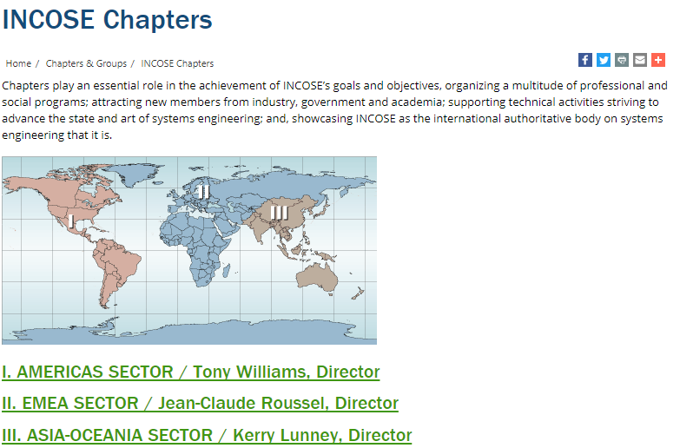
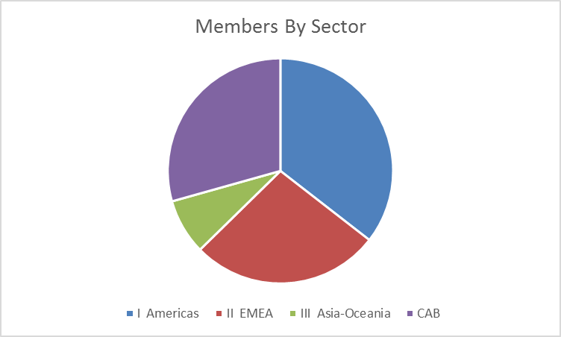
INCOSE Chapters Around the World
Over 70 Chapters in over 35 Countries
Sector | Members
I Americas | 5337
II EMEA | 4081
III Asia-Oceania | 1199
CAB | 4412
 | 15029
Serge Landry, Director

Slide 13
AMERICAS SECTOR / Tony Williams, Director
Chapter | Country | Status
Argentina | Argentina | Emerging
Brasil | Brasil | Active
Canada | Canada | Emerging
Mexico | Mexico | Emerging
Alamo | US | Restart
Atlanta | US | Active
Blues | US | Active
Cascade | US | Emerging
Central Arizona | US | Active
Central Florida | US | MIA
Central Virginia | US | Active
Charleston Lowcountry | US | Active
Chesapeake | US | Active
Chicagoland | US | Active
Cleveland-Northern Ohio | US | Active
Colorado Front Range | US | Active
Crossroads of America | US | Active
Delaware Valley | US | Active
Emerald Coast | US | Restart
Enchantment | US | Active
Finger Lakes | US | Active
Great Plains Chapter | US | Active
Hampton Roads Area | US | Active
Chapter | Country | Status
Heartland | US | Active
Huntsville | US | Active
Liberty | US | Active
Los Angeles | US | Active
Michigan | US | Active
Midwest Gateway | US | Active
New England | US | Active
North Star | US | Active
North Texas | US | Active
Orlando | US | Active
San Diego | US | Active
Seattle Metro | US | Active
SF Bay Area | US | Active
Snake River | US | Active
Southern Arizona | US | Active
Southern Florida | US | Emerging
Southern Maryland | US | Active
Space Coast | US | Active
Texas Gulf Coast | US | Active
Three Rivers | US | Active
Wasatch | US | Active
Washington Metro Area | US | Active
Wright Brothers | US | Active
Active (includes Restart and MIA): 41
Emerging: 5

Slide 14
EMEA SECTOR / Jean-Claude Roussel, Director
Territory | Name | Url
Denmark | Denmark | http://www.incose.dk
Finland | FINSE | http://www.finse.org
France | AFIS | http://www.afis.fr
Germany | GfSE | http://www.gfse.de/
Israel | ILTAM/Israel | http://www.iltam.org/activity_info.php?actid=act_SystemEngineering/
Italy | Italia | http://www.incose-italia.it/
Norway | NORSEC
Poland | Poland | http://www.incose.pl
Russian Federation | RUS | http://www.incose.ru
South Africa | South Africa | http://www.incose.org.za
Spain | Spain | http://www.aeis-incose.org/
Sweden | Sweden | http://www.incose.se
Switzerland | Suisse | http://www.incose.ch
The Netherlands | Netherlands | http://www.incose.nl
Turkey | Turkey | http://sistemmuhendisligi.com/
United Kingdom | United Kingdom | http://www.incoseonline.org.uk
Emerging Chapters
Middle East and Africa - contact Nauma Arshad: nauman.arshad@incose.org
Portugal - contact Eduarda Pinto Ferreira: epf@isep.ipp.pt
Tunisia - contact Omar Hammami: omar.hammami@incose.org
For additional information / details: info@incose.org

Slide 15
ASIA-OCEANIA SECTOR / Serge Landry, Director
Territory | Name | Url
Australia | Australia | http://www.sesa.org.au
China | Beijing | http://www.incose-beijing.com
India | India | http://www.incose.org/india
Japan | JCOSE | http://www.jcose.org/
Republic of Korea | KCOSE | http://www.kcose.org
Republic of Korea | KOSSE
Singapore | Singapore | http://www.incose.org/singapore
Southern China | Southern China
Taiwan | Taiwan

Slide 16
What We Are Planning to Cover
What is INCOSE
Certification
Technical Operations
Chapters
Chapter Officer Roles & Responsibilities
Chapter Excellence Program
Central Office Functions/Resources/Products
Events

Slide 17


Chapter Officers/Leadership Team
Serving on the Chapter Leadership Team is a privilege as well as a responsibility
Your chapter’s success will be directly related to your commitment and teamwork
Chapter leadership provides valuable “real world” developmental experience, superior in many ways to a business degree
Chapter leadership provides opportunities to enhance and accelerate your career
NOT

Slide 18
Chapter Officers/Leadership Team
The following is required by the INCOSE Bylaws as a minimum organization
  President
  President Elect (for the following year)/ Vice President
  Secretary
  Treasurer
Some chapters find 2 year terms very helpful
Other roles many chapters find helpful, (sometimes combined)
  Programs (chapter meetings, events)
  Development or Training (tutorials)
  Technical Director
  Membership (ambassadors, recruiting, retention)
  Communications (newsletter, website)
  Ad hoc committees, e.g. for elections and governance updates
  Liaison with CAB and other companies
  Additional Directors

Slide 19
Planning Responsibilities - President
Lead chapter planning by the Leadership Team soon after elections, then periodic review/update
  Needs to be a team effort (consider inviting non-board members from the general membership)
  Use of the Chapter Planning Workbook & Template is recommended
  The strategic portion provides long range guidance
    Maintain alignment with INCOSE Vision, Mission, Goals and Strategic Initiatives
    Consider a Strengths, Weaknesses, Opportunities, Threats assessment (SWOT) as a first step; conduct a gap analysis
    Strategic components include Vision, Mission, Goals, Strategy that are mostly unchanged year-to-year, providing continuity

Slide 20
Planning Responsibilities (2) - President
The second part of chapter planning focuses on the operational plans, also addressed in the Chapter Plans Workbook and Template
  Guided by, aligned with chapter’s Strategic Planning
  Include plans for activities and actions throughout the year such as attendance at IW and IS, work with other chapters or non-INCOSE entities, etc. (see Chapter Plans Workbook and Circle Awards criteria for ideas)
  Include plans/sections for
    Membership (recruiting and retention)
    Communications including website and publicity
    Ambassador/Promoter (companies, academia, other societies)
    Promotion of IW, IS, Certification, etc.
    Leadership succession planning

Slide 21
Other Typical Responsibilities - President
Vote with other Chapter Presidents to elect Sector Directors
Provide leadership to the profession, the Chapter Board and the membership.
Plan and chair Board and chapter meetings.
Manage all aspects of the chapter, whether internal, within INCOSE or external. Represent the chapter to INCOSE, and work with other chapter officers to ensure the interests of the chapter and INCOSE are properly represented.
Use Circle Awards criteria as metrics to evaluate progress
Identify, encourage, and mentor prospective chapter leaders
Conduct elections for the following year and ensure new list of officers is updated in Connect and submitted by January 31.
Mentor elected officers by setting expectations and offering guidance with issues that arise.
Vice President(s), Secretary, and Treasurer report to the President.

Slide 22
President’s Sample Check List
January (this year)
1/31 Set up Chapter Budget
1/31 Set up proposed meeting dates
1/31 Submit Treasurer's Report
1/31 Complete Officer Training presentation & discussion
1/31 Set up Board Meeting dates
1/31 Meet w/Board & discuss plans
1/31 Ensure Evidence uploaded for Circle Award
March
3/15 Complete Chapter Plans including Strategic,
Operations, Communications, Member Recruiting/Retention, Ambassador/Promoter
3/15 Ensure Evidence uploaded for Circle Award
July
7/31 Develop List of Officer Candidates
7/31 Review all components of Chapter Plans
7/31 Ensure Evidence uploaded for Circle Awards
September
9/30 Publish Officer Candidate Bios
9/30 Develop Chapter Survey
October
10/31 Hold Elections
10/31 Transmit Member Survey
10/31 Ensure Evidence uploaded for Circle Awards
November
11/30 Transmit Election results to INCOSE
11/30 Analyze Member Survey
11/30 Publish Member Survey results/analysis to guide next year’s planning
11/30 Officer Training presentation & discussion
December
12/15 Recognize Board and Chapter Members
12/15 Ensure Evidence uploaded for Circle Awards
January (next year)
1/4 Ensure All Evidence uploaded for Circle Awards
1/4 Certify and Send in Circle Awards Spreadsheet

Slide 23
Past President Suggested Tasks
Chair a chapter awards committee for Board/Member recognition
Assist President in leadership succession planning
NOT recommended to oversee the chapter’s Circle Awards – this should be done by the President Elect in preparation for role as President
Volunteer to be considered as a reviewer for the Circle Awards Committee
Volunteer to assist with the Keys to Effective Chapters Committee
Volunteer to support Sector roles (Sector Director,..)
Volunteer to represent Sector in various Committees (N&E,W&M,..)

Slide 24
Typical Responsibilities – President-Elect
Stand in when the President is not present
Oversee the Chapter Circle Award on-going evaluation, data collection and submittal
  Upload Circle Award evidence throughout the year to the Circle Award website (e.g. plans, newsletters, Board meeting minutes, activity announcements, etc.)
  Use to evaluate chapter’s progress in serving members, supporting INCOSE goals and promoting System Engineering
In smaller chapters may take on other responsibilities such as programs or membership.
Identify, encourage, and mentor prospective chapter leaders
Help mentor members of the leadership team by setting expectations and offering guidance with issues that arise

Slide 25
Typical Responsibilities – Vice President
There may be one or more Vice Presidents, depending on chapter size and plans
Assigned responsibilities may be for one or more areas
  Chapter Development – speakers for chapter meetings, tutorials
  Membership – recruiting, retention/renewal
  Ambassador/Promoters, CAB
  Communications (where not assigned to Secretary) – event promotions, newsletters, website
Identify, encourage, and mentor prospective chapter leaders

Slide 26
Typical Responsibilities – Secretary
Revised CHP-100 require separate Secretary and Treasurer
Record minutes of chapter and Leadership Team/ Board meetings
Oversee the communications such as website and newsletters
Help mentor members to develop in the chapter and encourage participation on the Leadership Team

Slide 27
Typical Responsibilities – Treasurer
Ensure chapter is responsible in all fiscal matters
Prepare the annual budget
Administer chapter income and payments with appropriate approval
Report income and expenses regularly at Board meetings
Ensure the chapter annual financial report is submitted to INCOSE main office by January 31
Help mentor members to develop in the chapter and encourage participation on the Leadership Team

