Slide 1
Chapter Leader Training
Unit 4 - Chapter Excellence Program
Prepared by the US Sector and Keys to Effective Chapters
Revision 3.0
Presented on 20 January 2018

Slide 2
What We Are Planning to Cover
What is INCOSE
Certification
Technical Operations
Chapters
Chapter Officer Roles & Responsibilities
Chapter Excellence Program
Central Office Functions/Resources/Products
Events

Slide 3
Chapter Excellence Program
Consists of two complementary components to help make your Chapter as successful as possible:
Keys to Effective Chapters Program
  Providing guidance, tips, and best practices throughout the year
Chapter Awards Program
  Recognizing chapter efforts

Slide 4
All Chapters Benefit from Continuous Improvement
Rather than focusing on the awards, the chapter support program concentrates on providing training, guidelines and best practices to assist chapters in providing value to their members. The awards’ criteria then provide metrics for the chapters to track and manage how well they are doing.
The program is based on three bedrocks:
Planning
Regular, interesting and engaging programs
Communications

Slide 5


Goal – Year-after-Year Consistently Effective Chapters
An active chapter involves its membership; plans for the current year with sustainability into future years – e.g. strategic planning, President-Elect, leadership succession planning
Interesting, engaging events & programs
X
X
Planning
Lack of effective planning and communications puts a chapter on a downward spiral
Communications
Chapter activities are an opportunity to find potential new board members – active, dependable involvement; intersection of individual interests and chapter needs
Circle awards provides metrics for a chapter to track their progress - and recognizes a chapter’s accomplishments in achieving INCOSE’s objectives and ideals

Slide 6
All Chapters Benefit from Continuous Improvement
The multi-component Keys to Effective Chapters program is available to assist chapters
Provides training for new officers
Veteran officers are available to help, share ideas
Provides good/best practices with templates and examples
Provides guidelines for planning and execution
Refined Chapter Circle Awards process to encourage planning and reduce ambiguity
Notes:
6

Slide 7
Keys to Effective Chapters Wiki
A Keys to Effective Chapter Wiki has been created to provide resources to assist chapters in a variety of ways
http://keys-to-effective-ch.wikispaces.com
(Or Google “INCOSE Chapter Wiki” – first result)
Chapter Leader Training for a smoother start
Chapter Planning Workbook and Template
Good/Best Practices in all areas of chapter activities to help you achieve better results
  Examples, tips, guidelines, templates, checklists, resources, etc
  New items are added to the Wiki from the Award submittals each year
  Chapters can share their own best practices by adding them directly to the Wiki
  Organized similarly to the Circle Awards criteria
Suggestions for new resources can be requested by emailing ChapterKeys@incose.org

Slide 8
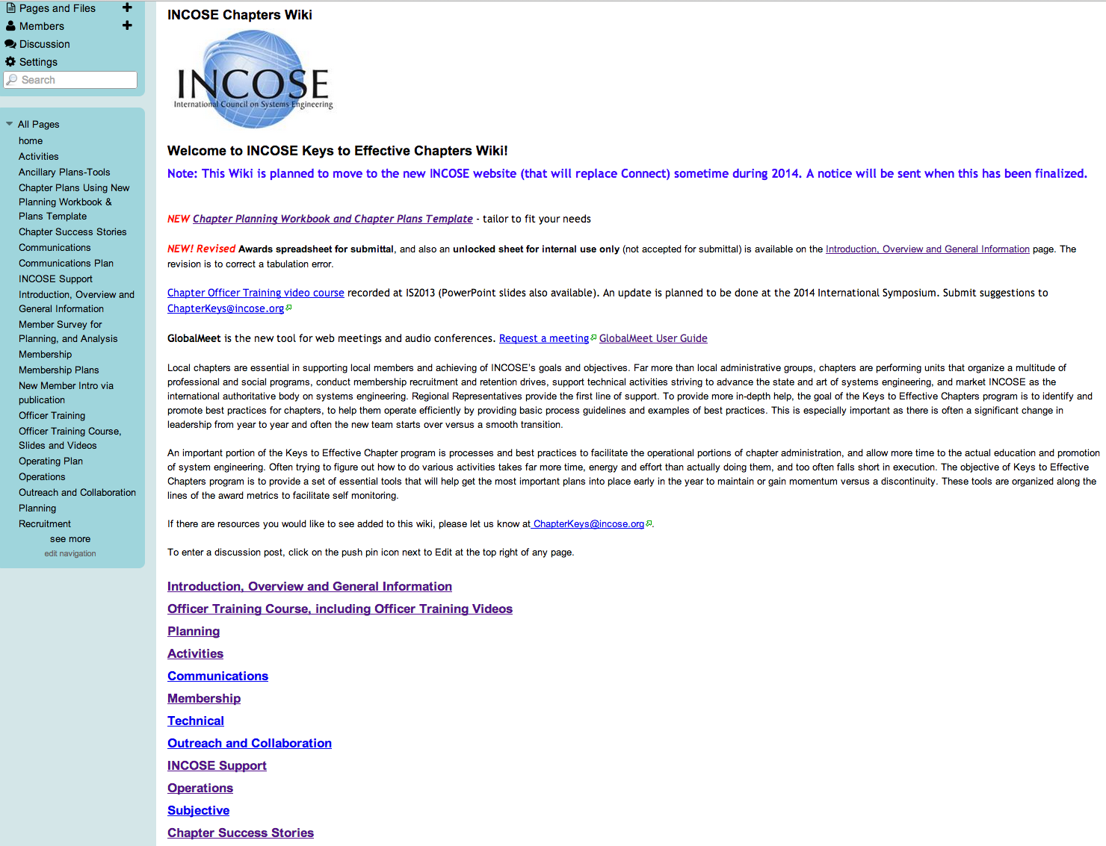
Chapter Keys Wiki

Slide 9
This Unit’s Organization
The balance of this unit is taken in the sequence of the Chapter Awards criteria and for the major criteria areas, provides an overview of chapter activities that will lead to their chapter’s effectiveness and can gain them recognition through Chapter Awards
  Training
  Planning
  Chapter Activities
  Communications
  Membership
Chapter Award Process Overview
  Technical Aspects
  Outreach
  Support to INCOSE
  Chapter Operations

Slide 10
Officer Training Component
Officers should attend a training session or webinar, with their leadership team to facilitate discussion (This material))
The comprehensive presentation, “Chapter Officer Training”, is available on the Keys to Effective Chapters Wiki for team training and personal review
  What is INCOSE
  Certification
  Technical Operations
  Chapters
  Chapter Officer Roles & Responsibilities
  Chapter Achievement Program
  Central Office Admin Functions/Resources/Products
  Events

Slide 11
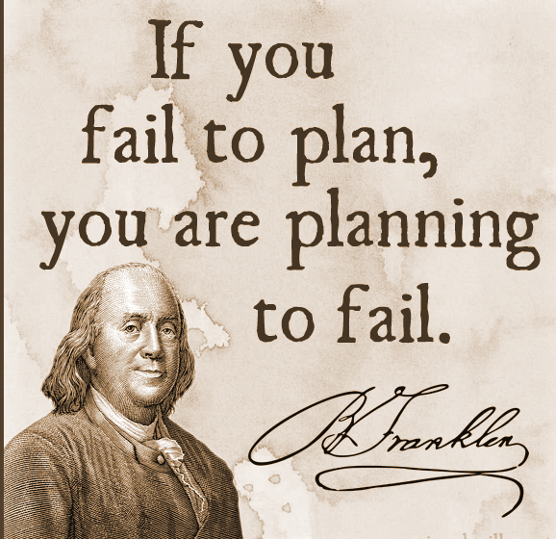
Chapter Planning Component
Planning is a team activity – not for just the President/VPs
Chapter Planning should be done as soon a possible after officer training and no later than April 15
Invite interested members-at-large to participate
Chapter Planning Workbook and Template is recommended, at least as a resource (to be revised in 2018)

Slide 12
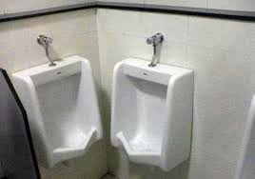
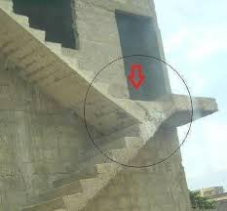


Lack of Planning:
Too Much Planning:

Slide 13
During Chapter Planning, Maintain Alignment with Overall INCOSE Mission and Goals
INCOSE Vision
A better world through a systems approach
Chapter Strategic Plan
Describes the chapter’s direction for long and short term, promoting smooth continuity year to year
Chapter SWOT
Strengths, Weaknesses,
Opportunities, Threats
INCOSE Mission
To address complex societal and technical challenges by enabling, promoting, and advancing Systems Engineering and systems approaches
INCOSE Goals
Focal point for dissemination of SE knowledge.
Promote international collaboration in SE practice, education, and research.
Assure establishment of competitive, scale-able professional standards in the practice of SE
Improve the professional status of all persons engaged in the practice of systems engineering.
Encourage governmental and industrial support for research and educational programs
INCOSE Strategic Objectives
Growth – double membership and embrace the healthcare, mobility, and energy business sectors
Alliances - amplify ability to achieve mission
Education - curricular recommendations widely adopted, raising the quality of engineering education
Products - produce and broker the most impactful systems engineering information in the world
Forums - produce and support the most impactful systems engineering forums in the world
Competency - team with industry to raise systems engineering competency across their supply chains
Transformation - accelerate the transformation of systems engineering to a model-based discipline

Slide 14
Early & Effective Planning Is Essential as Well as Periodic Updates
Chapter Strategic Component
Lays out the chapter’s direction for long and short term, promoting smooth continuity year to year
Chapter Operation Component
Addresses the chapter organization, budget, roles & responsibilities, chapter development (presentations and tutorials), facilities, schedule, metrics, reviews, & action item tracking. Also includes items from objectives/initiatives such as goals for technical papers, attendance at IW and IS, work with other chapters or non-INCOSE entities, etc.
Other aspects, such as below, should be incorporated integral to the Plan.
Chapter Membership
Addresses recruitment and retention
Chapter Communications
Includes website, newsletter, and publicity.
The Ambassador/Promoter plan can be included or documented separately.

Slide 15
Available Chapter Planning Tools
(To be revised and simplified in 2018)
‘Chapter Planning Workbook’ (intended to be tailored down to your chapter’s interests)
‘Chapter Plans Template’ (to capture “final” decisions from working through the Workbook)
‘How to do Strategic Planning’ PowerPoint on Key to Effective Chapters Wiki

Slide 16
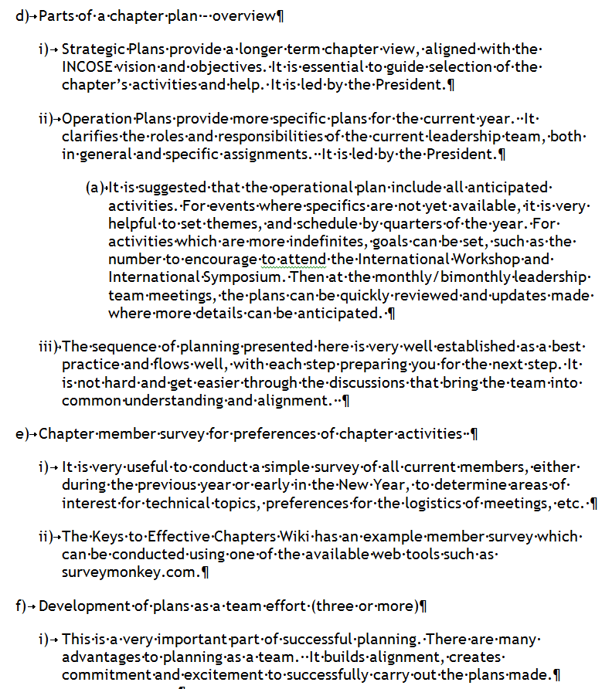
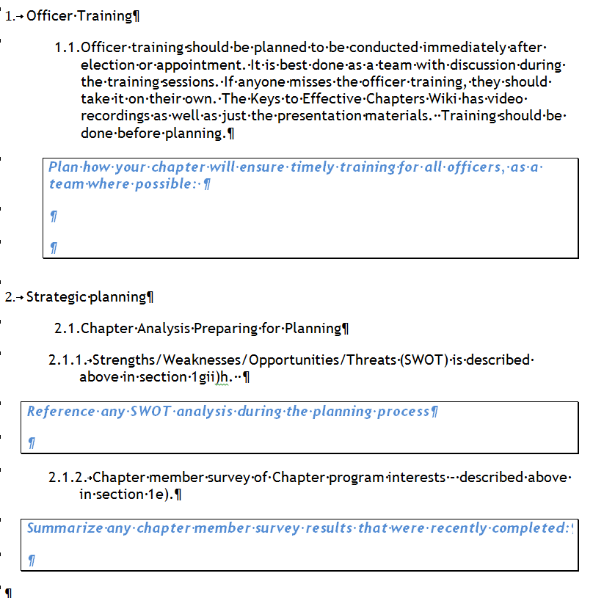
Chapter Planning Workbook

Slide 17
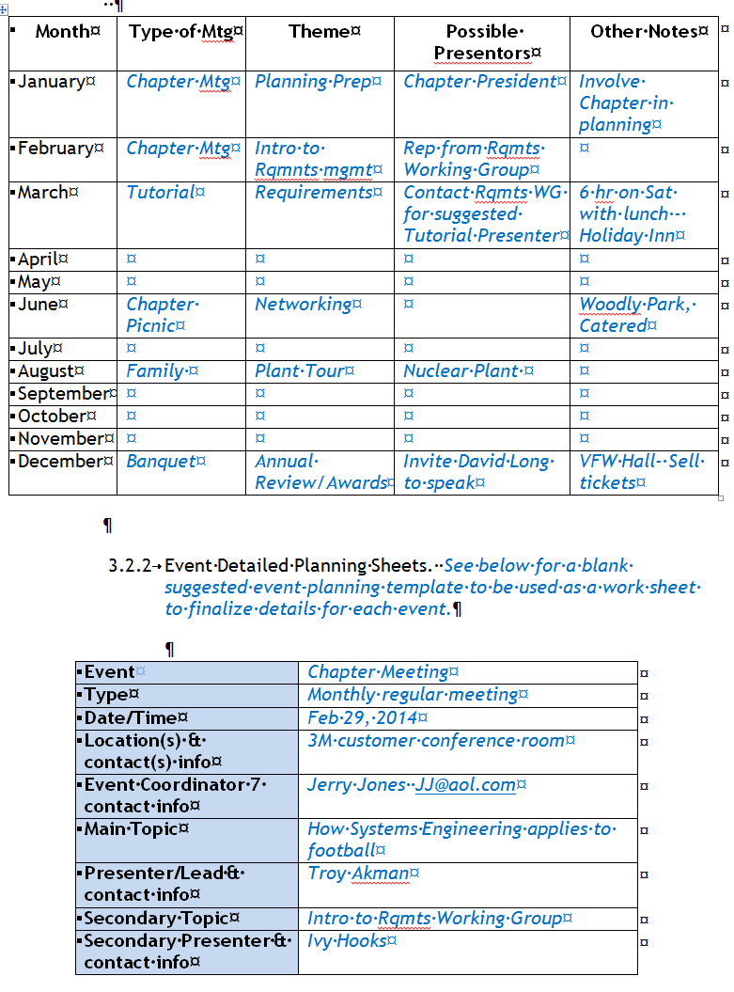
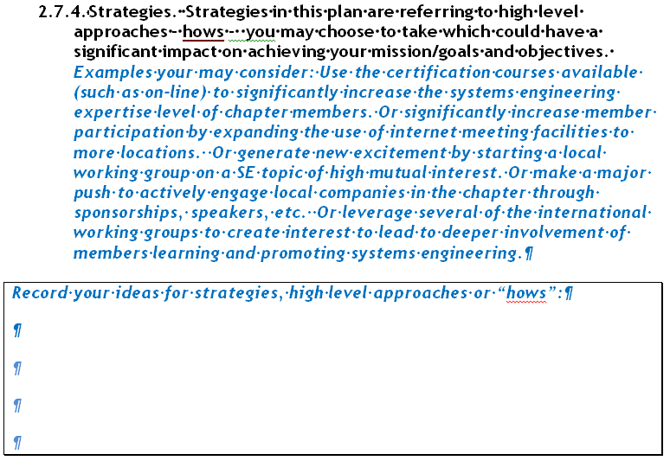
Chapter Planning Workbook

Slide 18
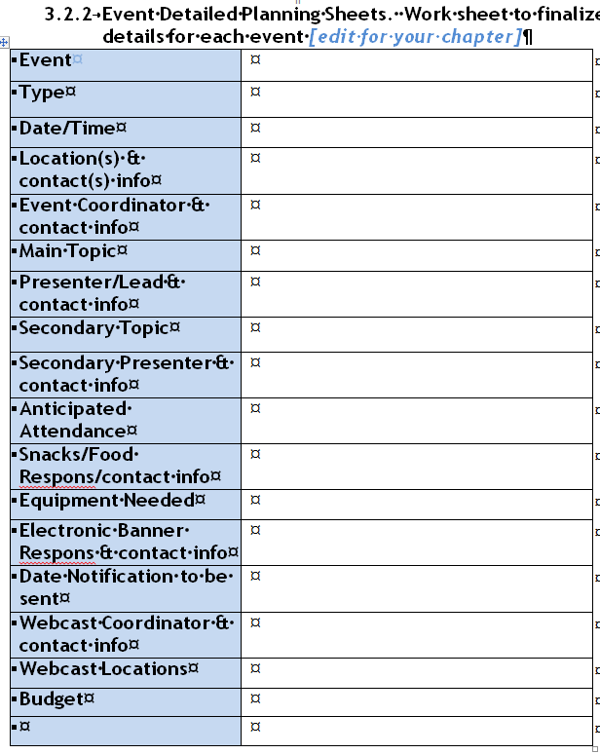
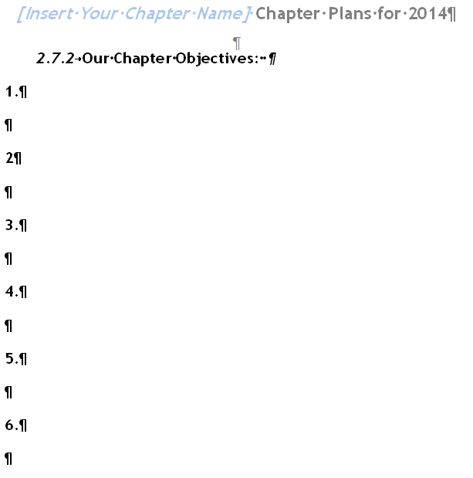
Chapter Plans Template

Slide 19
Best Practices Component
Good/best practices can be found in the Keys to Effective Chapters Wiki
New examples of Good/Best Practices are gleaned from the Circle Award submittals
In addition, selected templates and other examples are included
Chapters are encouraged to submit their best practices to share
The following sections are areas to apply Best Practices. They also map to sections of the Circle Award Criteria.

Slide 20
Activities Are a Chapter’s Life Blood
Chapter Meetings
Number ONE core chapter activity
Survey chapter members as to their interests
Chapter Tutorials
Another core chapter activity
Survey member companies and chapter members as to their needs and interests
Regional Conferences
Join with other nearby chapters to broaden offerings
Presentation Sources:
Working Groups
Work of local companies
SE in local Universities
Presenter doesn’t have to be local – use remote presenters via INCOSE provided Live Meeting
Tutorial Speakers Sources:
INCOSE experts
Experts from local companies
SE in local Universities
Working Groups
Regional Conferences:
Often each year areas in each sector have Regional Conferences
All are great opportunities for learning and networking

Slide 21
Effective Communications Encourage and Inform Chapter Members
Chapter Website
Chapter Newsletters
Chapter Publicity
Ambassadors / Promoters
Provides public presence
Websites can provide details for members
Update at least every other month
List contacts for current officers
Announcements for events
Link to INCOSE.org
Hardcopy or electronic format
Minimum of two pages (not including space for address, officers, editor, distribution, etc)
Include activities, event reports, membership information, reviews, etc.
Announcements of upcoming events (separate from website and newsletter)
Periodic evaluation of publicity progress to plan by BoD
Enlist ambassadors to promote INCOSE & chapter
Provide orientation
Periodic communications to ambassadors
Feedback from ambassadors
Periodic evaluation of ambassadors’ effectiveness
Social Media
Linked in
Facebook
Twitter

Slide 22
Growing Membership Involves More
System Engineers and Companies
Recruiting
Retention/ Renewal
Survey Chapter Members
Corporate Advisory Board (CAB) Members
Recruitment package available at chapter events
INCOSE materials
Local chapter specific information including contacts
Retention starts when a member joins
Reminder to renew
Personal contact with non-renewals
Feedback from those who do not renew
Survey chapter members as aid to setting chapter direction and addressing member desires
Chapter level and INCOSE level concerns
Recruit new CAB members
Active work between CAB(s) and chapter
New Members
Student Division
Personal Welcome
Publish name & brief bio of new members in newsletter/website (with their permission)
Start/support student division at a university
Student officers, activities

Slide 23
INCOSE Technical Aspects Extend the Practice of Systems Engineering
Technical Groups
(International in scope)
INCOSE Papers
Non-INCOSE Papers
Local Working Groups
Refereed article in INCOSE Journals
Paper presented at symposium/ seminar sponsored/ co-sponsored by INCOSE
Article on Systems Engineering published/ presented in non-INCOSE publication
Local Interest or Working Group (such as done in Europe)
Active participation by chapter member(s)
INCOSE International Technical Interest or Working Group (meets at International Workshops)
Active participation by chapter member(s)
Potential chapter presentations
Technical Product
Approved by the Technical Board as completed INCOSE product

Slide 24
Chapter Outreach & Collaboration Activities Promotes INCOSE & SE to Groups Outside INCOSE
Apply SE in local non-profit organizations
Active support
or involvement in SE activity for K-college
Joint meetings with other societies
Presentations about INCOSE
Joint meeting with society other than INCOSE
Systems Engineering explicitly explained or promoted
SE project with resulting product or report
Non-profit community organization
Civic organization
University or college (if project/report resulted)
No fees involved
Host or significant participant
Can be broader than just SE
Engr week, Future City, Science Fairs, robotics competitions
Present to executive in previously unrepresented (in local membership) organization
Local Engineering Club/Council
Provide Unpaid Speaker
Join/participate in local engineering club or council of technical societies
To university, career day, civic organization, non-INCOSE sponsored conference/seminar

Slide 25
Chapter’s Support to INCOSE Strengthens the Total Organization
Work with other chapters
Provide speakers
Publish in INCOSE INSIGHT
Attend International Workshop/ Symposium
Joint event or new chapter start-up
Meetings of other chapters
Articles (excluding letters to the editor, notices, chapter summaries)
Officer/Member attendance at International Workshop or Symposium
Donations
Chapter Awards Committee
Submit for INCOSE Individual Award
Chapter or individual donates to INCOSE Foundation
Chapter or individual donates to another chapter
Serve as reviewer for chapter awards
Submit nominee for individual INCOSE award (Founder, Fellow, Service)

Slide 26
Solid Chapter Operations Facilitate Repeatable Chapter Performance
Chapter elections
Regular leadership team meetings
Chapter display/ banner
Provide candidate biographies with ballot
Mailed with ballots at least 30 days prior to election close
Separate meeting for leadership team
Agenda and Minutes
At chapter events
Include chapter & INCOSE logos
Use an electronic banner (PowerPoint loop) to educate about INCOSE, promote chapter events
Chapter events
Active leadership
Public recognition
Scheduled and publicized at least 3 months in advance
Officers remain INCOSE members in good standing throughout their term
Individual and organizational contributions publically recognized

Slide 27
Chapter’s Support to INCOSE Strengthens the Total Organization
Work with other chapters
Provide speakers
Publish in INCOSE INSIGHT
Attend International Workshop/ Symposium
Joint event or new chapter start-up
Meetings of other chapters
Articles (excluding letters to the editor, notices, chapter summaries)
Member attendance at International Workshop or Symposium
Donations
Chapter Awards Committee
Submit for INCOSE Individual Award
Chapter or individual donates to INCOSE Foundation
Chapter or individual donates to another chapter
Serve as reviewer for chapter awards
Submit nominee for individual INCOSE award (Founder, Fellow, Service)

Slide 28
Solid Chapter Operations Facilitate Repeatable Chapter Performance
Chapter elections
Regular leadership team meetings
Chapter display/ banner
Provide candidate biographies with ballot
Mailed with ballots at least 30 days prior to election close
Separate meeting for leadership team
Agenda and Minutes
At chapter events
Include chapter & INCOSE logos
Use an electronic banner (PowerPoint loop) to educate about INCOSE, promote chapter events
Chapter events
Active leadership
Public recognition
Scheduled and publicized at least 3 months in advance
Officers remain INCOSE members in good standing throughout their term
Individual and organizational contributions publically recognized

Slide 29
Chapter Awards
Chapter Awards provide an excellent opportunity to evaluate how well your chapter is doing by comparing against criteria of best practices
Focuses on Chapter efforts, not individual accomplishments
It provides awareness for Chapter Leadership and general membership on the values the chapter is providing to their members
Governed by REC-104, Chapter Awards

Slide 30
Chapter Performance-Data/Evidence Collection Vital for Self Evaluation by Chapter, and for Awards
Officer Training
Soon after elections
Data/Evidence Collection
Chapter collects data throughout year from plans and activities and stores on website for self evaluation and award submittal
Operations
Elections, BOD meeting agenda/minutes, banner, recognition
Chapter Plans
Strategic, Operational, Membership, Communications, etc.
INCOSE Support
Work with/support other chapters, IW/IS attendance, $
Chapter Activities
Chapter meetings, presentations, tutorials, socials
Outreach/Collaboration
Other chapters, societies, CAB, non-corporate community, schools
Communications
Active chapter website all year; newsletters, publicity flyers, Ambassador two-way correspondence
Technical
Papers, working group participation, technical products, Certification promotion
Membership
Recruiting package, renewal reminders & feedback, survey of members, student division details, CAB enlistment

Slide 31
Chapter Recognition Awards
Bronze Circle Award 2,500 points
Silver Circle Award 5,000 points
Gold Circle Award 8,000 points
Platinum Circle Award 12,000 points

Slide 32
Chapter Award Submittal Spreadsheet
Use as metrics for chapter management - updating throughout the year, reviewing at BoD meetings
Planning section has due dates to encourage timely planning
Descriptions/criteria clarified
Documentation requirements detailed to reduce ambiguity
Each section’s total points is limited to a set maximum
Credit allowed for International Symposium preparation (but with same section maximum points)
Gold & Platinum award has minimum points per section to encourage a balanced program

Slide 33
Gold & Platinum Awards Have Minimum Requirements
Gold Award requires a minimum of 8000 points; Platinum 12,000 points
Planning must be a team effort by the Chapter Leadership Team
To ensure a “balanced scorecard”, minimum points are required per section
  Training – 300 points
  Planning – 600 points
  Events – 1000 points
  Communications – 1000 points
  Membership – 500 points
  Technical – 500 points
  Outreach & Collaboration – 500 points
  INCOSE Support – 500 points
  Operations & Local Recognition – 500 points

Slide 34
Chapter Award Spreadsheet Submittal
Due Date & Certification
To allow more time for the evaluations, all evidence and spreadsheet must complete uploading to the Chapter Awards website no later than 1st Sunday in January (earlier submittals encouraged and most appreciated)
Chapter must certify on the first worksheet tab that the data/evidence and spreadsheet that are submitted are complete and as intended since the process does not allow time for the evaluators to search for data

Slide 35
Chapter Award Review Process Designed to be Fair and Impartial
Performed by a team of seasoned chapter officers
Each chapter submittal is reviewed by three reviewers
Reviewers excluded from reviewing their own chapter or any they have had direct association with
Evaluation differences are discussed for consensus
Recommendations are submitted to the Board of Directors for review and approval
Chapters can appeal their rating

Slide 36
Chapter Special Awards
President’s Award for Outstanding Chapter criteria allows no repeat awards within three years of previously winning Outstanding Award (i.e., cannot win Outstanding Chapter again until two years have passed with other winners)
Director’s Award for Most Improved Chapter criteria also allows no repeat awards within three years of previously winning Most Improved Award (i.e., cannot win Most Improved Chapter again until two years have passed with other winners)
Good Neighbour Award REC-112– New, October 20, 2017. Recognizes Chapters for contributions toward the well-being (growth and sustainability) of other Chapters in pursuance of the interests of INCOSE as a whole. $2000 USD + plaque

Slide 37
Goal - Efficient and Effective Chapters
Sector Directors and their assistants are first line of support
The Keys to Effective Chapter Wiki provided for chapters to upload what is working (or not working) in your chapter, FAQs, etc.
Chapter officers invited to submit questions about any phase of chapter planning, operations, or awards to ChapterKeys@incose.org for a response from veteran officers
Circle awards provide a means for INCOSE to recognize a chapter’s accomplishments in achieving INCOSE’s objectives and ideals
  Circle Awards criteria provide proactive metrics for a chapter to track their progress in serving members and promoting systems engineering throughout the year (not a last minute effort)

Slide 38
Feedback Sought
The Keys to Effective Chapters program, and the awards criteria outlined herein are based on the recommendations of seasoned chapter officers who have reviewed many chapter award submittals and drawn from their own chapter experiences. Suggestions for improvements are welcome.
Chapters are invited to submit comments and suggestions for chapter support to ChapterKeys@incose.org.
  Direct contributions to the Wiki even more appreciated!
Chapters are invited to submit comments and suggestions concerning the Chapter Awards to ChapterAwards@incose.org

