Slide 1
Chapter Leader Training
Unit 5 –
- Central Office Functions, Resources, and Products
- Events
Prepared by the Americas Sector and Keys to Effective Chapters
Revision 3.0
Presented on 20 January 2018

Slide 2
What We Are Planning to Cover
What is INCOSE
Certification
Technical Operations
Chapters
Chapter Officer Roles & Responsibilities
Chapter Excellence Program
Central Office Functions/Resources/Products
Events

Slide 3
INCOSE Admin Office Functions and Resources are provided by:
Christine Kowalski – Operations Manager
Carol Berardino – Certification Operations Manager
Danielle “Dani” DeRoche - Chapter and Certification Administrator

Slide 4
Topics
GlobalMeet Resource for webinar and remote meeting participation
EOY Financial Reporting: Templates/Due Dates
Chapter INCOSE Promotional Items

Slide 5
GlobalMeet
INCOSE Shared Resources Request Site: https://connect.incose.org/help/WebinarServices/Pages/Home.aspx
Global Meet User Guide:
https://connect.incose.org/Shared%20Documents/NEW%20IT%20Help%20Guides/Archive/GlobalMeet-Web-UserGuide_Jan2013.pdf

Slide 6
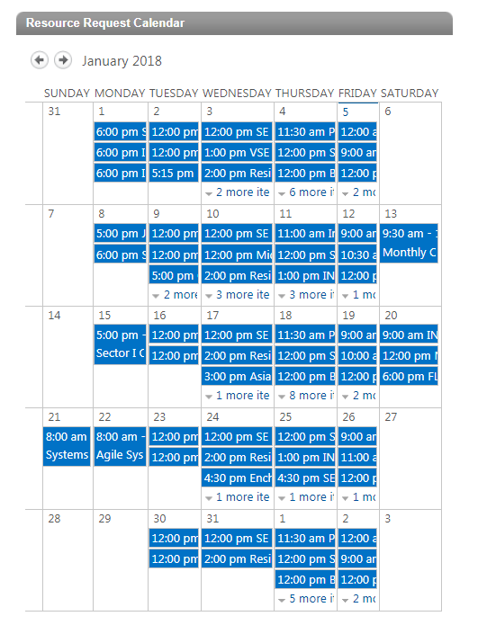
GlobalMeet
Resource Request Calendar
  All requests populate here

Slide 7
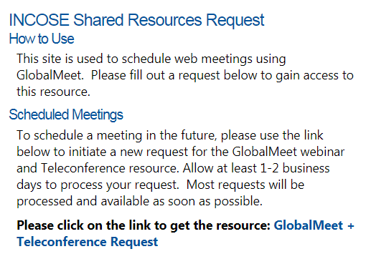
GlobalMeet
Once you login to www.incose.org, and go to Connect, hover over the Help button in the Menu Bar. Then select Webinar Services (or use this link).
Note: Be sure to review the User Guide and Getting Started Webpage links in the How to Use Scheduled Meetings
Click on link to start GlobalMeet/WebEx Request

Slide 8
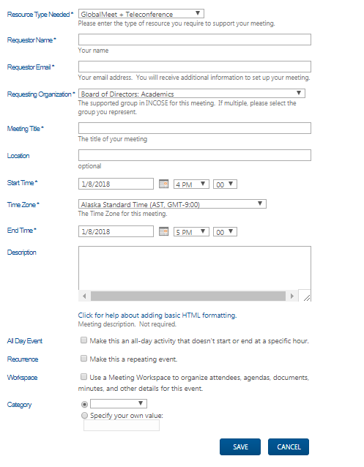
GlobalMeet
Complete the request form for desired meeting date and time.

Slide 9
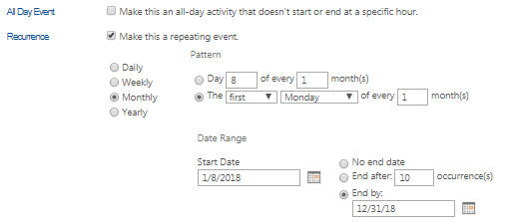
GlobalMeet
If it is a reoccurring meeting, please make sure to select the check box for it. More options will drop down to select the frequency.
  Example: If your Chapter Meeting is the first Monday of every month, select that from the drop down and enter a starting date request and an end date.
Once you have the desired date and time set up, click Save. You will receive an email notification once the GlobalMeet/WebEx has been assigned. Login information and instructions will be provided in the email confirmation.

Slide 10
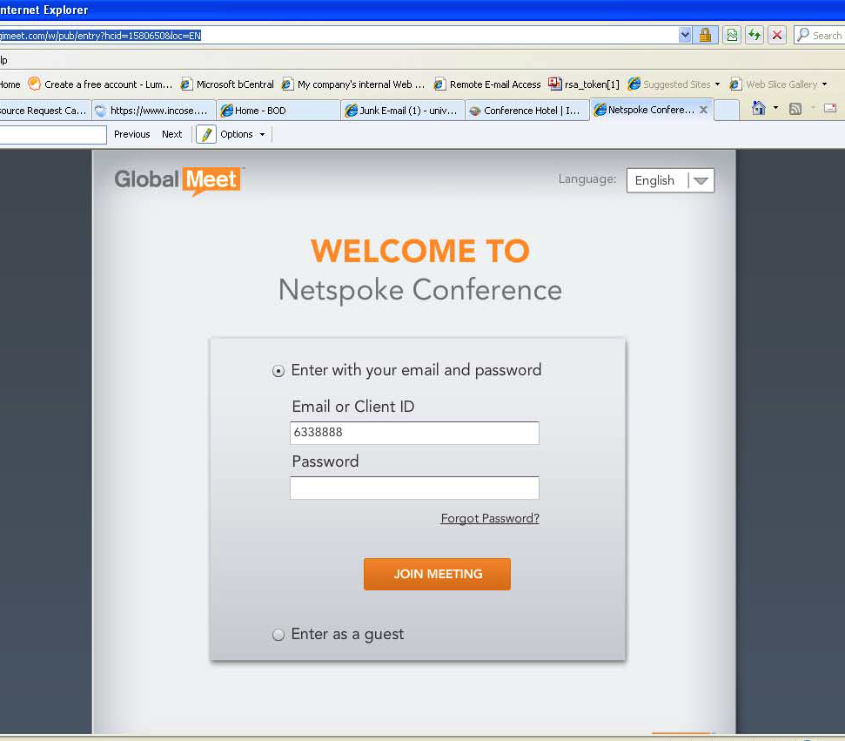
GlobalMeet Audio
Copy the web address and enter the Client ID and password in order to test / use your resource account. Attendees will sign in as Guests.
Please be sure to test the platform on the computer you will be using. Some organizations may have computers locked down where you cannot download the executable file which allows you to use the Screen Share of your desktop. You will need to have your IT department open your
computer and provide rights to do the download.

Slide 11
End of Year Chapter Financial Reporting
All chapters must have their financial reports emailed by 31 January to receive their chapter shares in March.
NOTE: US Chapter Shares are disbursed half in March for 1 September through 28/29 February and half in September for the dues shares from 1 March – 31 August.
INCOSE must have the completed financial reports as the chapter finances are included in our 990 tax report to the IRS. If you have any questions please contact info@incose.org
The report templates for US/Non US Chapters are in Connect on the Americas Sector Document site. Please be sure to email a copy of your Chapter bank statement reflecting the 31 December balance. If you have any questions, please don’t hesitate to contact our office.
Chapters POC: Danielle, info@incose.org; danielle.deroche@incose.org

Slide 12
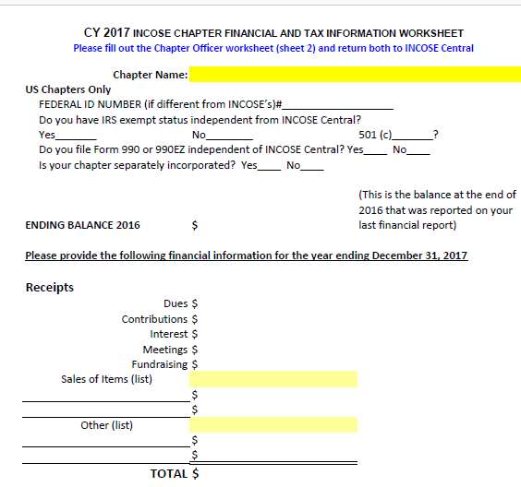
End of Year Chapter Financial Reporting
Direct Link to Form on INCOSE Connect: https://connect.incose.org/Chapters/Americas/Shared%20Documents/Forms/AllItems.aspx
Example from Tab 2 of Financial Report Template

Slide 13
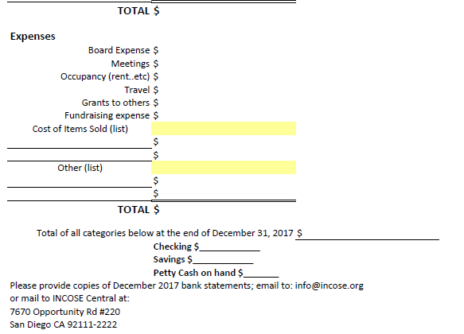
End of Year Chapter Financial Reporting
Direct Link to Form on INCOSE Connect: https://connect.incose.org/Chapters/Americas/Shared%20Documents/Forms/AllItems.aspx
Example from Tab 2 of Financial Report Template cont.

Slide 14
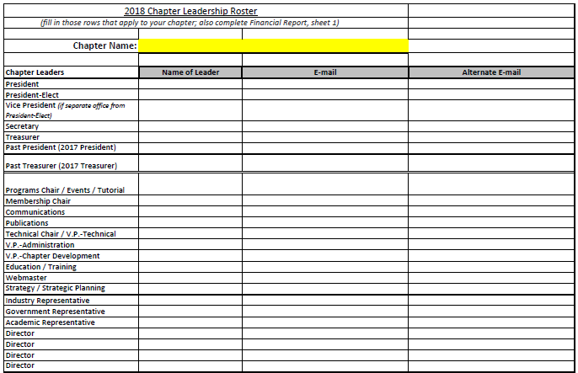
End of Year Chapter Financial Reporting
Direct Link to Form on INCOSE Connect: https://connect.incose.org/Chapters/Americas/Shared%20Documents/Forms/AllItems.aspx
Example for Tab 3 of Financial Report Template.
Note: The Chapter Leadership tab is essential for getting permissions updated for the Chapter Leadership. Please do not skip this tab!

Slide 15
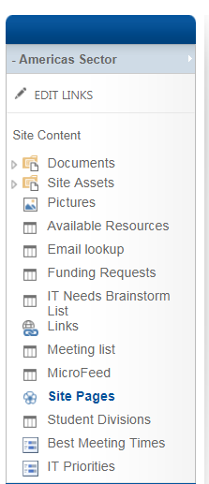
Promotional Items Ordering
1. Select Chapters from Menu Bar
2. Click on - Americas Sector.
3. Select “Available Resources from side
menu.

Slide 16
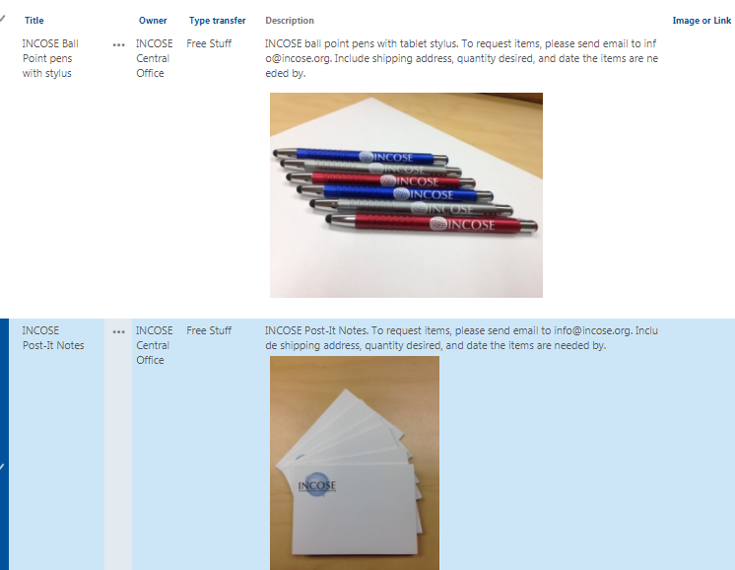
Promotional Items Ordering
4. View Items available. Most items are available at no cost, but others are only available to borrow. Please view each item description for ordering details.

Slide 17
Chapter Resource Links Available on Connect & INCOSE Home Page
A wealth of information is available to assist chapters.
  Keys to Effective Chapters Wiki (http://keys-to-effective-ch.wikispaces.com)- Chapter Leader Training, best practices, and more.
    Access to Veteran Officers - Ask questions and share information with officers all over the world - ChapterKeys@incose.org
Use your INCOSE Connect account to access the links below.
INCOSE home page/Chapters/Chapter Resources (drop down) includes the following resources:
  Asynchronous Presentations - A selection of presentations available to chapters with slides and audio (under INCOSE home page/Chapters/Chapter Resources drop down)
  Upcoming events Americas - https://connect.incose.org/Chapters/Americas/SitePages/Home.aspx
  INCOSE Events - https://www.incose.org/newsevents/currentevents

Slide 18
Publications & Products Promote Systems Engineering with Members and Companies
INSIGHT, quarterly publication
Systems Engineering – The Journal of INCOSE
Journal of Enterprise Transformation
Annual Proceedings – INCOSE Symposia Library / Wiley Online (must be logged in to use the link)
INCOSE online Store has numerous publications and products (most at no cost!)

Slide 19
INSIGHT, the Newsletter of INCOSE
Published four times per year
In Connect and Wiley Online Library
Archives back to 1993 in Connect.
Special theme in each issue. 2018 themes include:
  MBSE Alternatives to SysML
  Enabling and Practicing Systems Engineering Agility
  Systemic Engineering Challenges in Complicated and Complex Systems
  Trade-Off Analytics

Slide 20
Systems Engineering
Dr. Olivier de Weck (MIT), Editor-in-Chief
Refereed journal
Published quarterly by John Wiley & Sons
Access the Journal on line
  Current and past issues
  Full text in PDF
  Registration Key obtained by following instructions in the Members Area of the web
Instructions for authors found in INSIGHT and the INCOSE website

Slide 21
Journal of Enterprise Transformation (JET)
Provides a forum for original articles on trends, new findings, and ongoing research (both theory and application) related to enterprise transformation
ET brings together interdisciplinary research in management, industrial and systems engineering, information systems, organizational behavior, political science, economics, etc.
Affiliated with IISE and INCOSE
Published by Taylor & Francis
Quarterly
Deeply discounted subscriptions available to members – gives both online access and hard copy journal

Slide 22
INCOSE Members Newsletter
Focused on happenings of interest from across the systems community from around the world
News from Working Groups, insights on upcoming standards, items of interest from beyond INCOSE’s borders
Quarterly
Available in Connect and at https://www.incose.org/ProductsPublications/periodicals/newsletter

Slide 23
INCOSE Connect
Members & Associate Member can access once they have logged into www.incose.org.
  https://connect.incose.org/Pages/Home.aspx
Technical Products & Publications are available in the Library on Connect: (https://connect.incose.org/Library/Pages/default.aspx).
  Some examples:
    Webinars
    Tutorials
    INSIGHT Archive
    WG Programs & Projects
    Chapter Websites
  Member directory
  Chapter membership records (access limited to chapter officers)

Slide 24
Other INCOSE Resources
Papers & Proceedings – Best Papers 2014-2017
Papers & Presentations Library – search engineering for paper presentations made at the annual INCOSE symposia since 2010
INCOSE eNote is a monthly update on one page emailed to those requesting
Webinars – free weekly and monthly web-based service
  Tech Ops Training Working Groups presents the INCOSE SE Handbook 4.0 Tutorial series over a six month period beginning in October
  Monthly Tech Ops resents recognized experts in the field who discuss the “state of the Art” in Systems Engineering
  Webinars Qualify for PDUs

Slide 25
INCOSE Online Store
https://connect.incose.org/pages/store.aspx
  Soft Copy Product Samples:
    A Complexity Primer for Systems Engineers
    Guide for the Application of Systems Engineering in Large Infrastructure Projects
    Guide for Writing Requirements (Soft Copy)
    Project Managers Guide To SE Measurement for Project Success (Soft Copy) - $25 for non-members
    Systems Engineering Handbook v. 4.0
    SE Handbook Tutorial
    Guide for Writing Requirements
    SE Vision 2025 (Soft Copy)
  Hard Copy Products
    Integrating Program Management and Systems Engineering - $75 Member/$99 Non Member

Slide 26
Updating Chapter Officers
Please send all Chapter officer updates to info@incose.org. Permissions must be updated through Admin Access on the database.

Slide 27
Resources for Leadership Team
Your Sector Director and their assistants
Keys to Effective Chapters Wiki site
Chapter Circle Awards Connect site
Chapter real-time membership roster database
GlobalMeet web meeting capability provided by INCOSE
Chapter public website hosting by INCOSE
Connect chapter website with document storage, discussion board, etc.; separate pages for leadership team
Chapter presentations from Working Groups and Committees – a great, untapped resource

Slide 28
What We Are Planning to Cover
What is INCOSE
Certification
Technical Operations
Chapters
Chapter Officer Roles & Responsibilities
Chapter Excellence Program
Central Office Functions/Resources/Products
Events

Slide 29

Activities Are Key to Involved Chapters and Members
Regular meetings of local chapters
Annual International Symposium in summer
Annual International Workshop at the end of January/first of February
Technical Working Groups – member participation; chapter presentations
Regional conferences
Extensive professional networking
Collaboration with other Societies
Involvement in the local community

Slide 30
Previous International Workshops
2018 International Workshop in Jacksonville, FL, USA
2014-2017 International Workshop in Torrance, CA, USA
2013 International Workshop in Jacksonville, FL, USA
2012 International Workshop in Jacksonville, FL, USA
2011 International Workshop in Phoenix AZ, USA
2010 International Workshop in Mesa AZ, USA
2009 International Workshop in San Francisco CA, USA
2008 International Workshop in Albuquerque NM, USA
2007 International Workshop in Albuquerque NM, USA

Slide 31

2018 International Workshop
Jacksonville, FL
20 - 23 January 2018
Installation of the INCOSE officers
Annual report to the membership on results and plans for the coming year
Working sessions for Working Groups, technical and administrative committees

Slide 32
Previous International Symposia
2017 International Symposia in Adelaide, Australia
2016 International Symposia in Edinburgh, Scotland
2015 International Symposia in Seattle, WA, USA
2014 International Symposia in Las Vegas, NV, USA
2013 International Symposia in Philadelphia, PA, USA
2012 International Symposia in Rome, Italy
2011 International Symposia in Denver, CO, USA
2010 International Symposia in Chicago, IL, USA
2009 International Symposia in Singapore
2008 International Symposia in Utrecht, The Netherlands
2007 International Symposia in San Diego, CA, USA

Slide 33

2018 International Symposia
Washington D.C.
7 July – 12 July, 2018
  Technical papers, panels, tutorials, exhibits, plus many opportunities to collaborate with experts and practitioners from diverse domains
  Chapter leadership meetings, new member orientation, some working group meetings

Slide 34
INCOSE Americas Sector Regional Conferences
Cooperative ventures among multiple chapters within a region
  Typically one chapter serves as the host, the conference site rotates
  Participation and among chapters is governed by a Memorandum of Agreement (MOA)
Structure best served by the establishment of a Regional Conference Committee
  Ensures continuity and allows for knowledge transfer
  Templates can be reutilized and Lessons Learned can be preserved
New position of Americas Sector Assistant Director of Events to provide support to these committees
  Serve as Americas Sector Director Representative
  Assist in providing templates, contacts and best practices

Slide 35
INCOSE Americas Sector Regional Conferences - Examples
Great Lakes Regional Conference (GLRC)
  2017 GLRC 11: Superior System Solutions for Today’s Complex Environments
  2016 GLRC 10: Celebrating 10 Great Years!
Western States Regional Conference (WSRC)
  2018 WSRC: Systems Engineering Out West; Ogden, UT, Sept. 20-22, 2018
  2016 WSRC: Los Angeles, CA, April 9-10, 2016
Texas Gulf Coast Chapter (TGCC) SE Conference
  Houston, Texas, May 5, 2017
Systems Engineering Development Conference (SEDC)
  Washington DC in even years (skipped this year due to IS)

Slide 36
INCOSE EMEA Sector Regional Conferences & Workshops - Examples
EMEASEC 2014 : EMEA Sector SE Conference
  Oct 2014, Cape Town, South Africa
EMEASEC 2018 : EMEA Sector SE Conference
  5-7 Nov 2018 , Berlin, Germany
EMEA WS 2015 : 1st EMEA Sector Workshop
  Oct 2016, Paris, France
EMEA WS 2017 : 2nd EMEA Sector Workshop
19-20 Sep 2017, Mannheim, Germany

Slide 37
INCOSE EMEA Sector Regional
Multi-chapters Events - SE Tours
Nordic SE Tour
  Germany, Finland, Sweden, NL, Poland, Denmark
Southern SE Tour (SESE)
  France, Spain, Italy, Switzerland
Air Land Sea SE Tour (ALSSE)
  Norway, Sweden, NL
ROBAFIS (AFIS), RobSE (GfSE)
  Robotic Competition for Students

Slide 38
INCOSE EMEA Sector Regional
National Events - Examples
AFIS Workshop, CSDM (France)
GfSE Workshop, TDSE (Germany)
UK SE Conf, WS (UK)
South Africa SE Conference
SWISSED Conf (Switzerland)
ROBAFIS (France), RobSE (Germany)
  Robotic Competition for Students
…

Slide 39
Systems Engineering Affiliated Conferences in 2018
Connected Medical Device & IOT Security Summit
  http://tcbi.org/iotmdsec/
  25-26 January 2018
  Baltimore, MD
CSER 2018 16th Annual Conference on System Engineering Research
  http://www.sercuarc.org/events/16th-annual-conference-on-systems-engineering/
  8-9 May 2018
  Charlottesville, Virginia
SYSCON 2018: The 12th Annual IEEE International Systems Conference
  http://ieeesyscon.org/
  24-26 April, 2018
  Vancouver, BC Canada
13th Annual System of Systems Engineering Conference
  http://sosengineering.org/2018/
  19-22 June, 2018
  Paris, France
Check the INCOSE events calendar and your Region for upcoming conferences http://www.incose.org/newsevents/events/index.aspx

