Slide 1
Chapter Leader Training Unit 3 – Chapters and Officer Roles
Note – for scheduling reasons, the 2021 Chapter Leader training is not necessarily scheduled in the module order
Prepared by the US Sector
and Keys to Effective Chapters
Revision 4.0
Presented on January 19, 2021

Slide 2
What We Are Planning to Cover
What is INCOSE – Overview and Strategic Direction
Technical Services
Technical Operations
Corporate Advisory Board
Chapter Officer Roles & Responsibilities
Chapter Excellence Program – Circle Awards and Keys to Successful Chapters Wiki
Central Office Functions/Resources/Products

Slide 3
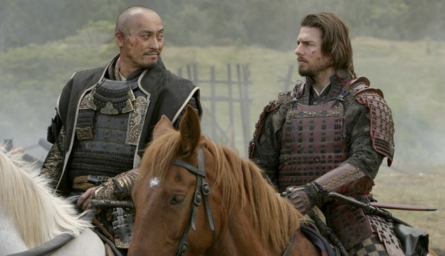
Are Chapters relevant in an online world?
... Perhaps “nothing could be more necessary” (The Last Samurai)

Slide 4
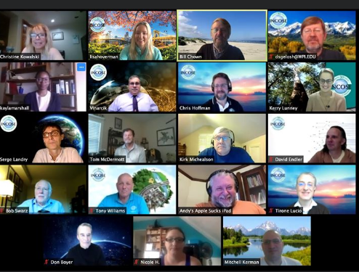
INCOSE is about who you know and who you can get to know
Chapters are about who you know, and who you can get to know

Slide 5
Chapters Play Essential Roles Supporting INCOSE’s Goals and Objectives
Organize professional and social programs that facilitate continuous professional development and networking
Conduct membership recruitment and retention initiatives
Support technical activities to advance the state and art of systems engineering practice, education and research
Market INCOSE as the international authoritative body on systems engineering
Increase the visibility of INCOSE and the systems engineering profession
Develop local initiatives such as
Tutorials and handbooks
SE certification support programs
Activities with other professional organizations

Slide 6
Critical Success Factors for Chapters
Continuous recruiting and development of leadership team
Chapter officer training
Leadership teamwork
Chapter planning
Mentoring by Sector Leadership
These are leading indicators predictive of sustained performance

Slide 7
Chapters Have Responsibilities (per CHP-100)
Operate in accordance with INCOSE bylaws CHP-100 (https://www.incose.org/docs/default-source/policiesbylaws/chp-100.pdf?sfvrsn=12
Governance
Have a President, President Elect or VP, Secretary and Treasurer at a minimum - all individual INCOSE members in good standing
Maintain more than 25 members
Hold Annual General Meetings (AGM) or equivalent
Hold regular meetings of the Chapter officers/directors (at least quarterly) and document results with minutes
Maintain a Chapter bank account
Maintain adequate financial records.
Make financial records available quarterly, if requested.
Do not act for, or incur any financial obligation in the name of INCOSE without authorization from the INCOSE Board of Directors
US Chapters only: File an annual report, including financials (to support IRS filings) to Sector Director and INCOSE Central
Non-US Chapters: Provide copies of their annual financial report filed with their national governments to INCOSE.
Make proper usage of the INCOSE name and logotype as detailed in policy COM-101, Use of INCOSE Name and Logo.
Services
Conduct a minimum of four meetings annually, open to all members.
Hold a minimum of one event annually, open to all members and non-members.

Slide 8
New Member Welcome is Critical to Engagement and Retention
Suggested Framework
New members get welcome package with information about INCOSE and the chapter
Member chair personally contacts new member a few weeks after welcome package
Q&A
Invite to next meeting to get to know the chapter
Have a ‘new member welcome’ period before chapter programs
Member chair and/or chapter president or other officers meet new members, learn their interests, try to find them engagement opportunities
Notes – your mileage may vary – need to tailor this to your chapter unique circumstances

Slide 9
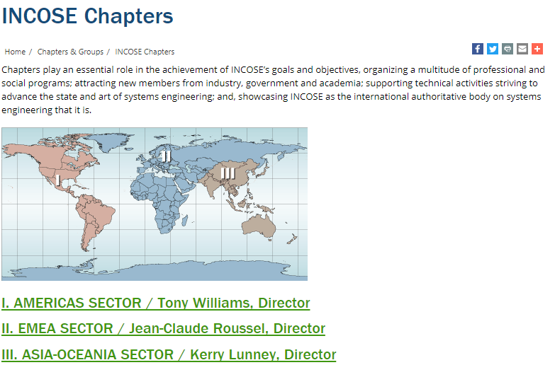
INCOSE Chapters Around the World
Over 70 Chapters in over 35 Countries
Sector | Members
I Americas | 5467
II EMEA | 3756
III Asia-Oceania | 1210
CAB | 7990
 | 18423
As of Jan 2021
Lucio Tirone, Director
Serge Landry, Director

Slide 10
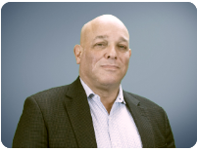
AMERICAS SECTOR / Tony Williams, Director
Chapter | Country | Status
Brasil | Brasil | Active
Canada | Canada | Emerging
Atlanta | US | Active
Blues | US | Active
Cascade | US
Central Arizona | US | Active
Central Virginia | US | Active
Charleston Lowcountry | US | Active
Chesapeake | US | Active
Chicagoland | US | Active
Cleveland-Northern Ohio | US | Active
Colorado Front Range | US | Active
Crossroads of America | US | Active
Greater Philadelphia | US | Active
Emerald Coast | US | Restart
Enchantment | US | Active
Finger Lakes | US | Active
Great Plains Chapter | US | Active
Hampton Roads Area | US | Active
Chapter | Country | Status
Heartland | US | Active
Huntsville | US | Active
Liberty | US | Active
Los Angeles | US | Active
Michigan | US | Active
Midwest Gateway | US | Active
New England | US | Active
North Star | US | Active
North Texas | US | Active
Orlando | US | Active
San Diego | US | Active
Seattle Metro | US | Active
SF Bay Area | US | Active
Snake River | US | Active
Southern Arizona | US | Active
Southern Maryland | US | Active
Space Coast | US | Active
Texas Gulf Coast | US | Active
Three Rivers | US | Active
Wasatch | US | Active
Washington Metro Area | US | Active
Wright Brothers | US | Active
Active (includes Restart and MIA): 41
Emerging: 5

Slide 11
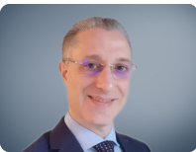
EMEA SECTOR / Lucio Tirone, Director
Territory | Name | Url
Belgium | Belgium
Denmark | Denmark | http://www.incose.dk
Finland | FINSE | http://www.finse.org
France | AFIS | http://www.afis.fr
Germany | GfSE | http://www.gfse.de/
Israel | ILTAM/Israel | http://www.iltam.org/activity_info.php?actid=act_SystemEngineering/
Italy | Italia | http://www.incose-italia.it/
Norway | NORSEC
Poland | Poland | http://www.incose.pl
Russian Federation | RUS | http://www.incose.ru
South Africa | South Africa | http://www.incose.org.za
Spain | Spain | http://www.aeis-incose.org/
Sweden | Sweden | http://www.incose.se
Switzerland | Suisse | http://www.incose.ch
The Netherlands | Netherlands | http://www.incose.nl
Turkey | Turkey | http://sistemmuhendisligi.com/
United Kingdom | United Kingdom | http://www.incoseonline.org.uk
Emerging Chapters Middle East and Africa - contact Nauma Arshad: nauman.arshad@incose.org Portugal - contact Eduarda Pinto Ferreira: epf@isep.ipp.pt Tunisia - contact Omar Hammami: omar.hammami@incose.org For additional information / details: info@incose.org

Slide 12
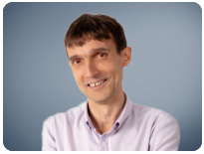
ASIA-OCEANIA SECTOR / Serge Landry, Director
Territory | Name | Url
Australia | Australia | http://www.sesa.org.au
China | Beijing | http://www.incose-beijing.com
India | India | http://www.incose.org/india
Japan | JCOSE | http://www.jcose.org/
Republic of Korea | KCOSE | http://www.kcose.org
Singapore | Singapore | http://www.incose.org/singapore
Southern China | Southern China
Taiwan | Taiwan

Slide 13
Chapter Officers/Leadership Team
Serving on the Chapter Leadership Team is a privilege as well as a responsibility
Your chapter’s success will be directly related to your commitment and teamwork
Chapter leadership provides valuable “real world” developmental experience, superior in many ways to a business degree
Chapter leadership provides opportunities to enhance and accelerate your career
NOT

Slide 14
Chapter Officers/Leadership Team
The following is required by the INCOSE Bylaws as a minimum organization
President
President Elect (for the following year)/ Vice President
Secretary
Treasurer
Some chapters find 2 year terms very helpful
Other roles many chapters find helpful, (sometimes combined)
Programs (chapter meetings, events)
Development or Training (tutorials)
Technical Director
Membership (ambassadors, recruiting, retention)
Communications (newsletter, website)
Ad hoc committees, e.g. for elections and governance updates
Liaison with CAB and other companies
Additional Directors

Slide 15
Planning Responsibilities - President
Lead chapter planning by the Leadership Team soon after elections, then periodic review/update
Needs to be a team effort (consider inviting non-board members from the general membership)
Use of the Chapter Planning Workbook & Template is recommended
The strategic portion provides long range guidance
Maintain alignment with INCOSE Vision, Mission, Goals and Strategic Initiatives
Consider a Strengths, Weaknesses, Opportunities, Threats assessment (SWOT) as a first step; conduct a gap analysis
Strategic components include Vision, Mission, Goals, Strategy that are mostly unchanged year-to-year, providing continuity

Slide 16
Planning Responsibilities (2) - President
The second part of chapter planning focuses on the operational plans, also addressed in the Chapter Plans Workbook and Template
Guided by, aligned with chapter’s Strategic Planning
Include plans for activities and actions throughout the year such as attendance at IW and IS, work with other chapters or non-INCOSE entities, etc. (see Chapter Plans Workbook and Circle Awards criteria for ideas)
Include plans/sections for
Membership (recruiting and retention)
Communications including website and publicity
Ambassador/Promoter (companies, academia, other societies)
Promotion of IW, IS, Certification, etc.
Leadership succession planning

Slide 17
Other Typical Responsibilities - President
Vote with other Chapter Presidents to elect Sector Directors
Provide leadership to the profession, the Chapter Board and the membership.
Plan and chair Board and chapter meetings.
Manage all aspects of the chapter, whether internal, within INCOSE or external. Represent the chapter to INCOSE, and work with other chapter officers to ensure the interests of the chapter and INCOSE are properly represented.
Use Circle Awards criteria as metrics to evaluate progress
Identify, encourage, and mentor prospective chapter leaders
Conduct elections for the following year and ensure new list of officers is updated in Connect and submitted by January 31.
Mentor elected officers by setting expectations and offering guidance with issues that arise.
Vice President(s), Secretary, and Treasurer report to the President.

Slide 18
President’s Typical Check List
January (this year)
1/31 Set up Chapter Budget
1/31 Set up proposed meeting dates
1/31 Submit Treasurer's Report
1/31 Complete Officer Training presentation & discussion
1/31 Set up Board Meeting dates
1/31 Meet w/Board & discuss plans
1/31 Ensure Evidence uploaded for Circle Award
March
3/15 Complete Chapter Plans including Strategic,
Operations, Communications, Member Recruiting/Retention, Ambassador/Promoter
3/15 Ensure Evidence uploaded for Circle Award
July
7/31 Develop List of Officer Candidates
7/31 Review all components of Chapter Plans
7/31 Ensure Evidence uploaded for Circle Awards
September
9/30 Publish Officer Candidate Bios
9/30 Develop Chapter Survey
October
10/31 Hold Elections
10/31 Transmit Member Survey
10/31 Ensure Evidence uploaded for Circle Awards
November
11/30 Transmit Election results to INCOSE
11/30 Analyze Member Survey
11/30 Publish Member Survey results/analysis to guide next year’s planning
11/30 Officer Training presentation & discussion
December
12/15 Recognize Board and Chapter Members
12/15 Ensure Evidence uploaded for Circle Awards
January (next year)
1/4 Ensure All Evidence uploaded for Circle Awards
1/4 Certify and Send in Circle Awards Spreadsheet

Slide 19
Past President Suggested Tasks
Chair a chapter awards committee for Board/Member recognition
Assist President in leadership succession planning
NOT recommended to oversee the chapter’s Circle Awards – this should be done by the President Elect in preparation for role as President
Volunteer to be considered as a reviewer for the Circle Awards Committee
Volunteer to assist with the Keys to Effective Chapters Committee
Volunteer to support Sector roles (Sector Director,..)
Volunteer to represent Sector in various Committees (N&E,W&M,..)

Slide 20
Typical Responsibilities – President-Elect
Stand in when the President is not present
Oversee the Chapter Circle Award on-going evaluation, data collection and submittal
Upload Circle Award evidence throughout the year to the Circle Award website (e.g. plans, newsletters, Board meeting minutes, activity announcements, etc.)
Use to evaluate chapter’s progress in serving members, supporting INCOSE goals and promoting System Engineering
In smaller chapters may take on other responsibilities such as programs or membership.
Identify, encourage, and mentor prospective chapter leaders
Help mentor members of the leadership team by setting expectations and offering guidance with issues that arise

Slide 21
Typical Responsibilities – Vice President
There may be one or more Vice Presidents, depending on chapter size and plans
Assigned responsibilities may be for one or more areas
Chapter Development – speakers for chapter meetings, tutorials
Membership – recruiting, retention/renewal
Ambassador/Promoters, CAB
Communications (where not assigned to Secretary) – event promotions, newsletters, website
Identify, encourage, and mentor prospective chapter leaders

Slide 22
Typical Responsibilities – Secretary
CHP-100 require separate Secretary and Treasurer
Record minutes of chapter and Leadership Team/ Board meetings
Oversee the communications such as website and newsletters
Help mentor members to develop in the chapter and encourage participation on the Leadership Team

Slide 23
Typical Responsibilities – Treasurer
Ensure chapter is responsible in all fiscal matters
Prepare the annual budget
Administer chapter income and payments with appropriate approval
Report income and expenses regularly at Board meetings
Ensure the chapter annual financial report is submitted to INCOSE main office by January 31
Help mentor members to develop in the chapter and encourage participation on the Leadership Team

