Slide 1
Services Operations
Don S. Gelosh, PhD, ESEP-Acq
Services Director, INCOSE
Director, Systems Engineering Programs
Worcester Polytechnic Institute
Richard Beasley, ESEP
Deputy Services Director, INCOSE
Associate Fellow – Systems Engineering
Rolls-Royce plc

Slide 2
Value Streams under ServOps
Certification
Portfolio of offerings through which INCOSE confirms a member's competency in systems engineering.
Portfolio of conferences, workshops, seminars, and other physical and virtual gatherings offered by INCOSE alone and with its allies.
Events
Portfolio of offerings by INCOSE and its allies of both in-person and on-line courses to enhance a professional's specific knowledge, skills, and abilities in topics relevant to systems engineers.
Education & Training

Slide 3
ServOps – Knowledge Synergy
Certification
The key to advancement of INCOSE as a Professional Society is knowledge – knowledge creation, discovery, and transfer – all contributing to the state-of-the-art for Systems Engineering.
Systems Engineering Knowledge
While each Value Stream deals with certain perspectives of knowledge, all three work together in a synergistic fashion to enhance all the facets of knowledge.
Tremendous opportunities arise when all three Value Streams coordinate and collaborate their perspectives on knowledge to enhance the overall Value of INCOSE to its members and the Systems Engineering community.
Education & Training
Events
“Provide Value Through Impactful Services”

Slide 4
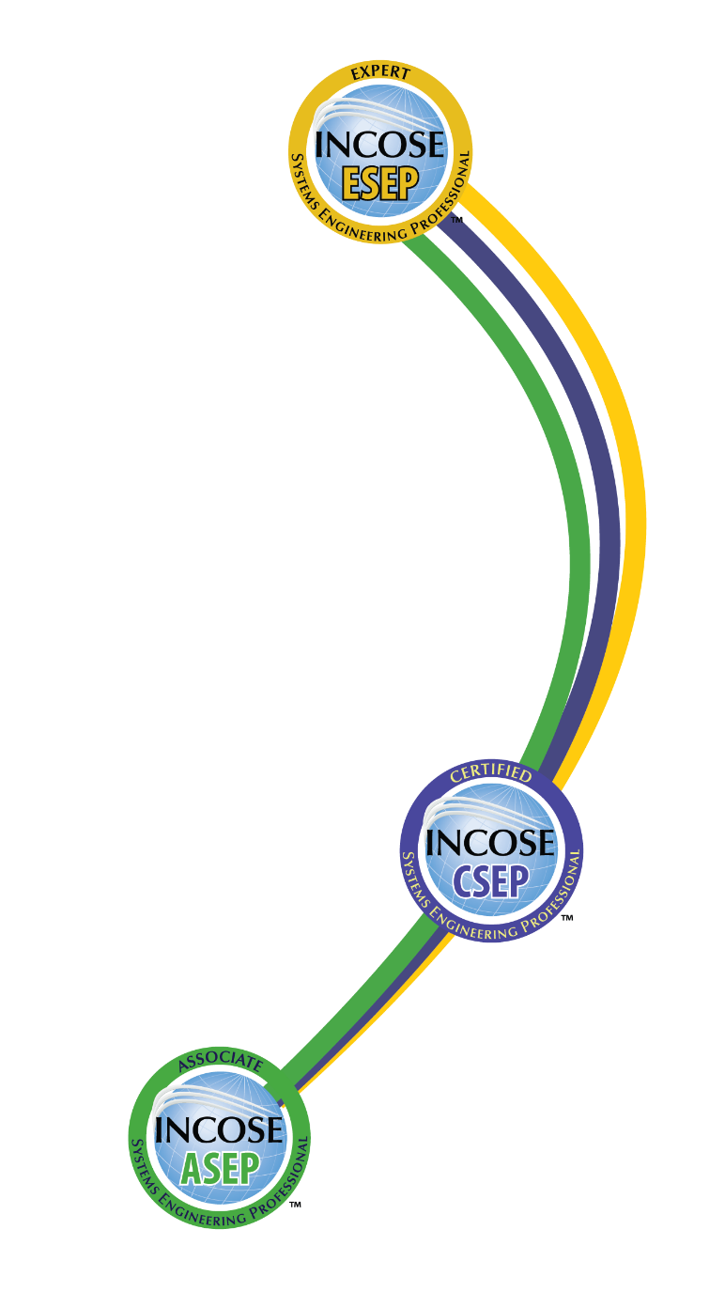
INCOSE SEP Architecture
For wherever you are in your career
Multi-Level Base Credentials
The base ASEP, CSEP, and ESEP credentials cover the breadth of systems engineering at increasing levels of leadership, accomplishments, and experience.

Slide 5
Synergy between chapters and certification
All certification levels require INCOSE membership.
  Certification draws in and keeps chapter members.
  Student membership counts.
  Students are a great source of volunteers.
ASEPs and CSEPs are required to do professional development.
  This can include chapter participation.
ESEPs are required to have done professional development.
  This includes chapter leadership.
Chapters can host certification exams and prep courses.
  These are valuable to members.
  These give you something to talk about in marketing and engagement.
Chapters can give advice on applications and help ESEPs prepare.
Academic Equivalencies are agreements with universities related to certification.
  These are a great way to partner with local universities.

Slide 6



Slide 7


What is the
Professional Development Portal?
The Professional Development Portal (PDP) is a comprehensive solution for Systems Engineers and other professionals who want to enhance their systems engineering knowledge and skills.
The PDP will provide access to:
Self-Assessment based on the INCOSE SE Competency Framework.
Recommendations of appropriate professional development content materials and programs provided by INCOSE and selected organizations, aligned to the individual user needs.
Quick references to Certification, Events, Working Groups, Mentoring, the Institute for Technical Leadership and other INCOSE offerings.
Initial PDP deployment scheduled for May 2021, in time for IS2021.
INCOSE Services Operations Providing a Long-Term Service for Systems Engineers.

Slide 8
Systems Engineering Competency Framework
Represents a world view of 5 competency groupings with 36 competencies central to the profession of Systems Engineering, including indicators of knowledge, skills, abilities and behaviors across 5 levels of proficiency.
Aligns with major ongoing INCOSE initiatives.
Supports a wide variety of usage scenarios including individual and organizational capability assessments.
Enables organizations to tailor and derive their own competency models that address their unique challenges.

Slide 9
36 Competencies Across 5 Groups
SE Management
Professional
Information Management
Planning
Monitoring and Control
Communications
Facilitation
Risk and Opportunity Management
Ethics and
Professionalism
Coaching &
Mentoring
Business & Enterprise Integration
Decision Management
Concurrent
Engineering
Configuration
Management
Acquisition
and Supply
Technical
Leadership
Emotional
Intelligence
Negotiation
Team Dynamics
Core SE Principles
Technical
General
Engineering
Systems
Thinking
Integrating
Requirements
Definition
Systems
Architecting
Transition
Operations
and Support
Capability
Engineering
Critical
Thinking
Quality
Finance
Project
Management
Logistics
Design For …
Integration
Interfaces
Verification
Validation
Systems Modelling
and Analysis
Lifecycles

Slide 10
Professional Development Resources
Professional Development Portal prototype demonstrated at IS2019
PDP MVS planned for IS2021
Tons of webinars and tutorials available on www.incose.org
Local INCOSE Chapters provide presentations on wide range of topics
SE Education: https://www.incose.org/academic-affairs-and-careers/se-education
Worldwide Directory: https://www.incose.org/docs/default-source/aboutse/se-academic-program-directory0231BA07E0A3.pdf?sfvrsn=a06bdc6_22
Academic Equivalency to Certification Knowledge Exam: https://www.incose.org/systems-engineering-certification/certification-agreements/equivalency-programs

Slide 11
Events (Global Reach)
INCOSE offers “cross-chapter” events for wider networking and integration / presentation of ideas
Flagship events for all INCOSE are:
  International Symposium – June / July every year
  International Workshop – January every year
  COVID travel restrictions have caused these events to be “virtual”
    We believe innovations in the virtual space will enable even better “hybrid” events once the pandemic is offer.
Sector (or regional) and topic specific events are also organized

Slide 12

Events – Community Offerings
Access / allow international conversations on Systems Engineering topics relevant and interesting to participants / INCOSE.
In 2021 we will continue to run Systems Exchange Cafes, running three (different days / times) every two weeks open to everyone.
Intended to be very informal, with topic as determined by attendees.
They are producing good discussion, with attendance between 10-25 attendees at each.
See https://www.incose.org/about-incose/community/virtual-cafe

Slide 13
Questions?
www.incose.org/IW2021

Slide 14
Any Questions?
Email Contacts
Certification Office:
certification@incose.org
Courtney Wright, CSEP
Certification Program Manager:
Courtney.Wright@incose.org
For more information visit:
www.incose.org/certification

Slide 15
Thank you!
For more information please contact:
Dr. Don Gelosh
+1-540-508-4774
dsgelosh@wpi.edu
www.incose.org/IW2021

