Slide 1



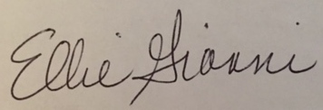
Certificate of APPRECIATION
Presented to
Joshua Freeman, CTI
With gratitude for CTI’s Support of the
INCOSE Chesapeake Chapter
During 2016 and 2017.
Mike Pafford
President
INCOSE Chesapeake Chapter
EleanoraAnn Gianni, ESEP
Past President
INCOSE Chesapeake Chapter

