Slide 1



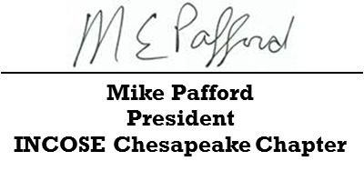
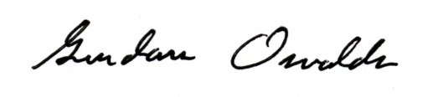
SAMPLE
Certificate of Recognition
Presented to
Insert Name Here
In recognition of receiving the 2017 INCOSE Founders Award for his significant long-term major contributions to INCOSE over the past 15 years. His high level of engagement includes impactful leadership that has been a catalyst for excellence at the chapter level, integration across INCOSE, and activities that have promoted the advancement of INCOSE, SE best practices, and certification.
INCOSE Chesapeake Chapter 8th Annual SEP Dinner
August 18, 2017
Gundars Osvalds, ESEP
Director of Programs
INCOSE Chesapeake Chapter

