Slide 1


Global Operations:
Marketing

Slide 2
Top Marcom Challenges
Branding
  Increase recognition
  Create trust/authority
  Makes acquiring new customers easier
Technology
  Improve customer experience
  Attract new customers

Slide 3


Slide 4















Is this INCOSE?

Slide 8


Slide 9


Slide 10


Slide 11
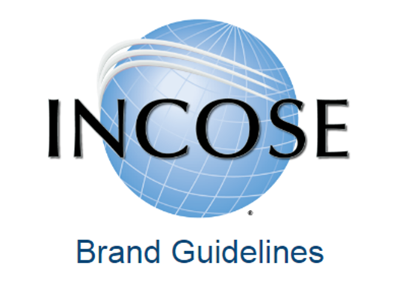
Read Ahead from Q1 Reminder
http://www.incose.org/brandguideline

Slide 12


Slide 13


Slide 14
