Slide 1












Special Thanks to the Following Sponsors
Table Sponsors:
Cyber Core Technologies
Integrity Technology Consultants (ITC)
Jovian Concepts
Johns Hopkins University Whiting School of Engineering
Engineering for Professionals (EP) Systems Engineering (SE) Program
Northrop Grumman Corporation
Vencore
Program Sponsor:
JHU Whiting School of Engineering EP SE Program
Advertising Sponsors:
Certification Training International (CTI)
SE Scholar, LLC
INCOSE Chesapeake Chapter Board of Directors
President: Ms. Ellie Gianni, ESEP
President-Elect: Mr. Mike Pafford
Past President: Mr. George Anderson, ESEP
Treasurer: Mr. Tony Gigioli
Secretary: Mr. Craig Tyler, ESEP
Communications Director: Mr. Patrick Williams, CSEP
Programs Director: Mr. Gundars Osvalds, ESEP
Membership Director: Mr. Mark Kaczmarek
7th Annual Systems Engineering Professionals Recognition Gala
Wednesday, August 24, 2016
THE ENGINEERS CLUB
THE GARRETT-JACOBS MANSION
Special Thanks to our Program Sponsor
Engineering for Professionals
Systems Engineering Program
Page 8

Slide 2
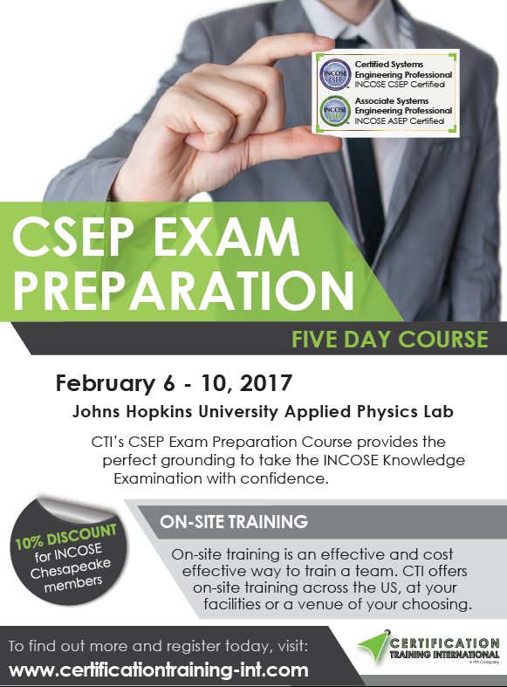
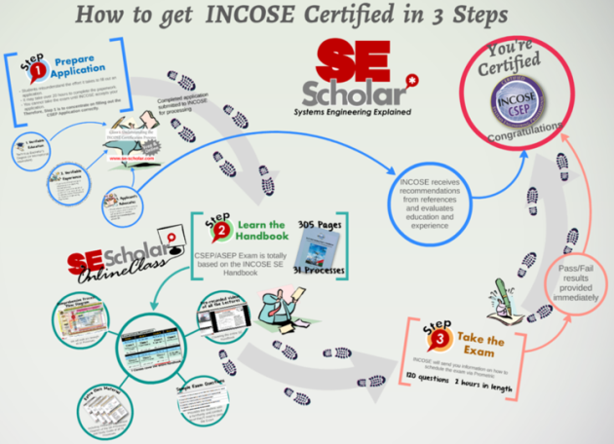

Guest Speakers
Ms. Kristen J. Baldwin was appointed the Acting Deputy Assistant Secretary of Defense for Systems Engineering in January 2016 while continuing as Principal Deputy, SE. She is the principal systems engineering advisor to the Secretary of Defense and is responsible for establishing and executing engineering policy and oversight across the Department. Ms. Baldwin also serves as the acting Defense Standardization Executive. She oversees the DoD strategy for Trusted Systems Design.
Ms. Courtney Wright CSEP-Acq, is the Program Manager for the INCOSE Certification Program. She has previously worked as a contractor supporting the United States Air Force, National Geospatial-Intelligence Agency, National Aeronautics and Space Administration, and Federal Aviation Administration. Ms. Wright earned her Bachelor’s degree in Mechanical Engineering from the University of Virginia and her Master’s in Operations Research from Georgia Tech. A small business owner, she also continues to consult as an instructor for professional development courses in systems engineering.
www.se-scholar.com
SE Scholar’s presentation on "How to get INCOSE Certified in 3 Steps."
Page 2
Page 7

Slide 3
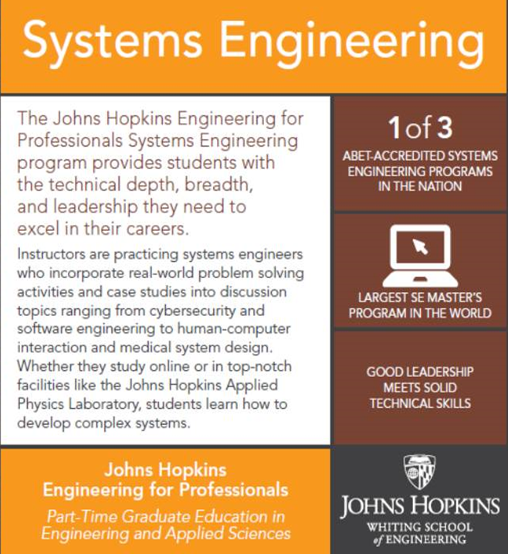

Chesapeake Chapter SEP Recipients
Ms. Viviana Acosta, CSEP, Booz Allen Hamilton Inc.,
Ms. Lindsey Beaubien, ASEP, Northrop Grumman Corp.
Mr. Robert Brouwers, CSEP, Northrop Grumman Corporation
Dr. David Flanigan, ASEP, Johns Hopkins University (JHU), Applied Physics Lab (APL)
Mr. Michael Folk, ASEP, Northrop Grumman Corp.
Mr. Ben Gianni, ASEP, Loyola University Maryland
Ms. Teresa Jackson, CSEP, Onyx Consulting Services
Mr. Daniel Leeds, CSEP, Northrop Grumman Corp.
Ms. Stephanie Miskiewicz, CSEP, Northrop Grumman Corp.
Mr. Ralph Morgan, ESEP, Leidos
Mr. Anthony Oliver, CSEP
Mr. John Pacak, CSEP
Ms. Jessica Tyler, ASEP, Booz Allen Hamilton Inc.
Mr. Edward Wienckoski, ASEP, NASA
Mr. Erik Williams, ASEP, Booz Allen Hamilton Inc.
Washington Metropolitan Area (WMA) Chapter SEP Recipients
Mr. Parfait Awouvi, ASEP, Northrop Grumman Corporation
Mr. Michael Bisconti, ESEP, Requirements & Architecture
Mr. Brian Bixby, ASEP
Mr. Daniel Canales, ASEP, Pennsylvania State University
Mr. Paul Ellia, CSEP, US Air Force (DoD)
Mr. Christopher Esposito, CSEP, Northrop Grumman Corporation
Dr. Paul Fomin, CSEP
Mr. Rajathi Ganesan, CSEP, NIST
Mr. Christopher Hansen, CSEP, BAE Systems
Mr. Rael Kopace, ASEP
Ms. Nicole Loomis, CSEP, Booz Allen Hamilton Inc.
Mr. Paul Mitchell, CSEP, NAVAIR
Mr. Nick Norelli, CSEP, KEYW
Mr. Shawn Pennington, CSEP
Mr. John Poirier, CSEP, Booz Allen Hamilton Inc.
Mr. Orlando Ruiz, CSEP, Northrop Grumman Corporation
Ms. Rachel Schei, CSEP, Northrop Grumman Corporation
Mr. Garrett Smiley, CSEP, ManTech International Corporation
Mr. Carl Stokes, CSEP, Federal Aviation Administration (U.S.)
CAB-Limited SEP Recipients
Mr. Bill Druce, JHU APL
Mr. Marcus Edwards, CSEP, Northrop Grumman Corporation
Mr. Justin Gliptis, CSEP, BAE Systems
Mr. Mike Hanlon, CSEP, BAE Systems
Mr. Jesse Ingram, CSEP, BAE Systems
Mr. Matthew Levert, CSEP, FAA
Mr. Kevin McElroy, CSEP, Leidos
Mr. Eric Schierling, CSEP, Vencore
Mr. John Sullivan, CSEP, FAA
Mr. David Weinel, CSEP, Booz Allen Hamilton Inc.
Member-at-Large SEP Recipients
Ms. Kimberly Gill, CSEP, Federal Aviation Administration
Mr. Bala Udayakumar, CSEP, Enterprise Business Services
Degrees & Certificates
Master of Science in Systems Engineering
Master of Science in Engineering in Systems Engineering
Graduate and Post-Masters Certificates
Systems Engineering Focus Areas/Tracks
Biomedical, Cybersecurity, Human Systems,
Modeling and Simulation, Project Management,
Software and Systems Engineering
Pathways Online, Online & On-Site, and On-Site
Johns Hopkins Engineering for Professionals
ep.jhu.edu
6810 Deerpath Road, Suite 100, Elkridge, MD 21075
410-516-2300 | 1-800-548-3647
TDD: 410-579-8124 | Fax: 410-579-8049
Page 6
Page 3

Slide 4
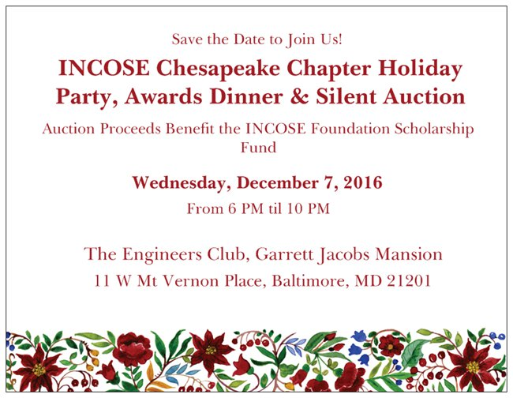





Welcome to the Chesapeake Chapter’s 7th Annual Systems Engineering Professional (SEP) Recognition Gala. We are celebrating those individuals who have obtained the prestigious INCOSE Systems Engineering Professional Certifications
Program Schedule
5:30 PM Reception and Cocktail Hour
7:00 PM Guests and Speakers are invited to be seated in the Dining Area. Welcome remarks by Ms. Ellie Gianni, ESEP, INCOSE Chesapeake Chapter President
8:00 PM Program begins with VIP, Guest Speaker, and Sponsor introductions by Chapter Presidents. Special thanks to our guest speakers: Ms. Kristen J. Baldwin, Acting Deputy Assistant Secretary of Defense, Systems Engineering DASD (SE); and Ms. Courtney Wright, CSEP, Program Manager, INCOSE Certification Program
Awarding of the Chapter SEP Certificates:
9:00 PM Formal Program ends. Guests are encouraged to further enjoy the mansion and congratulate our new SEP’s. Cash Bar Open on lower-level of Club.
10:00 PM Final Departure
Registration Opens in October at www.incose-cc.org
Page 4
Page 5

