Slide 1
INCOSE and CAB membership – Presentation to D.A.T.A, Inc.
What’s in it for Me?
27 Jul 12
Presented by
L. Nasta, INCOSE-WMA Chapter President

Slide 2
Agenda
What is INCOSE
What does it mean to be a Corporate Advisory Board (CAB) Member
Upcoming Opportunities to participate
Recommendation

Slide 3

What is INCOSE
Mission: Share, promote and advance the best of systems engineering from across the globe for the benefit of humanity and the planet.
Goals:
  To provide a focal point for the dissemination of systems engineering knowledge
  To promote international collaboration in systems engineering practice, education, and research
  To assure the establishment of competitive, scalable professional standards in the practice of systems
  To improve the professional status of all persons engaged in the practice of systems engineering
  To encourage governmental and industrial support for research and educational programs that will improve the systems engineering process and its practice

Slide 4
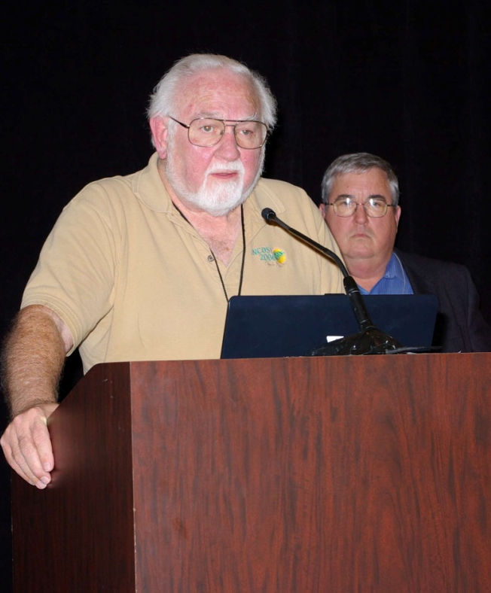
INCOSE Overview and Structure
Started in August 1990 by 35 senior technical managers
Incorporated as nonprofit technical society in January 1992
Charter expanded to International status in 1995
Organization Leadership
  Board of Directors
  Corporate Advisory Board
  Member Board
  Technical Operations, Working Groups and Initiatives
  Administrative Committees
  Administrative Office (Managing Executive)

Slide 5
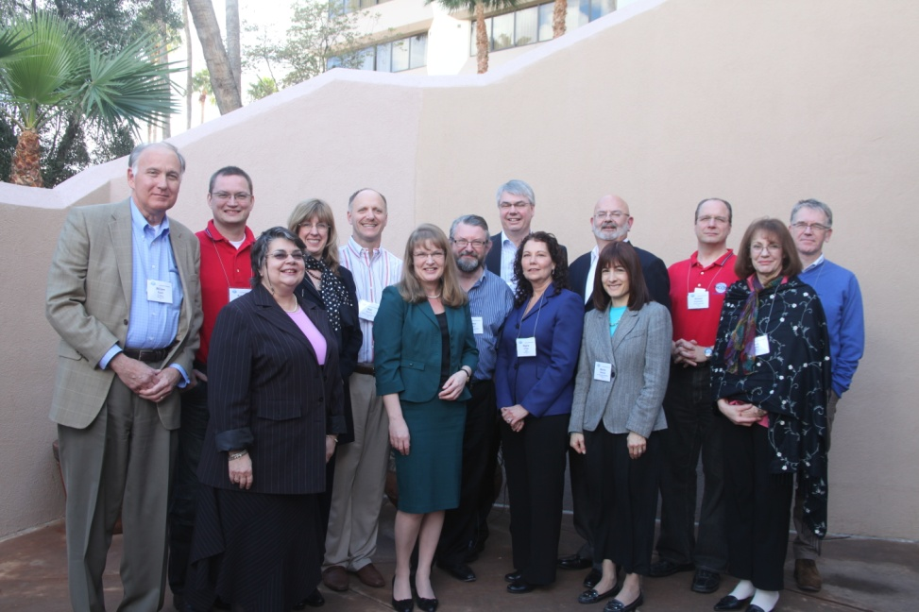
Board of Directors
Officers
  President
  President-Elect
  Secretary
  Treasurer
Directors
  Strategy
  Communications
  International Growth
  Commercial Outreach
  Technical Director
  Corporate Advisory Board
  Member Board Chairs
  Academic Matters
  IT
Current 2012 President is Mr. John Thomas, former VP at Booz Allen Hamilton.

Slide 6
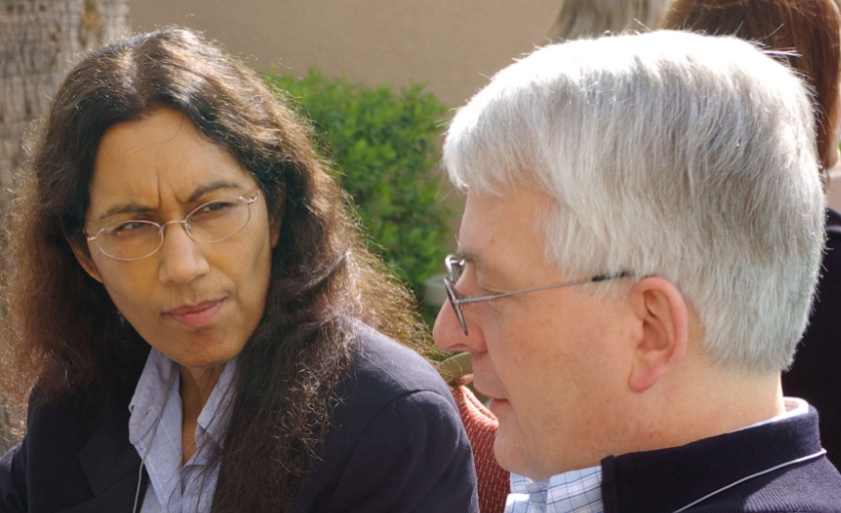
Corporate Advisory Board
The "Voice of the Corporate Customer" for INCOSE (but represents corporations – profit and non-profit, and academia) (see brochure)
Provides guidance on overall INCOSE direction, focus, and priorities
Acts as a conduit between INCOSE and sponsoring corporations for information exchange, key corporate systems engineering-related issues, and access to corporate executive management
Sponsors monthly Webinars that are archived and available after the online event
Provides additional resources for
INCOSE and support for chapters

Slide 7
Operations Overview
Sector Operations¹ – Chapters & Student Divisions across the globe
  Sector 1 – Americas
  Sector 2 – EMEA (Europe, Middle East, Russia)
  Sector 3 – Asia – Oceana (Asia, AUS)
Technical Operations
  Over 40+ working groups clustered in following groups: Government, Academic Liaison, Industry, Technology, Processes, Knowledge
Systems Engineering Certification Program
  ASEP, CSEP, ESEP
Other Offerings
  Products, Tools; Funded research; SE Standards Admin Operations (Based in San Diego, CA)
  participation; Partnership w/other Professional Assns, etc.
1- http://www.incose.org/chapters/geographic.aspx

Slide 8
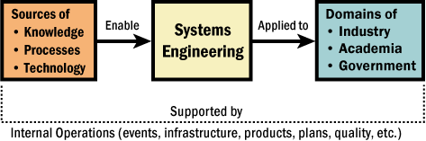
Technical Operations Snapshot
Power & Energy Systems
Process Improvement
Reliability Engineering
Requirements
Resilient Systems
Risk Management
SE Effectiveness
Space Systems
Standards
Systems Safety Integration
Systems Security Engineering
Systems Science
Training
Transportation
Verification & Validation
Very Small and Micro Entities
Affordability
Anti-terrorism International
Architecture
Autonomous System & Evaluation
Biomedical
Complex Systems
Cost Engineering
Decision Analysis
Defense Systems
Human Systems Integration
Infrastructure
Intelligent Enterprises
Knowledge Management
Lean Systems Engineering
Life Cycle Management
Measurement
Motor Sports
Net-centric Operations

Slide 9
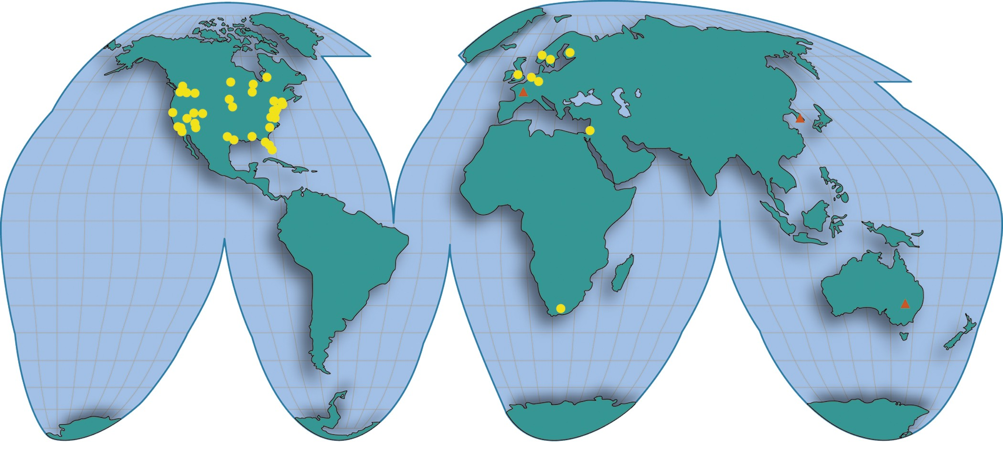
INCOSE Chapters Around the World
Chapters
Startups
Newest chapter, Brazil

Slide 10
What does it mean to be a CAB Member?
Benefits
  Publicity as a Systems Oriented Organization; Recognition in INSIGHT
  Membership Directory and INCOSE products
  Notification of INCOSE Meetings; Summary of INCOSE Proceedings
  Recognition in INCOSE Journal
  Complimentary Executive Registration at International Symposium *
  Position on the Corporate Advisory Board (CAB has a voting seat on INCOSE BoD) *
  *CAB representative responsible for own travel & accommodations

Slide 11
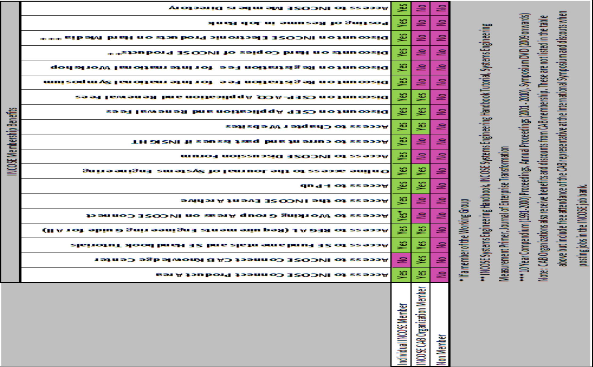
CAB Benefit Summary

Slide 12
CAB Member (cont)
Cost structure:
  $ 10,000 initial application
  $3750 annually thereafter
Application

Slide 13
Opportunities to Participate
International Workshop - January 2013
  Set event for Tech Ops WG to meet formally and announce/discuss initiatives
  Address Federation organizational needs
International Symposium – June 2013
  Philadelphia, PA
  WMA chapter will be providing support
  Sponsorship and Exhibitor opportunities
  Paper presentations and Tutorial opportunities
IS 2014 – Seoul, Korea
Ongoing
  Chapter Meeting Presentations and Tutorials

Slide 14
Recommendation –
Value Proposition
D.A.T.A or the ISC would benefit from involvement as an INCOSE CAB member
Believe ISC would be the better approach however due to D.A.T.A SE’s being small in number, and member benefits accruing to ISC members
  Access to products, WG activities, academic research
  Ability to provide inputs to same
  ISC companies/academic avenues to display/present products and/or research to Int’l audience
CAB or strategic partnership – Still a Question
Next Steps?

Slide 15
Backup

Slide 16
Publications
INSIGHT, quarterly newsletter
Systems Engineering: peer-reviewed Journal since 1998, 4 issues per year
Journal of Enterprise Transformation – peer-reviewed journal with IIE since 2011
Conference Proceedings since 1993, ipub
eNote, periodic email notifications

Slide 17
Products
Products from Working Groups
  Free to the public on the Web (www.incose.org)
    Tools Database
    Technical resource center
  From the Members Area on INCOSE Connect
    Measurement Primer
    Systems Engineering Handbook
    Systems Engineering Technical Vision 2020
    Webinar archives
    Obtain logon and password from the INCOSE Office
Products and publications available for purchase through INCOSE Office

Slide 18
Certification
In 2004 INCOSE initiated the Certified Systems Engineering Professional (CSEP) program; ASEP and CSEP-ACQ (2008); ESEP (2009)
Certification Is Open to Everyone interested in being recognized formally for their knowledge of systems engineering
Participation Is Voluntary
INCOSE Members Receive Reduced Rates for Initial Certification and Renewal

Slide 19
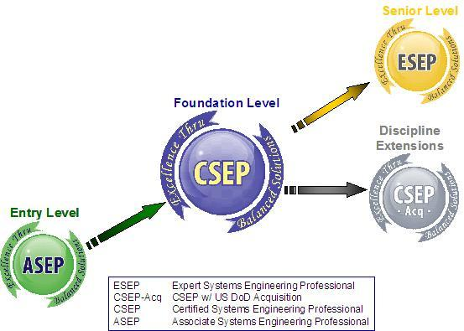
Certification options

