Slide 1
The International Council on Systems Engineering (INCOSE)
Jim Gottfried
INCOSE SD Past President
james.gottfried@incose.org
619-540-3830
Notes:
Welcome, and thanks for joining us today. I’ve been an INCOSE member since 1992 and have had the pleasure of watching INCOSE grow and evolve. I wanted to provide a brief introduction to INCOSE as it stands today as well as a sense of where we are heading tomorrow. I know that on this call we have new members, long time members, and even a few interested individuals who have never been a part of INCOSE. Hopefully what follows will be a good primer for all, but it won’t answer every question. This is where you come in. I hope you will share your questions along the way. We will have plenty of time at the end to ensure we answer them.
As an engineer, frequently I find myself describing the physical entity first. As we get started, I want to take a step back and provide a higher level view of the International Council on Systems Engineering.

Slide 2
We believe the systems perspective is essential to developing solutions for problems with a meaningful degree of complexity.
We believe the interesting things are often found in the gaps – between disciplines, between technologies, between components.
We believe the true challenges of today and tomorrow are systems challenges and that without the systems perspective, we cannot address these challenges effectively, efficiently, and free from unintended consequences.

Slide 3
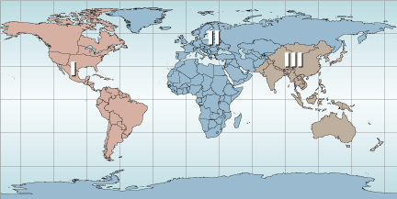
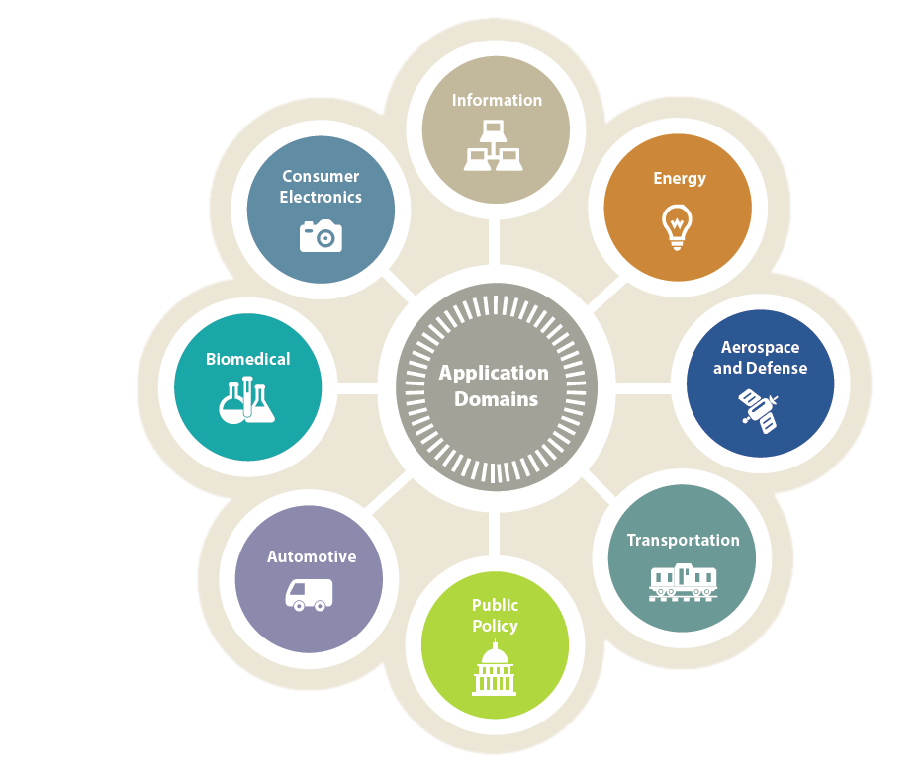
We connect systems practitioners around the world – across organizational boundaries, domain boundaries, and national boundaries.
We create, advance, and broker information on systems approaches to help the broader community address complex challenges.
We champion the systems perspective and the unique value of systems engineering and those who apply it.

Slide 4
68
58
75
9800
47
21
Notes:
Who is INCOSE? By the numbers:
We are 9777 members
In 58 countries
In 68 chapters
75 CAB members
21 academic council members
47 working groups

Slide 5
INCOSE: Who We Are
A not-for-profit membership organization founded in 1990 and dedicated to systems engineering
Approximately 10,000 members in government, industry, and academia
  Spanning aerospace & defense, transportation, health care, energy, and beyond
  68 local/national chapters and members in 58 countries
Our Mission: To share, promote and advance the best of systems engineering from across the globe for the benefit of humanity and the planet
Learn more at www.incose.org

Slide 6
INCOSE: Our Goals
To provide a focal point for dissemination of systems engineering knowledge
To promote international collaboration in systems engineering practice, education, and research
To assure the establishment of competitive, scalable professional standards in the practice of systems engineering
To improve the professional status of all persons engaged in the practice of systems engineering
To encourage governmental and industrial support for research and educational programs that will improve the systems engineering process and its practice

Slide 7
In INCOSE, We Value:
Systems Thinking – thinking and acting to apply systems approaches to address complex challenges and thus to realise successful sustainable solutions.
Pioneering and Innovation – taking opportunities ourselves or with partners to evolve systems approaches to meet future challenges.
Learning and Development – life-long learning with a changing world through education and continuing professional development, covering both technical and leadership competencies.
Respect, Diversity, Collaboration – building and maintaining respectful relationships internally and externally in order to enable effective collaboration across the diverse community.
Individuals – the importance of people, their intellect and influencing skill, to support complex decisions and to deliver enduring change.
Volunteerism – volunteers and staff working together to achieve our objectives and to deliver benefit to our members, individuals and society.

Slide 8
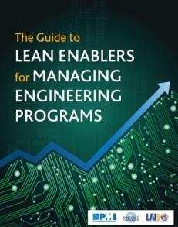
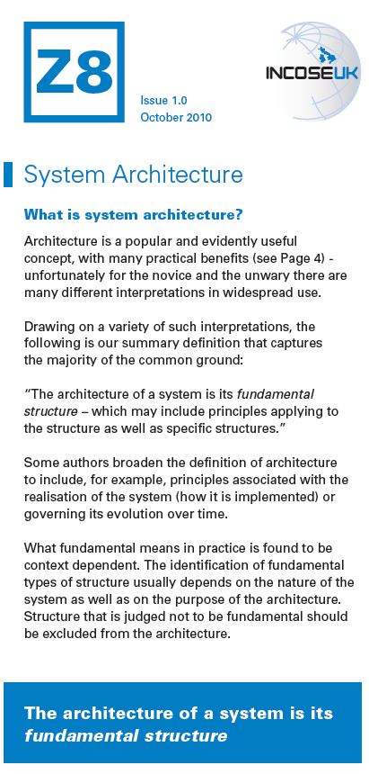
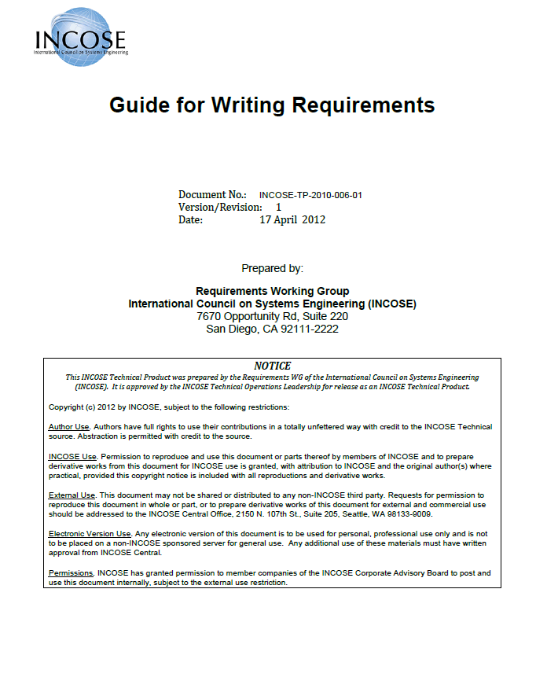
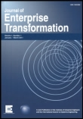
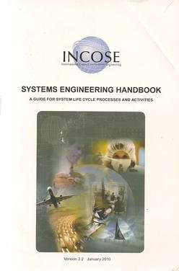

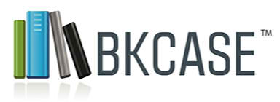


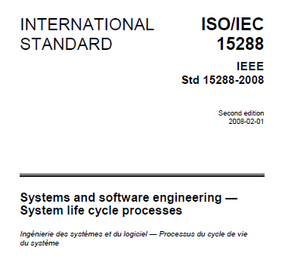


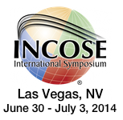
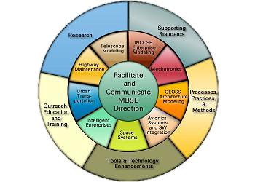
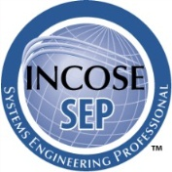

Notes:
How does this manifest itself? What does INCOSE do? What does INCOSE deliver?
Products
Developed locally, developed internationally
Produced alone and in partnership
Harmonization
Publications
Events
Major initiatives
At the local, national, sector, and international levels

Slide 9
INCOSE: The Organization
A Brief Overview of our Major Components

Slide 10
Technical Working Groups
47 different working groups in our Technical Operations organization
The technical heart of INCOSE supported by many national and local working groups
Focused on solving providing relevant problems and creating products for global use
Sponsors multiple monthly webinar series that are archived and available after the online event
Notes:
SE Handbook
Book: The Guide to Lean Enablers for Managing Engineering Program
First document which bridges SE, PM and Lean
Available for download on MIT website

Slide 11
Technical Operations
Agile Systems
Architecture
Automotive
Biomedical / Health Care
Complex Systems
Cost Engineering
Defense Systems
Global Earth Observation SoS
Human Systems Integration
Information Systems
Infrastructure
Intelligent Enterprises
Lean Systems Engineering
SE Management
Measurement
Model-Based Conceptual Design
Model-Driven System Design
Motor Sports
Net-centric Operations
Power & Energy Systems
Process Improvement
Requirements
Resilient Systems
Risk Management
Space Systems
Standards
Systems of Systems
Systems Safety Integration
Systems Security Engineering
Technology Life Cycle
Transportation
Verification & Validation
For more information or the complete list, visit http://www.incose.org
follow Home>Advancing the Practice>Technical Operations
Notes:
These working groups existing at the international, regional, and local levels
They focus on product development, information exchange, external collaboration, and more
They coordinate with other groups within INCOSE to set their priorities, but they are often 100% organic
If you don’t see a group that matches your interest area, start one

Slide 12
Corporate Advisory Board
Serves as the "Voice of the Corporate Customer" for INCOSE
Provides guidance on overall INCOSE direction, focus, and priorities
Acts as a conduit between INCOSE and sponsoring corporations for
  information exchange
  key corporate systems engineering-related issues
  access to corporate executive management
Provides additional resources for INCOSE and support for chapters

Slide 13
CAB Membership (Partial)
Air Force Institute of Technology
Airservices Australia
Alliant Techsystems
Analytic Services-Applied Systems
Thinking Institute
Astrium an EADS Company
ATKINS
BAE Systems
Bechtel
Boeing Commercial Airplane Co.
Boeing Defense, Space & Security
Boeing Research and Advanced Tech
Booz Allen Hamilton Inc.
C.S. Draper Laboratory, Inc.
Carnegie Mellon University Software
Engineering Institute
CASSIDIAN
Cranfield University
Cummins, Inc.
Defense Acquisition University
Deloitte
Deputy Asst Secretary of Defense for Systems Engineering, US DoD
DRS Technologies, Inc.
EADS N.V.
Exelis Inc.
Federal Aviation Administration
Ford Motor Company
General Dynamics
General Electric
George Mason University
Georgia Institute of Technology
Honeywell International
IBM Corporation
JAXA (Japan Aero Exploration Agency)
Jet Propulsion Laboratory
Johns Hopkins University
Keio University
L-3 Communications
Lockheed Martin Corporation
Los Alamos National Laboratories
ManTech International Corporation
MAP systeme
Massachusetts Institute of Technology
Medtronic, Inc.
Missouri University of Science & Tech
Mitsubishi Electric Corporation
Nanyang Technological University
NASA
National Geospatial-Intell Agency
National Reconnaissance Office
National University of Singapore
Naval Surface Warfare Center - Dahlgren
Northrop Grumman Corporation
PA Consulting
Pacific Northwest National Laboratory
Proctor and Gamble
Raytheon
Rockwell Collins, INC
Rolls Royce
Saab AB
SAIC
Sandia National Laboratories
Scitor Corporation
SELEX ES, a Finmeccanica Company
Siemens
Singapore University of Tech & Design
SRA International
Stevens Institute of Technology
Swedish Defence Materiel Admin
TASC, Inc.
Thales
The Aerospace Corporation
The MITRE Corporation
The SI
TNO Technical Sciences
UK MoD
United Technologies Corporation
University of Maryland
University of South Australia
Defense & Systems Engineering
University of Southern California
University of Texas at El Paso
US Army ARDEC
US Army TARDEC
Vitech Corporation
Volvo Construction Equipment
Woodward Inc.
Worcester Polytechnic Institute - WPI

Slide 14
CAB Members Benefits
• By participating in the creation and update of common CAB company needs that are delivered to the Board of Directors, Technical Operations, and other organization elements, the CAB member influences INCOSE's Direction, focus, and priorities.
• CAB member representative participates in two annual meetings created just for the CAB, where there are panels, speakers, workshops, and other strategy and networking opportunities.
• All employees of a CAB member have electronic access to all INCOSE products, even for employees who are not individual INCOSE members.
• All employees of a CAB member pay discounted fees to become certified under the INCOSE Certified Systems Engineering Professional program.
• CAB member sponsorship is recognized in several venues, including special mention in each issue of INSIGHT (INCOSE newsletter) and the INCOSE Journal of Systems Engineering, as well as special mention in the International Symposium brochure and proceedings.
• Each CAB member receives one complimentary registration for the INCOSE International Symposium.
• CAB member receives a complimentary one-half page advertisement in INSIGHT.

Slide 15



Chapters, Local and National
Organize professional and social programs that facilitate continuous professional development and networking
Host local activities
  Meetings
  Tutorials, workshops, mini-conferences and vendor fairs
  Contributions to working groups and projects
Disseminate announcements and news
Develop local initiatives such as
  Tutorials and handbooks
  SE certification support programs
  Activities with other professional organizations
Raise the visibility of INCOSE and the systems
engineering profession in the local region

Slide 16
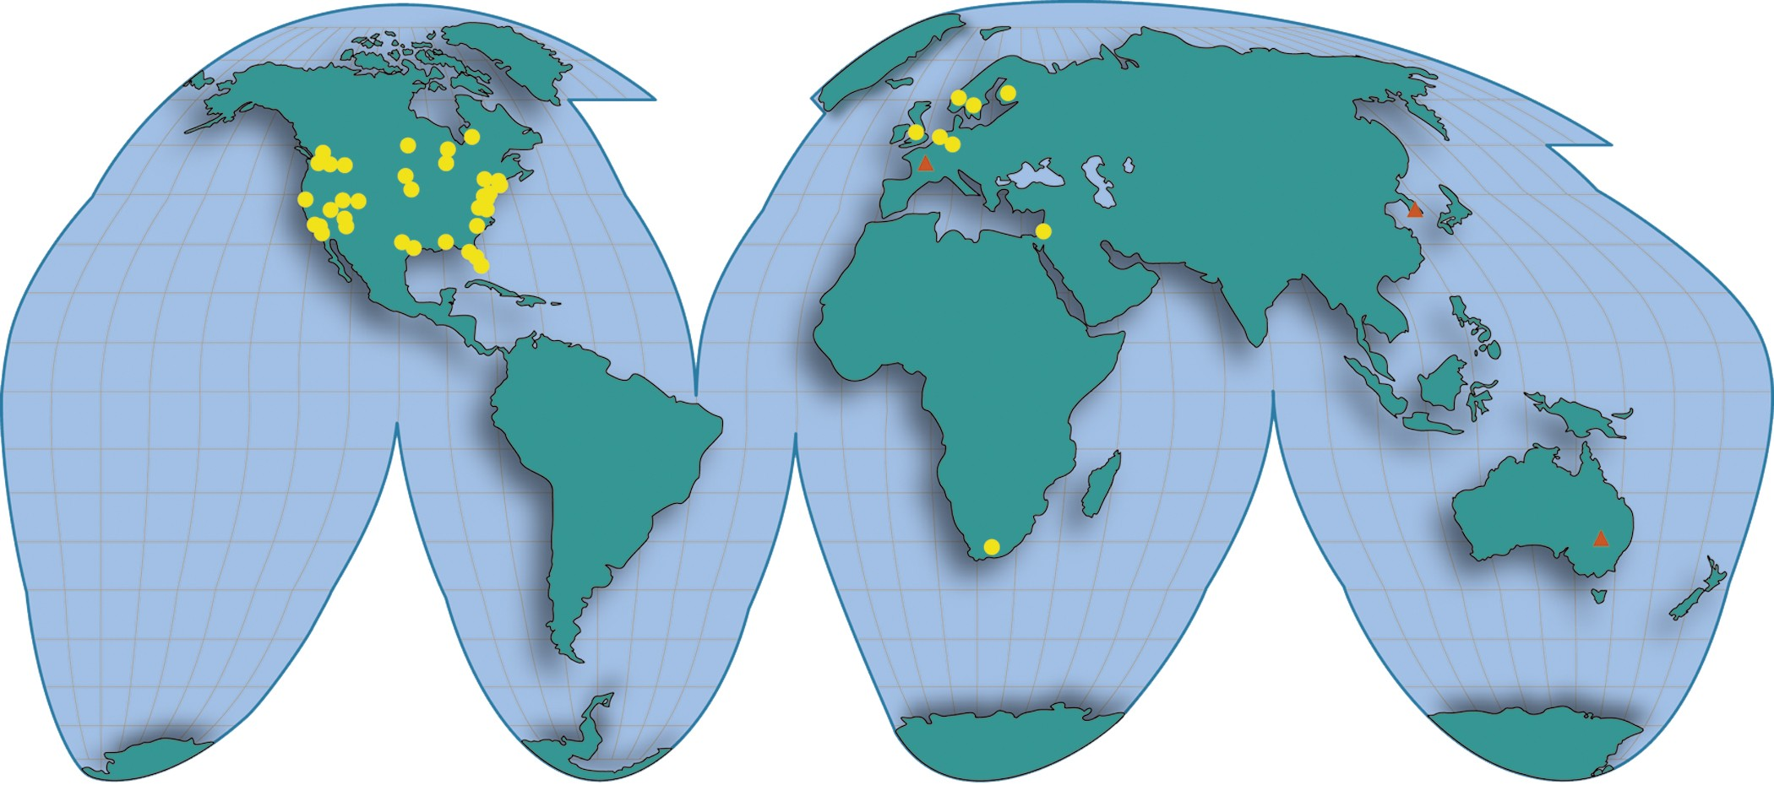
INCOSE Chapters Around the World
Chapters
Startups

Slide 17
Benefits of Individual Membership
A Summary of the Major Benefits for Individual Members

Slide 18
Leverage INCOSE Products
Notes:
Generated at the grassroots level or by focused INCOSE initiative
Produced alone and in collaboration with others
Developed at the chapter and the international level
Note the handbook in particular
Free in PDF format
Discount on hard copy
Version 4.0 coming January 7 – harmonized with the 15288 currently under balloting

Slide 19

Enjoy INSIGHT
60+ pages of INCOSE news and practitioner content
Published quarterly and available online and in hardcopy format
2014-2015 themes include
  Systems Engineering: Active Management of Unpredictable Risk
  2014 International Symposium Coverage: Las Vegas, Nevada
  Model-Based Conceptual Design: Engineering the Problem Space
  Resilient Systems
  Model-Based Systems Engineering
  Transformational System Engineering
Full archive of INSIGHT from 1993-today is available on INCOSE Connect
Notes:
The Newsletter of INCOSE, but much more. It’s really a hybrid newsletter and practitioners magazine

Slide 20
Access Systems Engineering
Refereed scholarly journal of INCOSE
Published quarterly by John Wiley & Sons
  Increasing to six times per year including special theme issues in 2015
Access the Journal online
  Current and past issues
  Full text in PDF
  Registration Key obtained by following instructions in the Members Area of the web
Instructions for authors found in INSIGHT and the INCOSE website

Slide 21
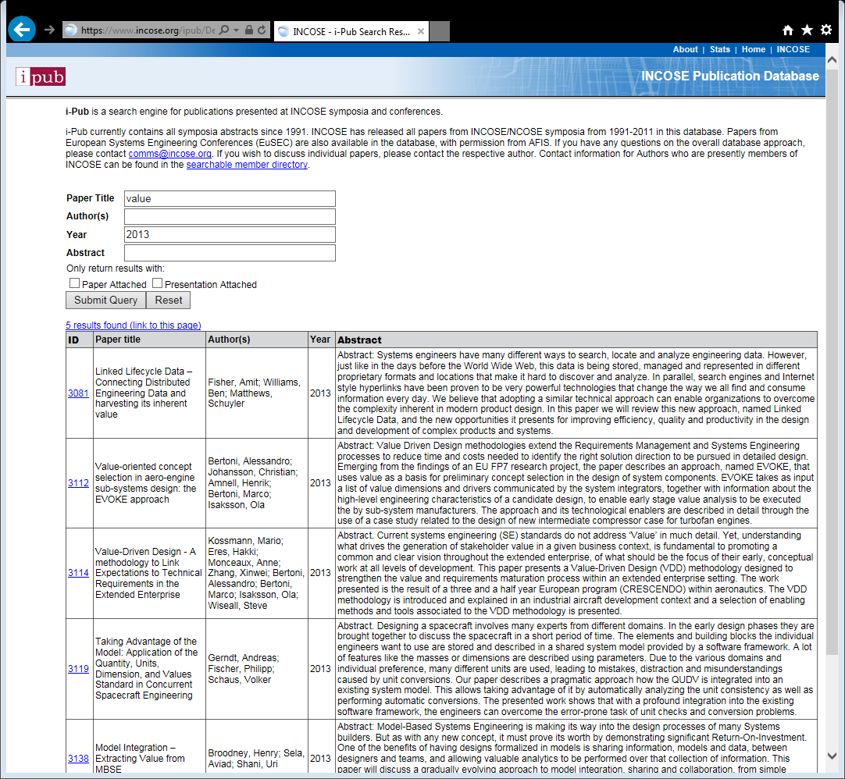
Search i-Pub
INCOSE’s online publication database
Contains over 3,000 papers dating back to 1991
Search by
  Author
  Keyword
  Year

Slide 22


Participate in INCOSE Events
7-9 Oct 2014. APCOSEC 2014 (Qingdao, China)
10-11 Oct 2014. 8th Annual Great Lakes Regional Conference (Chicago, IL, USA)
27-30 Oct 2014. EMEASEC 2014 (Cape Town, South Africa)
18-19 Nov 2014. INCOSE UK Conference 2014 (Tedford, UK)
24-27 Jan 2015. INCOSE International Workshop
(Los Angeles, CA, USA)
13-16 Jul 2015. 25th INCOSE International Symposium (Seattle, WA, USA)
…plus countless meetings, tutorials,
and workshops at the local level

Slide 23
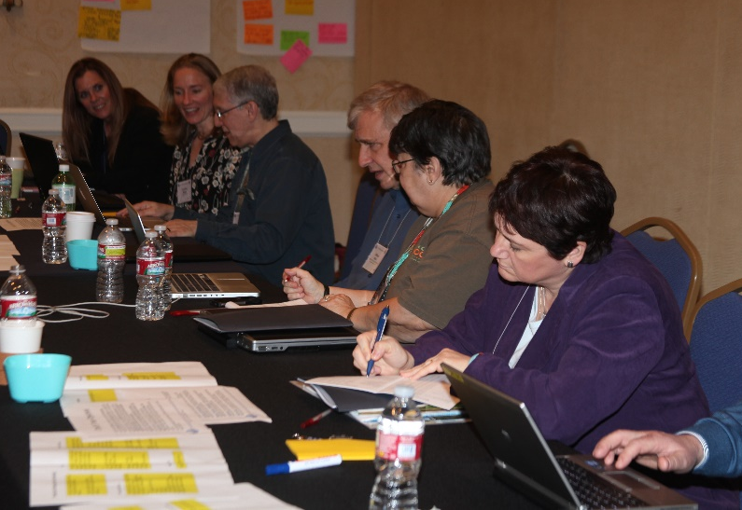
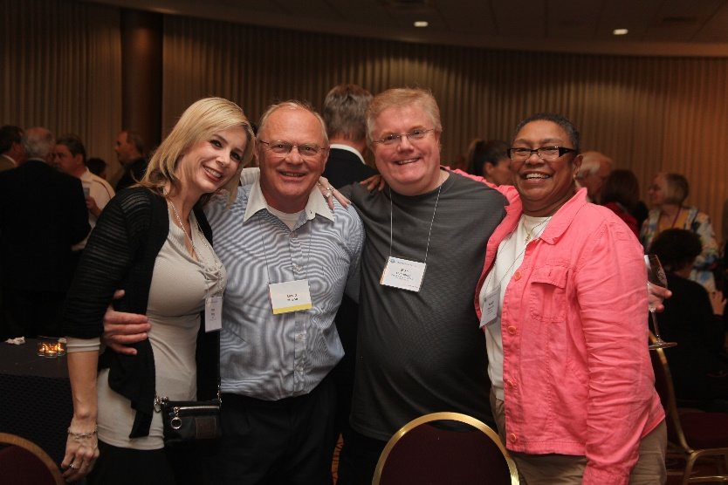
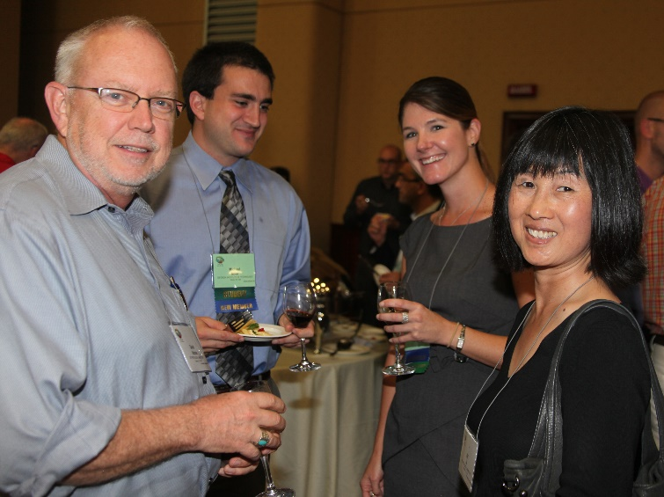
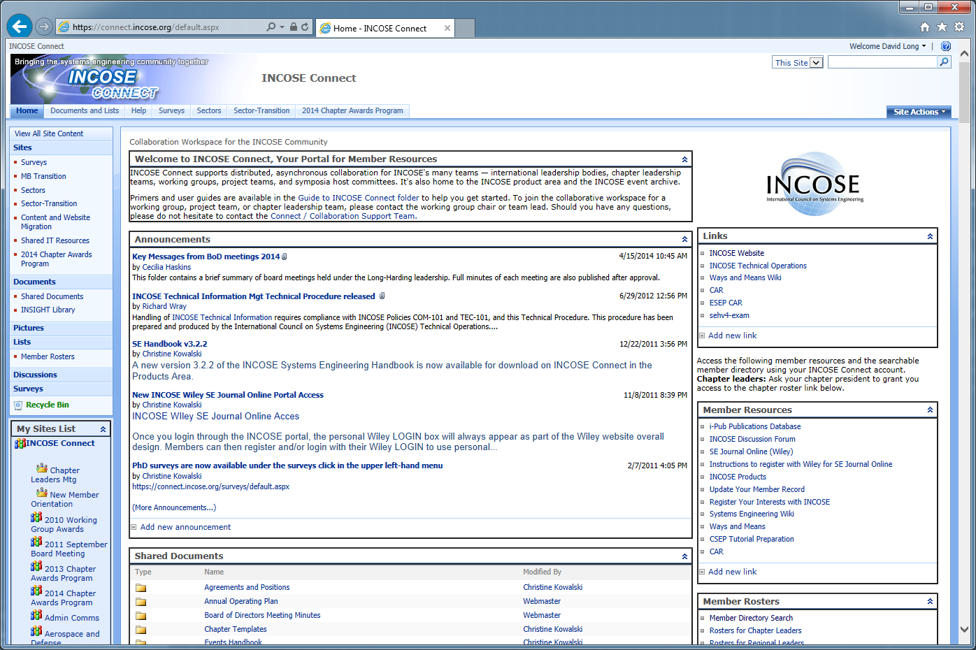
Collaborate with Systems Practitioners around the World

Slide 24
Benefits of Membership in INCOSE
Network with over more than 9,800 members in over 60 countries
Membership in a local INCOSE Chapter and meeting local colleagues (i.e. San Diego)
Access current and past issues of the
Systems Engineering Journal
Enjoy INSIGHT, INCOSE’s quarterly e-publication
Search the INCOSE publications database and
download thousands of past symposia papers
Gain exclusive access to INCOSE CONNECT,
the collaborative site for Members Only
Download INCOSE products including the Systems
Engineering Handbook, the Guide to Writing
Requirements, the Measurement Primer, Guide
To SE for Very Small Entities, and more
Collaborate with experts and practitioners
Contribute to INCOSE via Technical Activities

Slide 25
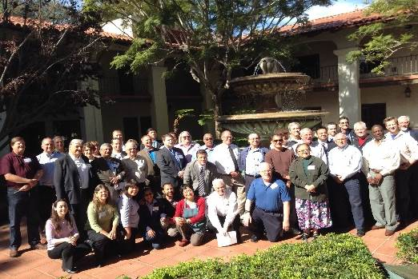

About the San Diego Chapter
Approximately 120 members
Monthly Chapter meetings with topics of interest to system engineers
Annual 1-day Mini-Conference
Educational Seminars taught by Industry or academic experts
Community focus on supporting STEM activities in local schools, providing financial grants to teachers and helping as needed
http://www.sdincose.org

Slide 26
INCOSE Support of STEM in San Diego
Provide $400 – 1100 grants to local 4th – 12th grade teachers who are teaching STEM related classes
  Grants pay for STEM materials, field trips, tablets, software, etc that teachers use to better teach STEM classes or after school science clubs
In 2014 awarded $15.5 K to 15 teachers across SD County
  High School 4 awards, Middle School 6 awards, 4th – 6th 5 awards
  5 awards each to North County, San Diego/East County, South County
$41K awarded to SD teachers over the past 3 years
Grant money comes from local corporations, societies, and individuals (Cubic, Northrop Grumman, SAIC, CareFusion, Cox, International Test and Evaluation Association, etc)
Very positive feedback from teachers receiving grants – significant accomplishments in starting new programs
Would ViaSat like to support STEM through this program?

Slide 27
SD INCOSE
X/2015 Monthly Meeting
Date, Time, Location
Third Wednesday of Month, X/2015, 5:10 – 7:20 PM
Giovanni’s Italian Restaurant, Clairemont Dr
Speaker
Mr/Ms Expert in SE or YYYY
Topic
Abstract of presentation
Great Italian dinner, $5 for members, $10 for guests
What about a North County satellite location at ViaSat?
More info at www.sdincose.org

Slide 28
What Can ViaSat do?
Encourage your SEs to join and be involved with INCOSE and the San Diego Chapter
  Pay for part or all of employees membership dues ($145 per year)
  Make membership in a professional organization such as INCOSE a positive evaluation factor on yearly performance reviews
  Support an SD INCOSE recruiting luncheon at ViaSat locations
  Support employees going to INCOSE International Symposium and International Workshop
  Sponsor a satellite site at ViaSat for SD INCOSE meetings
  Become an INCOSE CAB Member
  Work with SD Chapter on programs of benefit to ViaSat and your system engineering community
    Identify topics of interest to ViaSat for meetings, tutorials, and conferences
    Provide a speaker for a monthly meeting
    Provide topics and speakers for conferences
  Support local STEM teacher awards via contributing to INCOSE Foundation/SD Chapter teacher grant program

Slide 29
Certification: The Systems Engineering Professional (SEP) Program
A Brief Overview

Slide 30
The INCOSE SEP Program Purpose and Benefits
The INCOSE SEP program has been developed as the highest quality independent assessment of system engineering professionals benefiting:
Systems engineering community:
  Creates the standard to identify and develop systems engineering professionals
  Establishes a formal, recognized body of knowledge for the systems engineering community
System engineering professionals:
  Prepares the recipient to work across the extended enterprise with a common language and foundation
  Provides a portable standard of recognition for attainment of knowledge, education, and experience
Organizations/institutions:
  A universal, industry-approved measure of a professional’s knowledge –achieved through the independent evaluation of relevant tasks, projects, and programs
INCOSE’s certification program continues to grow due to the increasing recognition of its value to professionals, to organizations/ institutions, and to the overall systems engineering community

Slide 31
14 SE Functional Areas Recognized for Experience
SE Technical Areas
  Requirements Engineering
  Design Development
  System Integration
  Qualification, Verification, and Validation
SE Management Areas
  Technical Planning
  Technical Effort Assessment
  Risk and Opportunity Management
  Baseline Control
SE Support Areas
  Specialty Engineering
  Process Definition
  Training
  Tool Support
  Quality Assurance
Plus “Other”
  To allow for the variety of SE across domains
  Applicants should describe what they are claiming as other experience
Successful candidates must have balanced experience across multiple areas

Slide 32

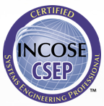
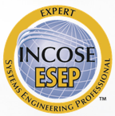
So Which Certification is Right for You?
If you have just started (or plan to start) practicing systems engineering or have recently graduated and are interested in systems engineering
If you are a practicing Systems Engineer with more than five years of systems engineering professional work experience
If you are a systems engineering leader with recognized systems accomplishments and have many years of systems engineering professional work experience

Slide 33
Looking Forward
INCOSE in 2015 and Beyond

Slide 34


INCOSE at 24

Slide 35
Pursuing INCOSE‘s
Five Year Objectives
Growth: INCOSE doubles its membership and embraces the healthcare, mobility, and energy business sectors
Alliances: INCOSE amplifies its ability to achieve its mission through diverse alliances
Education: INCOSE curricular recommendations are widely adopted around the world, raising the quality of engineering education
Products: INCOSE produces and brokers the most impactful systems engineering information in the world, grounded in effective practice and research
Forums: INCOSE produces and supports the most impactful forums in the world on systems engineering practice, policy, education and research
Competency: INCOSE teams with industry to raise systems engineering competency across their supply chains
Transformation: INCOSE accelerates the transformation of systems engineering to a model-based discipline

Slide 36

Advancing towards
Systems Engineering Vision 2025
Published June 2014
“Inspiring and guiding the direction of systems engineering across diverse stakeholder communities”
Freely available from the INCOSE website
  Hardcopies available for purchase

Slide 37

Leveraging and Shaping
INCOSE at 25
In webinars and online discussions
In a
working group
Via our products and publications
At an event
At the local chapter level
At the
international level
Notes:
The story of INCOSE at 25 continues to unfold.
It’s being written by a handful of dedicated professionals and countless passionate volunteers around the world.
And that’s what makes INCOSE so great and so powerful. From bottom to top, each one of us pays to be at the IW, pays to be here, and gives of our time to advance this profession and this organization.
Certainly our value proposition will continue to grow as we expand our products and services as well as well as continue our partnerships, initiatives, and events to touch the greater community.
Exciting times ahead
IT as a strategic enabler
Delivery of new products
Domain-specific instantiation and collaboration around the vision
Several other initiatives we can’t quite mention yet
Plus all of the wonderful work ongoing at the chapter level and across our technical community.
That being said, there is no singular value proposition for a member of INCOSE. As is the case with most professional bodies, you have the opportunity to craft your own based upon your circumstances and desires. Perhaps it’s simply leveraging the products and publications. Perhaps is continued professional development and pursuit of certification. Perhaps it’s active collaboration in a working group or service to advance the organization locally or internationally. There is a spectrum of opportunities open to each of us. I hope you avail yourself of those opportunities to create the right value proposition for you today and then refine it over time as your needs and desires evolve.
It’s a great time to be a systems engineer. It’s an exciting time to be part of INCOSE.

Slide 38
References
Websites and other sources
  INCOSE: www.incose.org
  INCOSE Connect: connect.incose.org
  iPub Publication Database: www.incose.org/ipub/
  SEBoK: www.bkcase.org/sebok/
Contact INCOSE through the website or at:
  info@incose.org

Slide 39

Questions?

