Slide 1

Ambassador Training 2018
Susann Faruque
1st Year Director
(Ambassador Coordinator)

Slide 2
Agenda
What is the INCOSE Ambassador Program?
Company Discussion Points
    What is INCOSE?
    Membership Benefits
    INCOSE Working Groups
    INCOSE Certifications
    INCOSE San Diego Chapter

Slide 3
INCOSE Ambassador Program
Why an Ambassador Program?
  Many companies benefit greatly from embracing Systems Thinking
    Reduce rework, positive impact to cost & schedule
    Most companies only need a little initiative
What is the INCOSE Ambassador Program?
  Company Systems Engineering conduit for two-way information flow
    Needs of company to Chapter
    Chapter capabilities and resources to company

Slide 4
INCOSE Ambassador Program
What are the ‘asks’ requested of an Ambassador?
  Serve as conduit to solicit feedback on how Chapter can support Systems Engineering education, training and knowledge needs of company
  Publicize Chapter events and opportunities to participate/volunteer
      Internal web sites
      Flyers
      Broadcast messages
      Brown bags/Lunch & Learns – Chapter resources will support
      Bulletin boards
      Etc.
  Solicit colleagues for chapter meeting presentations or tutorials
  Serve as conduit for CAB membership information, notify BoD of interest

Slide 5
INCOSE Ambassador Program
  Serve as POC for INCOSE support requests
    Facilities
    Chapter events
  Consider attending INCOSE San Diego Chapter BoD meetings
  Consider organizing company satellite chapter meetings by securing conference room to view webcast
  Network with other Ambassadors
    Quarterly Ambassador networking webinars
    Ad hoc events
    Engineering Symposium – post symposium meeting
  Support Ambassador Program Lead
    Management, administration and execution of program
  Work with INCOSE Membership chair on annual ambassador operational program

Slide 6
Material Content for a Promotional Meeting
INCOSE
  International Council on Systems Engineering
  Professional engineering organization centered on Systems Engineering
INCOSE Mission
  Share, promote and advance the best of systems engineering from across the globe for the benefit of humanity and the planet
INCOSE Vision
  To be the world’s authority on Systems Engineering

Slide 7
Systems Engineering Definition
Focuses on defining customer needs and required functionality early in the development cycle, documenting requirements, then proceeding with design synthesis and system validation while considering the complete problem:
  Cost & Schedule Performance Test
  Manufacturing Training & Support Operations
  Disposal
Integrates all the disciplines and specialty groups into a team effort forming a structured development process that proceeds from concept to production to operation. Systems Engineering considers both the business and the technical needs of all customers with the goal of providing a quality product that meets the user needs.

Slide 8

Benefits of INCOSE Membership
Network with 17000+ multi-national systems engineering professionals, individually, in a local chapter or in Working Groups
Quality presentations on SE topics of interest in chapter meetings, regional meetings, international workshops and international symposia
Receive quarterly publications
Receive Systems Engineering, the Journal of INCOSE
Leverage and advance through INCOSE working groups
Collaborate with experts and practitioners

Slide 9
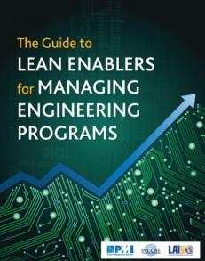

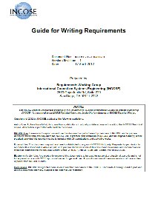
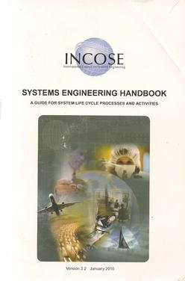

Benefits of INCOSE Membership
Download INCOSE products and resources free from INCOSE website
  SE Practitioner Body of Knowledge
  SE Handbook
  Tools Database
  Writing Good Requirements Guidebook
  Metrics Guidebook
  SE Leading Indicators Guide

Slide 10
Benefits of INCOSE Membership
Systems Engineering Journal
  Refereed scholarly journal of INCOSE
  Published quarterly by John Wiley & Sons
  Access the Journal online
  Current and past issues
  Full text in PDF
  Registration Key obtained by following instructions in the Members Area of the web

Slide 11
Tech Operations (Working Groups)
Affordability
Agile Systems
Architecture
Automotive
Health Care
Complex Systems
Critical Infrastructure
Decision Analysis
Defense Systems
Global Earth Observation SoS
Healthcare
Human Systems Integration
Infrastructure
Lean Systems Engineering
Life Cycle Management
Measurement
Natural Systems
MBSE Initiative
Model-based Conceptual Design
Object-Oriented SE Method
Oil & Gas
Power & Energy Systems
PM-SE Integration
Process Improvement
Requirements
Resilient Systems
Risk Management
Space Systems
Systems and Software Interface
Systems of Systems
Systems Safety Integration
Systems Security Engineering
Training
Transportation
For more information or the complete list, visit http://www.incose.org

Slide 12
INCOSE Annual Events
International Workshop
  January 26 – January 30, 2018 Orlando, Florida
  Annual report to membership on results and plans for coming year
  Working sessions for technical and administrative committees
  Opportunities for networking between active INCOSE volunteers
  http://www.incose.org/IW2019
International Symposium
  July 20 – July 25, 2018 Orlando, Florida
  Technical papers, panels, tutorials, exhibits, plus many opportunities to collaborate with experts and practitioners from diverse domains
  http://www.incose.org/symp2019
Notes:
Give a brief overview of the presentation. Describe the major focus of the presentation and why it is important.
Introduce each of the major topics.
To provide a road map for the audience, you can repeat this Overview slide throughout the presentation, highlighting the particular topic you will discuss next.

Slide 13
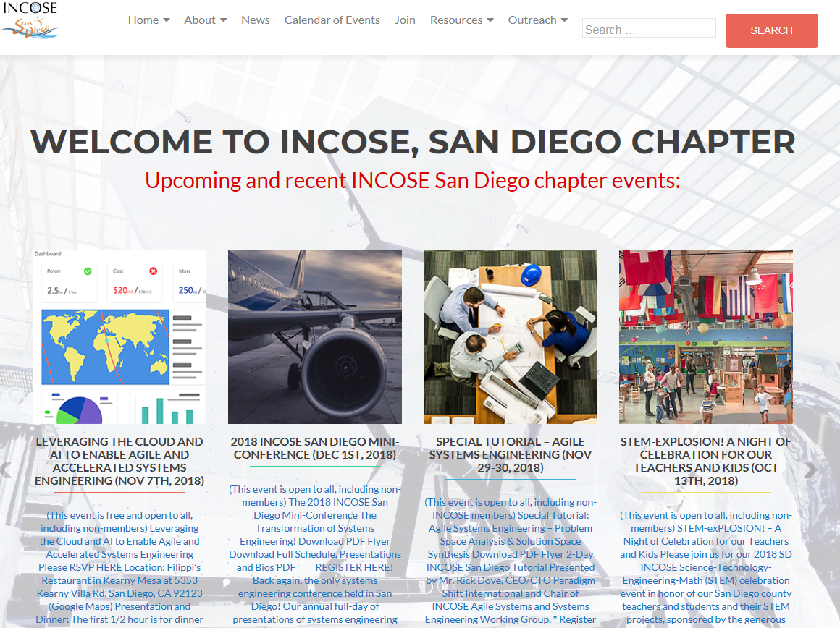
SD INCOSE Chapter Website
Event Announcements, Newsletters, & Download of Artifacts

Slide 14
Chapter Events & Meeting Topics
Past Meeting & Events Topics
Software Process Dynamics
A Better Brew – Benefits of Applying SE to the Beer Industry
Software Defined Systems – tutorial on SCA
Lightening Protection for Military Facilities
Border Wait Time Detection System
STEM-eXplosion Celebration for Teachers and Students
Leveraging the Cloud and AI to Enable Agile Accelerated Systems
2018 Agile SE Tutorial – Human Factors
2018 Min-Conference – MBSE, Cybersecurity, Science of Laws

Slide 15
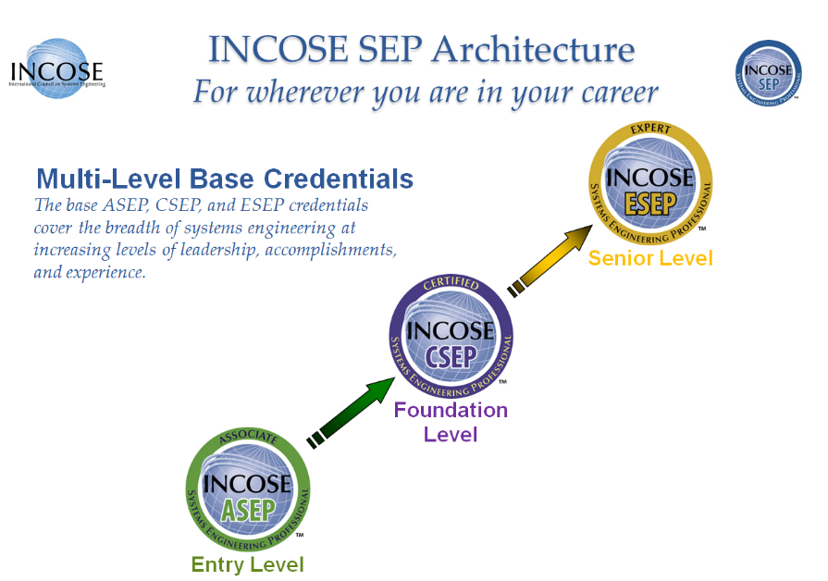
Chapter SEP Mentor Support
Notes:
Give a brief overview of the presentation. Describe the major focus of the presentation and why it is important.
Introduce each of the major topics.
To provide a road map for the audience, you can repeat this Overview slide throughout the presentation, highlighting the particular topic you will discuss next.

Slide 16
CAB Membership (Partial)
Aerospace Corporation
Airbus Group
AM General LLC
Analog Devices, Inc.
Analytic Services
Aviation Industry of China
BAE Systems
Bechtel
The Boeing Company
Bombardier Transportation
Booz Allen Hamilton Inc.
C.S. Draper Laboratory, Inc.
Carnegie Mellon University Software
Engineering Institute
Change Vision, Inc.
Colorado State University SE Programs
Cranfield University
Cubic
Cummins Inc.
Cybernet Systems Co, Ltd.
Defense Acquisition University
Deloitte
Drexel Univerity
Engility
Federal Aviation Administration
Ford Motor Company
Fundacao Ezute
General Dynamics
General Electric
General Motors
George Mason University
Georgia Institute of Technology
Honeywell International
IBM Corporation
Idaho National Laboratory
ISAE – Supaero
Isdefe
ISID Engineering, LTD
iTiD Consulting, Ltd.
Jet Propulsion Laboratory
John Deere
Johns Hopkins University
KBRwyle
KEIO University
L-3 Technologies
Leidos
Lockheed Martin Corporation
Los Alamos National Laboratories
ManTech International Corporation
Maplesoft
Massachusetts Institute of Technology
Medtronic, Inc.
Missouri University of Science & Tech
The MITRE Corporation
Mitsubishi Aircraft Corporation
NASA
National Security Agency
Nissan Motor Co, Ltd
Northrop Grumman Corporation
Pacific Northwest National Laboratory
Raytheon Corporation
Rockwell Collins, INC
Rolls-Royce
Saab AB
SAIC
Sandia National Laboratories
Shell
Siemens
Singapore University of Tech & Design
Stevens Institute of Technology
Swedish Defense Materiel Admin
Thales
TNO Technical Sciences
Tsinghua University
United Technologies Corporation
University of Maryland
University of New South Wales
University of Southern California
University of Texas at Dallas
University of Texas at El Paso
US DoD
Vencore
Virgina Tech
Vitech Corporation
Volvo Construction Equipment
Woodward Inc.
Worcester Polytechnic Institute - WPI

Slide 17
Chapter CAB Members Representation
CAB Companies
Cubic
SAIC
BAE Systems
Booz Allen Hamilton
Lockheed Martin
Northrop Grumman Corporation
Raytheon

Slide 18
SD INCOSE Chapter Leaders
http://www.sdincose.org
Susanna Faruque (2018 Ambassador Lead)
  1st Year Director
  Susanna.Faruque@gmail.com
Jim Gottfried (2019 Ambassador Lead)
  Director of Ambassador Programs
  Gottjim50@gmail.com
Howen Fernando
  VP of Chapter Development
  hqfernando@gmail.com
Notes:
Give a brief overview of the presentation. Describe the major focus of the presentation and why it is important.
Introduce each of the major topics.
To provide a road map for the audience, you can repeat this Overview slide throughout the presentation, highlighting the particular topic you will discuss next.

Slide 19
Call to Action
Feed company SE needs to Ambassador
Consider joining INCOSE as a member
    https://www.incose.org/incose-member-resources/join-incose
    Affiliate with San Diego Chapter
References
  INCOSE member benefits
    https://www.incose.org/from-the-cutting-edge
  INCOSE CAB benefits
      https://www.incose.org/incose-member-resources/corporate-advisory-board

