Slide 1
Strategic Planning Techniques -
The Why and How of Planning
INCOSE International Workshop 2016

Slide 2
Poll Experience
What Experience Have You Had
  SWOT
  Strategic Planning
  Product Planning
  Project Planning
  Department / Operational Planning
  Business/Marketing Planning
Yellow: Little/No Experience
Green: Some Experience
Blue: Very Experienced

Slide 3
Chose a Team Topic
A smaller chapter wants to increase attendance to 25% or even 50%.
An existing chapter has become mostly inactive and needs to revitalize.
Chapter wants to develop a dynamic relationship between the chapter and a local company or academic institution.
A group of chapters want to put on an area conference.
The startup of a new chapter.
A struggling chapter wants to join in partnership with a stronger chapter for help.

Slide 4
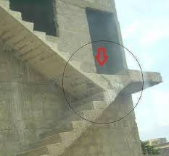
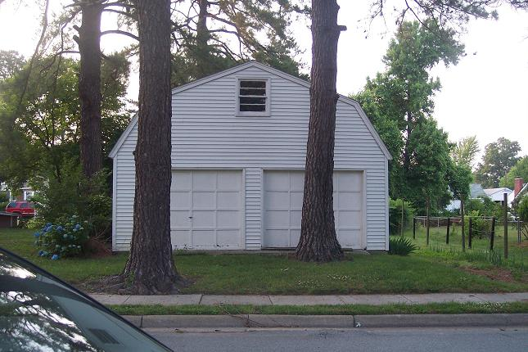
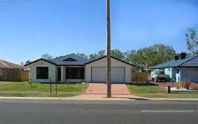

What Are Some Possible Reasons For these Planning Mistakes?
Notes:
Intelligence Challenged
Poor Planning
Poor Coordination
Lack of Communications
Vicious Compliance

Slide 5
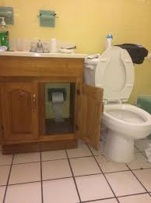
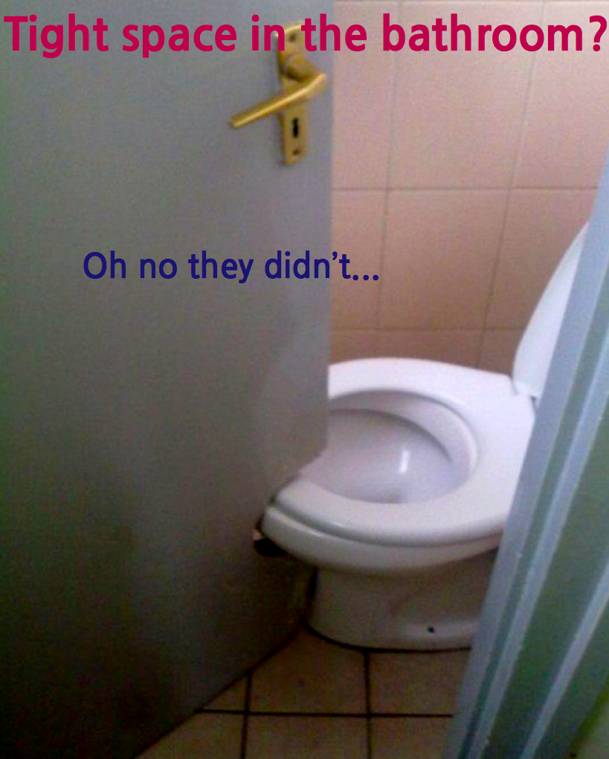
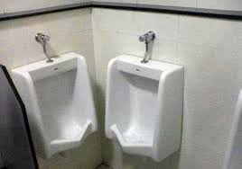
What Are Some Possible Reasons For these Planning Mistakes?
Notes:
Intelligence Challenged
Poor Planning
Poor Coordination
Lack of Communications
Vicious Compliance

Slide 6
Why Plan?
?

Slide 7
Why Plan?
Identifies and articulates your goals
Determines how to achieve your goals
Aligns stakeholders; help achieve consensus
Allows you to be proactive vs reactive
Planning is your path to create something new, change the state of anything, or successfully accomplish a project

Slide 8
What Are Some Elements Common to Plans
?
Notes:
Stakeholders
Resources
Vision/Mission/Concept/
Financial/Budget
Schedule
Goals/Objectives
Risks Assessment/Contingencies
Tasks/Responsibilities

Slide 9
What Are Some Elements Common to Plans
Problem Statement
Stakeholders
Resources
Vision/Mission/Concept/
Financial/Budget
Schedule
Goals/Objectives
Risks Assessment/Contingencies
Tasks/Responsibilities
Notes:
Stakeholders
Resources
Vision/Mission/Concept/
Financial/Budget
Schedule
Goals/Objectives
Risks Assessment/Contingencies
Tasks/Responsibilities

Slide 11
Basic Planning Steps
Steps Common in Planning
Define/identify Objectives – “What”
Action Steps to Accomplish Objectives - “How”
  Performance Requirements
  Contract or Charter
  Top Level Budget & Schedule
  Specific Tasks
    Tasks’ Budgets and Schedules
  Performance Metrics

Slide 12
Basic Planning Steps
Organizational Planning
Critical Need
Vision/Mission
Values
Goals (long term, typically > 3 years)
Strategy
Objectives (current year) leading to goals
Constraints – Budget, Schedule, Resources
Action Steps to Accomplish Objectives
Performance Metrics

Slide 13
Basic Planning Steps
Project Planning
Mission/Objectives/Top Level Requirements in Contract or Charter – someone else did the upfront work
Action Steps to Accomplish Objectives
  Refine Requirements
  Top Level Budget & Schedule
  Specific Tasks
    Tasks’ Budgets and Schedules
  Performance Metrics

Slide 14
Consider the Strategic Planning That Came First

Slide 15
What is a Strategic Plan
The process of determining long-term goals and then identifying the best approach for achieving those goals
Provides clear direction through incremental steps to achieve the long range goals
Developed by a leadership team
Requires team discussion and interaction
Reflects input from those it is to guide
Notes:
The vision is that future perfect state we envision that the North Texas Chapter of INCOSE should embody.
Our mission is that motivating force that causes us to be involved INCOSE.

Slide 16
Process Overview
SWOT/
Survey
Critical
Need
Leadership
Commitment
Values
Mission
Vision
Strategies
2015 Goals/
Objectives
2015 Metrics
2015 Initiatives
Update SWOT/ Mission/ Vision
Long Range Goals
Update Strategies
2016 Objectives
2016 Initiatives
2016 Metrics

Slide 17
INCOSE Values
Also Part of a Planning Process
Systems Thinking
.
Pioneering and Innovation
Learning and Development
Respect, Diversity, Collaboration
.
Individuals
Volunteerism

Slide 18
INCOSE Principles
Also Part of a Planning Process
Our values represent who we are. Our mission and vision represent what we are trying to achieve. Our principles represent how we pursue our mission / vision within the bounds of our values.
Impact INCOSE assesses its impact based on the delivery of value to members and other stakeholders
Partnership INCOSE builds and disseminates products and services jointly with others to maximize our impact
.
Holism INCOSE emphasizes the whole over the individual parts in our creation of an integrated global technical network.
Differentiation INCOSE recognizes the unique value of those who choose to affiliate with us, prioritizing direct affiliation and active participation over indirect or passive connection.
Volunteers INCOSE is led by volunteers who set our fundamental direction.

Slide 19
INCOSE Mission and Vision -
Developed as Part of a Planning Process
Mission
Share, promote and advance the best of systems engineering from across the globe for the benefit of humanity and the planet.
Vision
The world's authority on Systems Engineering. Also 2025 Vision
Goals
To provide a focal point for dissemination of systems engineering knowledge.
To promote international collaboration in systems engineering practice, education, and research.
To assure the establishment of competitive, scalable professional standards in the practice of systems engineering.
To improve the professional status of all persons engaged in the practice of systems engineering.
To encourage governmental and industrial support for research and educational programs that will improve the systems engineering process and its practice.

Slide 20
Process Steps
SWOT (Strengths, Weaknesses, Opportunities, Threats) provide an assessment of present and future. Survey of members
Critical Need must be established and used to motivate at the outset and when times get tough
Leadership Commitment is absolutely critical
Values provide a foundation for behavior and relationships
Mission describes primary motivation for what the plan is to accomplish

Slide 21
Process Steps (2)
Vision is a view of the ultimate state shared by all
Strategies are the general approaches/methods to achieve the vision
Goals are the long range accomplishments that will move toward the Vision
Objectives are shorter term (<1 year) steps to the Goals
Initiatives are specific action plans to achieve the Objectives
Metrics provide feedback on how things are going

Slide 22
Process Steps (3)
The Strategic Plan is updated periodically, typically annually
Values, Vision and Mission rarely change once finalized (which may take a year of tweaking)
Strategies and Goals are long term
Objectives are typically for a year or less
Initiatives should be targeted to 3 months are less
Metrics should be predictive if possible, and few in number

Slide 23
Methods
Allow 8-12 hours total for the planning steps
A good method to ensure full participation and all sides being heard is to have participants write their ideas on sticky notes – legibly and in complete sentences
Have the group affinitize like items and write a summary sticky for each grouping, reducing the number of items by a factor of 6 to 10.
Use some type of “big picture” view to facilitate easy understanding
Communicate the plan and status frequently with all stakeholders

Slide 24
Organization of Strategic Plan
3 – 5 Years
Strategies
Driving Issues
Values
This Year!

Slide 25
Organization of Strategic Plan
3 – 5 Years
Strategies
Driving Issues
Values
The vision is that future perfect state we envision that this Chapter/Working Group of INCOSE should embody.
This Year!

Slide 26
Organization of Strategic Plan
3 – 5 Years
Strategies
Driving Issues
Values
Our mission is that motivating force that causes us to be involved in INCOSE.
This Year!
Notes:
The vision is that future perfect state we envision that the North Texas Chapter of INCOSE should embody.
Our mission is that motivating force that causes us to be involved INCOSE.

Slide 27
Organization of Strategic Plan
3 – 5 Years
Strategies
Driving Issues
Values
What are those issues that is true would sink this ship
This Year!

Slide 28
Example Driving Issue
The perception held by other systems engineers and business is that INCOSE is not critical to establishing and maintaining a competitive edge.
If there is an element of truth to this issue
statement, then we have a major perception
problem to solve!

Slide 29
Organization of Strategic Plan
3 – 5 Years
Strategies
Driving Issues
Values
Regardless of the path we take to achieve our mission the road we take must be guided by our values
This Year!

Slide 30
Example Values
Commitment to excellence
Commitment to acting with integrity
Commitment to serving members

Slide 31
Organization of Strategic Plan
3 – 5 Years
Strategies
Driving Issues
Values
Our strategies guided by our values is what sets our course for the foreseeable future
This Year!

Slide 32
Example Strategies
Improve and personalize communications
  Members
  Potential Members
  Companies, both CAB and other that would benefit from improved systems engineering
Leverage core systems engineering expertise of members and INCOSE resources
Partner with schools at all levels for system engineering education
Establish a corporate outreach program

Slide 33
Organization of Strategic Plan
These goals are those accomplishments we want to accomplish within 3 to 5 years
3 – 5 Years
Strategies
Driving Issues
Values
This Year!

Slide 34
Example Goals
Prepare systems engineers for certification. Establish a continuing education credit program (required for re-certification)
Host conferences to promote and consolidate systems engineering in the area and gain recognition for the chapter and its members.
Increase member involvement
  Increase participation in sponsored activities by 15% per year
  Double membership by 2020
Continue to perform at Gold Level or above

Slide 35
Organization of Strategic Plan
3 – 5 Years
Strategies
Driving Issues
Values
The objectives are those accomplishments we want to achieve this year as we head down the road towards the accomplishment of our goals
This Year!

Slide 36
Organization of Strategic Plan
The initiatives are those actions chosen to take in order to accomplish this year’s objectives
3 – 5 Years
Strategies
Driving Issues
Values
This Year!

Slide 37
