Slide 1
Future-Proofing Your Systems Engineering Skills
Rick Hefner, PhD (Moderator), Caltech
Andrew Murrell, Northrop Grumman
Mark McKelvin, The Aerospace Corporation
Ken Preston, DBA, Boeing
Tutorial on March 12 (registration at INCOSE-LA website)

Slide 2
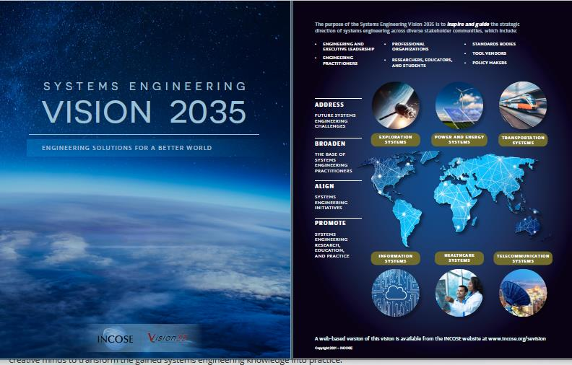
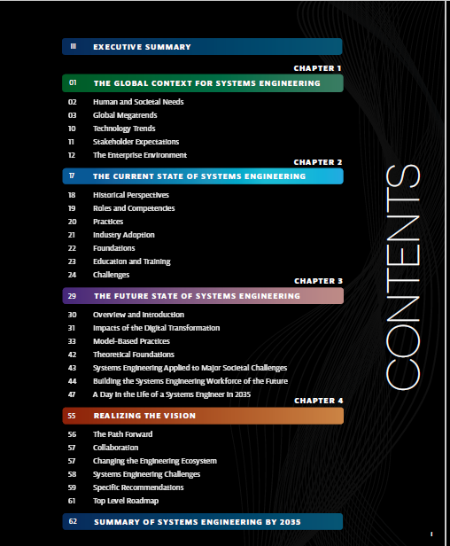
Systems engineers must actively pursue knowledge and skills to remain relevant
The INCOSE SE Vision 2035 (available on the INCOSE website) provides guidelines

Slide 3
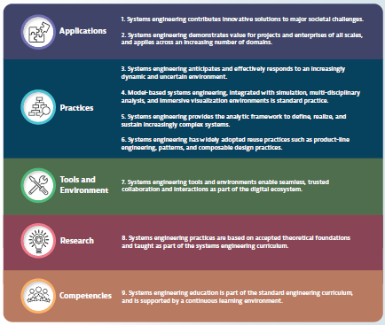
The Global Context for Systems Engineering
Changing global environment
Changing nature of systems and technology
Demands of enterprises
Evolving practice of systems engineering

Slide 4
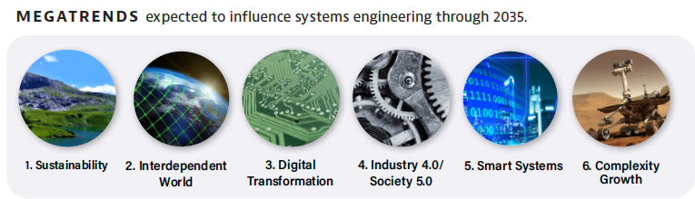
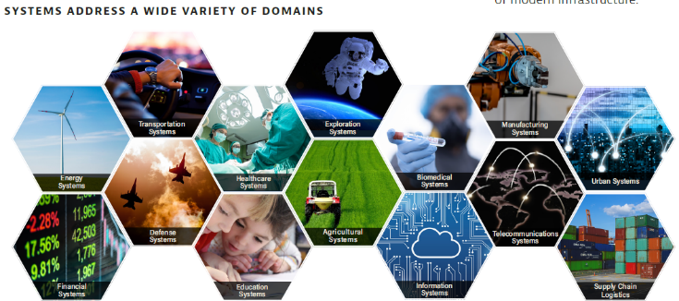
The Global Context for System Engineering

Slide 5
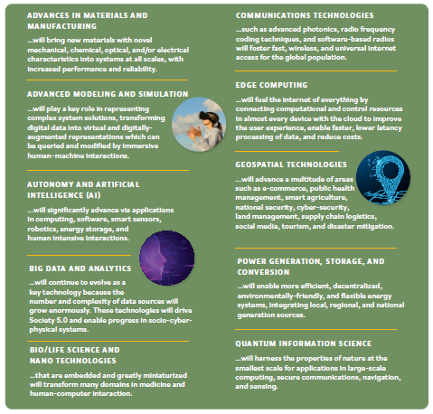
Influencing Factors for System

Slide 6
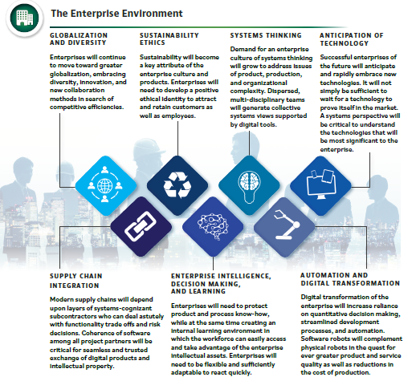
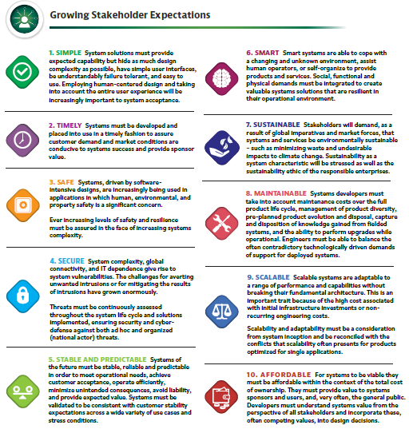
The Enterprise Environment and Growing Stakeholder Expectations

Slide 7
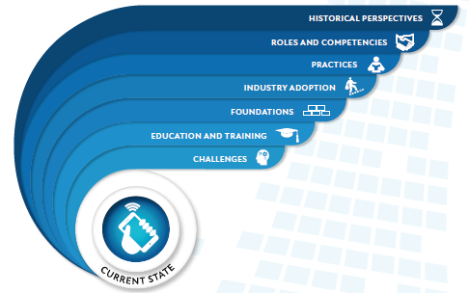

The Current State of Systems Engineering

Slide 8
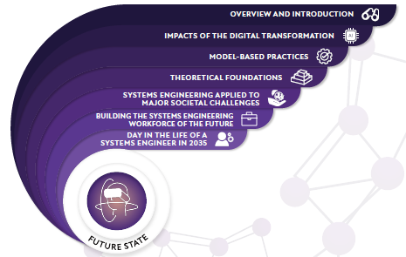
The Future State of Systems Engineering
Impacts of the digital transformation, model-based practices
Impacts of AI on SE
Architecting flexible, resilient, trusted systems
Using data science methods to understand complex systems behavior
Shifts in acquisition towards collaborative processes

Slide 9
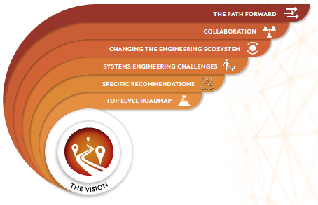
Realizing the Vision of Systems Engineering

Slide 10

Andrew Murrell, CSEP
AE Graduate of Embry Riddle Aeronautical University
Principal Systems Engineer, Northrop Grumman
2021/2022 INCOSE-LA Director: Secretary
UCI Certified Program Manager (among others)
Over a decade of experience in optical, electro-mechanical actuation systems, and research and development
Work experience with Rockwell Collins, Eaton Aerospace, and Northrop Grumman
Numerous patents
2017 and 2021 INCOSE-LA Presidents award recipient, 2019 INCOSE-LA service award recipient, 2021 NG Simon Ramo Systems Engineering Excellence award nominee

Slide 11
Northrop Grumman Systems Engineering
“Prime” defense contractors has a diverse series Business Units and Programs
Many programs as a “Prime” involve complex systems and complex subcontracting to other companies
Often times a “Prime” is a subcontractor for other “Primes”
Without vertical integration of systems, contractual system requirements and interfaces become the driving mechanism for successful system development before integration at the “Primes”

Slide 12
Systems Engineering Skills
Less than 5 years from contract win to first deployment
Good SE Practices (SEH 5, SEBok, NASA SE Handbook) and communication between internal team, vendors, and stakeholders is essential
MBSE and Digital Twin accelerates program delivery (especially with reuse)
General understanding and competency in all main engineering areas (Systems, Mechanical, Software, and Electrical) is essential for effective requirement capture
Common high level analysis and modeling programs such as Matlab and Python to solve and automate complex problems

Slide 13
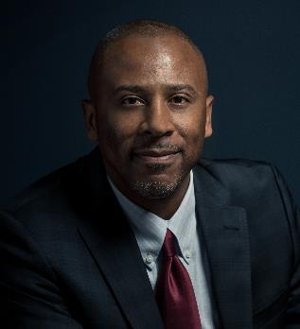
Mark McKelvin
Mark McKelvin is a Senior Project Leader for System of Systems Engineering in the Space Systems Architect Division of SSG. In his role, he leads teams from multiple organizations and Government on the practical application of digital engineering techniques, providing strategic thought leadership, and mentoring across Aerospace.
Mark is an adjunct faculty member in the System Architecting and Engineering program at the University of Southern California, past INCOSE LA Chapter President, and currently the Programs Director of INCOSE LA. Prior to joining the Aerospace, he served as software systems engineer and fault protection engineer at the Jet Propulsion Lab, and he has experience at General Motors Research, Army Research Lab, Intel Corporation, Sandia National Labs, and HRL.
Mark has a B.S. in Electrical Engineering from Clark Atlanta University, and M.S. and Ph.D. degrees in Electrical Engineering and Computer Sciences from the University of California, Berkeley.

Slide 14
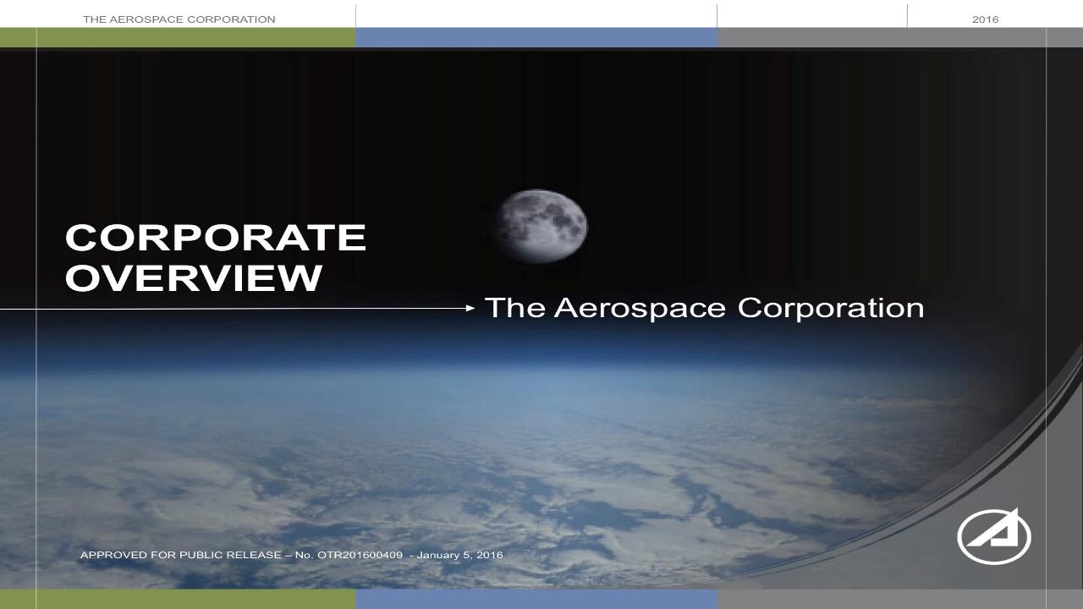

Slide 15
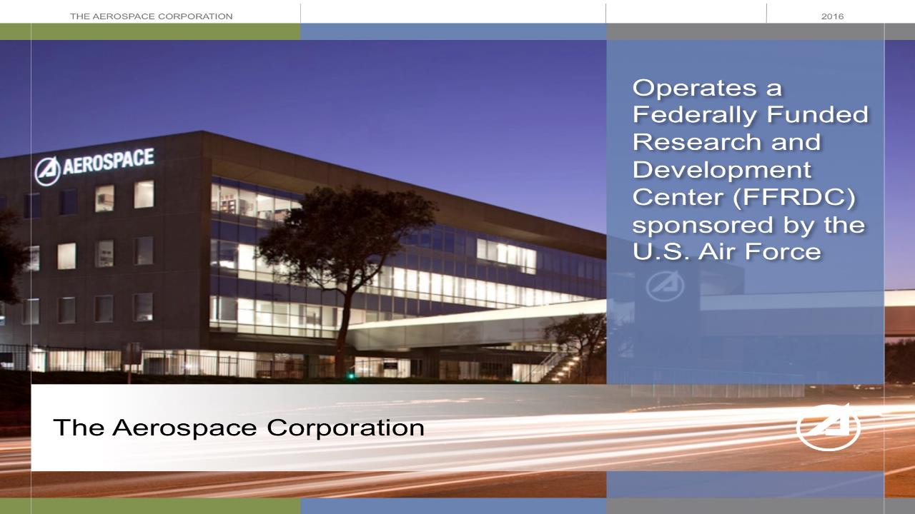

Slide 16
Observations
Key Challenge: Integration across the space enterprise (including people, processes, and technology)
Trends
  Increasing emphasis on system of systems integration
  Increasing use of technology to improve the quality and speed of business and engineering processes
  Increasing use of models and software across the system lifecycle
Preferred Skills
  Software engineering and use of formal methodologies
  Systems thinking
  Creativity and agility (ability to be goal-focused, iterative)

Slide 17
Key Questions
Which global needs and megatrends do you see shaping the future skills needed by systems engineers?
In your industry, how are stakeholder needs for future systems changing?
How do you see the application of systems engineering changing in the future?
In your industry, what skills are in most demand for today’s market? What skills are critical for the future?
What advice would you give a mid-career engineer who is trying to enter your industry?

Slide 18
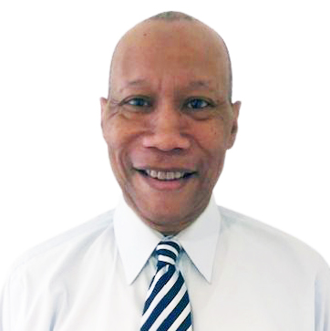
Ken Preston, DBA
Dr. Kenneth L. Preston has 35 years of aerospace and defense industry experience. He is a Sr. Project Engineer, Technical Lead Engineer (TLE), and Boeing Designated Expert (BDE) on the Boeing C-17 Program. He leads the technical oversight of parts management obsolescence and project support, and is a member of the site Innovative team charged with discovering and generating new, creative value in technical products.
He has published and presented papers through the International Council on Systems Engineering (INCOSE), including “Big Data Analytics/Role of Analytics in Systems Engineering,” “Customer Analytics for Service Excellence in Systems Engineering,” and “Systems Thinking as a Competitive Advantage for Suppliers.”
Dr. Preston received his Doctor of Business Administration (DBA) and MBA in Project Management from Columbia Southern University. He holds an MS and BA in Physics (Laser Spectroscopy) from Hampton University/Institute and a California Community College Lifetime Teaching Credential in Physics.

