Slide 1
INCOSE IS 2017
INCOSE PRACTITIONER'S CHALLENGE

Slide 2
Situation Overview
Plastics have long been hailed as a light, safe alternative to glass containers
Plastics take an average 450 years to decompose
In the US alone, over 35 billion plastic water bottles are thrown away each year
Worldwide, over 500 billion plastic bags are used annually.
Plastics from all over the world find their way into streams and rivers, and eventually make their way to the sea.
Synthetic fabrics degrade into small plastic fibers that can make their way to the ocean
About 19 Billion tons of plastic waste end up in the oceans each year – and the amount of global trash is expected to increase every year for the next century!

Slide 3
Initial containment actions
Collect
Reduce island size and filter plastic out.
Dispose
What do we do with the filtered plastic
Prevent
Prevent more plastic from getting into the ocean.

Slide 4
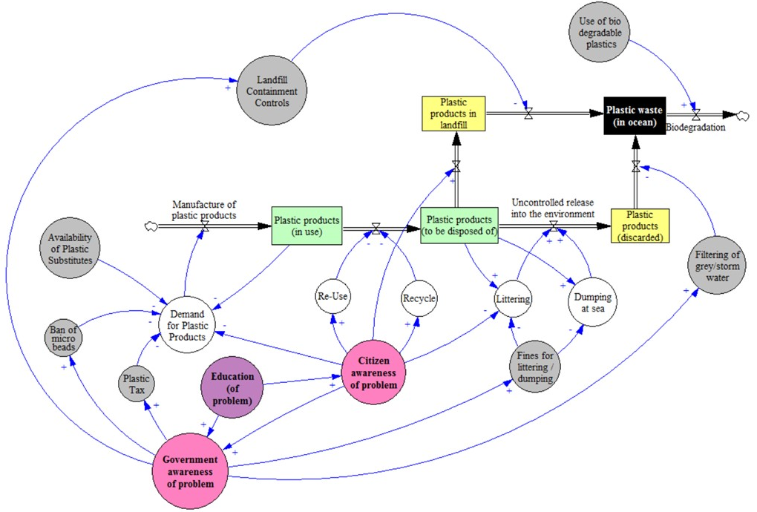
Plastic Context

Slide 5
Stakeholders
People
Individuals
Government
Boat/Ship
Defense
Pleasure
Cargo
Marine Biodiversity
Fish/Animals
Politicians
NGOs
Fishers
Water Quality

Slide 6
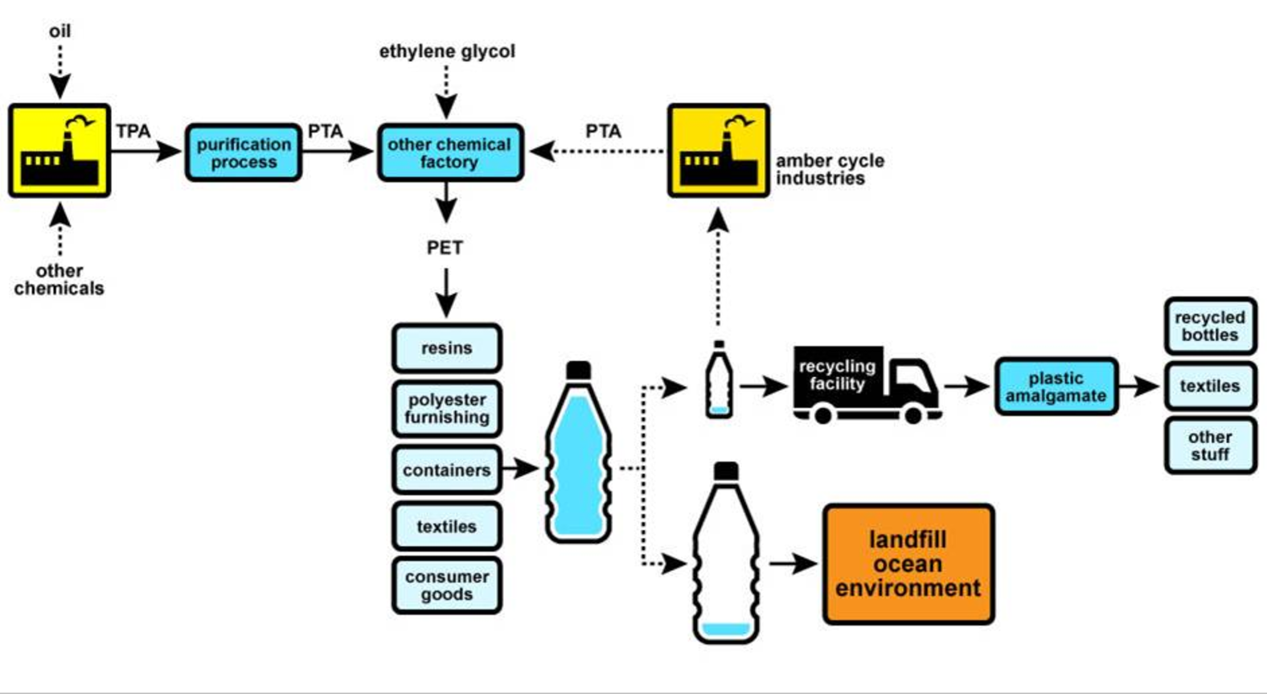
Plastic Lifecycle
Change to BIO-DEGRADABLE
ELIMINATE THE NEED FOR PLASTIC USE
Incentivize / Innovate for Substitutes that are BIO-DEGRADABE
DISPOSE

Slide 7
Inadequate substitutes
Economic
Indirect disposal
Material not biodegradable
Substitutes are expensive
Cheap to manufacture
Micro-plastic from domestic products in dark water
Material used to create plastic is cheap and readily available
Water run-off from landfill
Cheap to dispose than recycle / reuse
Substitutes are labour intensive
Plastic in ocean
Politics support not available to make a change
Disposal of fishing nets
Not all plastic can be reused
Technology not available to reuse all plastics
Regulatory framework not available to incentivise good behaviour over bad behaviour.
Barrage dumping
Legal commercial and private shipping waste dumping in ocean
Collection for reuse not provided
Inability to Reuse
Politics & Regulation
Direct disposal
Fishbone Analysis for Plastic in Ocean

Slide 8
Discussion – Pollution Causes / Levers
Inappropriate disposal
  Fines for bad disposal
  Rewards good disposal
Lack of bio-degradability alternatives
  Incentivise innovation for substitute bio-degradable alternatives
  Reduce / minimize use of non-bio-degradable plastics through appropriate social, political, legislative levers
  Communicate / Mark Plastics for their environmental friendliness (degradability)
Inability to re-cycle / re-purpose
  Reduce / minimize use of non-bio-degradable plastics through appropriate social, political, legislative levers
  Incentivise innovation to re-cycle / re-purpose (non-bio degradable) waste plastic
Humans Need for Plastics
  Eliminate the need for use of Plastics where possible
  Incentivise innovation for substitute bio-degradable alternatives
  Reduce / minimize use of non-bio-degradable plastics through appropriate social, political, legislative levers
  Incentivize innovation in the
Inappropriate containment of disposed / waste plastics

Slide 9
Sorting and Dispose Proposals
Manufacturing
3D Printers
Toys
Energy
Incineration
Package to Dispose
Bury
Compost
Benches
Shoes
Jewelry
Recycling
Launch to Sun
Biological
Other
Research and development

Slide 10
Challenges - Collection
Time to Degrade
Large to molecule
Molecule to gone
Ocean Flow
Volume
% of large:small
Environmental Impact
Sources
Types
Commitment to change
Global
Countries
Navigation hazard
Solid
Fluid
Time to Dump
Trend of size/output

Slide 11
Challenges - Disposal
Research and Analysis
Logistics Issues
Social Issues
Technological Issues
Political Issues
Organizational Issues
Scale
Storage
Location
Complexity
Risk
Obsolescence
Information Issues
Misinformation
Inaccuracies
External Issues
Sorting Issues
PVC
HDPE
PET

