Slide 1
Speaker Meeting
September 10, 2019
International Council on Systems Engineering (INCOSE) Los Angeles Chapter
1
Notes:
1
10/4/2019
1

Slide 2
Agenda
Time | Topic
5:30 pm | Networking
6:00 pm | Announcements
6:20 pm | Reflections on Chapter
6:30 pm | “OpenMBEE: An open-source model-based engineering environment” Sean Marquez, Space Cooperative Inc.
7:30 pm | Adjourn
Welcome!

Slide 3
Virtual Networking
Briefly introduce yourself (e.g., name, title, company)
Host site (The Aerospace Corporation, El Segundo)
INCOSE Los Angeles remote sites
Other INCOSE chapters
Other virtual attendees
Announcement of job openings
Open to anyone!

Slide 4
Meeting Site Coordinators
Remote Site | Coordinator | Contact
Aerospace Corp. (El Segundo) | Deborah Cannon | deborah.a.cannon@aero.org
Antelope Valley (Palmdale) | Dr. J. S. Shelley | J.Shelley@csulb.edu
California State University, Dominguez Hills | Dr. Antonia Boadi | aboadi@csudh.edu
Ricardo Defense (Goleta) | Paul Stowell | paul.stowell@control-pt.com
Northrop Grumman Corp. (Redondo Beach – Employees Only) | Deanna Regalbuto | deanna.regalbuto@ngc.com
Parker CSD (Irvine – Employees Only) | Luke Blair | Luke.blair@parker.com
Virtual Attendees | Deborah Cannon | deborah.a.cannon@aero.org
Thanks to all for registering in advance!
Please contact the Programs Director, Nazanin Sharifi (programs@incose-la.org) if you would like to host a remote site.

Slide 5
Welcome New Members!
Name | Organization
Jacob Harbuck
Anthony Williams | Lockheed Martin Aeronautics
Xueqing Hu
Fredy Benitez
Ryan Yanagi | California State Polytechnic University, Pomona
Kendall Young | Alion Science and Technology
Robin Rose | Base2 Solutions
Yong Cheng | Shanghai Jiao Tong University
Dan Bergstrom | Alion Sciences and Technology
Yong Wu | Northrop Grumman Corporation
Total Active Members (not including Associates, as of 9/6/2019):
403

Slide 6
What’s New at INCOSE-LA?

Slide 7
Announcements –
Upcoming Chapter Events
Chapter Events
Tutorial on Advanced Model-based Systems Engineering: October 5, Long Beach
Speaker meeting: “Systems Engineering: An Enabler for Artificial Intelligence,” Dr. Rick Hefner, October 8
Chapter elections are coming soon!
Please let us know if you are interested in volunteering
No Board of Directors meeting this Friday due to WSRC!
For a list of chapter events, go to: www.incose-la.org and look out for an email notice!

Slide 8
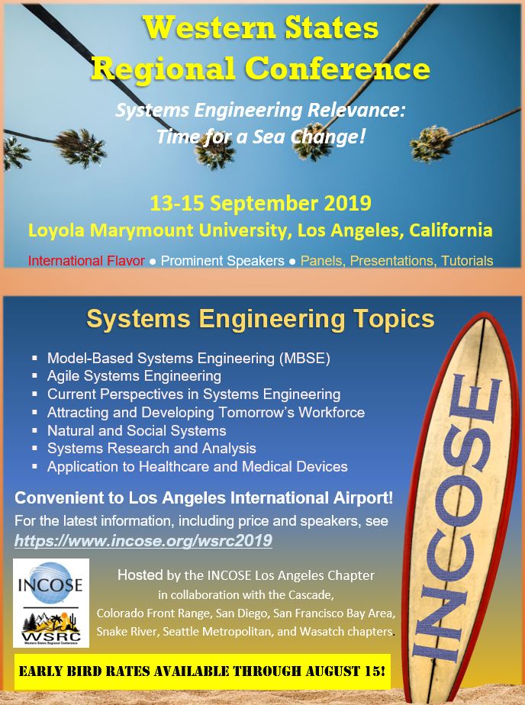
Announcements –
Chapter Conferences
Sept 13-15, Western States Regional Conference @ LMU
More information: https://www.incose.org/wsrc2019

Slide 9
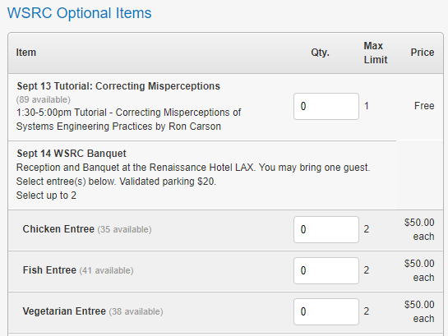
Announcements –
Chapter Conferences
The WSRC banquet is open to anyone that wants to attend without registering for the conference!

Slide 10
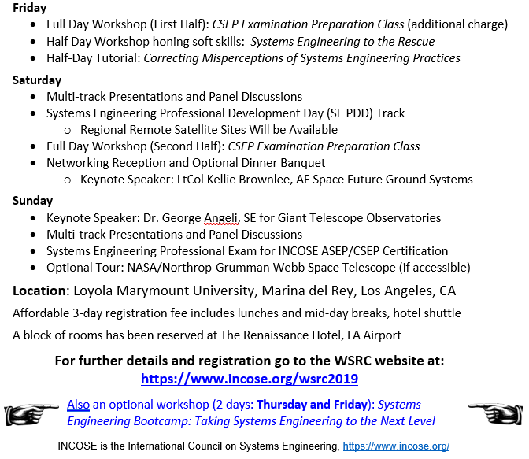
Announcements –
Chapter Conferences

Slide 11
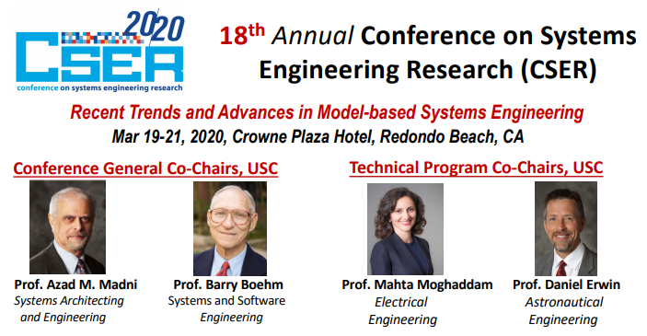
Announcements –
Chapter Conferences
March 19-21, Conference on Systems Engineering (CSER) 2020 @ Redondo Beach Crowne Plaza
Website: cser2020.org
September 15, 2019: Full papers due!
December 15, 2019: Notification to authors
Contact: Eric Belle (eric.belle@incose.org) for volunteer opportunities

Slide 12
Announcements – Around LA
8th Annual Mars Rover and Professional Society Expo, September 21
Arrive early, registration starts at 10 am!

Slide 13
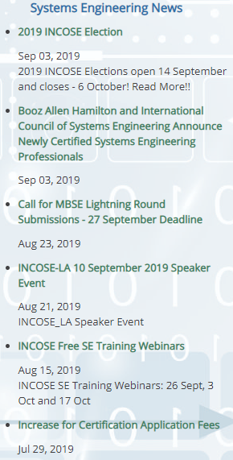
Other Announcements?
See what is happening around INCOSE: www.incose.org/
Note: the dates here are not the actual dates of the events, they are dates the event was created.

Slide 14
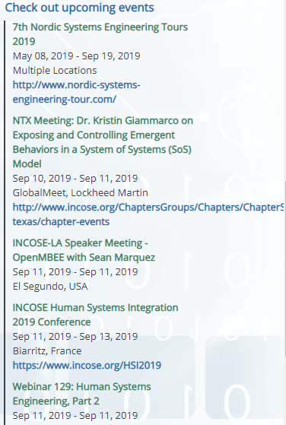
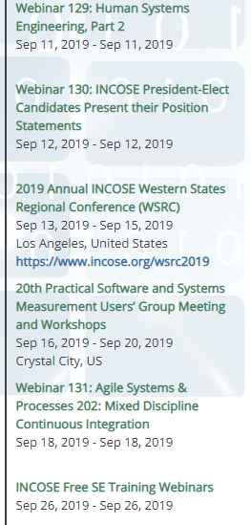
Other Announcements?

Slide 15
Volunteer Opportunities
Treasurer
Manages finances, reimbursements
Represents Chapter on financial matters
Remote site coordinator
Coordinates communication with remote sites for speaker meetings
Networking coordinator
Plan networking events
Propose new methods to improve Chapter networking
Membership records management support
Support the Membership Director in collecting attendance records and membership matters
Conference committee members (CESR)
Management
Technical

Slide 16
Reflections
What is the INCOSE LA Chapter doing well?
What can be improved?
Notes:
Dr. Antonia Boadi is a member of the Physics Department at CSU Dominguez Hills (CSUDH) where she serves as Director of the Intelligence Community Center of Academic Excellence. She completed a Ph.D. in Electrical Engineering at the University of Southern California. Since 2001, she has served as Principle Investigator on an uninterrupted stream of external grant funding from Verizon, U.S. Department of Education, Office of the Director of National Intelligence, U.S. Department of Homeland Security and the Nuclear Regulatory Commission.
Dr. Boadi developed the curriculum for CSUDH’s graduate Systems Engineering program which, pending final authorization, will welcome its first cohort during the 2020-2021 academic year. She founded PROWESS, the PaRtnership of Women Excelling as Scientists and Scholars, a puberty-to-Ph.D. pipeline with funding from the Verizon Foundation.
Dr. Boadi was awarded a Career Development Grant by the Department of Homeland Security to pursue a second doctoral degree in Public Policy with an emphasis in Counter-Terrorism. She is a member of INCOSE’s Anti-Terrorism Working Group.
Abstract
The American homeland security enterprise was established eleven days after the September 11, 2011 terrorist attacks. The Department of Homeland Security (DHS) unified organizations from 22 federal agencies. In addition to responding to unprecedented technological challenges, DHS leadership has forged linkages between federal, state and regional entities, some of which had previously been prohibited from collaborating, or even sharing information.
Collaborative governance is the ascendant paradigm in Public Administration and Public Policy. It aims to empower stakeholders with competing interests to arrive at a consensus and make recommendations regarding a policy or program. Dr. Boadi posits that collaborative governance processes can be enhanced through the application of Systems/Systems-of-Systems Engineering principles and methodologies.
This presentation discusses the generic application of SE and SoS principles and methodologies to notional nuclear/radiological counter-terrorism scenarios and activities.

Slide 17
Reflections
What is going well?
Diverse speaker meetings and trainings
What can be improved?
Plan some networking events (~3-4 per year)
Enlist more volunteers
Other notable comments:
Better to hear speaker in room
Notes:
Dr. Antonia Boadi is a member of the Physics Department at CSU Dominguez Hills (CSUDH) where she serves as Director of the Intelligence Community Center of Academic Excellence. She completed a Ph.D. in Electrical Engineering at the University of Southern California. Since 2001, she has served as Principle Investigator on an uninterrupted stream of external grant funding from Verizon, U.S. Department of Education, Office of the Director of National Intelligence, U.S. Department of Homeland Security and the Nuclear Regulatory Commission.
Dr. Boadi developed the curriculum for CSUDH’s graduate Systems Engineering program which, pending final authorization, will welcome its first cohort during the 2020-2021 academic year. She founded PROWESS, the PaRtnership of Women Excelling as Scientists and Scholars, a puberty-to-Ph.D. pipeline with funding from the Verizon Foundation.
Dr. Boadi was awarded a Career Development Grant by the Department of Homeland Security to pursue a second doctoral degree in Public Policy with an emphasis in Counter-Terrorism. She is a member of INCOSE’s Anti-Terrorism Working Group.
Abstract
The American homeland security enterprise was established eleven days after the September 11, 2011 terrorist attacks. The Department of Homeland Security (DHS) unified organizations from 22 federal agencies. In addition to responding to unprecedented technological challenges, DHS leadership has forged linkages between federal, state and regional entities, some of which had previously been prohibited from collaborating, or even sharing information.
Collaborative governance is the ascendant paradigm in Public Administration and Public Policy. It aims to empower stakeholders with competing interests to arrive at a consensus and make recommendations regarding a policy or program. Dr. Boadi posits that collaborative governance processes can be enhanced through the application of Systems/Systems-of-Systems Engineering principles and methodologies.
This presentation discusses the generic application of SE and SoS principles and methodologies to notional nuclear/radiological counter-terrorism scenarios and activities.

Slide 18
Reflections
How did you hear about speaker meeting (August)?
Email | Newsletter | Website | Friend
3 | 1
Recommendations for future speaker meeting topics.
MBSE/Systems Engineering
Systems of Systems Engineering
Were you able to network effectively?
Yes | No | Maybe
2 | 1 | 1
Notes:
Dr. Antonia Boadi is a member of the Physics Department at CSU Dominguez Hills (CSUDH) where she serves as Director of the Intelligence Community Center of Academic Excellence. She completed a Ph.D. in Electrical Engineering at the University of Southern California. Since 2001, she has served as Principle Investigator on an uninterrupted stream of external grant funding from Verizon, U.S. Department of Education, Office of the Director of National Intelligence, U.S. Department of Homeland Security and the Nuclear Regulatory Commission.
Dr. Boadi developed the curriculum for CSUDH’s graduate Systems Engineering program which, pending final authorization, will welcome its first cohort during the 2020-2021 academic year. She founded PROWESS, the PaRtnership of Women Excelling as Scientists and Scholars, a puberty-to-Ph.D. pipeline with funding from the Verizon Foundation.
Dr. Boadi was awarded a Career Development Grant by the Department of Homeland Security to pursue a second doctoral degree in Public Policy with an emphasis in Counter-Terrorism. She is a member of INCOSE’s Anti-Terrorism Working Group.
Abstract
The American homeland security enterprise was established eleven days after the September 11, 2011 terrorist attacks. The Department of Homeland Security (DHS) unified organizations from 22 federal agencies. In addition to responding to unprecedented technological challenges, DHS leadership has forged linkages between federal, state and regional entities, some of which had previously been prohibited from collaborating, or even sharing information.
Collaborative governance is the ascendant paradigm in Public Administration and Public Policy. It aims to empower stakeholders with competing interests to arrive at a consensus and make recommendations regarding a policy or program. Dr. Boadi posits that collaborative governance processes can be enhanced through the application of Systems/Systems-of-Systems Engineering principles and methodologies.
This presentation discusses the generic application of SE and SoS principles and methodologies to notional nuclear/radiological counter-terrorism scenarios and activities.

Slide 19
Speaker Introduction
Sean Marquez
Space Cooperative Inc.

