Slide 1
Requirements Working Group
Summary of INCOSE-IW 2021 for INCOSE-LA
Rick Hefner, Ph.D.
rhefner@caltech.edu, 626.395.4043
Notes:
This presentation highlights current trends in systems engineering, including the expanding global context, societal needs, technology trends, and expanding applications and approaches.

Slide 2
RWG Charter
1
Purpose
The purpose of the Requirements Working Group (RWG) is to advance the practices, education and theory of needs and requirements development and management and the relationship of needs and requirements to other systems engineering functions.
2
Goal
Expand and promote the body of knowledge of needs and requirements and its benefits within the systems engineering community
3
Scope
Activities relating to best practices for needs and requirements development and management throughout the product lifecycle including:
Elicitation Analysis Allocation Traceability
Elaboration Management Change Management
Expression Verification Validation
All IW2021 presentations and associated materials are available on the RWG Connect web site: https://connect.incose.org/WorkingGroups/Requirements/Pages/Home.aspx
Click on the “RWG sessions at IW2021” link on the left, then select “documents”
The RWG is comprised of members from industry and academia with a common purpose of improving the practice of systems engineering through improvement of Needs and Requirements development and management

Slide 3
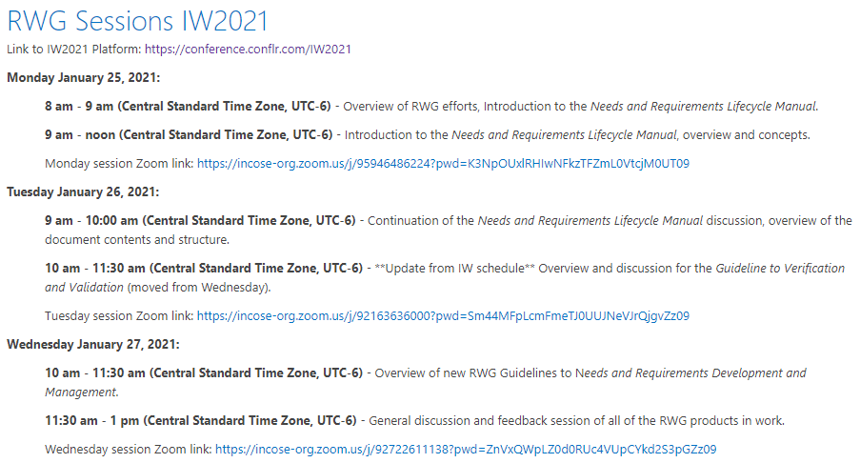
Planned Sessions for IW2021
Recordings on the RWG Connect site at incose.org

Slide 4
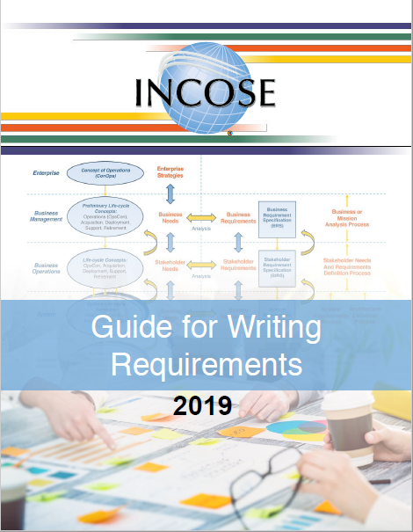
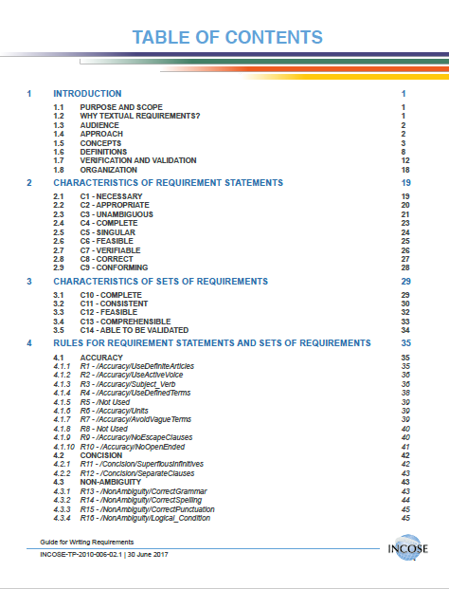
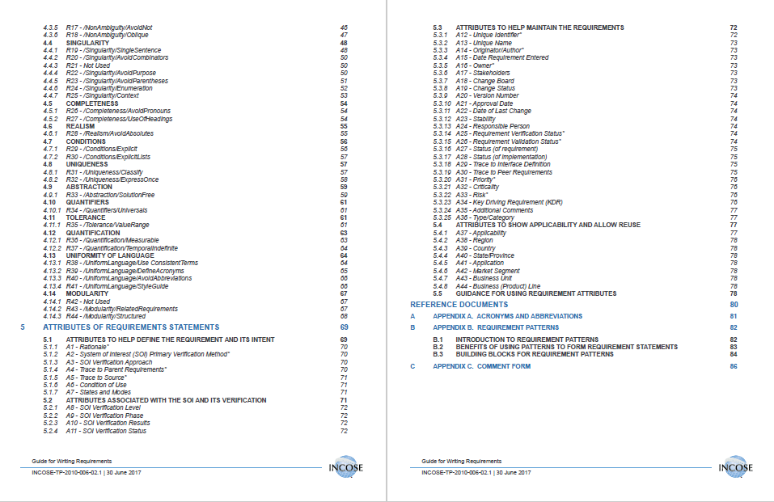
Current RWG Published Products
Guide for Writing Requirements – 2019 version
Guide for Writing Requirements Summary – 2019 version
Whitepaper: Integrated Data as a Foundation of SE – March 2019

Slide 5
Upcoming RWG Products
RWG Inputs
RWG Inputs
New
Updates
New
New
RWG Inputs

Slide 6
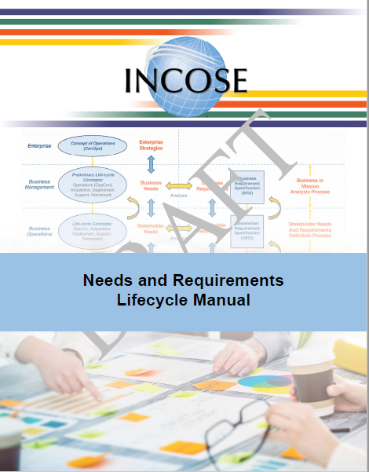
New Product – Needs and Requirements Lifecycle Manual
This Needs and Requirements Lifecycle Manual (NRLM) addresses the lack of detailed practical guidance on developing and managing needs and requirements
This manual is a supplement to and elaboration of the INCOSE SE HB, providing more detailed guidance on the what, how, and why concerning needs and requirement definition and management, verification, and validation
It addresses ambiguity and inconsistencies in ontology concerning needs and requirements definition and management, verification, and validation
A large focus on Requirements has overshadowed the fundamental concept of ensuring products address the Needs – this manual aims to showcase the strong importance of both Needs and Requirements in the development of systems

Slide 7
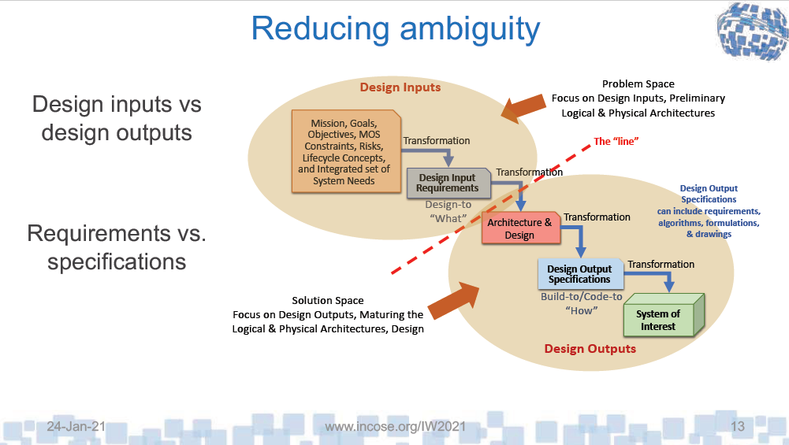

Slide 8
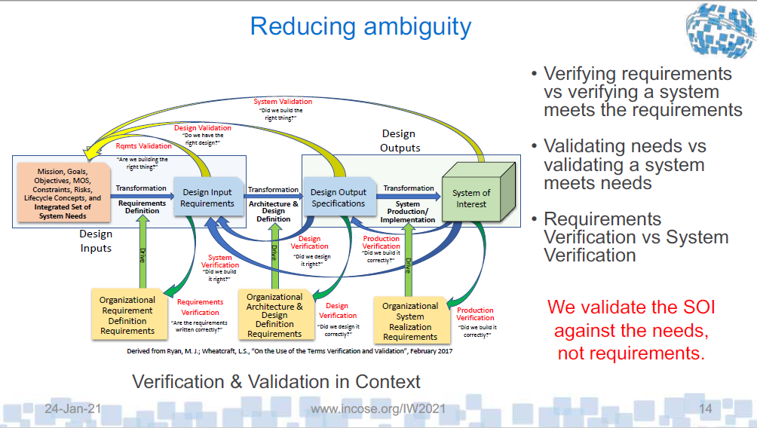

Slide 9
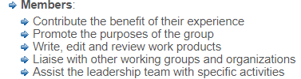
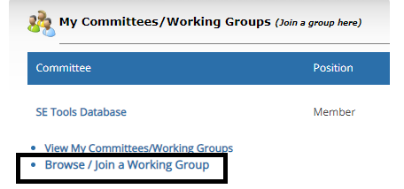
How to Become Involved in RWG
As a large working group, the RWG has been very active in virtual events as well as smaller product team efforts
Joining the working group enables the members to learn about the products, provide opportunity to contribute (or review), and participate in the RWG virtual events with other practitioners
Members can be very involved (product support) or minimally involved (watch meeting recordings), the intention is to enable all levels of participation and interaction

