Slide 1
CubeSat System Reference Model (CSRM) Project

Slide 2
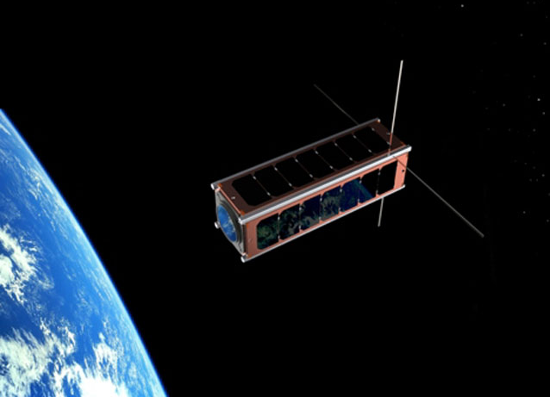
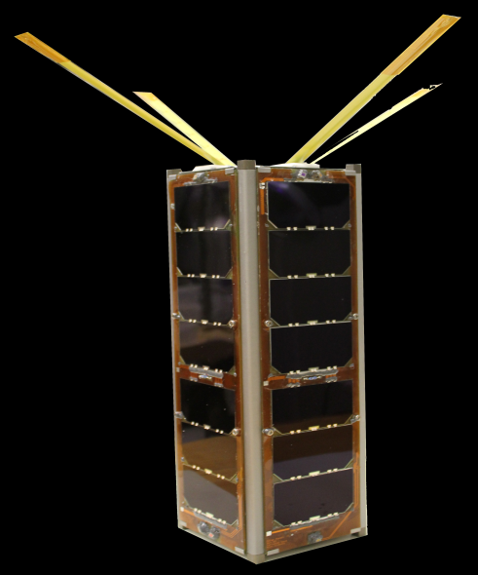
CubeSat System Reference Model (CSRM) Project
International Council on Systems Engineering (INCOSE) Space Systems Working Group (SSWG) project
CSRM Project Objectives
  Objectives of CSRM Project
  Demonstrate Model-Based Systems Engineering (MBSE) as applied to a CubeSat Mission
  Develop a CSRM that a university team can uses as starting point for their mission-specific model
  Develop the CSRM as an Object Management Group (OMG) Specification
The CSRM architecture can be applied to SmallSats
  Logical architecture of a CubeSat space-ground system
  Repository for systems engineering artifacts
  The CSRM has sufficient flexibility for the mission team to modify the logical architecture for the mission and systems engineering methodology
  Next Step: Explore how the approaches and methodologies used in the development of the CSRM can be applied to Mission Engineering
    “the application of systems engineering to the planning, analysis, and designing of missions where the mission is the system of interest”.
CubeSat unit is 10x10x10 cm and about 1.3 kg
Originated 1999 – Stanford Univ and Cal Poly Univ
Contact Info:
David Kaslow
david.kaslow@gmail.com
Alejandro Levi
alejandro.g.levi@ieee.org
Notes:
xx

Slide 3
CSRM Fundamental Elements
CubeSat System Reference Model (CSRM)
Logical architecture of a CubeSat space – ground system
Repository for systems engineering artifacts
Technical Measures
Specifications
Behaviors
Specifications
Validation Verification
Specifications
Stakeholders
Regulatory Agencies
Sponsor
Mission
CubeSat Deployer
Requirements
Enterprise
Space Segment
CubeSat
Ground Segment
Subsystems
Components
Architecture
Enterprise
Space Segment
CubeSat
Ground Segment
Subsystems
Components
An exo-structure for population with mission-specific elements
Notes:
xx

Slide 4
CSRM as an OMG Specification
Object Management Group (OMG)
An International Standards Organization
Issue CSRM RFP
Normative
CSRM Specification Document
CSRM Profile XMI File
Evaluation and Down Selection
Compliance Criteria
Non-Normative
CSRM Model File
CSRM HTML File
Approve and Distribute
In the past, OMG Specifications have been entirely document-based
Notes:
xx

Slide 5
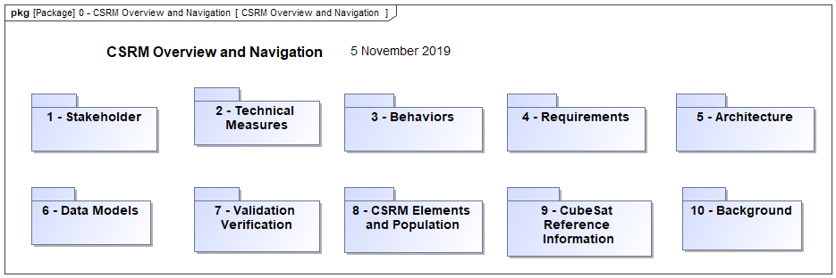
CSRM Landing Page
The CSRM landing page provides for an overview and navigation including the requirements and architecture hierarchies
5
Notes:
xx

Slide 6
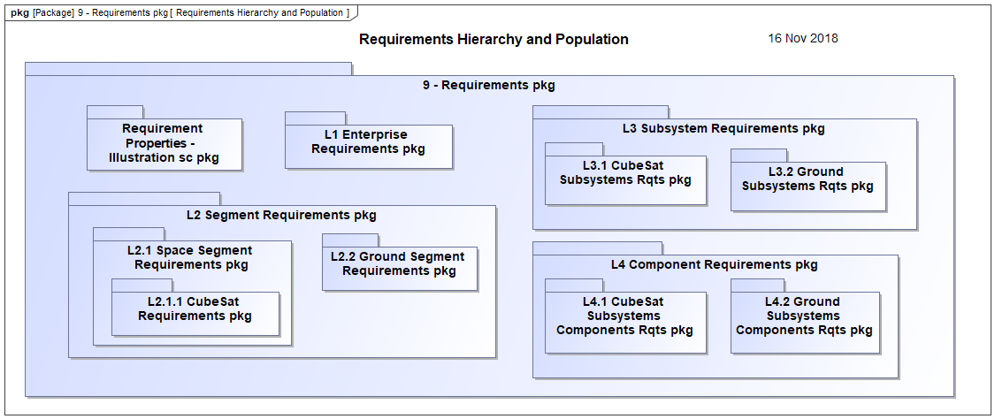
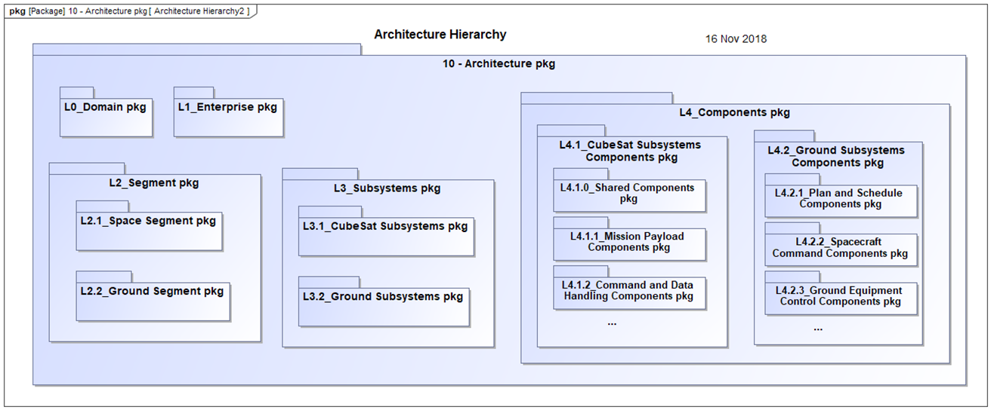
Requirements & Architecture Hierarchy
CSRM provides for defining and tracing requirements from stakeholders, use cases, technical measures down to subsystems and components and to validation and verification activities
CSRM logical architecture provides the starting point for a mission-specific team establishing their logical and physical architectures
6
Notes:
xx

Slide 7
Mission Engineering Scope
CSRM
OMG
Mission Engineering Activities
Descriptive Mission Model
Establish
Project CSRM
Submit Elements for Incorporation
Establish Mission
Logical Model
Roll-up Supplemental Elements
Map Model Elements to ME Activities
Establish Mission
Physical Model
Supplement Model Elements
Dynamic Model
Architecting for Mission Engineering
Notes:
xx

