Slide 1
Systems Thinking Workshop Summary
Dorothy Benveniste, Programs Director, INCOSE LA Chapter
djbenven@outlook.com

Slide 2
Thought Leaders
Kerry Lunney, INCOSE President Engineering Director, Thales Australia, Expert SE Professional (ESEP)
Jawahar Bhalla, Principal JB Systems, Sydney Australia
Advocate/Educator in the use of Systems Thinking as foundation for resolving complexities in work and life
Fellow of Engineers Australia and Eng. Executive and Chartered Professional Engineer. 25-yr veteran in large-scale system design, development, integration of software and hardware
Sue Gabriele, Ph.D., Educator Gabriele Educational Materials and Systems, Los Angeles
Innovator/Consultant in systemic school and workplace renewal
Notes:
Dr. Willy Donaldson started up 8 companies, currently teaches at Christopher Newport University (CNU) in Virginia. Wrote Simple Complexity about how to apply systems thinking on complex systems. A webinar titled “Digital Transformation Using MBSE from the field” July 15, 2020.
https://connect.incose.org/Library/Webinars/Documents/Webinar%20140%20Donaldson%2015%20July%202020%20Digital%20Transformation%20using%20MBSE_Notes%20from%20the%20Field.mp4
Tom McDermott: with Stevens Institute
Mark Sampson: the MBSE Initiative Chair
David Long: the Vitech CEO and former INCOSE President

Slide 3
Workshop Approach
  Broaden the knowledge in the understanding and application of Systems Thinking and share across INCOSE constituents
Working Groups
Initiatives
Members
  Format is a reflective practice--each participant given equal time to comment on a selected topic or trend impacting our discipline
Demonstrate use of Systems Thinking in Uncertain Times
Knowledge benefits INCOSE WGs, Initiatives, Members

Slide 4
Agenda Topics
Systems Thinking 101 and RoundTables repeated each day
Engineering integrity
Apply systems thinking to real-world problem
Systems Thinking Workshop
RoundTable Reflections
How do we understand a System
Perspectives on What is Systems Thinking

Slide 5
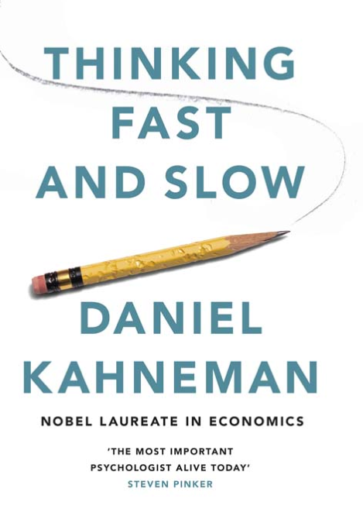
What is Systems Thinking?
1
An approach to understanding a system by examining the interactions among its components and between the system and external environment.
2
Essential to proper systems engineering, provides the framework for understanding and influencing the system’s behavior.
3
Design of reliable systems relies on applying the rules of systems thinking to the definition of the system boundary, structure and interfaces to predict system performance.

Slide 6
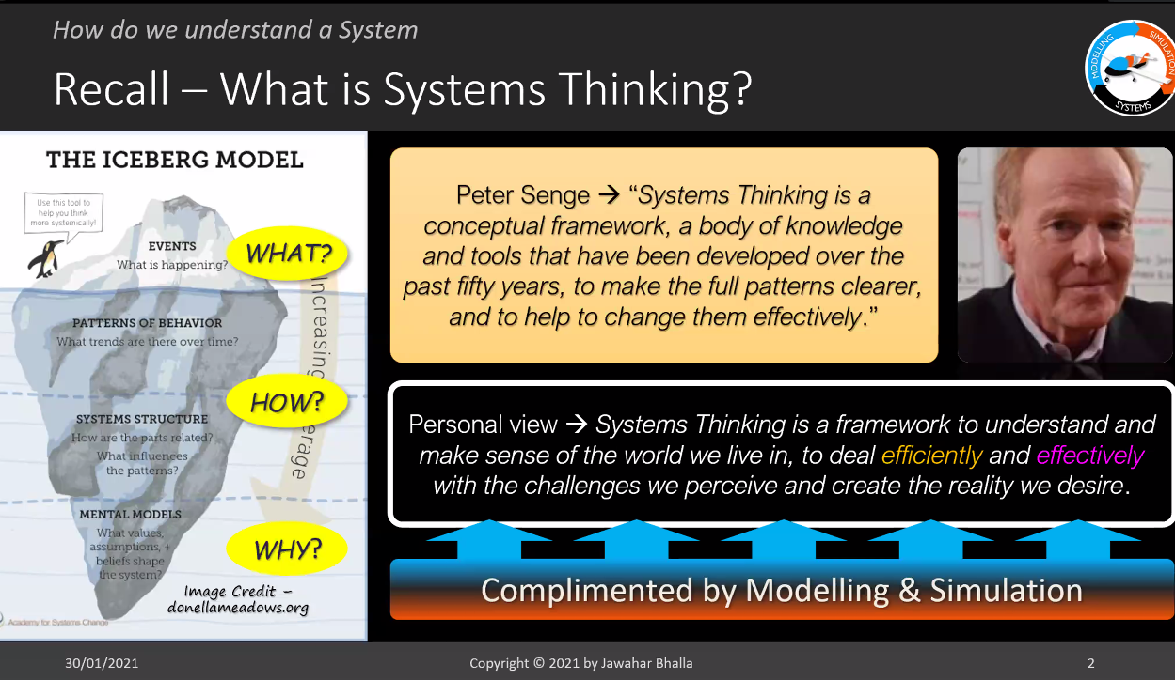
How we understand a system

Slide 7
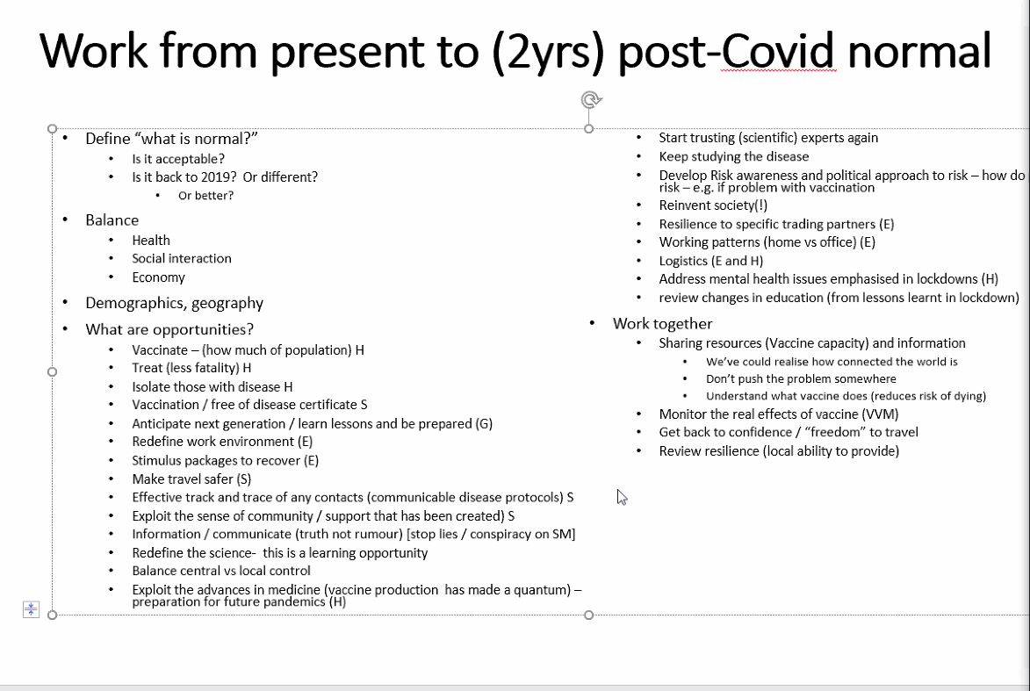
Real-World Problem: COVID-19

Slide 8
RoundTable Reflections*
“Behavior gets better before it gets worse. Low-leverage fixes work in the short term. Cause and effect are not closely related in time and space.”
Habits of a Systems Thinker describe ways of thinking about how systems work and how actions taken can impact results seen over time: Habits of a Systems Thinker (waterscenterst.org)
“Many people, even smart, technical people, think more in absolutes and isolated detail, and don't deal well with process flow.”
“The main problem is we live in a reductionist world. People are taught knowledge, but not how to think. ST is an essential skill for all our engineers, and key to ensuring all the parts work together and the requirements are well understood.”
*Comments from Workshop Members

Slide 9
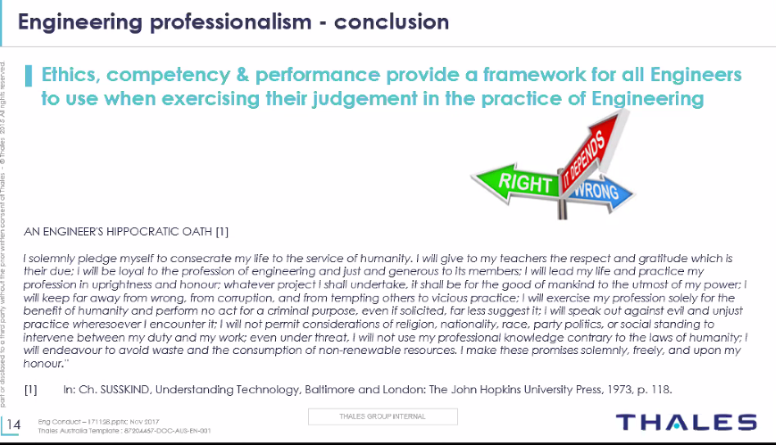
Engineering Integrity

