Slide 1

INCOSE Los Angeles Chapter
Monthly Speaker Meeting
May 10, 2022

Slide 2


Agenda
5:30 PM – Introductions and Networking
6:00 PM – President’s Remarks
6:15 PM – Conversational Capacity Presentation by Craig Weber,
The Weber Consulting Group
7:15 PM – Q&A
7:30 PM – Adjourn meeting
Thank You for Registering in Advance!

Slide 3
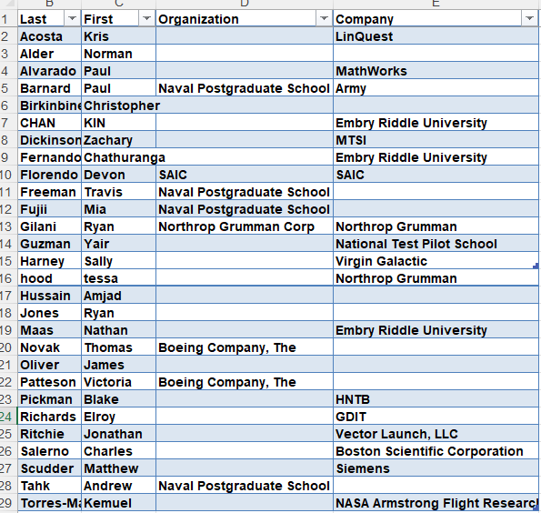
Welcome 2022 New Members!

Slide 4

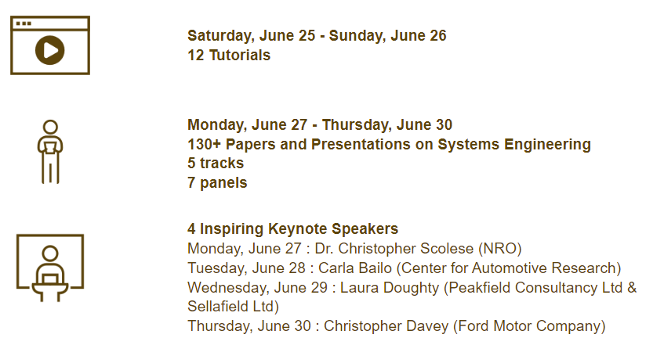
International Symposium - June 25--30, 2022
Technical Program is now online @ https://www.incose.org/symp2022/symposium/event-schedule

Slide 5
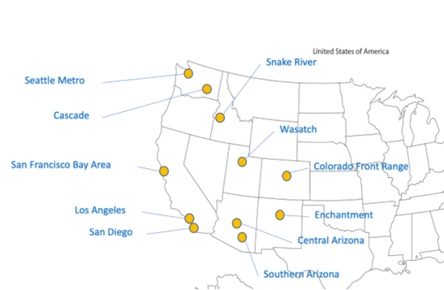
2022 Western States Regional Conference: Sept. 30-Oct. 2
﻿Call for Submissions - due May 16th
WSRC website https://www.incose.org/wsrc/
The fifth annual WSRC, hosted by the Colorado Front Range Chapter, will showcase the latest innovations in SE research and demonstrate real-world applications and solutions. Our presenters will highlight the utility of their cutting-edge work. We will share how we are driving change in the Systems Engineering community.
You are cordially invited to submit a proposal for a presentation, tutorial, or panel discussion in which you emphasize the practical application of your research and deployment efforts. New and novel applications of SE highly desired. Industries: Transportation, Health and Biomedical, Social Systems, Public Planning, Aerospace and Defense, Environment.
Proposals must be submitted through EasyChair: https://easychair.org/my/conference?conf=wsrc2022. Submission must include:
Title
Presenter(s)’ name, affiliation, contact information, and brief biography.
For presentations, include an abstract that clearly identifies (1) the issue to be addressed, (2) the main points of the presentation, and (3) what the audience will take away.
For panels, please identify why the topic is relevant, general format and discussion points, panel participants who have committed to participate, and a summary of their position statements.
For tutorials, please identify top-level learning objectives, topical outline, and proposed duration.
Abstract Submission Due May 16, 2022
Submissions Accepted June 1, 2022
Final Presentation Due Aug 12, 2022
Key Dates

Slide 6
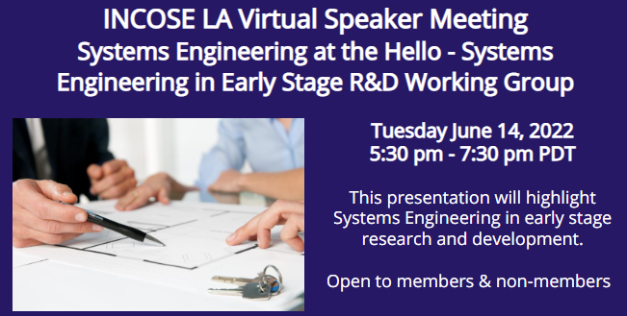

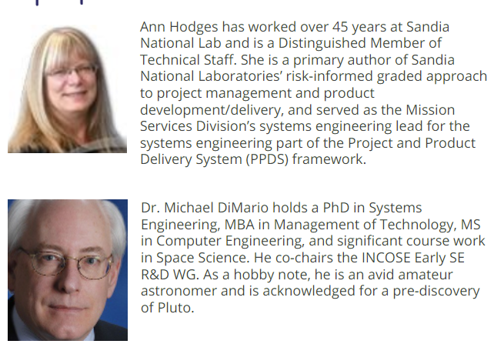
Next Month 06/14/22 Speaker Meeting:
SE In Early Stage R&D Working Group

Slide 7
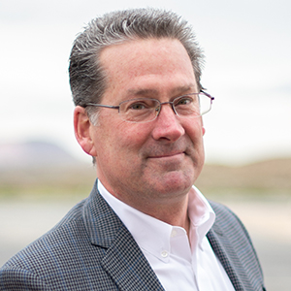

Tonight 05/10/22 Speaker Meeting:
Conversational Capacity, by Craig Weber
Craig Weber is an international consultant who helps people and teams improve their performance by treating dialog as a discipline. Drawing on rigorous research in psychology, leadership studies, business management, and neuroscience, the Conversational Capacity discipline helps people build healthier, more adaptive teams and working relationships.
Hs is founder of The Weber Consulting Group, an alliance of experts committed to helping people build more resilient, healthy, and agile organizations. His client list includes Boeing, SAIC, PWC, Pfizer, US Air Force and Los Alamos National Laboratories.
Known for his distinctive and engaging style, Craig is a sought-after consultant and speaker. His unique work is outlined in his best-selling book, “ Influence in Action: How to Build Your Conversational Capacity, Do Meaningful Work, and Make a Powerful Difference.” Visit https://weberconsultinggroup.net/ to learn more.
Facebook

