Slide 1
INCOSE Los Angeles Chapter Monthly Speaker Meeting
June 14, 2022

Slide 2
Agenda
5:30 PM – Introductions and Networking
6:00 PM – President’s Remarks
6:15 PM – SE In Early-Stage R&D Working Group Update
Ann Hodges and Michael DiMario
7:15 PM – Q&A
7:30 PM – Adjourn meeting
Thanks for your support! Please share our events with friends & colleagues

Slide 3
Welcome 2Q2022 New INCOSE Members!
INCOSE-LA, largest US Chapter, boasts 436 members from over 40 organizations
We attract sys engineering Industry and Gov’t professionals from around the world
We conduct quarterly Workshops and monthly Speaker Meeting presentations
You are cordially invited to join us at www.incose-la.org

Slide 4
32nd Annual INCOSE IS 2022 in Detroit
Includes Automotive and Aerospace Sectors
INCOSE brings International Symposium to Detroit as the Automotive sector is dynamic changing
Carla Bailo, President/CEO, Center for Automotive Research (CAR), delivers a Keynote Address and leads Automotive Executive roundtable session with other Automotive Sector Leaders
INCOSE IS 2022—June 25--30, 2022 Technical Program: https://www.incose.org/symp2022/symposium/event-schedule

Slide 5
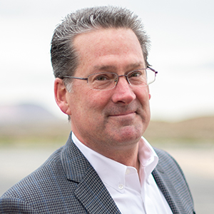
06/18/22 Interactive Virtual Workshop, 9 am –1 pm: Developing Conversational Skills, by Craig Weber
Led by communications expert Craig Weber, you will practice how to build healthier, more adaptive teams and learn how to:
Strengthen core skills in problem solving, decision-making, and change management
Exert greater influence and help good ideas get the traction they deserve
Remain levelheaded in high-stakes situations
Boost competence and confidence when dealing with difficult issues under stress
Register at: Register at: tinyurl.com/5n73up2s
Facebook
Craig Weber is on a mission to empower people striving to make their workplaces and communities a better place. Founder of The Weber Consulting Group, an alliance of experts committed to helping people build more resilient, healthy, and agile teams, his client list includes Boeing, SAIC, PWC, Pfizer, USAF and Los Alamos National Labs.

Slide 6
07/12/22 Speaker Meeting: Digital Data Packages: Making the Digital Thread Work, by David Long
David Long has spent over 30 years helping organizations increase their systems engineering proficiency and working to advance the state of the art.
David is founder and president of Vitech and led development of innovative, industry-leading methods and software to engineer next-generation systems.
He co-authored A Primer for Model-Based Systems Engineering and frequently delivers keynotes, tutorials, and workshops around the world.
An INCOSE Fellow and Expert Systems Engineering Professional, David was the 2014/2015 president of INCOSE. He holds a bachelor’s degree in Engineering Science and Mechanics, and Master’s degree in Systems Engineering from Virginia Tech.
David Long, ESEP
Register at: tinyurl.com/LA12JulySpkr

Slide 7
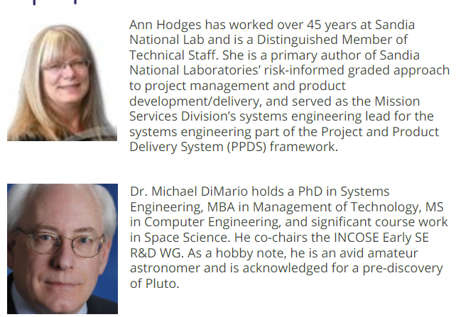
Tonight 06/14/22 Speaker Meeting: Systems Engineering In Early-Stage R&D Working Group Update

