Slide 1
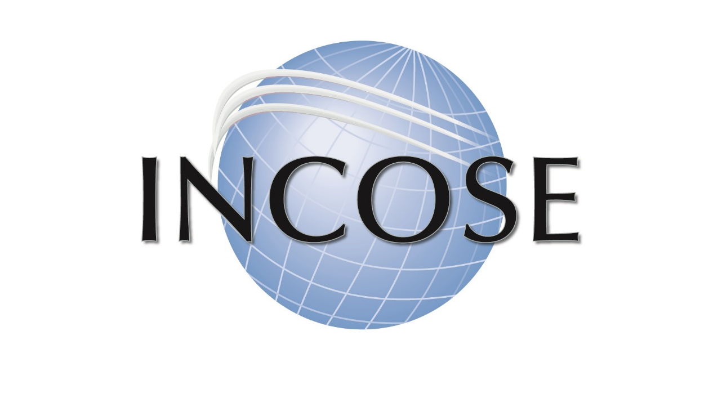
The International Council on Systems Engineering
A better world through a systems approach
Notes:
Option 1 for a title slide

Slide 2
Systems Engineering: Importance & Impact
Systems engineers are at the heart of creating successful new systems.
They are responsible for the system concept, architecture, and design.
They analyze and manage complexity and risk.
They decide how to measure whether the deployed system actually works as intended.
They are responsible for a myriad of other facets of system creation.
Systems engineering is the discipline that makes their success possible – their tools, techniques, methods, knowledge, standards, principles, and concepts.
The launch of successful systems can invariably be traced to innovative and effective systems engineering.

Slide 3
About INCOSE
Founded to develop & disseminate the interdisciplinary principles and practices enabling successful systems
Connects Systems Engineering professionals with educational, networking, and career-advancement opportunities
Developing the global community of systems engineers and systems approaches to problems
Focused on producing state-of-the-art work products that support and enhance Systems Engineering global visibility

Slide 4
Vision & Mission
VISION - A better world through a systems approach.
MISSION - To address complex societal and technical challenges by enabling, promoting, and advancing Systems Engineering (SE)and systems approaches.

Slide 5
Strategic Objectives
Premier
INCOSE is the Global Leader for Systems Engineering Professionals
Future
INCOSE is leading the Future of Systems Engineering, academically, in emerging domains, and in practice
Value
INCOSE delivers value XXX

Slide 6
Our Members Improve the World
Our members:
drive the discipline forward, developing state-of-the-art solutions and products for their customers.
solve real-world problems and save time and money in the process.
improve system performance, drive change, and make a lasting impact on the world of systems engineering.

Slide 7
Membership
INCOSE membership represents a broad spectrum – from student to senior practitioner, from technical engineer to program and corporate management, from science and engineering to business development.
Members work together to advance their technical knowledge, exchange ideas with colleagues, and collaborate to advance systems engineering.

Slide 8
Why Join INCOSE
INCOSE is the global Systems Engineering professional society – providing the opportunity for life long learning in systems approaches
A community of peers, resources for your career, and a place to be a leader
INCOSE members stand out and are often sought after as experts. INCOSE members share practices and learn from each other.
INCOSE members create products, produce events and represent the organization in international forums.
INCOSE members increase the body of knowledge and advance the practice of systems engineering.
Network with nearly 17,000 members in 70 countries
Increase your professional stature with the INCOSE Systems Engineering Professional Certification

Slide 9
INCOSE Reach
EMEA Sector
Asia-Oceania Sector
Americas Sector
Notes:
Need title suggestions here

Slide 10
Chapters & Groups
At the heart of INCOSE is the ability to connect people.
Whether you are interested in increasing your circle of influence, or in working on an issue, INCOSE Chapters and Working Groups offer unparalleled points of connection.

Slide 11
Membership Benefits
A global network of colleagues who understand systems engineering
Certification opportunities
Access to quarterly e-Publications, INSIGHT and Journal of Systems Engineering
Electronic version of the Systems Engineering Handbook
Collaborate with experts and practitioners worldwide
Exclusive access to INCOSE Connect, the collaborative space for INCOSE Members Only
Member discounted registration to the International Workshop and International Symposium.

Slide 12
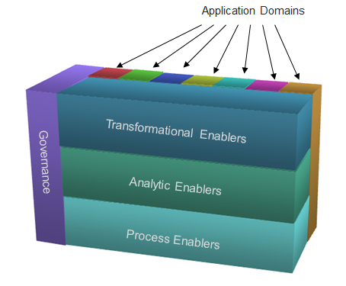
Working Groups
Working Groups (WGs) are the resource practitioners need.
Discuss, collaborate, share in person, and online across more than 60 WGs in INCOSE with a wide diversity of interests.
INCOSE WGs create products, present panels, develop and review standards.

Slide 13
Working Group Members
Bring value to other INCOSE stakeholders in your interest area
Build expertise and contacts
Help develop and review international standards
Share information across WGs
Create products to advance the state, art and practice of Systems Engineering.

Slide 14
Corporate Advisory Board
The INCOSE Corporate Advisory Board (CAB) is the Voice of the Customer to the INCOSE leadership.
The CAB provides strategic guidance to technical leadership, leading to the development of systems engineering products and input to standards to meet their needs.
Notes:
Requires input from CAB as to Value Proposition

Slide 15
WHY JOIN THE INCOSE CAB?
CAB membership allows your organization to guide the direction of the discipline.
Employees can gain access to the state-of-the-art products.
Align with peers and fellow industry leaders, grow your global footprint, and learn about how other industry leaders are applying systems engineering to solve business problems.
Gain better access to talent – find and hire competent, certified Systems Engineers through your INCOSE connection.

Slide 16
CAB Associate Member Benefits
<Add statements about Associate Member benefit to employees>

Slide 17
Academic Council
Forms the branch of the CAB facilitating discussion and exploration of issues relevant to academia and setting a path for achievement with strategic collaborations within INCOSE.
A well-educated workforce is key to Global Prosperity
Council member organizations offer bachelors, masters and doctorate degrees in systems engineering and related programs.
Active in advancing the state-of-the-art of systems engineering through academic programs.
Notes:
Need to change National to Global on website.

Slide 18
Academic Council Associate Member Benefits
Many INCOSE/Academic Council member benefits extend to Academic Council organization employees. (align with Associate Member benefit on the CAB slide)

Slide 19
INCOSE Student Divisions
Undergraduate and/or graduate students who wish to become actively involved in INCOSE while enrolled in an accredited course of study at a college or university.
Student Divisions are operated as a component of a nearby chartered INCOSE chapter, and require:
1) a student body interested in becoming involved with INCOSE,
2) a faculty member who is a member of INCOSE and willing to act as the Division mentor and liaison between INCOSE and the university, and
3) active sponsorship and participation by a chartered INCOSE chapter.

Slide 20
Current INCOSE Student Divisions
Notes:
Need aid from Ariela

Slide 21
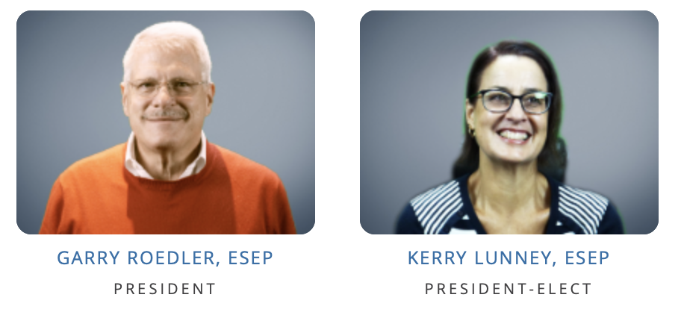
INCOSE Leadership
INCOSE is managed by a Board of Directors in accordance with its bylaws.
The Board of Directors sets strategy and policies that serve the stakeholders – members and practitioners of systems engineering.
Board members are both elected and appointed.

Slide 22
Current INCOSE BoD
Officers
President: Kerry Lunney, ESEP, Thales Australia
President-Elect: Marilee Wheaton, INCOSE Fellow, The Aerospace Corporation
Secretary: Kayla Marshall, CSEP, Lockheed Martin Corporation
Treasurer: Mike Vinarcik, ESEP, SAIC
At-Large Directors
Strategic Integration: Tom McDermott, Stevens Institute
Academic Matters: Bob Swarz, Worcester Polytechnic Institute (WPI)
Marketing & Communications: Lisa Hoverman, HSMC
Outreach: Dr. Mitchell Kerman, Idaho National Laboratory
Americas Sector: Antony Williams, ESEP, Jacobs
EMEA Sector: Lucio Tirone, CSEP, Fincantieri
Asia-Oceania Sector: Serge Landry, ESEP, Thales Solutions Asia
Chief Information Officer (CIO): Bill Chown, BBM Group

Slide 23
INCOSE Local Chapter
Number of Members
Years Established
Meeting Venue(s)
Meeting Frequency
Meeting Structure
How to Join
Contacts

Slide 24
INCOSE Foundation
Committed to rewarding skills through scholarships for those engaged in finding solutions to complex technical challenges at all stages of their education or career.
Offers possibilities for people to pursue goals that anticipate the future – for them and for the world.
Scholarships Include:
ISEF, the International Science and Engineering Fair INCOSE Award to a pre-college student
The Chesapeake Chapter Award
The Stevens Doctoral Award for Promising Research in Systems Engineering to a PhD Candidate
The James E. Long Award for Post Doctoral work

Slide 25
INCOSE Welcomes You!
Interested in learning more?
www.incose.org

Slide 26
EXTRA/ADDITIONAL/TEMPLATE SLIDES
Use the following slides as needed

Slide 27
Title: Optima 40 pt – 32 pt
Content text: Arial 28 pt or less (Color = black/dark gray*)
Title color: (Color = RGB 43 111 171)
*See official color palette for gray choices

Slide 28
Goals
Provide a focal point for dissemination of Systems Engineering knowledge.
Promote international collaboration in Systems Engineering practice, education, and research.
Assure the establishment of competitive, scalable professional standards in the practice of Systems Engineering.
Improve the professional status of all persons engaged in the practice of Systems Engineering.
Encourage governmental and industrial support for research and educational programs that will improve the Systems Engineering process and its practice.

Slide 29
Impact
INCOSE is the standard for the advancement of Systems Engineering
INCOSE produces state-of-the-art work products that further the discipline, leading to improvements in productivity and effectiveness.
INCOSE also collaborates with several organizations to increase its impact with members serving as experts to influence products and standards.

Slide 30
Values & Principles
INCOSE Values
Systems Thinking
Pioneering and Innovation
Learning and Development
Respect, Diversity, Collaboration
Individuals
Volunteerism
INCOSE Principles
Impact
Partnership
Holism
Differentiation
Volunteers

