Slide 1

Selling Yourself as Systems Engineering Thought Leader
Honor Lind, Samantha Bernal, Anthony Abi Badra
.

Slide 2




Honor A. Lind is Director of Marketing and Communications for INCOSE. She has over 20 years’ experience in marketing, and in recent years has focused on engineering organizations. She has a master’s degree in public administration with a focus on nonprofit management and marketing, and also has degrees in art and communications. In her art, she focuses on telling a story through art, symbol, and mythology.
Samantha Bernal graduated from the University of Wisconsin with a degree in broadcast and digital marketing communication. She has worked in Radio, Social Media, and Digital Website design for over 12 years. She has been with INCOSE for the past four plus years.
Anthony Abi Badra is a Business Improvement Manager at Airbus. He is a former INCOSE intern and holds a Master’s Degree in Aerospace Engineering and Systems Engineering, and a Bachelor’s Degree in Mechanical Engineering. He is interested in systems engineering research, and has published a Model-Based Systems Engineering research paper at IEEE SysCon 2023.

Slide 3
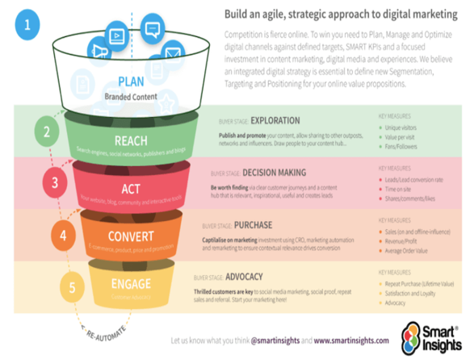
What is Marketing?
Marketing: the activity or business of promoting and selling products or services, including market research and advertising.
Notes:
Honor

Slide 4





Why Market?
Spread the message about your chapter or working group
Increase membership
Increase engagement
Promote products & publications
Increase reach outside of INCOSE
Notes:
Honor

Slide 5

How has the digital age changed marketing?
Translation of ads and campaigns to digital ads, web site ads, pop-up ads, paid social media ads
Addition of new kinds of “ads” like social media posts that promote something
Importance of customer community—tribes, people who naturally promote your product/service
Notes:
Honor

Slide 6
Who needs
Anybody who wants to be effective in getting new ideas, methods or products accepted and adopted
Anyone who wants to improve a process, an organization or the world
Anyone who wants to create a business, a product or a successful organization
marketing?
You can’t know if something will be successful UNTIL you effectively market it
Notes:
Honor

Slide 7
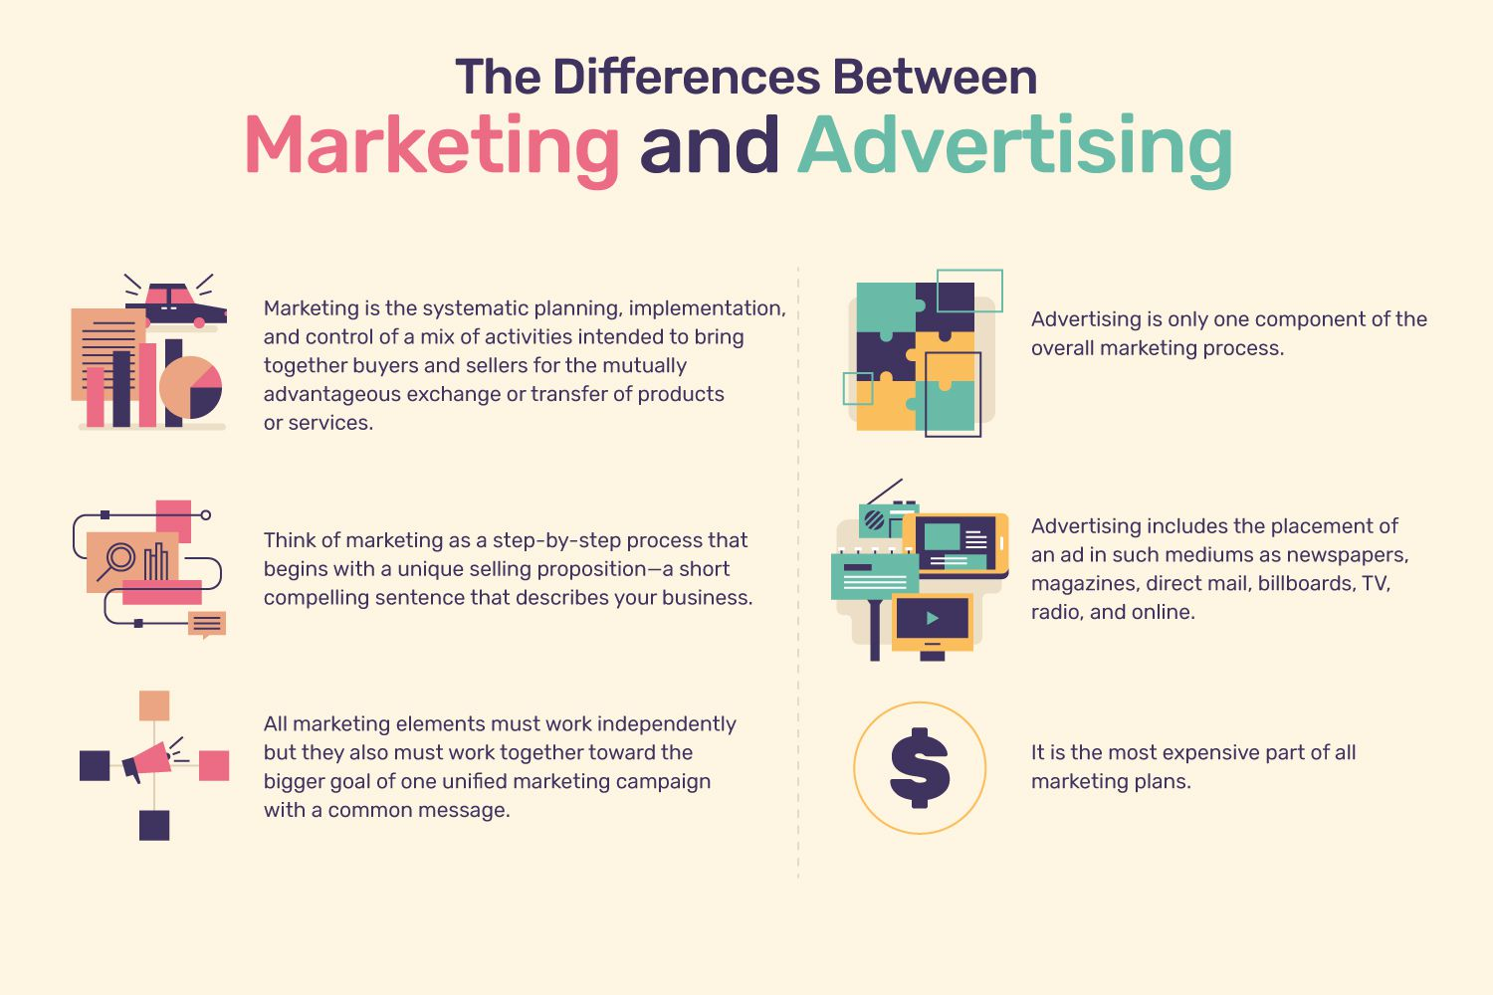
Marketing vs advertising
Marketing is the systemic plan
Advertising is a part of the process where you deliver the message
Public Relations is the story-telling of marketing
Notes:
Honor

Slide 8


How can you implement marketing?
Promoting your chapter
Branding yourself
Spreading a new method at work
Selling a proposed project
Creating change
Notes:
Honor

Slide 9





Setting campaign aims
Who?
Why?
What?
Where?
When?
Notes:
Honor
Before you start your campaign you must consider the following. Who are you targeting? What are you offering them? Where is your target market? When will you target? This will ensure that you are delivering the right message, to the right audience.

Slide 10
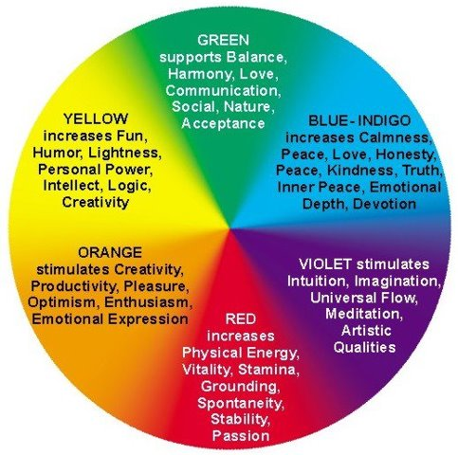
branding
Points to consider when branding:
Color/symbolism- why color matters?
Name
Logo Design
Tag line
Call-to-Action
Value Statements
Mission Statements
Vision Statements
Source:
https://www.google.com/url?sa=i&url=https%3A%2F%2Fwww.universeofsymbolism.com%2Fcolormeaning.html&psig=AOvVaw2Vbwz20Mx9ww7lKDq902Sk&ust=1674779291361000&source=images&cd=vfe&ved=0CA8QjhxqFwoTCOiAk5j94_wCFQAAAAAdAAAAABAE
..
Notes:
Sam

Slide 11

Call to Action
A call to action aims to prompt an immediate response. Some examples are:
Buy now
Show now
Learn more
Click here
Empower yourself
Follow us
.
Notes:
Honor

Slide 12
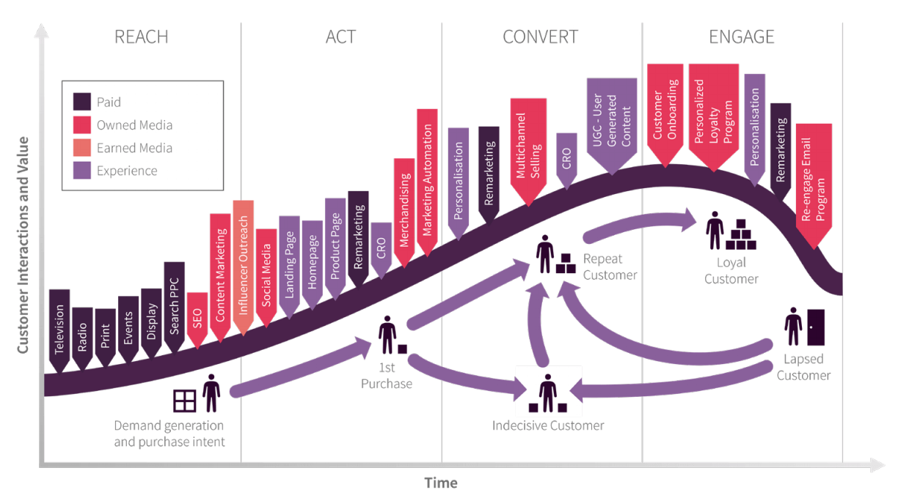
Reach, Act, Convert and Engage
The stages of marketing campaigns and key issues that need to be included in your campaign plan are:
Campaign goals and tracking.
Campaign insight and targeting.
Key campaign messages and offers.
Campaign media plan and budget.
Campaign asset production.
Campaign execution.
Source: https://www.smartinsights.com/wp-content/uploads/2021/02/E-commerce-growth-customer-lifecycle.png
.
Notes:
Honor

Slide 13
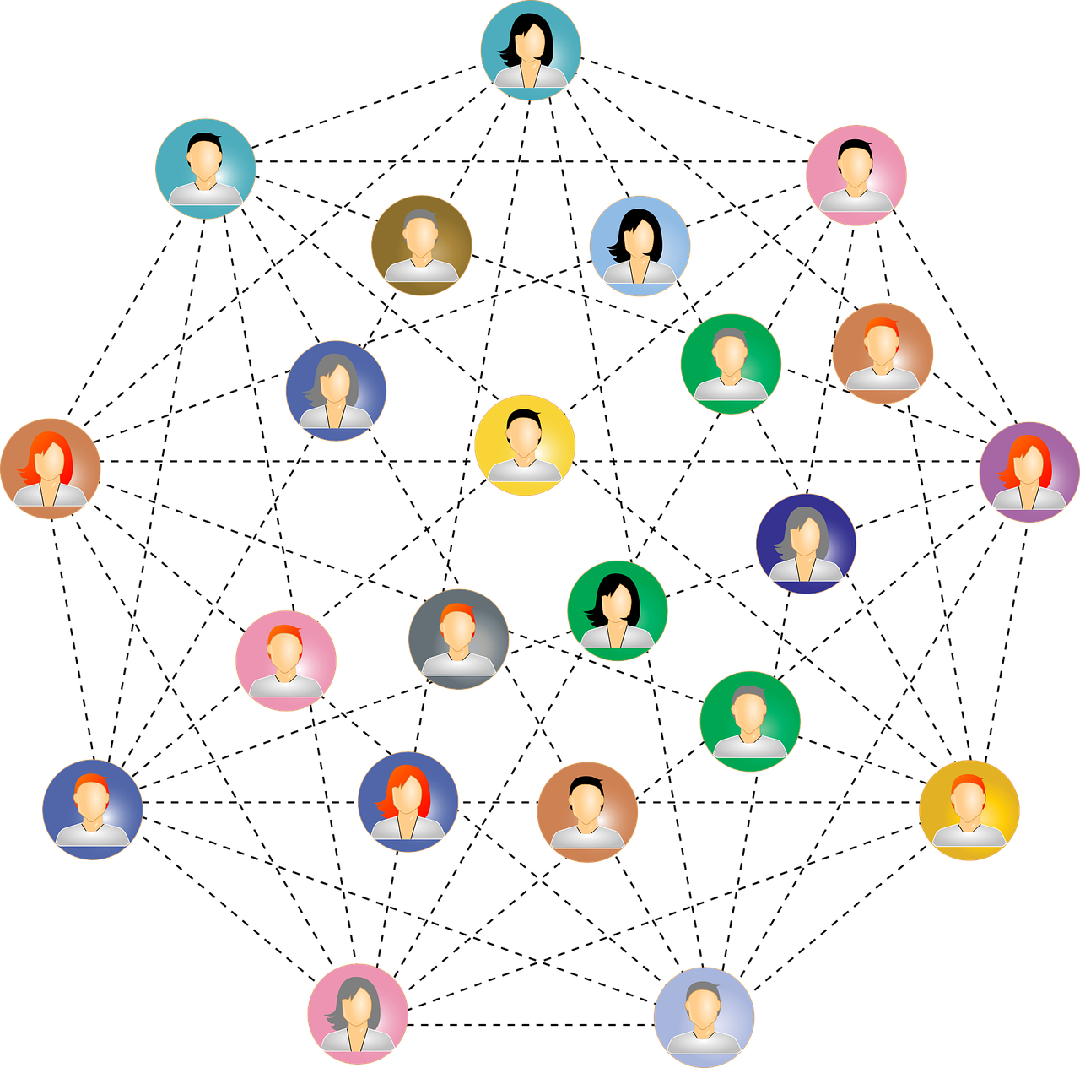
Messaging yourself to the global Community
Walk through the narrative journey, the process of the Campaign journey. Step by step of how to implement a campaign with INCOSE.
Branding INCOSE example: Certification, LTMYS
Visual journey
Connect, Learn, Lead, Prosper Campaign as an example
.
Notes:
Honor

Slide 14


Why does branding yourself matter?
Short terms
Expertise Showcase
Thought Leadership
Educate Your Audience
Community Engagement
Network Expansion
Consistent Visibility
..
Notes:
Sam

Slide 15

INCOSE Channels
Social media (LinkedIn, X formerly known as Twitter, Facebook, and Instagram)
LinkedIn Official Group
Members Newsletter
Impact Statement
INCOSE Website
Marketing HUB
Yammer
eNote
..
Notes:
Sam

Slide 16
How to post on social media?
Know your audience
Define Your Goals
Understand their interests
Determine your post's purpose
..
Notes:
Sam

Slide 17
Choose the Right Platform
Craft Engaging Content
Use Hashtags Wisely
Match your
content with the platform
Use eye-catching visuals and headlines
Include relevant hashtags
..
Notes:
Sam

Slide 18



How to post on LinkedIn?
Good Posts
Why Hashtags
The @ Symbol
Content Quality
Visual Appeal (images or videos)
Short and Impactful
Visibility
Categorization
Trending Topics
Tagging Connections
Collaboration
Networking
-
Notes:
Anthony
Posting on LinkedIn offers a unique platform for professional growth, networking, knowledge sharing, and personal branding. It's a powerful tool to advance to connect with your industry.
Content Quality: Share informative and professional content.
Visual Appeal: Use compelling visuals, like images or videos.
Short and Impactful: Keep your posts concise and to the point.
Visibility: Use relevant hashtags to increase post visibility.
Categorization: Organize your content under relevant industry tags.
Trending Topics: Ride on trending hashtags to boost your reach.
Tagging Connections: Use @ mentions to tag and involve your connections.
Collaboration: Mention relevant individuals or companies for collaboration.
Networking: Build connections and engage with your professional network.

Slide 19

Examples of What to Post on
Chapter Engagement
Conference Participation
Published Works
Achievements and Awards
Share Observations
Positive Insights
Cite Publications
Image Is Everything!
Notes:
Anthony

Slide 20

A
Picture
Is worth a thousand words

Slide 21
LinkedIn profile tips
• Create collage images 3-4 perform well
• Create and upload 1-2 minutes shorts to capture attention
- Add subtitles when you can
- Create live videos. Live videos create24x more engagement than regular videos on Linkedin
• Insert keywords: @ plus company, @ industry or @ person to identify and add to their thread
- Incorporate key phrases like # makeadifference #engineeringmatters
- Incorporate keywords and phrases that potential customers might use to search for your product or service.
- Include them in the About tab overview, clearly representing who you are and what you do
• Share relevant content.
- Share often.
- The more frequently you share content your followers engage with, the higher your Page will appear in search results.
• Use Emojis where you can
- In today's pictorial storytelling emojis attract followers and add to the context to frame the content
..
Notes:
Sam

Slide 22
LinkedIn Post Layout suggestion
Engaging Visual
Engaging Headline
Content
Mention People
Call to Action (CTA)
Relevant Hashtags
-
Notes:
Engaging Visual: Start with an attention-grabbing image or video related to your post.
Engaging Headline: Craft a compelling headline to pique interest.
Content: Write a concise yet informative message. Share your insights, thoughts, or the main point of your post.
Relevant Hashtags: Include a few relevant hashtags to increase discoverability.
Mention People: Mention individuals, companies, or groups relevant to your post by using the @ symbol.
Call to Action (CTA): Encourage engagement, such as asking a question or inviting comments.

Slide 23
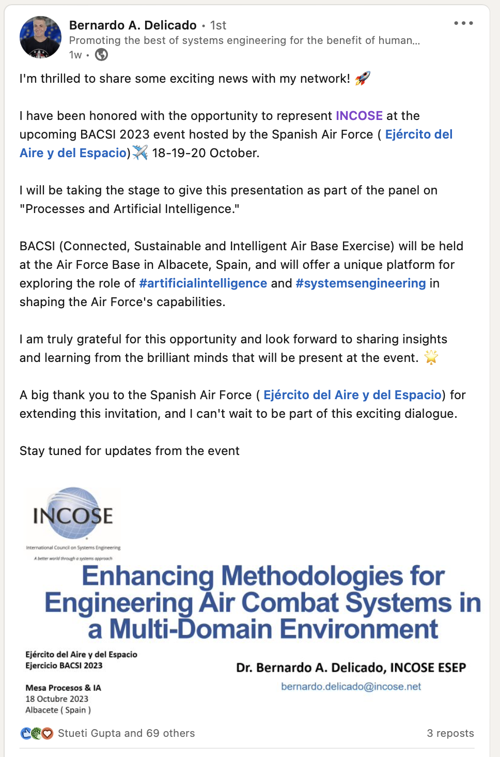
Good LinkedIn Posts Example
Engaging Headline
Mentions
Relevant Hashtags
Call to Action
Engaging Visual
Emojis

Slide 24
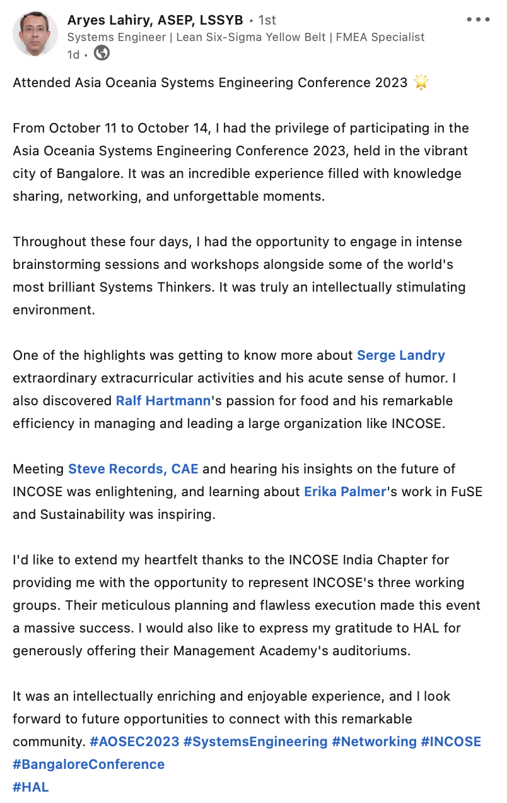
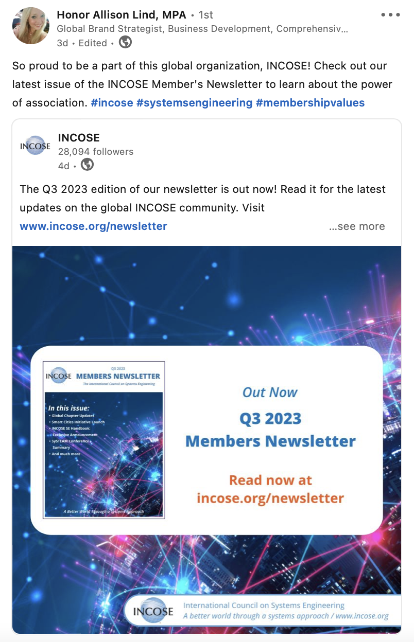
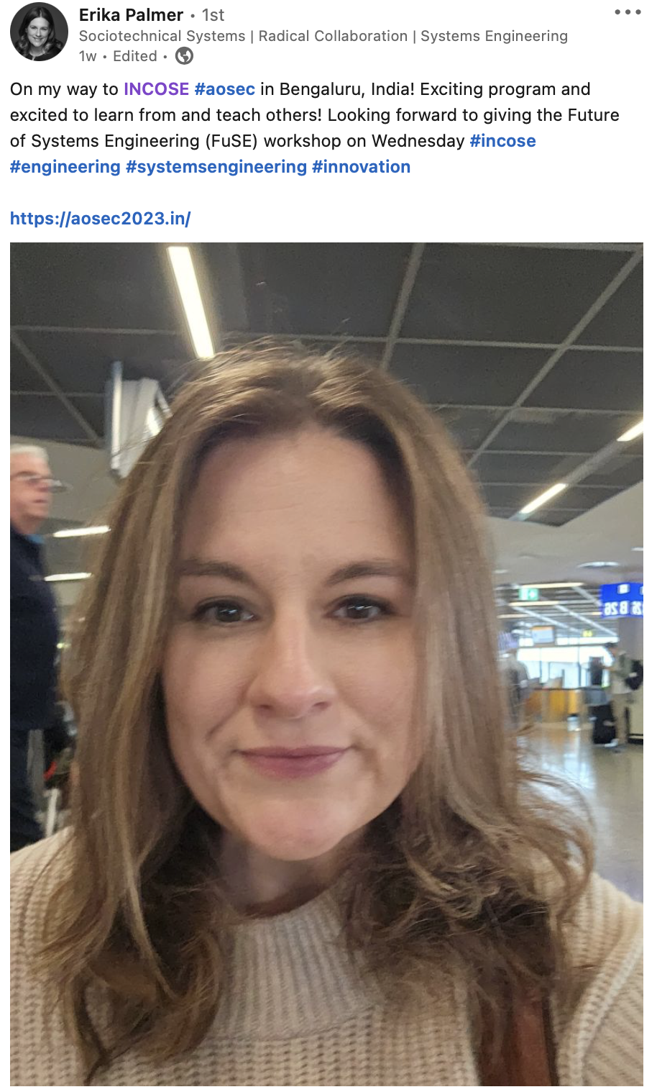
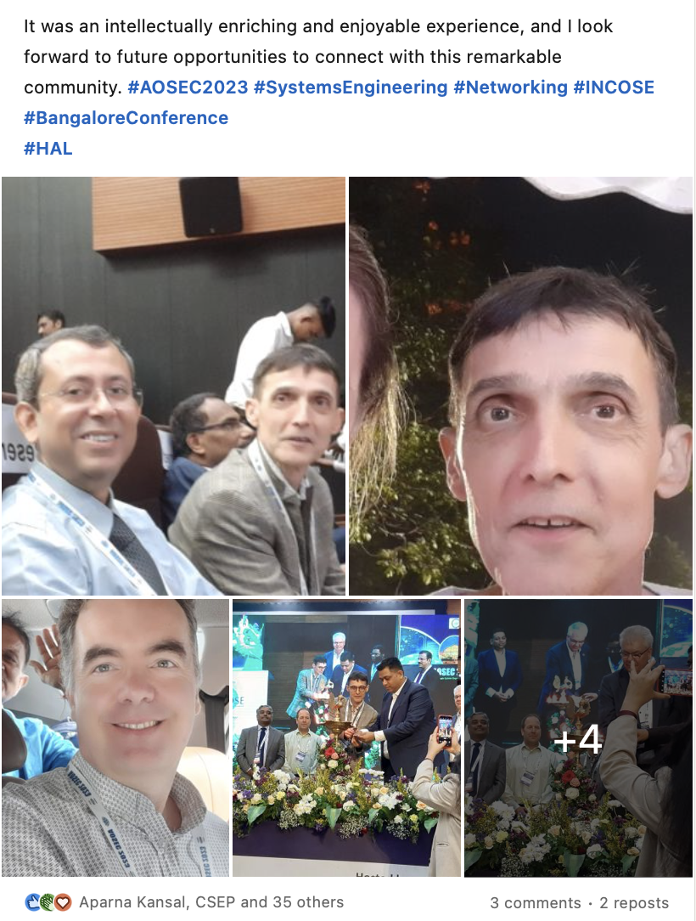
Good LinkedIn Post/Repost Examples

Slide 25
Thank you

Slide 26
Any questions?

Slide 27
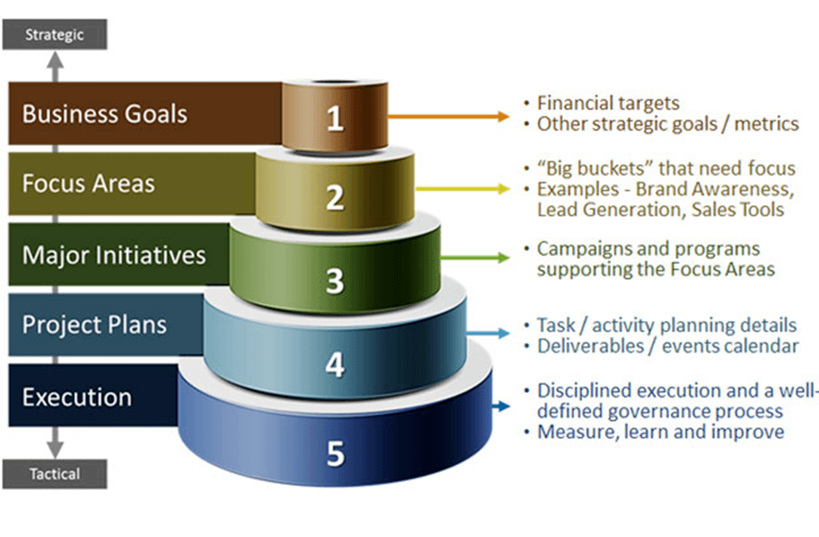
Marketing in a Nutshell
How Corporations/Organizations Do It
Organizational Strategy
Marketing Strategy
Needs Assessment
Campaign Strategy
  PR: the story / narrative
  Advertising: the call to action
Program Evaluation
Measure and monitor effectiveness of campaigns using outcomes
How You Can Implement Marketing
  Promoting your chapter
  Branding yourself
  Spreading a new method at work
  Selling a proposed project
  Creating change

