Slide 1

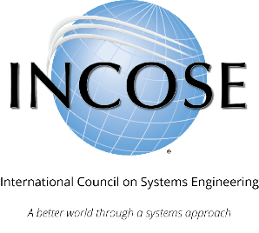
INCOSE
Systems Engineering Professional (SEP)
Certification Program
Program Summary

Slide 2





What is INCOSE?
The International Council on Systems Engineering (INCOSE) is a not-for-profit membership organization founded in 1990 to develop and disseminate
the interdisciplinary principles and practices that enable the realization of successful systems. A better world through a systems approach.
MISSION
Share, promote and advance the best of systems engineering from across the globe for the benefit of humanity and the planet.
VISION
The world's authority on Systems Engineering.
Certification is just one of many
INCOSE products and offerings.
incose.org/certification | 2

Slide 3
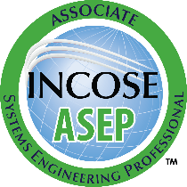
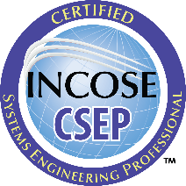
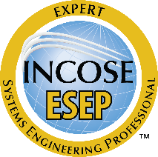
INCOSE SEP Architecture
For wherever you are in your career
Multi-Level Base Credentials
The base ASEP, CSEP, and ESEP credentials cover the breadth of systems engineering at increasing levels of leadership, accomplishments, and experience.
  If you have just started (or plan to start) practicing systems engineering or have recently graduated and are interested in system engineering
  If you are a practicing Systems Engineer with more than five years of systems engineering professional work experience
  If you are a systems engineering leader with recognized systems accomplishments and have many years of systems engineering professional work experience

Slide 4























Employer Job Postings ask for SEP
Employers who recognize and value SEP certifications

Slide 5































Universities have Academic Equivalency
Some of the universities that have courses equivalent to the INCOSE Knowledge Exam:
Notes:
How to apply for aceq: https://www.incose.org/_pdp/pdp_details?item=615

Slide 6
Complete list of universities with AcEq
(as of Aug 2025):
  Auburn University, USA
  Colorado State University, USA
  Cornell University, USA
  Drexel University, USA
  FAMU-FSU, USA
  Florida Tech, USA
  George Mason University, USA
  George Washington University, USA
  Georgia Tech, USA
  John Hopkins University, USA
  Loyola Marymount University, USA
  Marquette University, USA
  .
  Missouri University of S&T, USA
  Naval Postgraduate School, USA
  Penn State University, USA
  Queen Mary University of London, UK
  Southern Methodist University, USA
  Stevens Institute of Technology, USA
  University of Alabama in Huntsville, USA
  University of Arizona, USA
  University of Detroit Mercy, USA
  University of Maryland, USA
  University of Maryland Baltimore County, USA
  University of Maryland Global Campus, USA
  University of Michigan, USA
  .
  UNSW Canberra, Australia
  University of South Alabama, USA
  University of South Australia, Australia
  University of South-Eastern Norway, NOR
  University of Texas Arlington, USA
  University of Texas Austin, USA
  University of Utah, USA
  Virginia Tech, USA
  Wayne State University, USA
  Weber State University, USA
  Wichita State University, USA
  Worcester Polytechnic Institute, USA.
Notes:
How to apply for aceq: https://www.incose.org/_pdp/pdp_details?item=615

Slide 7
Associate Systems Engineering Professional
If you have just started practicing – or want to start practicing – systems engineering, then ASEP is for you. This certification is for people at the beginning of their career as a systems engineer. The ASEP has “book knowledge” but not yet significant experience as a systems engineer.
  Available for INCOSE Individual Members
  Knowledge verification required (INCOSE Knowledge Exam OR Academic Equivalency)
  Suitable for students, early career professionals, project and program managers, and all those who “speak systems engineering”” but do not have verifiable experience.

Slide 8
Certified Systems Engineering Professional
If you are a practicing Systems Engineer with more than five years of systems engineering professional work experience, then CSEP is for you.
  Available for INCOSE Individual Members
  Knowledge verification required (INCOSE Knowledge Exam OR Academic Equivalency)
  At least five years (60 months) of experience required with at least 12 months in at least 3 different functional areas, confirmed by references
  Suitable for independent practitioners, which includes most systems engineers.

Slide 9
Knowledge Verified by Exam or Coursework
Knowledge Requirements
  Based on INCOSE Systems Engineering Handbook v5 (available for free for INCOSE members)
  Required for ASEP and CSEP certification
  Can be verified through knowledge exam
  Can be verified through university coursework
Exam is
100 multiple-choice questions
100 minutes for exam
Proctored by video through computer or in-person at INCOSE events
  Allowed to be attempted up to 3 times per 12 months
Academic Equivalency allows course assessments
to meet knowledge requirement
  Must score highly in pre-approved university courses
  University professor submits list of eligible students to INCOSE
  Students become individual members and use course score to apply

Slide 10

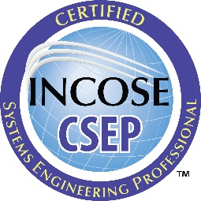
Certification Experience Requirements
SYSTEMS ENGINEERING EXPERIENCE DOCUMENTATION
  Applicants should document at least 60 months of work experience in SE, including at least 12 months in at least 3 different SE functional areas
  If applicants do not have a qualifying degree, they might need to document more than 5 months
  Work experience needs to be documented chronologically and without overlaps in Form1
MUST USE INCOSE FORMS AND FOLLOW INSTRUCTIONS, available at SEP Forms
incose.org/certification | 10

Slide 11
Certification Reference Requirements
SYSTEMS ENGINEERING EXPERIENCE CONFIRMATION
  Minimum requirement is recommendation letter from at least 1 manager. If more than 1 reference, can also use peers.
  References must confirm SE experience claims, including total months of work and experience in the different SE functional areas
  References must be knowledgeable of systems engineering (at least 5 years of experience in systems engineering)
MUST USE INCOSE FORMS AND FOLLOW INSTRUCTIONS, available at SEP Forms
incose.org/certification | 11

Slide 12
ASEP and CSEP Renewal
CERTIFICATION IS VALID FOR DEFINED TIME PERIOD
  5 Years for ASEP
  3 Years for CSEP
  Indefinite for ESEP
  All levels must maintain INCOSE individual membership
CERTIFICATION RENEWAL REQUIRES CONTINUING EDUCATION
  Minimum of 120 Professional Development Units (PDUs)
    Technical Society participation
    SE course work and publications
    SE job functions beyond daily work

Slide 13

Any Questions?
Certification Office
certification@incose.net
For more information visit
www.incose.org/certification

