Slide 1







International Council on Systems Engineering
A better world through a systems approach
CONNECT
LEAD
LEARN
PROSPER

Slide 2






INCOSE is the premier choice of systems engineers for professional development.
With over 30 years of experience, we are shaping the future of systems engineering.
We interact with systems engineers across the globe on a daily basis to set standards.
21,000
126
52
65
75
Members and
CAB Associates
Corporate Members
Chapters Worldwide
Countries with Active Members
Working Groups

Slide 3
INCOSE Member Breakdown
21%
EMEA Sector Members
28%
Americas Sector Members
7%
Asia-Oceania Sector Members
44%
CAB Associates
Stats from June 2022

Slide 4

Why Join INCOSE?
INCOSE is the global Systems Engineering professional society – providing the opportunity for life-long learning in systems approaches.
A community of peers, resources for your career, and a place
to be a leader.
INCOSE members stand out and are often sought after as experts.
INCOSE members share practices and learn from each other.
INCOSE members create products, produce events and represent
the organization in international forums.
INCOSE members increase the body of knowledge and advance
the practice of systems engineering.
Network with over 21,000 members in 75 countries.
Increase your professional stature with the INCOSE Systems Engineering Professional Certification.

Slide 5

Mission and Vision
VISION: A better world through a systems approach.
MISSION: To address complex societal and technical challenges by enabling, promoting, and advancing Systems Engineering and systems approaches.
OBJECTIVE: Global leader for systems engineering professionals for career development.
FUTURE: Lead the future of systems engineering, academically, in emerging domains, and in practice.

Slide 6







Membership Benefits
A global network of colleagues who understand systems engineering
Collaborate with experts and practitioners worldwide
Certification Opportunities
Exclusive access to INCOSE Connect, the collaborative space for INCOSE Members Only
Access to quarterly e-Publications, INSIGHT and Journal of Systems Engineering
Member discounted registration to the International Workshop and International Symposium.
Electronic version of the Systems Engineering Handbook

Slide 7
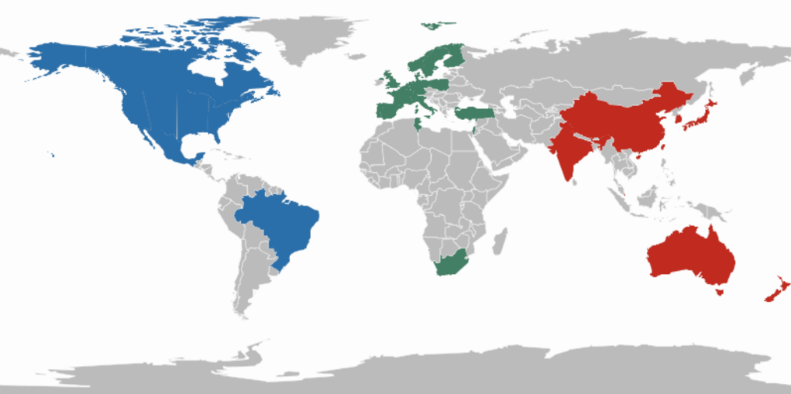
65 Chapters Worldwide
Chapters play an essential role in the achievement of INCOSE’s goals and objectives:
Organizing a multitude of professional and social programs
Attracting new members from industry, government and academia
Supporting technical activities striving to advance the state and art of systems engineering
Showcasing INCOSE as the international authoritative body on systems engineering that it is.
LEARN MORE
Incose.org/chapters

Slide 8























INCOSE Members per ESA Member State
Austria
32
Belgium
19*
Canada
296*
Czech Republic
2
Denmark 98*
Estonia
1
Finland
20*
France
932*
Germany
1314*
Greece
3
Hungary
1
Ireland
23
Italy
245*
Luxembourg 1
Netherlands
698 *
Norway
36*
Poland
18*
Portugal
4*
Romania
13
Spain
193*
Sweden
355*
Switzerland 126*
United Kingdom 1542*
MEMBERS & ASSOCIATES 5972
*for countries with chapters

Slide 9






Working Groups
INCOSE has over 50 active Working Groups. Some of the Working Groups are:
Artificial Intelligence Systems
Automotive
Human Systems Integration
MBSE Initiative
Natural Systems
PM-SE Integration
Requirements
Smart Cities
Social Systems
Working groups are the resource practitioners need.
Discuss, collaborate, share in person, and online with a wide diversity of interests.
Create products to advance the state, art and practice of systems engineering.
Help develop and review international standards
Bring value to other INCOSE stakeholders in your interest area
WGs run events, workshops, panels and much more
LEARN MORE: incose.org/workinggroups

Slide 10

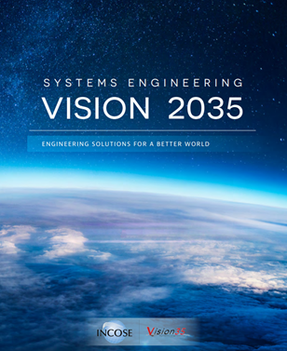
Systems Engineering Vision 2035
This Systems Engineering Vision was sponsored by INCOSE and produced by a team of leaders from the systems community, with inputs from across industry, academia, and government. The Systems Engineering Vision 2035 addresses:
The Global Context for Systems Engineering
The Current State of Systems Engineering
The Future State of Systems Engineering
Realizing the Vision
We encourage you to work with INCOSE to help realize this vision.
The complete Systems Engineering Vision 2035 is available as a website and PDF
LEARN MORE: incose.org/sevision

Slide 11


FuSE Program Value Statement
FuSE Vision: Inspire the Global Community
to Realize the
Vision of SE

Slide 12






FuSE Program Mission Statement
FuSE refines and evolves the SE Vision 2035 across competencies, research, tools & environment, practices, and applications.
Engage and inspire
the systems community for sustaining the future
of systems engineering
in realizing the
SE Vision 2035
FuSE fosters involvement and collaboration within and outside of INCOSE.
FuSE educates, shares success, and expands.

Slide 13






7 Success Factors for the FuSE Program
Attractive
Engage members and non-members
Inclusive
From an exclusive club to inclusive initiative
Close to
application
Involvement of
companies and domains
Fresh
Relevant and updated road map and context
Passion
To get the working group proud to be part of it
Implementation
The degree to which the road map is realized
Global
promotion
Attractive global digital marketing

Slide 14
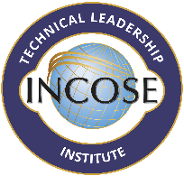

Initiatives: TLI and SySTEAM
The Technical Leadership Institute (TLI) is a global network of INCOSE members committed to improving technical leadership skills to better address the complex sociotechnical challenges of the twenty-first century. TLI members come from a wide range of countries.
LEARN MORE:
incose.org/tli
SySTEAM aims to promote a more just, equitable, and transparent approach to education in general, and interdisciplinary systems thinking/systems engineering competencies in particular, aimed at reducing disparities in educational quality, access, and competency attainment.
LEARN MORE: incose.org/systeam

Slide 15

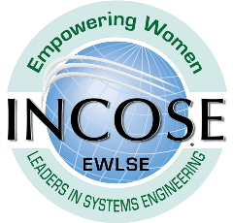
Initiatives: Diversity, Equity and Inclusion & EWLSE
Policy DEI-100 was established for the Diversity, Equity, and Inclusion (DE&I) initiative as an imperative effort within INCOSE to ensure that structures and mechanisms are in place to make INCOSE an organization where everyone can comfortably be their authentic self, recognize themselves in other members, and have an equal voice and opportunity in their interactions within the organization.
Strategic Goals of DEI:
Goal #1: Affirming greater inclusion and diversity within INCOSE membership.
Goal #2: Recruitment of more members from diverse backgrounds. Work is already underway to achieve Goal #2. New Membership Engagement (NMET) Diversity Equity & Inclusion (DEI)
LEARN MORE: incose.org/dei
EWLSE’s mission is to create an open systems engineering environment welcoming to all; promote the demonstrated value of women as systems engineers and leaders; engage women in engineering and systems engineering at all levels of education around the world; and enable increased participation and retention of women in systems engineering leadership.
LEARN MORE: incose.org/ewlse

Slide 16
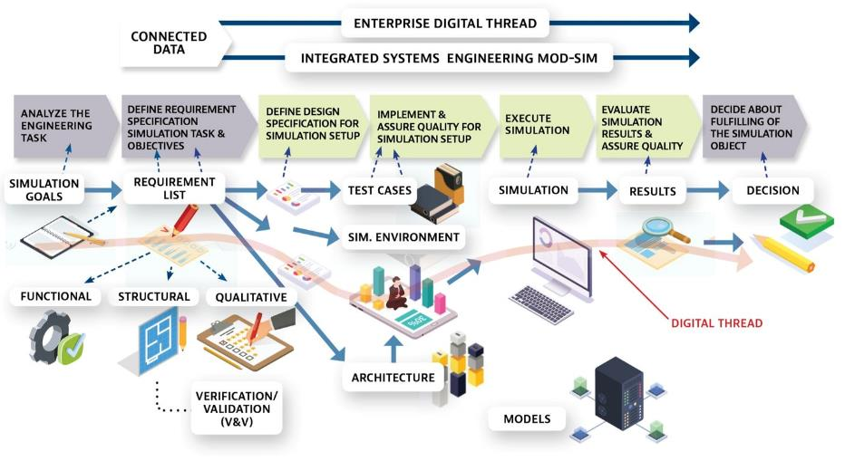
MBSE
The future of systems engineering is predominantly Model-Based (MBSE)
FROM:
The adoption of MBSE is uneven across industry sectors and within organizations.
Custom, one-off simulations are used for each project, and there is
still limited reuse of models especially during critical early phases of systems architecting and design validation.
TO:
Systems engineers routinely compose task-specific virtual models using ontologically linked, digital twin-based model-assets.
These connected models are updated in real-time providing a virtual reality-based, immersive design and exploration space. This virtual global collaboration space is cloud- based, enabled by modelling as
a service and supports massive simulation leveraging cloud-based high-capacity compute infrastructure.
Families of unified ModSim frameworks exist enabling small and medium businesses along with Government agencies to collaborate.

Slide 17
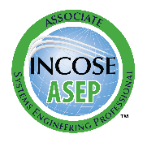
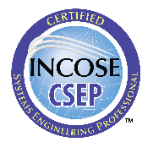
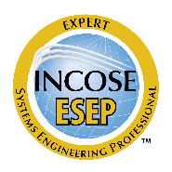
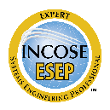

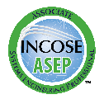
INCOSE Certification
The Certification Program offers internationally recognized systems engineering qualification at three levels; confirming an individual’s competency through demonstrated knowledge, education and experience.
Systems Engineering Professional (SEP) certification formally recognizes an individual’s progress through their career as they develop and apply systems engineering knowledge and practices.
INCOSE offers three levels of certification ASEP, CSEP and ESEP.
4,033
371
Current Active Certifications
LEARN MORE: incose.org/certification
2,239
1,323
Stats from June 2022

Slide 18

Corporate Advisory Board
Corporate Advisory Board membership allows organizations to guide the direction of the discipline.
Employees can gain access to the state-of-the-art products.
Align with peers and fellow industry leaders, grow your global footprint, and learn about how other industry leaders are applying systems engineering to solve business problems.
Gain better access to talent – find and hire competent, certified Systems Engineers through your INCOSE connection
The INCOSE Corporate Advisory Board (CAB) is the Voice of the Customer to the INCOSE leadership.
The CAB provides strategic guidance to technical leadership, leading to the development of systems engineering products and input to standards to meet their needs.
LEARN MORE: incose.org/cab

Slide 19

Academic Council
A branch of the Corporate Advisory Board facilitating discussion and exploration of issues relevant to academia and strategic collaborations within INCOSE.
A well-educated workforce is key to Global Prosperity.
Council member organizations offer bachelors, masters, and doctorate degrees in systems engineering and related programs.
Active in advancing the state-of-the-art of systems engineering through academic programs.
LEARN MORE: incose.org/cab

Slide 20

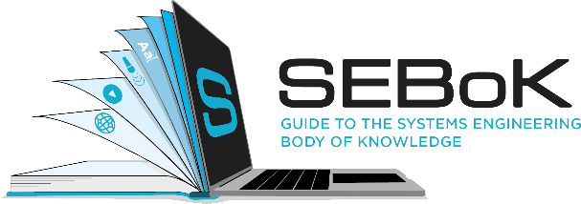




Resources

Slide 21


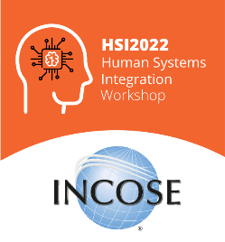


Conferences and Events
International Symposium 2023
International Workshop 2023
Human Systems Integration 2022
Europe, Middle East,
Africa (EMEA) Workshop
and Systems Engineering Conference (WSEC) 2023
LEARN MORE:
incose.org/events-and-news

Slide 22

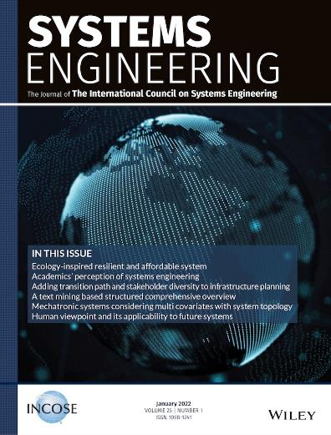
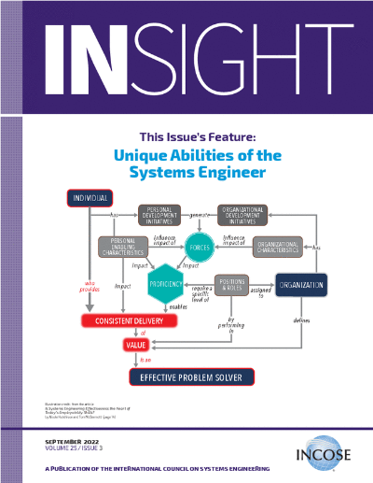
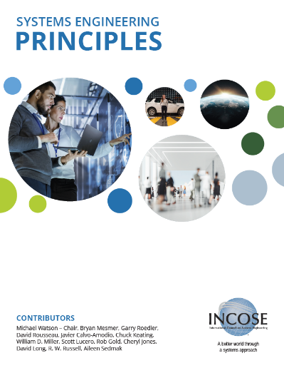
Publications
LEARN MORE:
http://connect.incose.org/store

Slide 23




The INCOSE Foundation
Committed to rewarding skills through scholarships for those engaged in finding solutions to complex technical challenges at all stages of their education or career.
Offers possibilities for people to pursue goals that anticipate the future – for them and for the world.
SCHOLARSHIPS INCLUDE:
  ISEF, the International Science and Engineering Fair INCOSE Award to a pre-college student
  The Chesapeake Chapter Award
  The Stevens Doctoral Award for Promising Research
  in Systems Engineering to a PhD Candidate
  The James E. Long Award for Post Doctoral work

Slide 24


Questions?

Slide 25


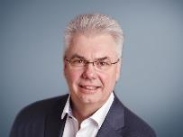




Contact Us
International Council on Systems Engineering
A better world through a systems approach
Ralf Hartmann, INCOSE Fellow
INCOSE President-Elect
Ralf.Hartmann@incose.net
+49 173 9829232
For more information contact infor@incose.net, marcom@incose.net | www.incose.org
@INCOSE
@incose_org
@incose_org
INCOSE

