Slide 1
Virtual System Integration and
Early Functional Validation in the Whole Vehicle
Gerhard Steininger, Dassault Systèmes

Slide 2
Agenda
How to control system complexity?
System Engineering Approach – Have we done the right things?
Virtual Integration in the whole vehicle
Emergency Brake Assistance as the Use Cases
Conclusion and Outlook

Slide 3
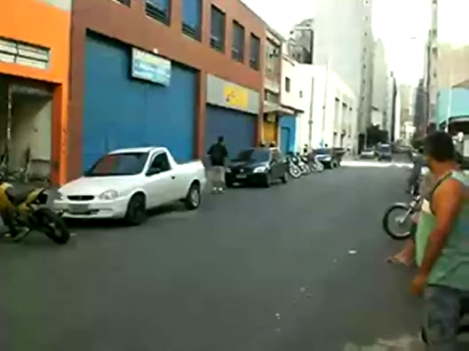
Why do we need automotive safety control systems?

Slide 4

And why do we need Advanced Driver
Assistance Systems (ADAS)?

Slide 5
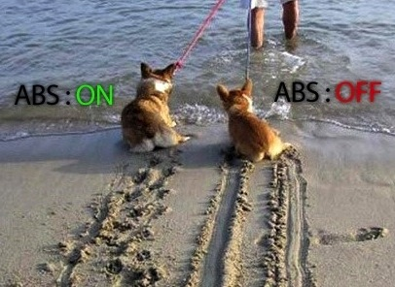

Control systems and embedded systems are core technologies to improve automotive safety and comfort
Electronic Stability Control
(ESC)
Lane Keeping Assistance System (LKAS)

Slide 6

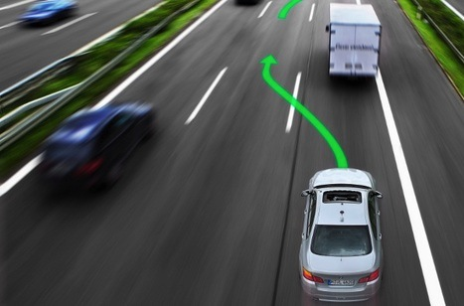




Example ADAS: Permanently increasing complexity
Adaptive Cruise Control
Front Collision Warning
Lane Departure Warning
Lane Keeping Assistance
Lane Change Warning
Parking Assistance
Light Assistance System
Night Vision Pedestrian Detection
Up to semi and highly automated driving
Source: BMW

Slide 7
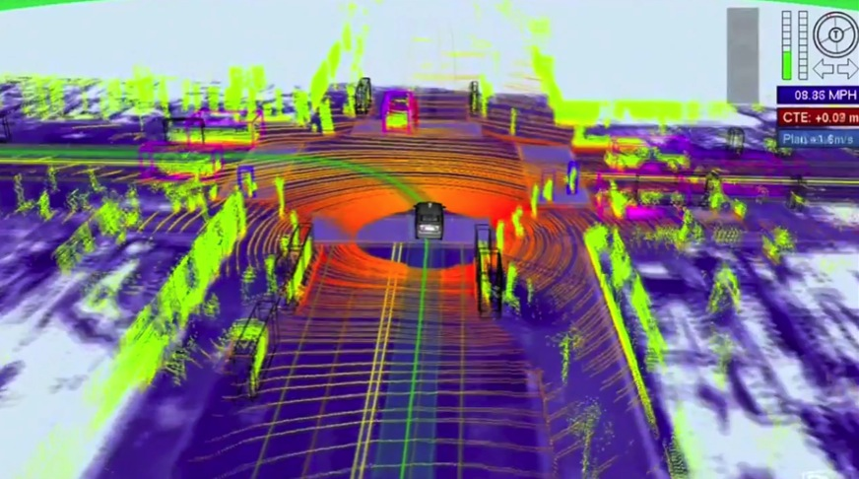
Google self-driving car activities

Slide 8





Regulation pushes requirements
Normal Driving
Hazard
Pre-Crash
In-Crash
Post-Crash
ACTIVE SAFETY
Historically almost no regulatory enforcement Stronger consideration by ECE, FMVSS e.g.: US: Electronic Stability Control (ESC) mandatory from 2010 Europe: ESC from 2011, Brake Assist from 2011 for cars ESC incl. roll over prevention from 2011 for trucks and trailers Emergency brake for trucks from 2014 Lane departure warning for trucks from 2016 ABS for Motorcycles >125 cc from 2016
PASSIVE SAFETY
Passive Safety Systems are very strongly promoted (ECE, FMVSS) Historically there are 3 focus areas: Body Structure and vehicle design - Vehicle structure - Vehicle interiors - Pedestrian protection Seatbelts Airbags
ECE: Economic Commission for Europe
FMVSS: Federal Motor Vehicle Safety Standards

Slide 9
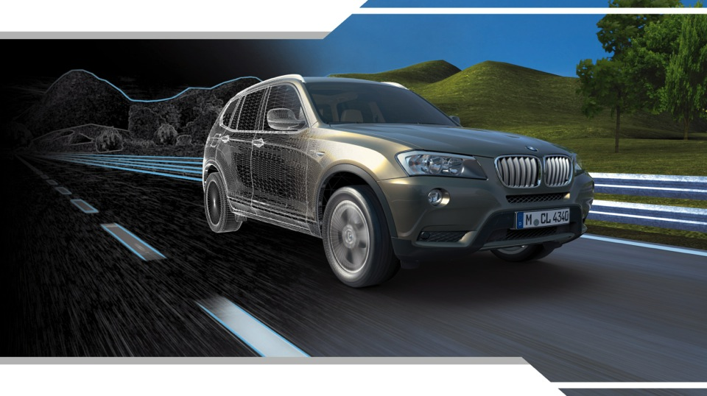
Different targets
Ergonomics
Weight
Quality
Drivability
Integrated Functions
Environment / Emission
Cost of Ownership
Ride Comfort
Styling
Handling
Safety

Slide 10
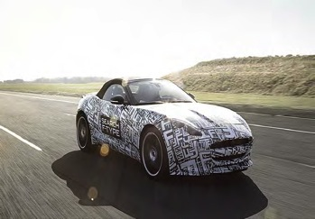
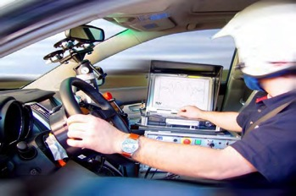
Current state
Early evaluation and validation
Approximately 60% of development time no real prototype available
Validate global vehicle
Less than 10% of the engineers get evaluation experience in global vehicle

Slide 11



Managing the validation effort
Variants
Processes
Technology
Integration Effort
Validation and Testing Effort
Network Functions
Tools
Methods
Time

Slide 12


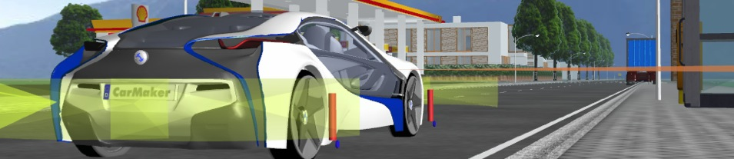
Merging validation and verification: X-in-the-Loop
Verification
  Have we done things correctly?
  Tested on system level and below
  Tested versus specifications
Validation
  Have we done the correct things?
  Tested on top level
  Tested versus expectations and design goals
X-in-the-loop approach
  Early integration of components, systems and algorithms into a virtual vehicle prototype
  Seamless evaluation and validation by virtual test driving with corporate maneuver catalogs and evaluation criteria

Slide 13
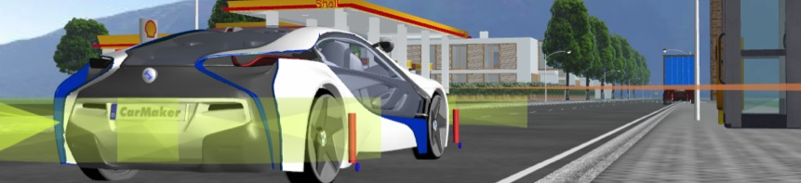




Seamless integration throughout the development process
Seamless integration using CarMaker
Office / MiL
Office / SiL
Lab / HiL
Real Vehicle
Models & Parameters
Test Maneuvers & Evaluation Criteria

Slide 14
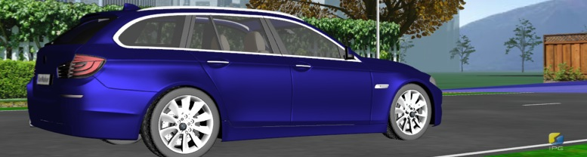
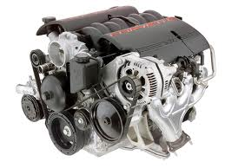
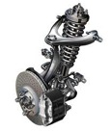
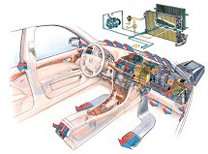
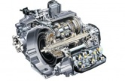
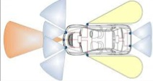
Virtual test driving using an integration and test platform
CarMaker
Functional Mock-Up Interface for Co-Simulation
Engine
with controls
Drivetrain
with controls
Chassis
with controls
ADAS
with controls
E/E

Slide 15
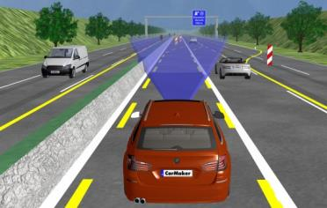
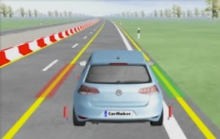
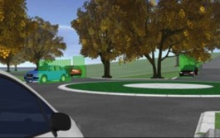
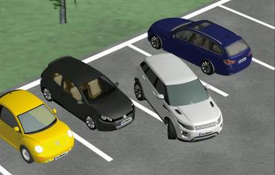
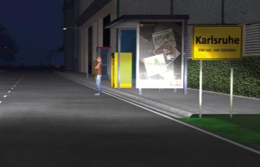
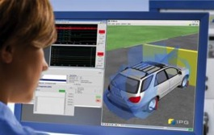
Maneuver-based testing by virtual test driving
  Verification of safety requirements
  Validation of key functions in connected systems
ACC / CAS
LDW / LKAS
Autonomous Driving
Parking Assistance
AFLS
Active/Passive Safety

Slide 16
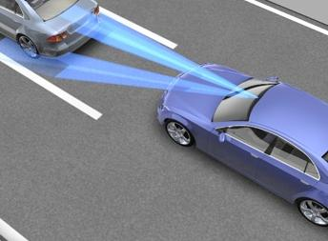
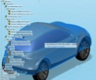









Use case: Emergency Brake Assistance (EBA)
Geometry
DS car model
Modeled in CATIA
ECU
MATLAB / Simulink model for Emergency Braking
FMU in Autosar Builder generated
FMU integrated in V6
Requirements
DA Sensor
Modeled in C-Code
Radar / Ultrasonic / Lidar / Camera
1 – 3 independent beams with 10 – 15 m
Behind windscreen or at the front
For obstacle identification
Brake
Dymola model from Modelon / Modellica Chassis library

Slide 17
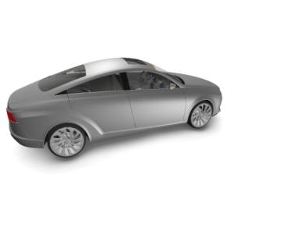
The EBA has 2 - 3 Functionalities
1
2
3
Emergency
Brake
Assistance
PreFill
Brake Assist
Support
Autonomous
Braking
Preconditioning of
the Brake System
Sensitivity Adjustment
of Brake Assist
Thresholds
Graded,
Autonomous
Deceleration
Request
Vehicle
Driver Information
Headup Display
Kombi HMI
ADAS
Autonomous Braking
ACC
Emergency Break Assist
Pre-fill
PreFill
Brake Assist Support
Sensitivity Adjustment Brake Assist
Autonomous Braking
Chassis
Braking Systems
ABS
ESC
Steering
Suspension

Slide 18
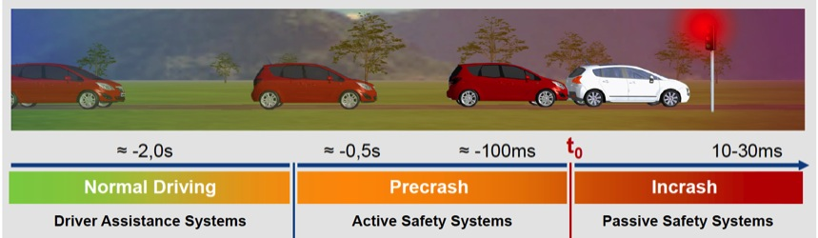
Required behavior models for the Emergency Brake Assist
HMI Behavior
Therefore functional Mock-up of the whole vehicle is needed.
Brake Behavior
Adaptive Cruise
Control
Lane Keeping
Support
Control Behavior
Autonomous Braking
Warning & Brake Pre-Fill
Speed
Hazard Identification
Vehicle Response
Sensor Behavior
Vehicle Behavior
Environment Model
TTC – Time to Collision
Time

Slide 19




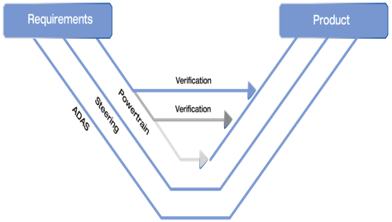













Virtualization of the development process
Engineering Processes
Early validation of systems and components along the V-cycle
6. Integration and Verification
6
5. Preparation of different components specification
Documents and delivery of models from suppliers
5
4
1. Clarification of requirements
4. Addition of concept properties / functional structure
3
1
2
Virtual ECU
2. Definition of fundamental concept properties
3. Addition of internal requirements
Model
Software
Hardware
Vehicle
-in-the-Loop

Slide 20
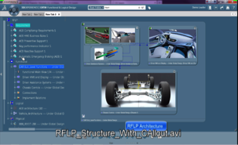
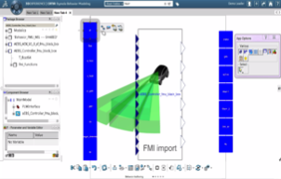
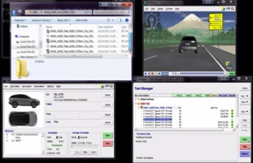
From Requirements to Systems and Simulation with Verification and Validation

Slide 21


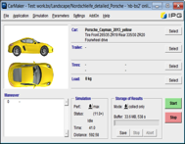
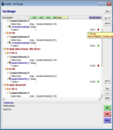
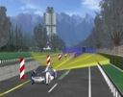
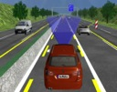
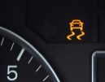
Integrating of virtual test driving into the development process
Maneuvers & criteria in CarMaker
Design models
Component models
Controller models
Test catalogs
Evaluation criteria
Maneuvers & Criteria in CarMaker
6
7
5
4
Test Conduction
1
Simulation results
Evaluation results
Test reports
Performance Tests
Controller Robustness
Collision avoidance
Braking distance …
3
2
Function Tests
AEBS
ACC
ESP…
Safety Software Tests
ISO 26262
Communication
Diagnostics …

Slide 22
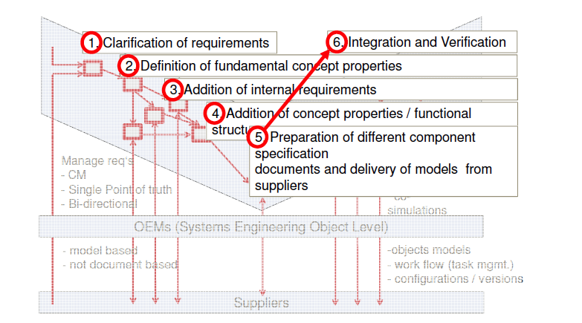
Systems engineering based on GAAG* recommendations
Remarks
The figure represents the GAAG MBSE Working Group summary about the future System Engineering process
  6 checkpoints along the V-Model to verify the deliverables and context
  The process includes all R-F-L-P relevant artefacts
*: GAAG: Global Automotive Advisory Group

Slide 23
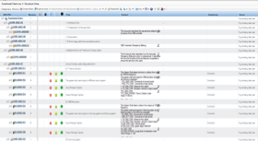
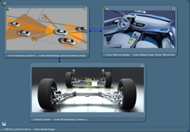
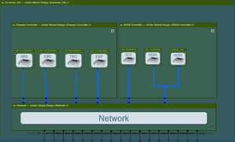
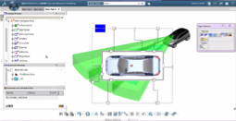
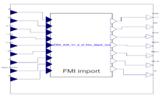
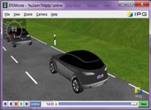


Major steps according the GAAG MBSE masterplan
1
2
3
Clarification of requirements | Definition of fundamental concept properties | Addition of internal requirements
Addition of concept properties / functional structures | Preparation of different component specs | Integration and verification
4
5
6
MATLAB
SIMULINK
FMI
Test and Integration Platform
DYMOLA
others
Authoring
Tools

Slide 24
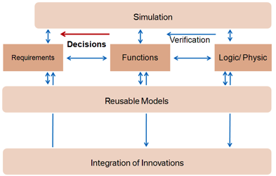
GAAG objectives and MBSE ** roadmap
Objective: Exchange of Systems Engineering Objects interfacing suppliers (solution partners) and OEM’s
Actual focus of GAAG WG
model based systems engineering
Geometrical
part of Physic JT
Functions
(evtl. solved by FMI*
and AutoSAR) tbd.
Requirements
ReqIF
Logic
Behavioral Models
FMI*
Full SE
Closing gaps
Structuring and linking models
Integration with CAE (FEA, CFD, ..)
*: FMI: Functional Mock up Interface
**: Model Based System Engineering
today

Slide 25
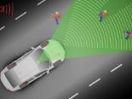


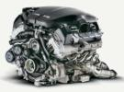



Interoperability between domains and disciplines for EBA
Product Development
Comments
B
P
E
C
Body
Chassis
EE
PT
There are different PD domains like Body, Chassis EE and Powertrain
Within the domains are different engineering disciplines like mechanical, electrical and SW Engineering
Every domain and the different disciplines are using different models and methods
Objective is to integrate domains and disciplines and aggregate it from subs-system to system and vehicle level
Mechanical
Electrical
Engineering Disciplines
Chassis
Braking Systems
EBA
ABS
Pre Fill
SW
ESC
Brake Assist Support
Steering
Autonomous Braking
Suspension

Slide 26



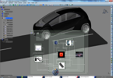
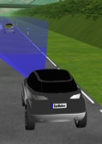

The traditional PLM platform has to become a SE platform
Consistent, up-to-date product data
Product structure and change management
Early phase
Consistent
Change Management
Early data
Conceptional alternatives
Cost
Weight
Features
Parametric construction
Independent view
Control of Commonality
Modularity
From target to project controlling
Integration CAD/ CATIA
Embedded Software
Behavior Models
Functions
Configuration
management
Target management
Integration CAD/ Construction
Electrics/Electronics
3D Experience

Slide 27
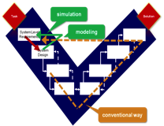




MBSE is possible with organization, processes and latest Technology
System-Responsible
Organization
Vehicle Architect
Test Manager
System related Commitment
and roles
Function responsible
Component Responsible
HMI- Responsible
Processes
and methods
R
F
L
P
Technology
and standards
ReqIF

Slide 28
Thank you. Questions?

