Slide 1


INCOSE Measurement Working Group
August 20, 2025
The Measurement Working Group
Salvatore R. Bruno
Enterprise Operations Metrics and Analysis Principal Engineer
Six Sigma Certified Green Belt
Practical Software and Systems Measurement LM POC
INCOSE Measurement Working Group Chair
INCITS Working Group 10 Representative
Boehm CSSE Member

Slide 2
Measurement Working Group Presentation
Agenda
INCOSE Measurement Working Group Summary 7 Minutes
Measurement Fundamentals 19 Minutes
The Measurement Domain Realm 13 Minutes
Questions and Answers 5 Minutes

Slide 3
Measurement Working Group Presentation
Measurements Working Group Summary
What does the Measurement Working Group do?
Why is the Measurement Working Group Important?
Any Obstacles, Challenges, or Issues Slowing Us Down?

Slide 4
Measurement Working Group Presentation
What does the Measurement Working Group Do?
Promotes Measurement Monitoring and Tracking of System Engineering Activities:
  Performance Indicator reporting and analysis – metric types, thresholds, likely problem areas, …
  Measurement activities and practices – successful processes and procedures
  Tools, Templates and Techniques – the foundational elements to run a measure program
Quarterly WG Meetings / Presentations
Share and Educate on Measurement Activities, Advancements, Studies, …
Create documents, guidebooks, and publications
  Internal (within INCOSE)
  External (Joint venture/partnerships)

Slide 5
Measurement Working Group Presentation
Why is the Measurement Working Group Important?
Provides direct and indirect measurement expertise
  Direct – Define and document tools, techniques, processes and indicators for those leading or responsible for a measurement reporting environment as well as those interested in knowing more about how a measures, metrics, and indicators should be used.
  Indirect – Reference material, examples, consortium teams, event/activity calendar, and a user request board.
Guide a company’s program measurement coordinator’s ability to perform their role
Provide answers or recommendations to working group members metric questions

Slide 6
Measurement Working Group Presentation
Any Obstacles, Challenges, or Issues Slowing Us Down?
Working Group Foundational Issues
  Working Group Storage / Repository Location
  Working Group Communication Protocol
  Working Group Membership
    INCOSE Members
    Non-INCOSE Members
Working Group Restart
  Working Group became dormant in 2021
  Selection of new Chair occurred in April 2023
  Focus on DE Measurement Framework Guidance v2.0 from April 2023 to December 2025
  INCOSE Digital Engineering Insight Article
  Addressing WG Obstacles, Challenges and Issues prior to restart in January 2026
2025
2026

Slide 7
Measurement Working Group Presentation
Measurement Fundamentals
Measurement Activities
Measurement Tempo / Cadence / Business Rhythm
Measurement Attributes / Features / Characteristics

Slide 8
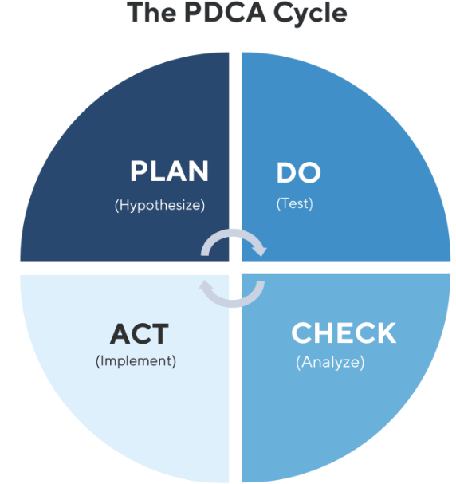
Measurement Working Group Presentation
Measurement Activities
Status Reporting
  Ensuring a regular reoccurring reporting of business and programs/projects activities
  Data Collection
  Analysis
  Status Dashboard Updates
On Demand Analysis Research / Investigation
Continuous Measurement Infrastructure Improvement
Monthly Tempo

Slide 9
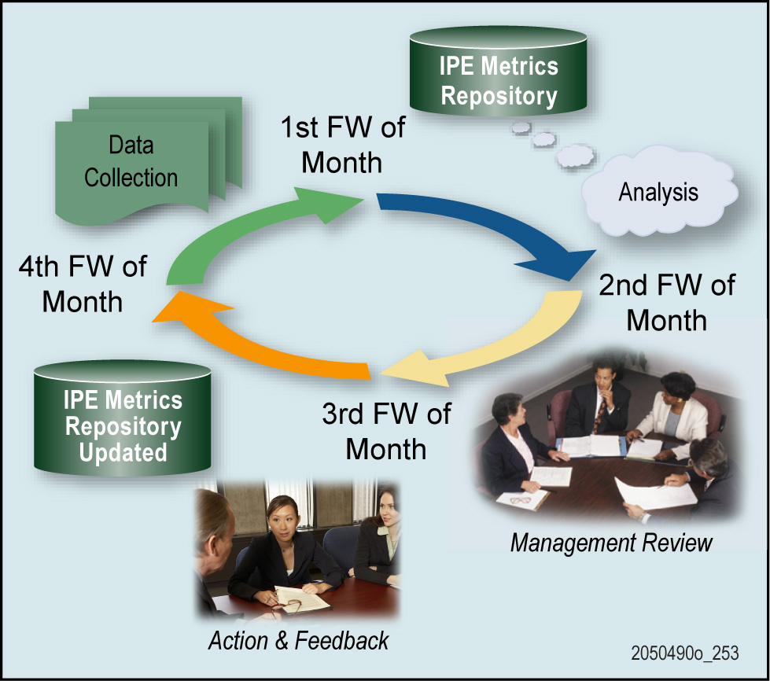
Measurement Working Group Presentation
Measurement Tempo / Cadence / Business Rhythm
On-Demand, Daily, Weekly, Monthly, Quarterly, Semi-Annual, and Annual
Example: The Monthly Cadence
FW 1 – Data Collection and Storage
FW 2 – Analysis of Indicators
FW 3 – Management Review of Results
FW 4 – Action and Feedback
80%
63%
17%
20%
18%
2%

Slide 10
Measurement Working Group Presentation
Measurement Tempo / Cadence / Business Rhythm
On-Demand, Daily, Weekly, Monthly, Quarterly, Semi-Annual, and Annual
Example: The Monthly Cadence
Automation
FW 1 – Data Collection and Storage
FW 2 – Analysis of Indicators
FW 3 – Management Review of Results
FW 4 – Action and Feedback
80%
63%
15%
17%
65%
20%
18%
18%
2%
2%
Improvements Maturity Areas
Data collection automation
Data Quality – Proper source data reporting
AI analysis assistance

Slide 11
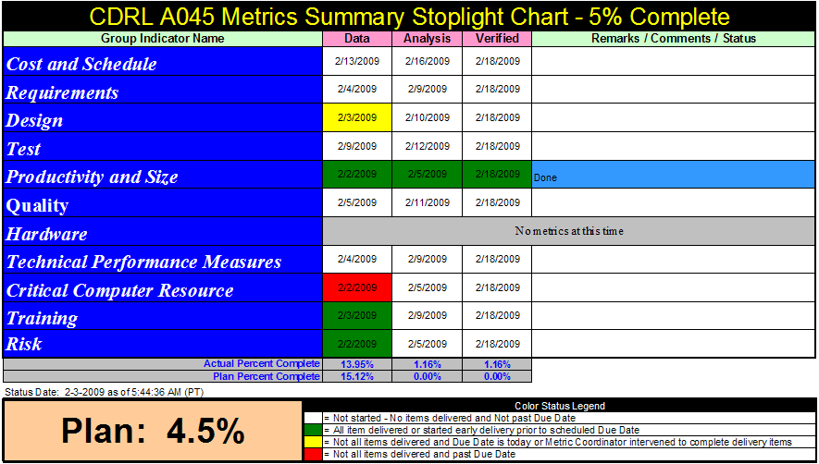
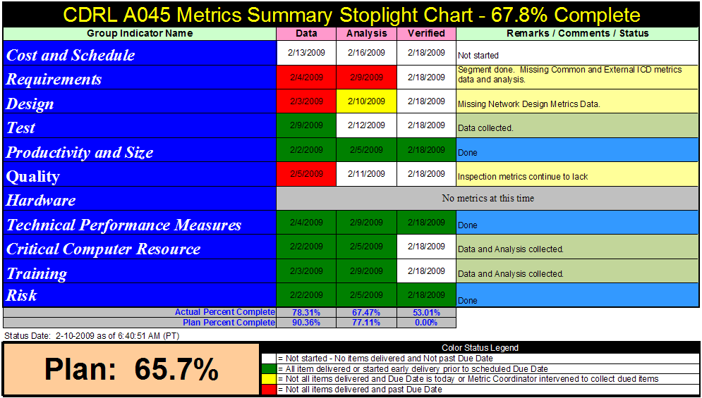
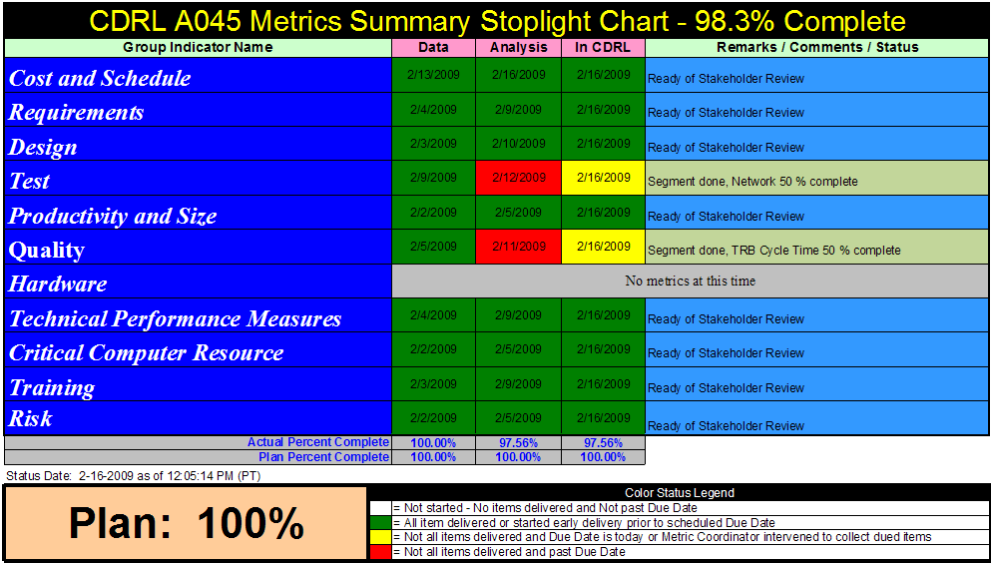
Measurement Working Group Presentation
Measurement Tempo / Cadence / Business Rhythm
Weekly Measurement Status Progress
FW1
FW2
FW3

Slide 12
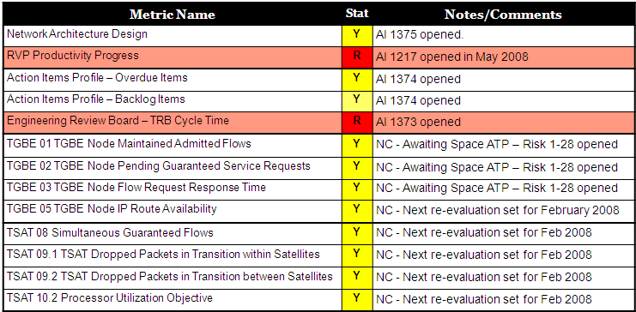
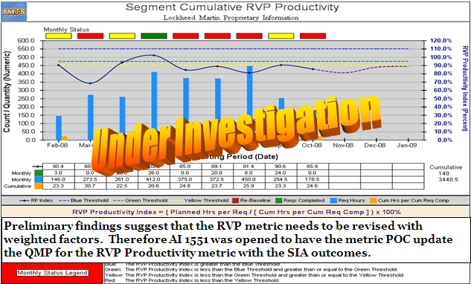
Measurement Working Group Presentation
Measurement Tempo / Cadence / Business Rhythm
FW 1 – Data Collection and Storage
FW 2 – Analysis of Indicators
FW 3 – Management Review of Results
FW 4 – Action and Feedback

Slide 13
Measurement Working Group Presentation
Measurement Tempo / Cadence / Business Rhythm
FW 1 – Data Collection and Storage
FW 2 – Analysis of Indicators
FW 3 – Management Review of Results
FW 4 – Action and Feedback
BAM!

Slide 14
Measurement Working Group Presentation
Measurement Tempo / Cadence / Business Rhythm
FW 1 – Data Collection and Storage
FW 2 – Analysis of Indicators
FW 3 – Management Review of Results
FW 4 – Action and Feedback
Action
Items
BAM!

Slide 15
Measurement Working Group Presentation
Measurement Tempo / Cadence / Business Rhythm
FW 1 – Data Collection and Storage
FW 2 – Analysis of Indicators
FW 3 – Management Review of Results
FW 4 – Action and Feedback
Risks
Action
Items
BAM!

Slide 16
Measurement Working Group Presentation
Measurement Tempo / Cadence / Business Rhythm
FW 1 – Data Collection and Storage
FW 2 – Analysis of Indicators
FW 3 – Management Review of Results
FW 4 – Action and Feedback
Risks
Action
Items
BAM!

Slide 17
Measurement Working Group Presentation
Measurement Tempo / Cadence / Business Rhythm
FW 1 – Data Collection and Storage
FW 2 – Analysis of Indicators
FW 3 – Management Review of Results
FW 4 – Action and Feedback
Lessons Learned
Risks
Action
Items
BAM!

Slide 18
Measurement Working Group Presentation
Measurement Tempo / Cadence / Business Rhythm
FW 1 – Data Collection and Storage
FW 2 – Analysis of Indicators
FW 3 – Management Review of Results
FW 4 – Action and Feedback
Process Improvement
Lessons Learned
Risks
Action
Items
BAM!

Slide 19
Measurement Working Group Presentation
Measurement Tempo / Cadence / Business Rhythm
FW 1 – Data Collection and Storage
FW 2 – Analysis of Indicators
FW 3 – Management Review of Results
FW 4 – Action and Feedback
Process Improvement
Lessons Learned
CDRL Delivery
Risks
Action
Items
BAM!

Slide 20
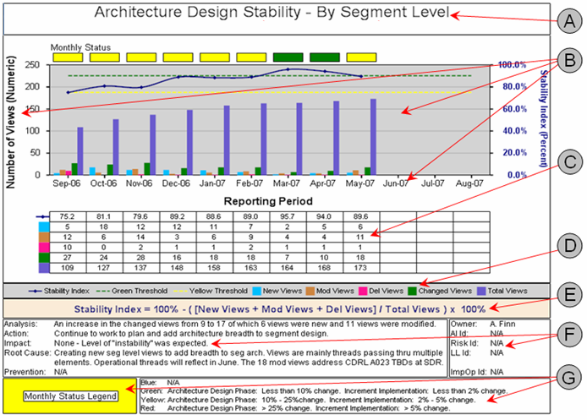
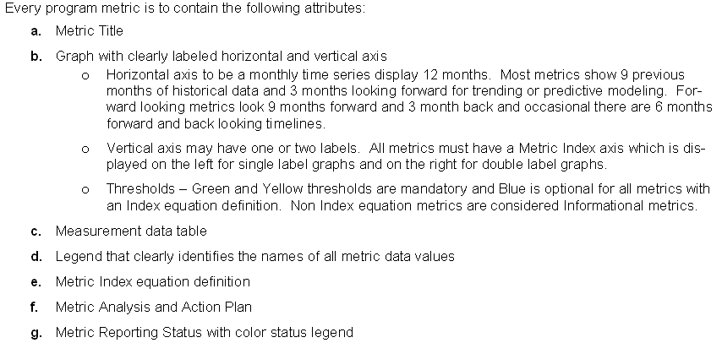
Measurement Working Group Presentation
Measurement Attributes / Features / Characteristics

Slide 21
Measurement Working Group Presentation
The Measurement Domain Realm
Metrics,
Measures,
Measurements,
Indicators

Slide 22
Measurement Working Group Presentation
The Measurement Domain Realm
New Conceptional Study
Metrics,
Measures,
Measurements,
Indicators

Slide 23
Measurement Working Group Presentation
The Measurement Domain Realm
Generic Definition: A method to measure something.
Metrics,
Measures,
Measurements,
Indicators

Slide 24
Measurement Working Group Presentation
The Measurement Domain Realm
Generic Definition: A method to measure something.
Systems Engineering Definition: A set of quantifiable measurements used to track, monitor, and assess the performance of various business processes and activities.
Metrics,
Measures,
Measurements,
Indicators

Slide 25
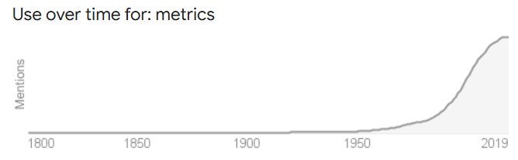
Measurement Working Group Presentation
The Measurement Domain Realm
Generic Definition: A method to measure something.
Systems Engineering Definition: A set of quantifiable measurements used to track, monitor, and assess the performance of various business processes and activities.
Metrics,
Measures,
Measurements,
Indicators

Slide 26
Measurement Working Group Presentation
The Measurement Domain Realm
Generic Definition: A method to measure something.
Systems Engineering Definition: A set of quantifiable measurements used to track, monitor, and assess the performance of various business processes and activities.
INCOSE MWG Definition: TBD (To Be Defined – or – To Be Determined)
Base upon the current study of understanding the Measurement Domain Realm
Metrics,
Measures,
Measurements,
Indicators

Slide 27

Measurement Working Group Presentation
The Measurement Domain Realm
They measure something!
Metrics,
Measures,
Measurements,
Indicators

Slide 28
Measurement Working Group Presentation
The Measurement Domain Realm
They measure something!
They provide feedback on
  Past Performance (lagging)
  Expected Results (leading)
  Anticipated future outcomes (predictive)
Metrics,
Measures,
Measurements,
Indicators

Slide 29
Measurement Working Group Presentation
The Measurement Domain Realm
They measure something!
They provide feedback on
  Past Performance (lagging)
  Expected Results (leading)
  Anticipated future outcomes (predictive)
Metrics,
Measures,
Measurements,
Indicators
New

Slide 30
Measurement Working Group Presentation
The Measurement Domain Realm
A comparison to
another standard!
They measure something!
They provide feedback on
  Past Performance (lagging)
  Expected Results (leading)
  Anticipated future outcomes (predictive)
Metrics,
Measures,
Measurements,
Indicators
New

Slide 31
Measurement Working Group Presentation
The Measurement Domain Realm
Plan versus Actual
A comparison to
another standard!
They measure something!
They provide feedback on
  Past Performance (lagging)
  Expected Results (leading)
  Anticipated future outcomes (predictive)
Metrics,
Measures,
Measurements,
Indicators
New

Slide 32
Measurement Working Group Presentation
The Measurement Domain Realm
Plan versus Actual
A Contractual Requirement(s)
A comparison to
another standard!
They measure something!
They provide feedback on
  Past Performance (lagging)
  Expected Results (leading)
  Anticipated future outcomes (predictive)
Metrics,
Measures,
Measurements,
Indicators
New

Slide 33
Measurement Working Group Presentation
The Measurement Domain Realm
Plan versus Actual
A Contractual Requirement(s)
  Cost
  Schedule
  Features/Capabilities
A comparison to
another standard!
They measure something!
They provide feedback on
  Past Performance (lagging)
  Expected Results (leading)
  Anticipated future outcomes (predictive)
Metrics,
Measures,
Measurements,
Indicators
New

Slide 34
Measurement Working Group Presentation
The Measurement Domain Realm
Plan versus Actual
A Contractual Requirement(s)
  Cost
  Schedule
  Features/Capabilities
Company Goal(s) and Objective(s)
A comparison to
another standard!
They measure something!
They provide feedback on
  Past Performance (lagging)
  Expected Results (leading)
  Anticipated future outcomes (predictive)
Metrics,
Measures,
Measurements,
Indicators
New

Slide 35

Measurement Working Group Presentation
The Measurement Domain Realm
Are We Meeting
the Standards?
Plan versus Actual
A Contractual Requirement(s)
  Cost
  Schedule
  Features/Capabilities
Company Goal(s) and Objective(s)
A comparison to
another standard!
They measure something!
They provide feedback on
  Past Performance (lagging)
  Expected Results (leading)
  Anticipated future outcomes (predictive)
Metrics,
Measures,
Measurements,
Indicators
New

Slide 36
Measurement Working Group Presentation
The Measurement Domain Realm
System Engineering
Requirements
Are We Meeting
the Standards?
Plan versus Actual
A Contractual Requirement(s)
  Cost
  Schedule
  Features/Capabilities
Company Goal(s) and Objective(s)
A comparison to
another standard!
They measure something!
They provide feedback on
  Past Performance (lagging)
  Expected Results (leading)
  Anticipated future outcomes (predictive)
Metrics,
Measures,
Measurements,
Indicators
New

Slide 37
Measurement Working Group Presentation
The Measurement Domain Realm
Generic Definition: A method to measure something.
Systems Engineering Definition: A set of quantifiable measurements used to track, monitor, and assess the performance of various business processes and activities.
INCOSE MWG Definition: TBD (To Be Defined – or – To Be Determined)
Base upon the current study of understanding the Measurement Domain Realm
Metrics,
Measures,
Measurements,
Indicators

Slide 38
Measurement Working Group Presentation
The Measurement Domain Realm
Generic Definition: A method to measure something.
Systems Engineering Definition: A set of quantifiable measurements used to track, monitor, and assess the performance of various business processes and activities.
INCOSE MWG Definition: A method to measure the performance of a specific business or system engineering process or requirement is satisfying the intended goal or objective.
Unofficial
Metrics,
Measures,
Measurements,
Indicators

Slide 39
Measurement Working Group Presentation
The Measurement Domain Realm
Generic Definition: A method to measure something.
Systems Engineering Definition: A set of quantifiable measurements used to track, monitor, and assess the performance of various business processes and activities.
INCOSE MWG Definition: A method to measure the performance of a specific business or system engineering process or requirement is satisfying the intended goal or objective.
Unofficial
In order words, a metric (measure, measurement or indicator) provides feedback on how well (goodness) your specific item is compliant.
Metrics,
Measures,
Measurements,
Indicators

Slide 40
Measurement Working Group Presentation
The Measurement Domain Realm
Generic Definition: A method to measure something.
Systems Engineering Definition: A set of quantifiable measurements used to track, monitor, and assess the performance of various business processes and activities.
INCOSE MWG Definition: A method to measure the performance of a specific business or system engineering process or requirement is satisfying the intended goal or objective.
Unofficial
In order words, a metric (measure, measurement or indicator) provides feedback on how well (QUALITY) your specific item is compliant.
Metrics,
Measures,
Measurements,
Indicators

Slide 41


Measurement Working Group Presentation
The Measurement Domain Realm
Metrics,
Measures,
Measurements,
Indicators

Slide 42
Measurement Working Group Presentation
The Measurement Domain Realm
Metrics,
Measures,
Measurements,
Indicators

Slide 43

Measurement Working Group Presentation
The Measurement Domain Realm
Metrics,
Measures,
Measurements,
Indicators

Slide 44
Measurement Working Group Presentation
The Measurement Domain Realm
A completely Different Topic
Metrics,
Measures,
Measurements,
Indicators

Slide 45
Measurement Working Group Presentation
The Measurement Domain Realm
People
Management
Processes
Control – Data/Info - Improvement
Products/Services
Contractual Agreement
Management – Customer, Leadership, Strategy, Change, Evidence-based, Decision making, and Relationship
Control – process control, control charts, acceptance sampling, and product quality control – three levels of minor, major and critical
Improvement – tools/equipment, AeroCodes, feedback
Data/Information – measures processes, results and structures
Product – Performance, Features, Reliability, Consistency, Conformance, Durability, Serviceability, Aesthetics, Perceived Quality

Slide 46





Measurement Working Group Presentation
antifying
nomalies
eft
n
he
ard
In Summary,
Quality is simply the action to find and remove imperfections within the business operations of our company and keeping them from reoccurring.

Slide 47


Measurement Working Group Presentation
Questions and Answers

Slide 48
BACK-UP

Slide 49


Salvatore R Bruno
LM Enterprise Operations – Measurement and Data Analysis Principal Engineer
Mr. Bruno brings a rich experience in largescale systems development, consulting, and executive level leadership of product development and information technology solutions for the government/defense, telecommunications, and shipping industries. Prior to joining Lockheed Martin, he was a software engineer/analysis with Lawrence Livermore National Laboratory and technical applications project manager at Pacific Bell. He successful led and built consulting and professional services practices for Embarcadero Systems Corporation, InfoGain, Contra Costa County, and Idapta.
At Lockheed Martin, Mr. Bruno is responsible for establishing standardize policies/procedures, processes, and definitions of performance measurement practices across the company’s business areas and ensures the successful reporting of enterprise, business areas, and program metrics. His scope of influence includes identifying innovative ideas, process improvement practices, quality initiatives, and tool automation.
Mr. Bruno is a leading authority on the creation and use of indicators development and practices. He’s the founder and host of the “Program Measurement Coordinators” Community of Practice, and has created performance measurement dashboards using Alteryx, SQL Server, Tableau, and Excel. Mr. Bruno has invented and created new, innovative and meaningful indicators such as the Scalometer and Statoport, uses statistical analysis to identify problems and recommend process improvement changes, and initiates new measurement concepts like QPI (Quality Performance Index), expanding the color rating performance spectrum, promotes quality principles with human factors engineering designs into his solutions.
Mr. Bruno has a MS in Systems Management from the University of Denver; a BS in Mathematics and Computer Science from California State University, East Bay. He is a LM Associate Fellow, certified six sigma green belt, INCOSE Measurement Working Group Chair, INCITS Measurement Working Group Lead, and was an adjunct professor for Golden Gate and Chapman Universities.

