Slide 1
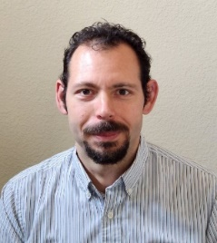




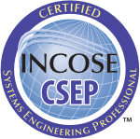
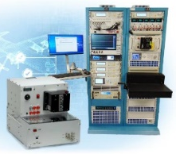
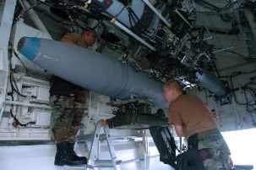
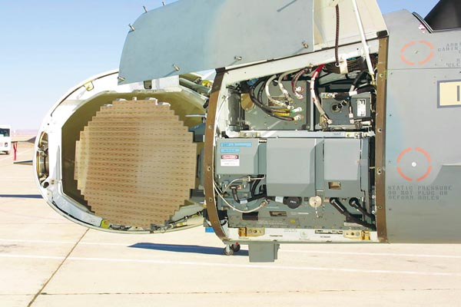

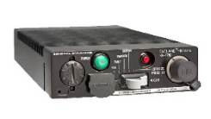
Seth Sherman
Senior Principal Systems Engineer
seth.h.sherman@rtx.com
210-415-5704
469-307-2516
MS Systems Eng, U of Arizona
BS Aerospace Eng, UT @ Austin
2005-2012
A-10 Precision Engagement Program
A-10 Propulsion Upgrade Program
Obsolescence remediation for Threat Emitters and ICBMs
+120
~20 yrs in Aerospace and Defense:
RTX, L3H, CACI, SwRI
INCOSE NTX
VP Tech Development (2023)
Chapter Development (2024)
President (2025)
2012-2019
Automated Test System Sustainment Initiative II
B-2 Armament Testing
Bomb Armament Tester
2019-2021
Remote Rekey Modernization Program
2021-Present
Advanced Technology and Agile Development Programs
-MBSE
-RF Apertures
-Architectures

Slide 2
For those of you taking the test:
You know yourself better than I do for test preparation
Test Based on INCOSE Handbook Version 5
Handbook is based on ISO 15288 - Systems and software engineering — System life cycle processes
Read the book! They can test you on any material within it!
Ask yourself, how could the test ask me about the material I just read?
FYI: ISO 15288.1 IEEE Standard for Application of Systems Engineering on Defense Programs

Slide 3
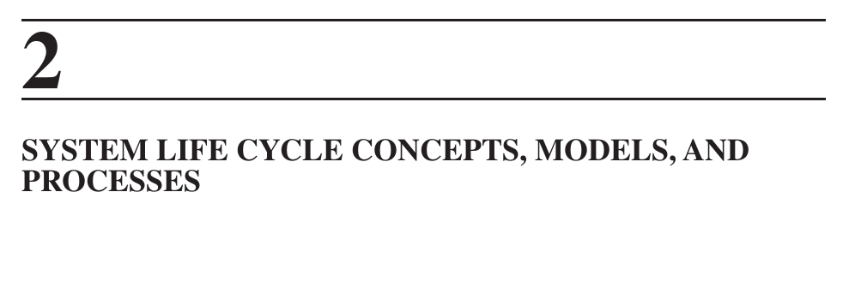
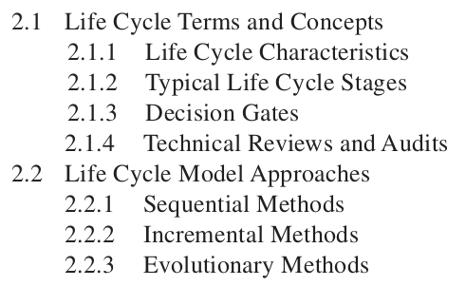
You may see notes on sides and tops to provide additional context and details

Slide 4
2.1 Life Cycle Terms and Concepts
Purpose of SE: Enable successful realization of system while optimizing among competing stakeholder objectives
Break effort into stages for verification/check fulfillment and risk
Stages are not: Singular or sequential
Decision gates represent critical decision points within the lifecycle
Regular reviews are necessary to ensure progress is being made with acceptable risks

Slide 5
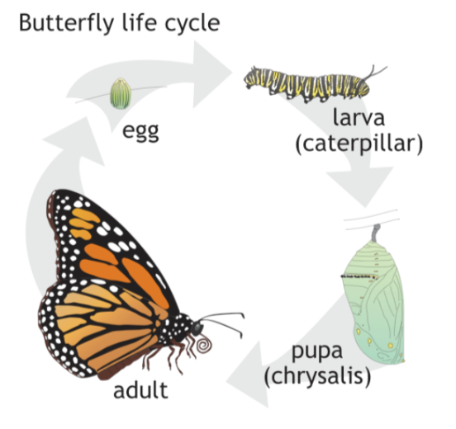
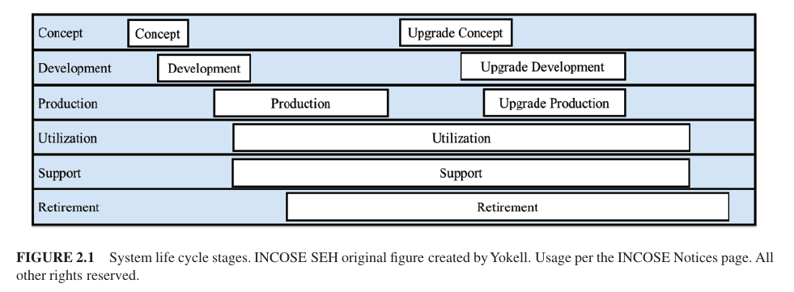
2.1.1 Life Cycle Characteristics
Stages mark progress, Common ones shown below
Can occur concurrently, figure is notional
What is a life cycle: Series of stages through which something passes

Slide 6
2.1.1 Life Cycle Characteristics (cont’d)
Lifecycle in layers (up and down)
Requirements
  Allocated down
  Decision gates for evaluation
System Y
System X
System of Systems
System of Interest
Try to Synchronize
Subsystem A
Subsystem B
Assembly 1
Assembly N

Slide 7
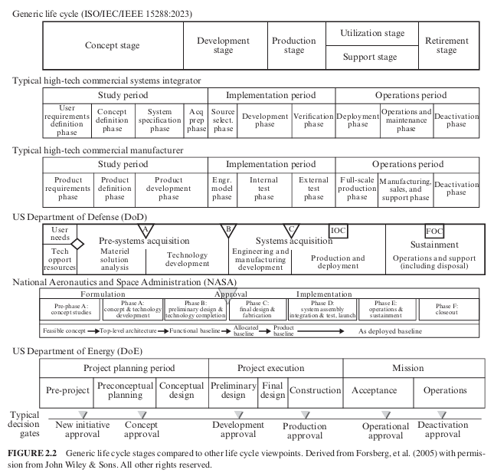
2.1.2 Typical Life Cycle Stages
Demo alignment between generic life cycle and other models
Models include decision gates
DoD Life Cycle
DoD 5000.02

Slide 8
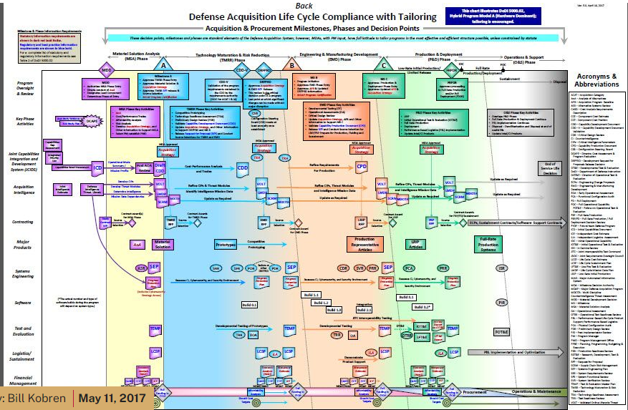
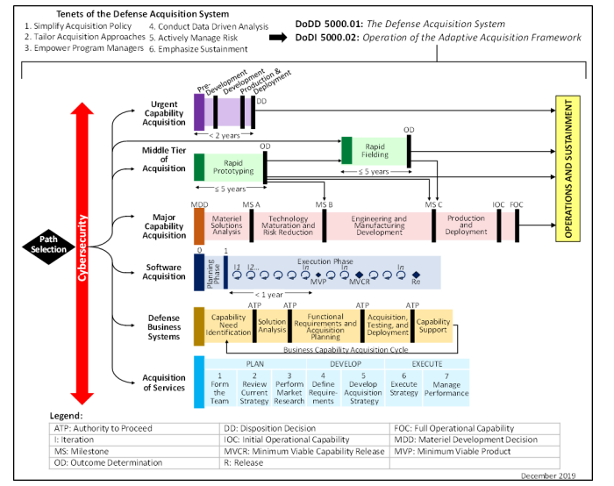
DoD Is transitioning to different acquisition strategies aligned with products, enable rapid response
Not on test, more informational and awareness

Slide 9
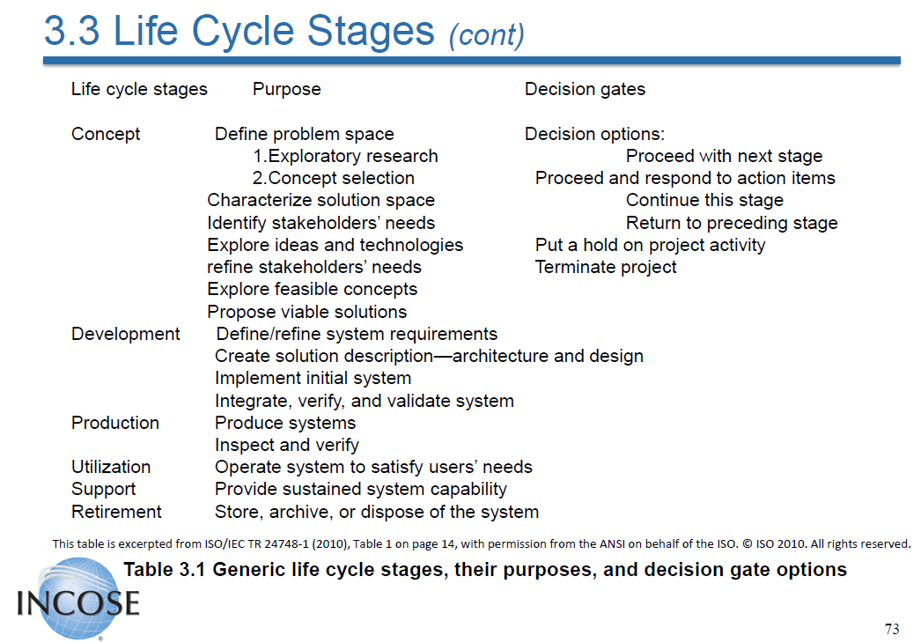
Decision Gates
From V4
Slide 73

Slide 10
Concept Stage
Recognition of a need for new/modified capability
Explore options: address short- and long-term considerations
  Survey, trade studies, analyses to explore solution space
You want to: define the problem space, characterize solution space, have a set of requirements
Outputs: Operational Concept, support concept, feasibility, models, architecture, stakeholder requirements
Decisions made during this stage drive future costs and increase in difficulty to change over time

Slide 11
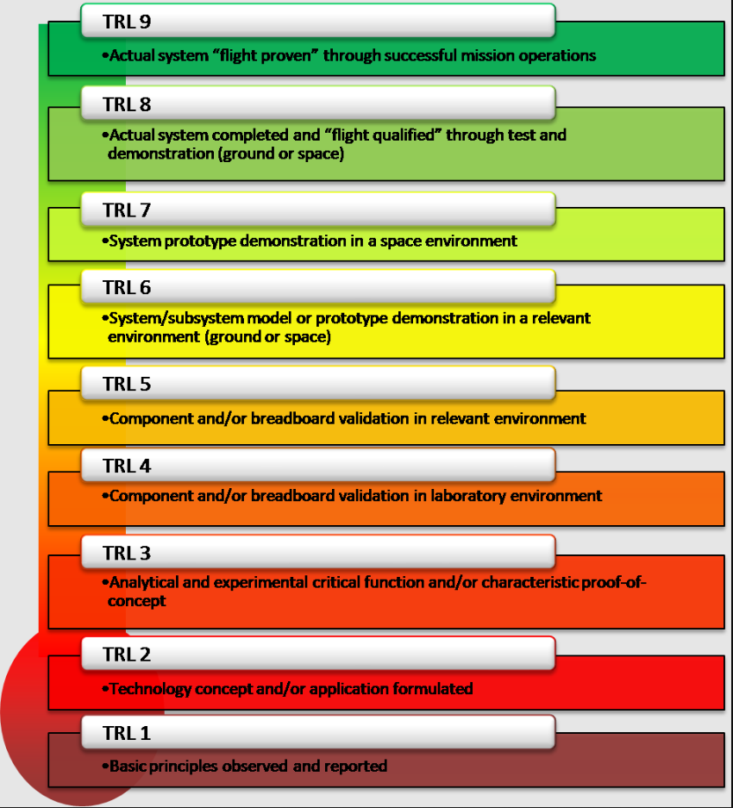
Defense Acquisition University (DoD 5000.02)
TRL and MRL Assessment
NASA TRL (DoD prescribes to same concepts)
From DoD MRL Book
MRL | Description
10 | Full rate production demonstrated and lean production practices in place
9 | Low rate production demonstrated; Capability in place to begin full rate production
8 | Pilot line capability demonstrated; Ready to begin Low Rate Initial Production
7 | Capability to product systems, subsystems, or components in a production representative environment
6 | Capability to produce a prototype system or subsystem in a production relevant environment
5 | Capability to product prototype components in a production relevant environment
4 | Capability to product the technology in a laboratory environment
3 | Manufacturing Proof of Concept Developed
2 | Manufacturing Concepts Identified
1 | Basic Manufacturing Implications Identified

Slide 12
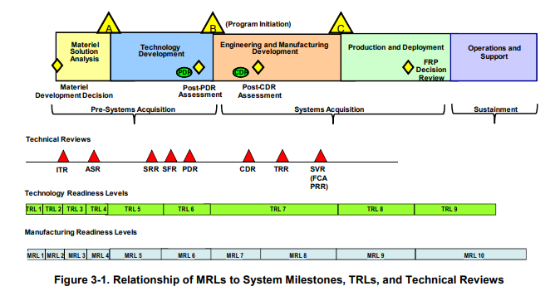
Also FYI – Be Aware of Sustainment Maturity Levels!

Slide 13
Development Stage
Define the system of interest
System analyses studies, and additional Modeling and Simulation
Mature concepts and stakeholder needs
Drive an engineering baseline: req’ts, architecture, design, docs
Outputs: SOI, requirements, integration plan, verification, validation, etc.

Slide 14
Production, Utilization, Support, Retirement
Production: Approval to translate baseline to actual system
  SoI becomes reality
Utilization: Use of system or parts of system in intended environment to provide capability
  Mods occur throughout this stage (life extension)
Support Stage: Planned around support for utilization
  Address deficiencies, reduce op cost, resolve supportability
Retirement: Remove SoI from service
  How to dispose of product? – safety, chemicals, etc.

Slide 15
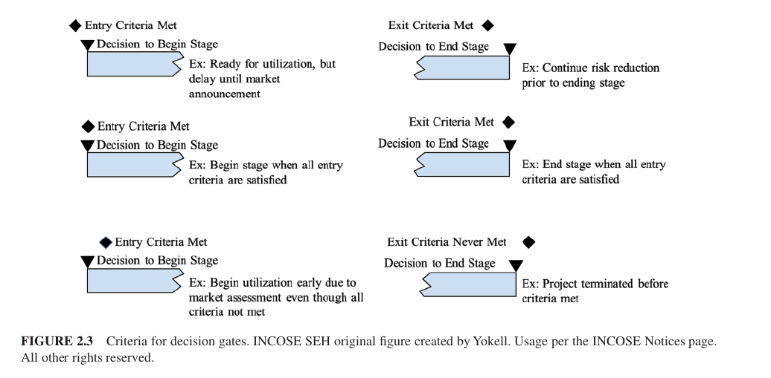
2.1.3 Decision Gates
Decision points in system life cycle, risk mitigation, progress
Confirm:
  Maturity within threshold
  Deliverables satisfy business case
  Sufficient resources
  Unresolved issues
  Overall risk

Slide 16
2.1.3 Decision Gates (cont’d)
Decision options:
  Begin next stage,
  re-do some of this stage,
  go to earlier stage,
  hold,
  terminate
Want qualified personnel weighing in on decision
Assess current market/environment, does it still make sense
Generate/capture a set of artifacts

Slide 17
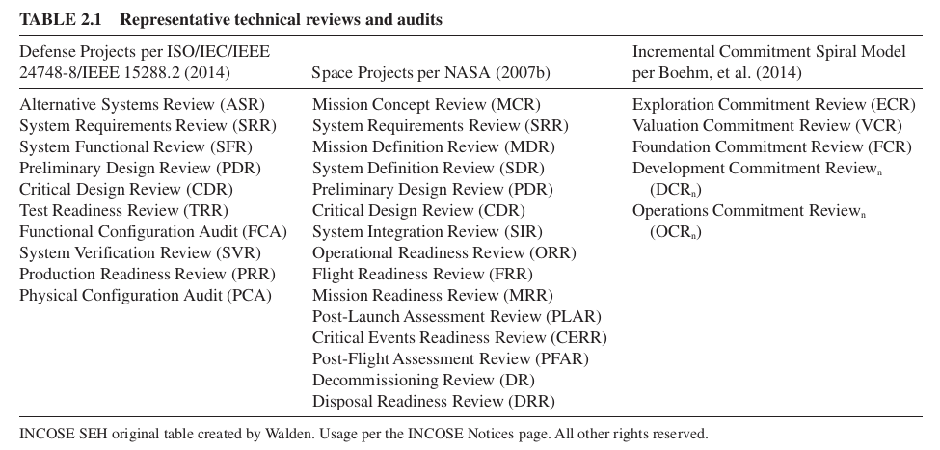
2.1.4 Technical Reviews/Audits
Not decision gate itself (not deciding), may be part of one
Assess progress, coordinate activities and get status
Capture in SEMP and schedule

Slide 18
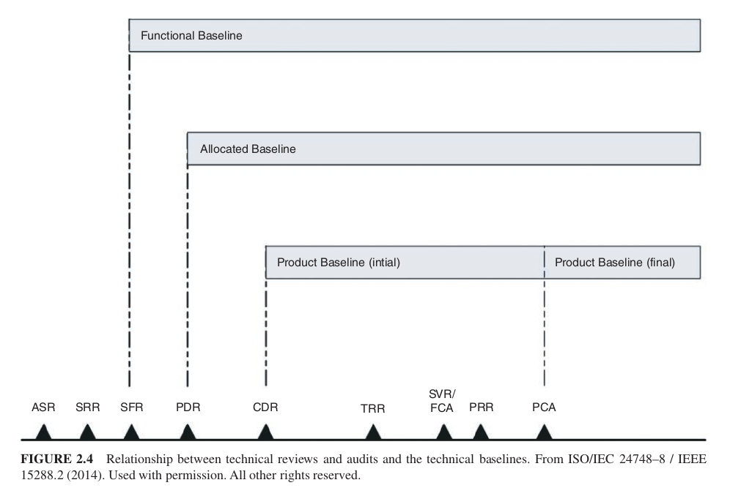
Progress Assessment
Requirements
Stakeholder Expectations
Quality characteristics
Maturity
Risk
Path to move forward (verify/validate)

Slide 19
2.1.4 Technical Reviews/Audits (cont’d)
Good Practices
Right Participants
Plan meeting, mutually agreeable
Multiple instances at multiple system layers
Eliminate unnecessary reviews
Clear entry/exit
Roles and responsibilities
Risk driven
Dry-runs
SMEs and independent reviewers
Action items – and follow up
PM
Lead SE / Chief Engineer / Lead Engineer
Review or Audit Chair
Recorder
Acquirer
Supplier
Ver/Val Lead
Tech leads

Slide 20
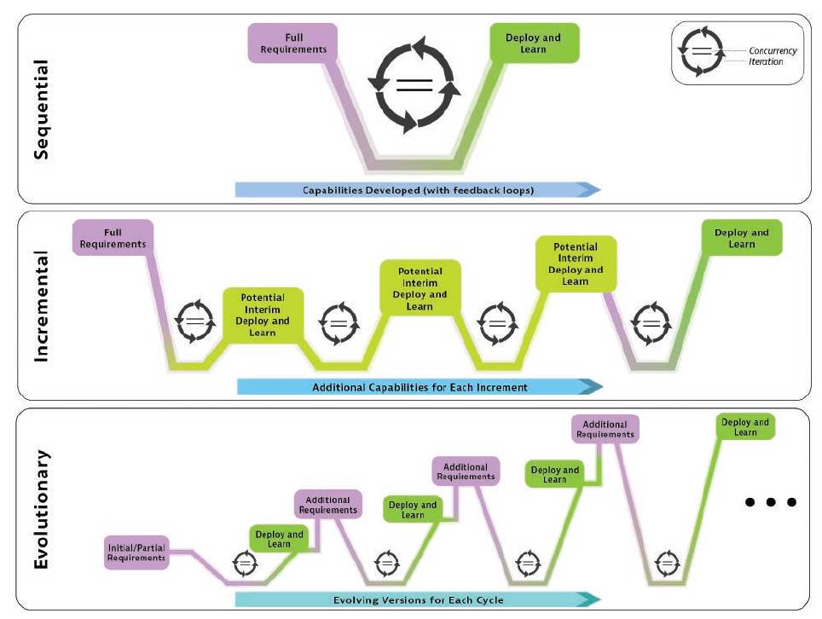
2.2 Life Cycle Model Approaches
Categories to Divide Life Cycle Approaches
  Sequential
  Incremental
  Evolutionary
Which do you apply?
  Op environment stability
  Risks
  Size, complexity, novelty
  Duration
  Integrity issues
  Technology opportunity
  Resources

Slide 21
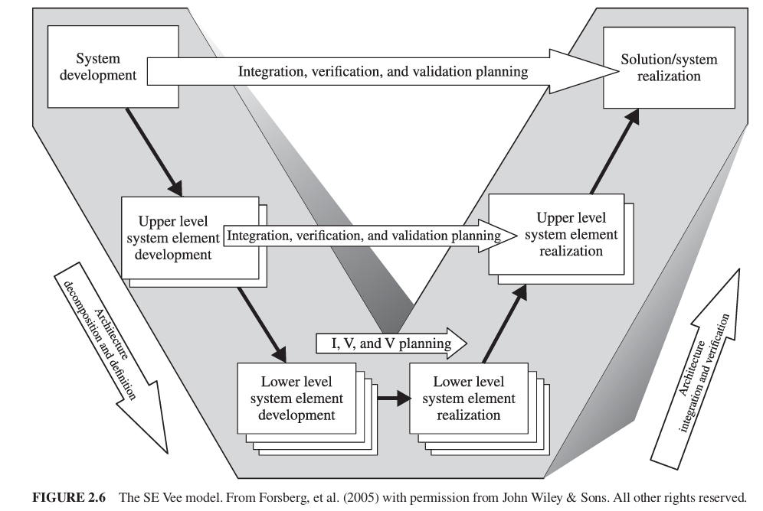
Sequential Method

Slide 22
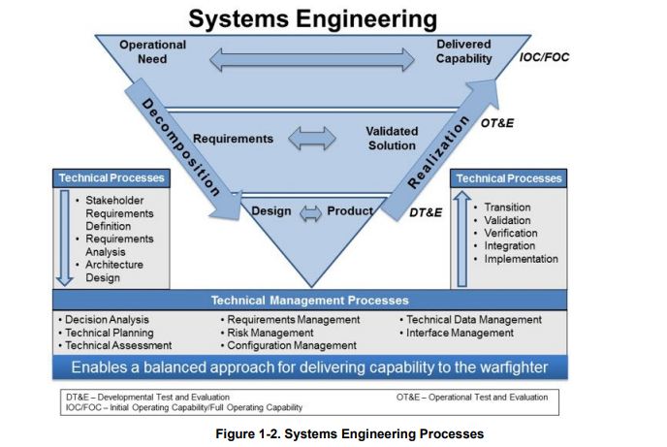
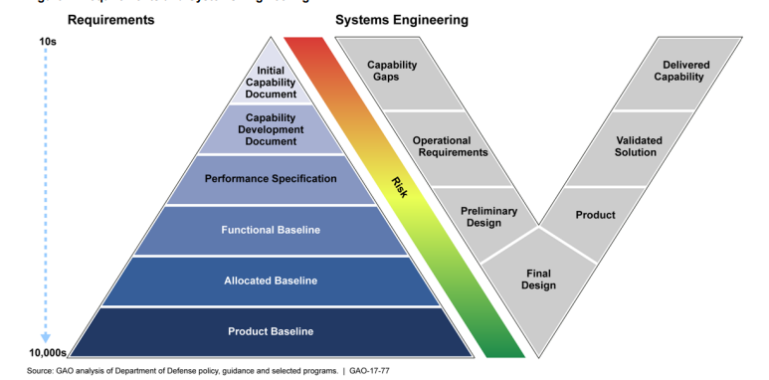
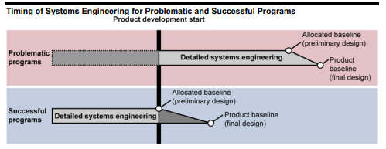
DoD Systems Engineering Guidebook Vee
Not on test
Office of Under Secretary of Defense
GAO-17-77: Detailed Systems Engineering Prior to Product Development Positions Programs for Success

Slide 23
2.2.1 Sequential Method
General flow with feedback, but single delivery
Progress is linear
Coordinating large teams – underlying framework, disciplined approach
Predictability, stability, repeatability, high assurance
Plans that are tied together, communicating across multiple teams

Slide 24
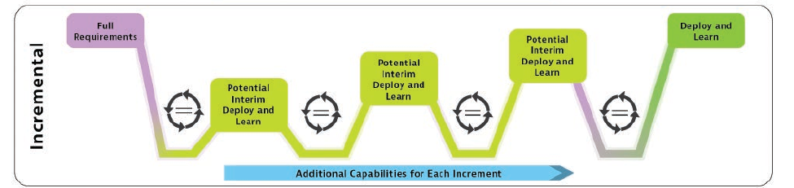
2.2.2 Incremental Method
Provide initial capability (or set) followed by successive deliveries
Capabilities of final delivery known at beginning
Incremental mechanism still allows for technology insertion
Cycles are to be planned with coordinated events (test, deployment)

Slide 25
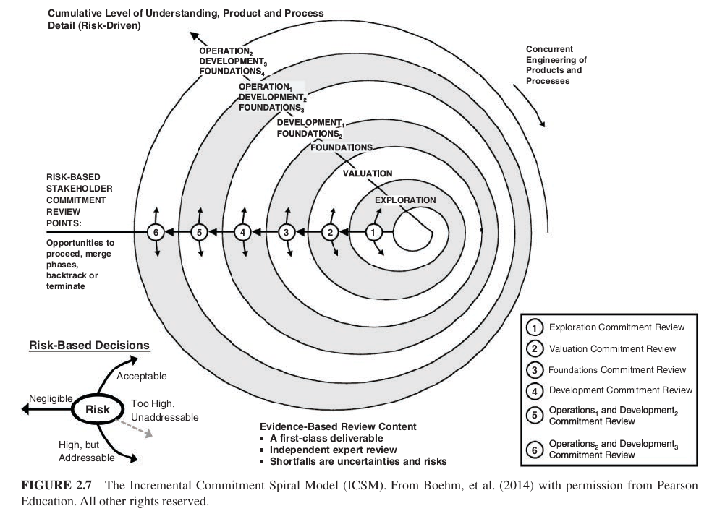

Slide 26
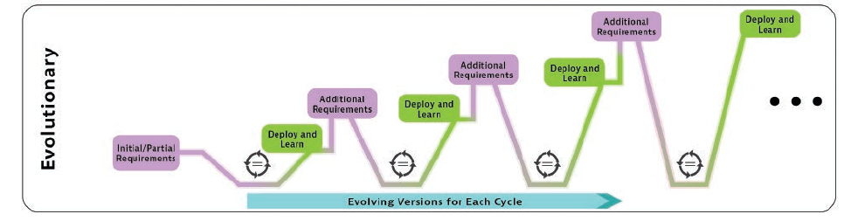
2.2.3 Evolutionary Method
For use with novel systems
Requirements up front may be partially known or unknown
Enables adaptability and flexibility to situation
R&D Projects and software development using agile

Slide 27
2.2.3 Evolutionary Methods (Cont’d)
Cycles are periodic, planned – results in deployable version
Requirements grow and refined each cycle
Early cycles, goals are less clear – gain experience, knowledge
Advantage – obtain steady and high-quality feedback from stakeholders – drive Minimal Viable Product
Decision – should newer release replace older version?
  Make decisions in terms of life cycle cost

Slide 28
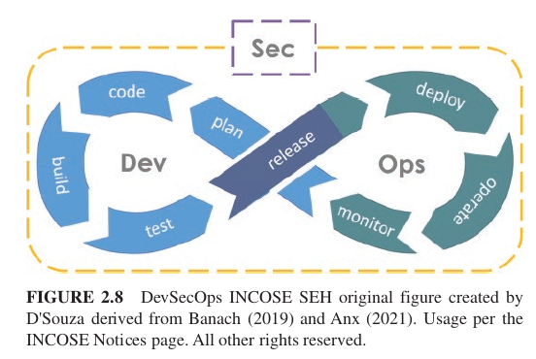
2.2.3 Evolutionary Methods (Cont’d)
Example = DevOps = continuous delivery of capabilities

Slide 29
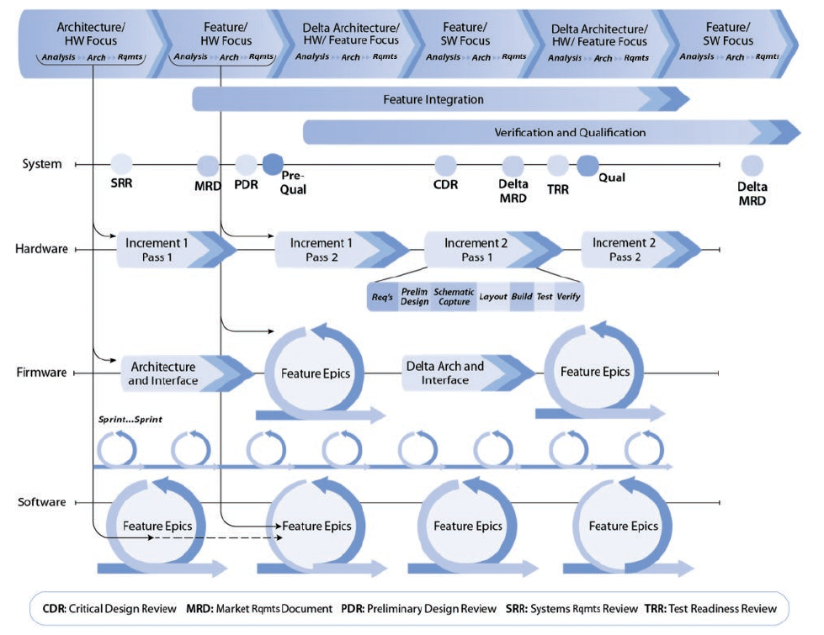
2.2.3 Evolutionary Methods (Cont’d)
Mixed Multi-Disciplinary Approach
Timing is different between disciplines

Slide 30
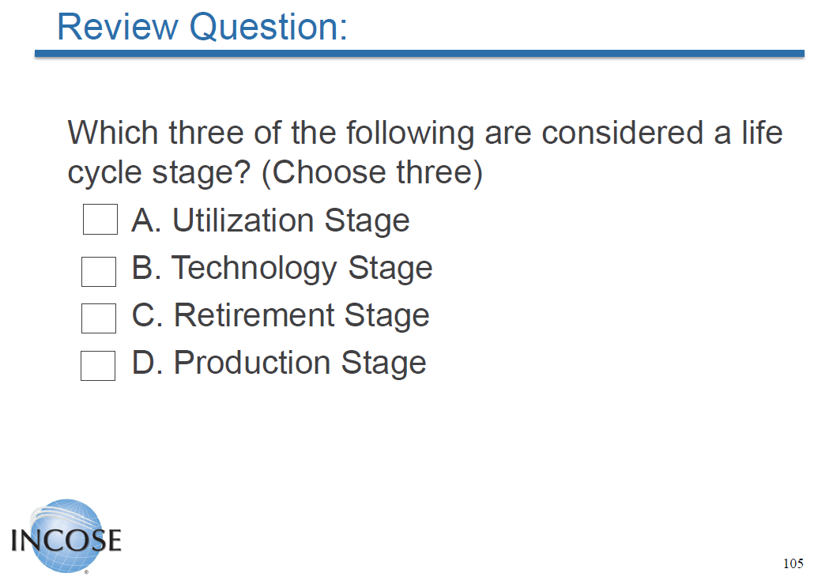
Slide 105

Slide 31
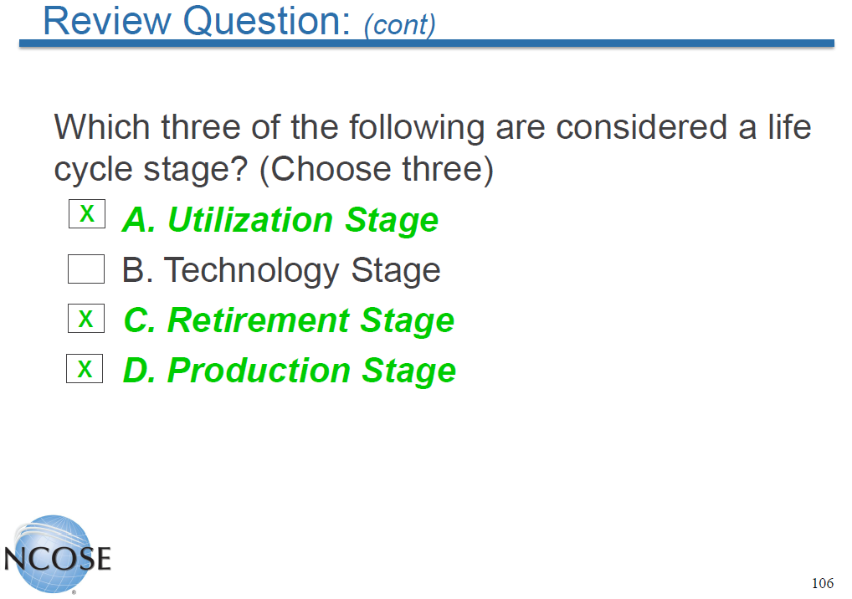
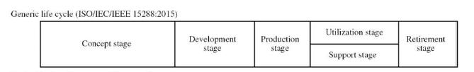
Slide 106

Slide 32
Summary
Systems have a lifecycle with different stages
Stages are to be adapted to customer/program needs
Reviews are used to assess program/product status, risk and state
Gates are used for deciding forward path of program
Not every review is a Gate
Multiple lifecycle / development approaches exist
Use/combination thereof should be tailored to specific product/program

Slide 33
THANK YOU!!!
Good Luck!
You can do it!
Seth.h.Sherman@rtx.com
ntxinfo@incose.net

