Slide 1
Darth Vader's Secret Weapon: Implementing Mission Engineering with UAF
Matt Gagliardi mgagliardi@systemxi.com
Matthew Hause mhause@systemxi.com
James N Martin James.N.Martin@aero.org
Mark A Phillips mark.phillips@rtx.com

Slide 2
This Presentation is all about: M.E.
Mission Engineering
© 2024 SSI, Aerospace, RTX

Slide 3
SR 71 Mission Profile Diagram

Slide 4
Introduction
As a means of exploring how to identify potential capability gaps within its air, land, and seas forces,
the U.S. Department of Defense developed the Mission Engineering Guide
to help define key terms and relationships between mission-related elements
This presentation shows how UAF can be extended to leverage the concepts in the Mission Engineering Guide and
use them to model missions and the resources used to execute them,
while referencing a widely known Star Wars battle as an example
© 2024 SSI, Aerospace, RTX

Slide 5
What is Mission Engineering?
Mission Engineering (ME) is an interdisciplinary process encompassing the entire technical effort to analyze, design, and integrate current and emerging operational needs and capabilities to achieve desired mission outcomes
ME is a top-down approach that delivers engineering results to identify enhanced capabilities, technologies, system interdependencies, and architectures to guide development, prototypes, experiments, and SoS to achieve reference missions and close mission capability gaps
ME uses Systems and Systems of Systems (SoS’s) in an operational mission context to inform stakeholders about building the right things, not just building things right, by guiding capability maturation to address warfighter mission needs
Mission Engineering Guide. Available online at https://ac.cto.mil/wp-content/uploads/2020/12/MEG-v40_20201130_shm.pdf
© 2024 SSI, Aerospace, RTX

Slide 6
Mission Engineering Terms
Mission: The task, together with the purpose, that clearly indicates the action to be taken and the reason behind the mission. More simply, a mission is a duty assigned to an individual or unit
Mission Thread (MT): A sequence of end-to-end mission tasks, activities, and events presented as a series of steps to achieve a mission
Mission Engineering Thread (MET): Mission threads that include the details of the capabilities, technologies, systems and organizations required to execute the mission
© 2024 SSI, Aerospace, RTX

Slide 7
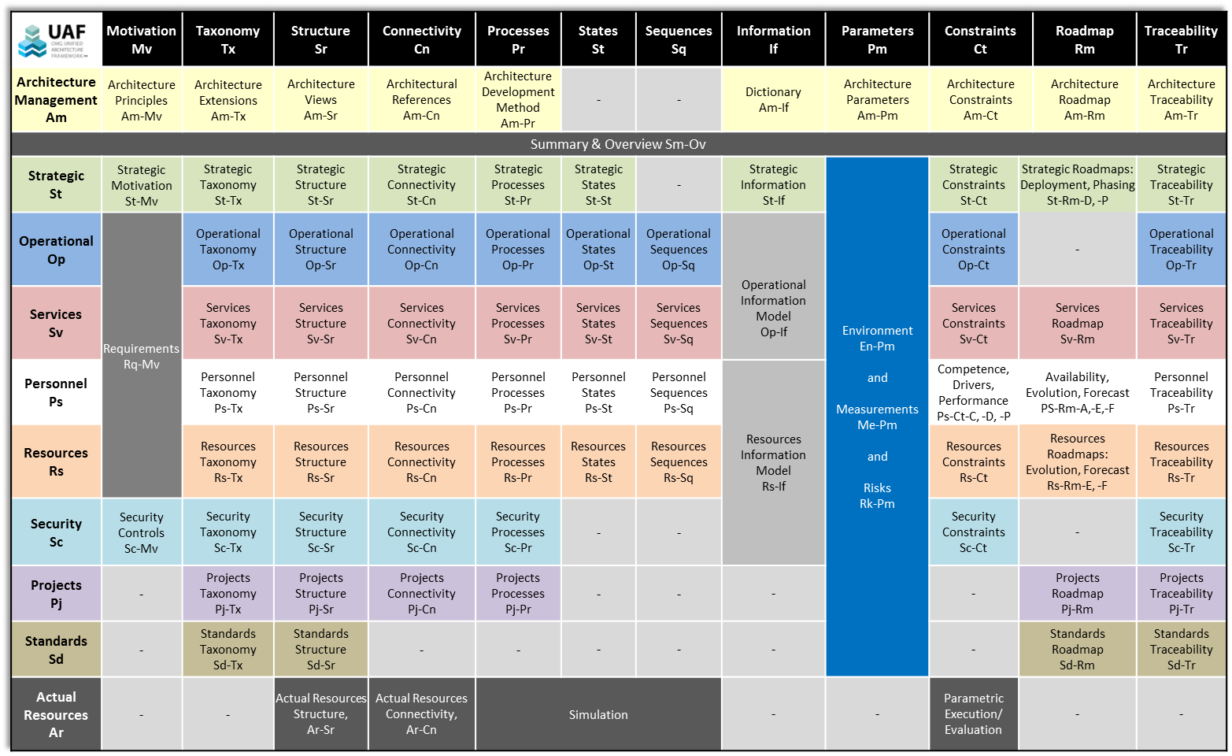
Mission Engineering Views in UAF
Roadmaps
Capabilities & Threats
Mission Threads
MOE’s & MOP’s
Services
Personnel
Mission Engineering Threads
Security
Projects

Slide 8
Different Groupings and Patterns Revealed at Different Scales
Scales
Groupings
Patterns
Descriptions
Broad Descriptions
Net-centric
Capabilities-based Effects
Evolutionary Development
Emergent Behavior
Enterprise
Systems Engineering
Enterprise &
Sub-enterprise
Capabilities
Constraints
System of Systems
Engineering
Tens of
System of Systems
(Mission Strings)
Mission Descriptions
Mission-based Execution
Composition and Structure of Systems and SOS’s
…
Constraints
…
Functionality
…
Functional Descriptions
Detailed Specifications
Detailed Requirements
Systems
Engineering
Hundreds of Independent
Systems
…
Source: DeRosa, Joseph K. 2005., “Enterprise Systems Engineering,” Air Force Association, Industry Day, Day 1, Danvers, MA, 4 August 2005, https://www.paulrevereafa.org/IndustryDay/05/presentations/index.asp

Slide 9
Enterprise Strategic Planning
Enterprise SE Processes
Performance Assessments
Strategic Technical Planning
Goals & Objectives,
Scenarios & Strategies
Performance Management
Capability-Based Planning Analysis
Technology & Standards Planning
Metrics,
Plans
Capability Gaps,
Capability Roadmaps
Technology Gaps,
Technology Roadmaps
Technology Specs,
Standards Roadmaps
Gap Fillers
Enterprise Architecture & Conceptual Design
Enterprise Requirements Definition & Mgmt
Programs & Projects
Architecture Definitions
Architecture
Definitions
Architecture
Assessments
Opportunities & Risks
Enterprise Evaluation & Assessment
Opportunity & Risk Assessment & Management
Opportunities & Risks
Opportunities & Risks
Architecture
Assessments
Exploitation Plans,
Mitigation Plans
Portfolio Management
Resource Allocation & Budgeting
Architecture Objectives
Portfolio Recommendations

Slide 10
Mission Engineering and the UAF (1)
Strategic Capability and Enterprise Concepts:
Defines the “why” and “what” and “when” before the “how”
For ME, these are used to define the mission goals, purpose, timescales, structure, architecture, quantitative metrics, and temporal and physical mission structures
Operational Logical Architecture:
Defines the enterprise architecture in a solution in-dependent form including behavior and structure
These views define all aspects of the Mission Thread
Security:
Identifying risk, its mitigation, and integrating security into the architecture
Mission risks and mitigation can be defined and quantified to increase mission success
Standards:
Definition of and compliance with standards in the architecture. Standards correspond to guidance, rules of engagement, doctrine, etc
For specific elements of doctrine, the standard can be imported into the model, defined as types of requirements, and linked to model elements
© 2024 SSI, Aerospace, RTX

Slide 11
Mission Engineering and the UAF (2)
Resources/Systems:
Systems, software, technologies, etc that will implement the solution by implementing the operational or logical elements
These views and elements form the Mission Engineering Thread (MET) that implements the Mission Thread (MT)
UAF also provides temporal concepts to show how the systems evolve over time as well as variations and trade off analysis between candidate solution architectures
Personnel/ Human Factors:
How people and systems interact, and their expected knowledge & skills
These are the organizational structures, configurations, equipment, behavior, etc. pertaining to the MET
Built-in Traceability:
Between Multiple Views as well as Between Layers and Across Layers
These demonstrate that capability and mission goals have been met
© 2024 SSI, Aerospace, RTX

Slide 13
Mission Engineering Guide (MEG) 2020
The ME guide “describes the foundational elements and the overall methodology of Department of Defense (DoD) ME, including a set of ME terms and definitions that should be part of the common engineering parlance for studies and analyses, building upon already accepted sources and documentation from the stakeholder community in the Office of the Secretary of Defense (OSD), Joint Staff, Services, and Combatant Commands
The guide:
Describes the main attributes of DoD ME and how to apply them to add technical and engineering rigor into the ME analysis process
Enables practitioners to formulate problems, and build understanding of the main principles in-volved in performing engineering analysis in a mission context
Provides users with insight as to how to document and portray results or conclusions in a set of products that help inform key decisions
For both novice and experienced practitioners across DoD and industry
A living document that will evolve in parallel with engineering best practices
Will mature the guide to include relevant information to conduct mission-focused analyses and studies in support of maturing new joint warfighting concepts, warfighter integration, and interoperability of systems of systems (SoS), as tools and infrastructure evolve to support ME (DoD, 2020)
© 2024 SSI, Aerospace, RTX

Slide 18
Mission Integration for the US Department of Defense
The Deputy Assistant Secretary of Defense for Mission Integration in the Office of the Under Secretary of Defense for Research and Engineering (OUSD R&E) recently briefed the NDIA Systems and Mission Engineering conference on Mission Engineering (ME) research and development activities taking place within the Department of Defense
The Mission Integration Office is working with the branches of the armed forces, industry, and academia to determine best practice for ME. (Roman, Dahmann, 2022)
The current guidance from the OUSD (R&E) Mission Integration office is to evaluate implementation of UAF for ME.
This presentation and the example model are assisting in that effort
© 2024 SSI, Aerospace, RTX

Slide 19
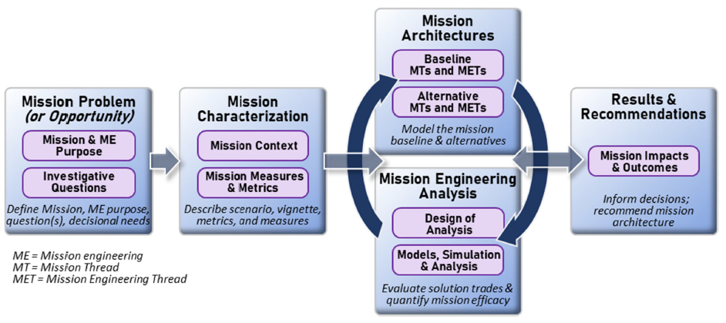
Mission Engineering Process

Slide 20
SR 71 Mission Profile Diagram

Slide 22
A Long Time Ago in a Galaxy Far, Far, Away….
The Battle of Hoth was a major battle fought in 3 ABY and was considered a major victory for the Galactic Empire and the single worst battlefield defeat suffered by the Rebel Alliance during the Galactic Civil War
The battle was an Imperial invasion led by Darth Vader, aimed at destroying the Rebel Alliance's Echo Base hidden on the remote ice world Hoth and capturing Luke Skywalker
The base's location was discovered when a Viper probe droid, deployed by Darth Vader's Death Squadron, landed on the planet - prompting the Rebels to begin an evacuation of Hoth
https://starwars.fandom.com/wiki/Star_Wars:_Episode_V_The_Empire_Strikes_Back#The_Battle_of_Hoth
© 2024 SSI, Aerospace, RTX

Slide 23
Why the Battle of Hoth?
The example used in this paper is the Battle of Hoth from the second Star Wars movie, “The Empire Strikes Back”
We are using this as an example because it is well known, contains a rich source of systems, strategies, missions, and behavior as well as illustrates joint operations
As it is based on a movie, there are no issues of classified materials or problems relating to the release of information
The actual model created to describe the complete mission would be a large undertaking requiring several diagrams
For reasons of space and time, we have limited this to a set of example diagrams to express the main concepts covered
© 2024 SSI, Aerospace, RTX

Slide 24
Mission Engineering Views in UAF
Capabilities & Threats
Mission Threads
MOE’s & MOP’s
Mission Engineering Threads

Slide 25
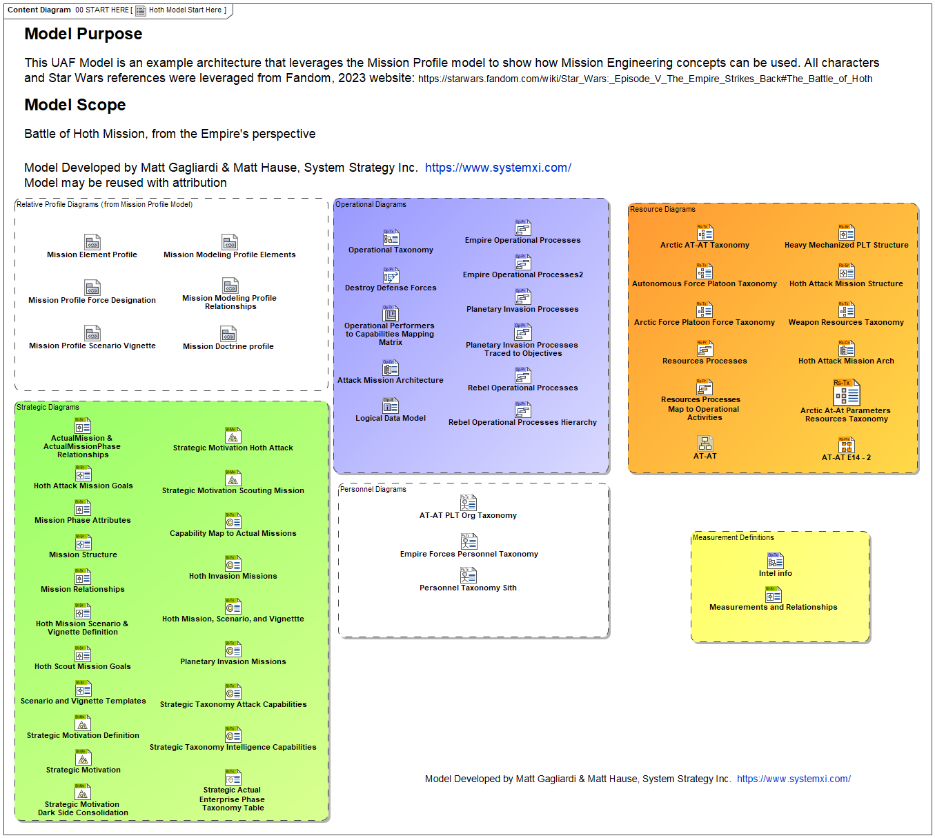
Model Overview
© 2024 SSI, Aerospace, RTX

Slide 26
Definition of Concepts
Concept | Definition
Driver* | Thing that forces us to work or act; that which urges you forward
Challenge* | A demanding or stimulating situation; a call to engage in a contest or fight
Enterprise State* | Condition with respect to circumstances or attributes
Capability | Ability to do something under particular conditions and environments, to achieve a desired effect.
Opportunity* | A possibility due to a favorable combination of circumstances
Risk* | A source of danger; a possibility of incurring loss or misfortune
Effect | A phenomenon that follows and is caused by some previous phenomenon
Outcome* | Something that happens or is produced as the final consequence or product
Concern | A matter of relevance or importance to a stakeholder regarding an entity of interest.
© 2024 SSI, Aerospace, RTX

Slide 27
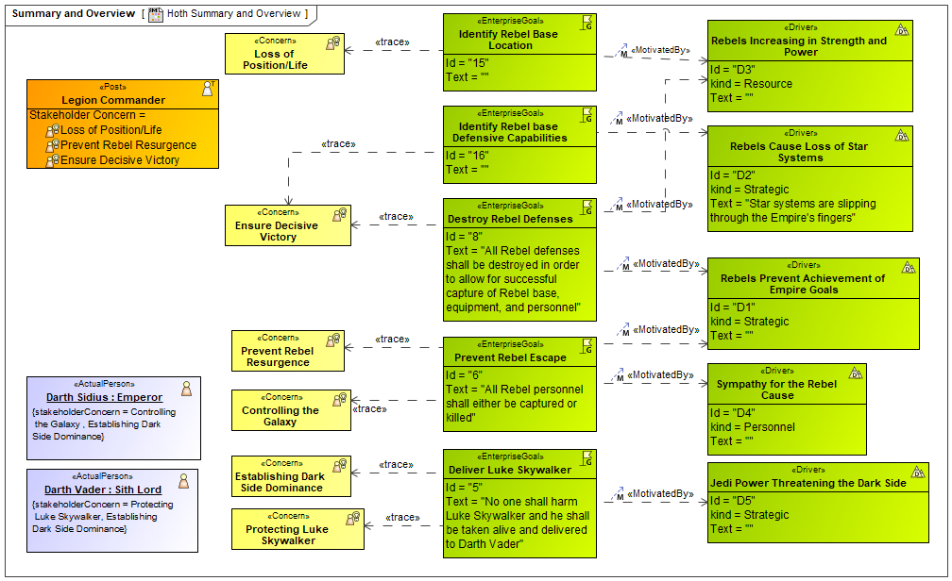
Stakeholders, Concerns, Goals and Drivers
Stakeholder
Types
Stakeholders of the mission likely have enduring concerns that are independent of the mission but relate to its goals.
The Legion Commander (a post Admiral Ozzel fills), Darth Sidius, and Darth Vader have Concerns that relate directly to the mission goals, linking to Drivers.
Goals
Driver
Concerns
Stakeholder
Individuals
© 2024 SSI, Aerospace, RTX

Slide 28
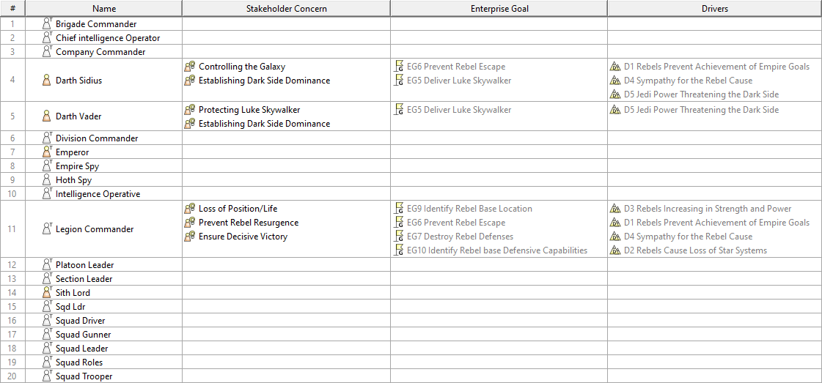
Table of Concerns and Stakeholders
© 2024 SSI, Aerospace, RTX

Slide 29
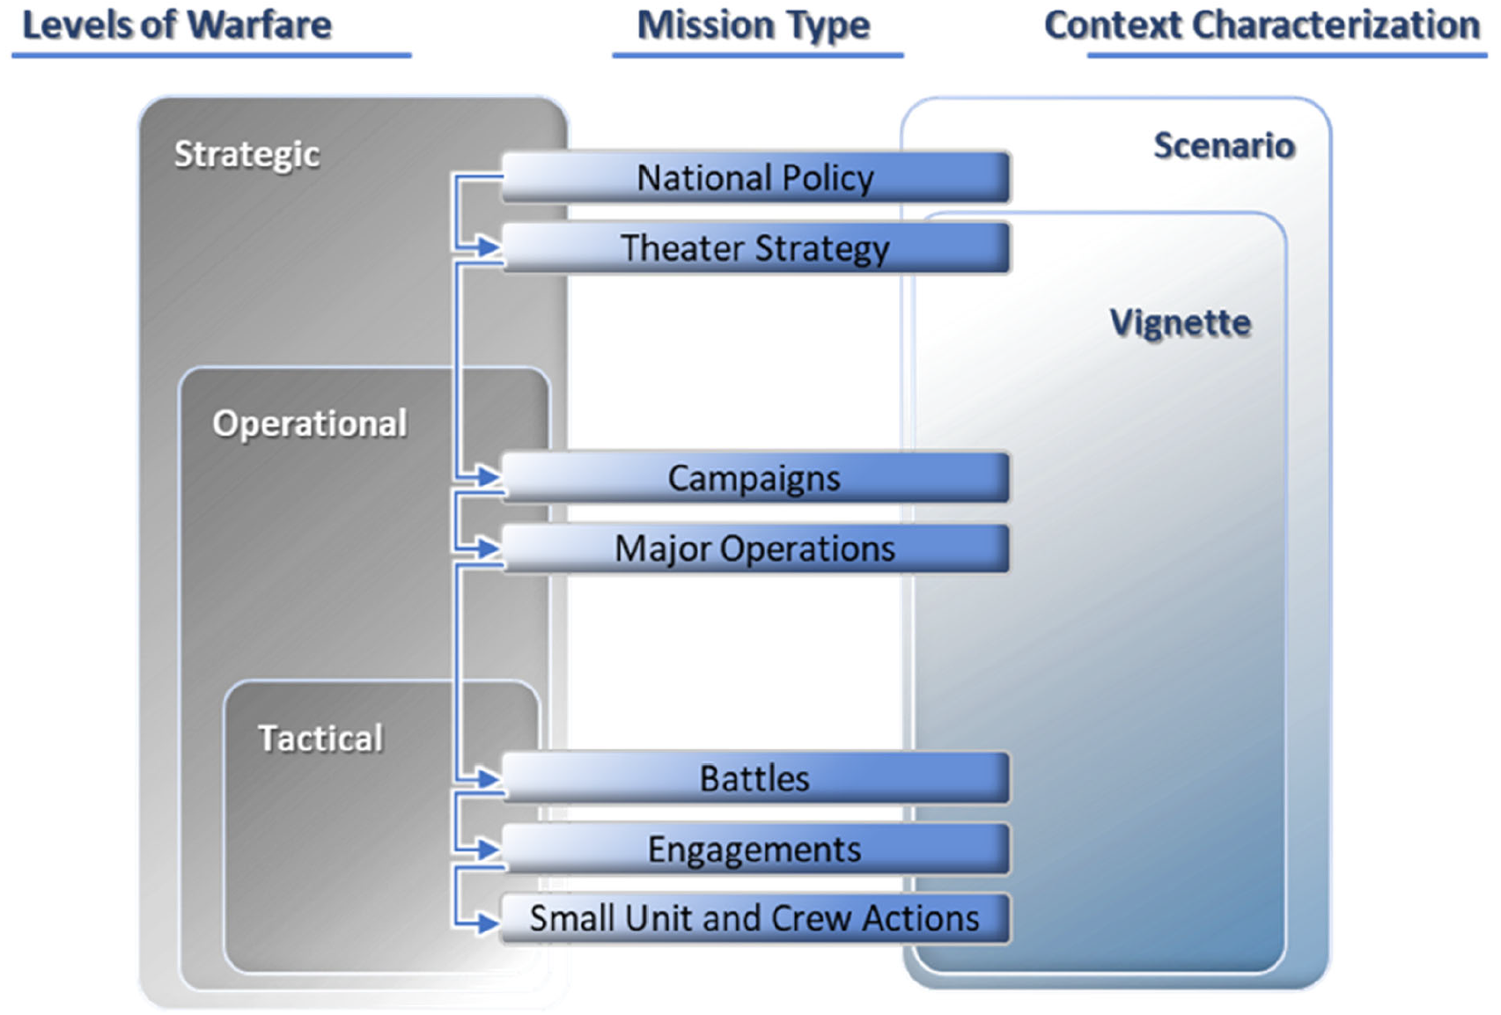
Mission Types, Levels, and Context
© 2024 SSI, Aerospace, RTX

Slide 30
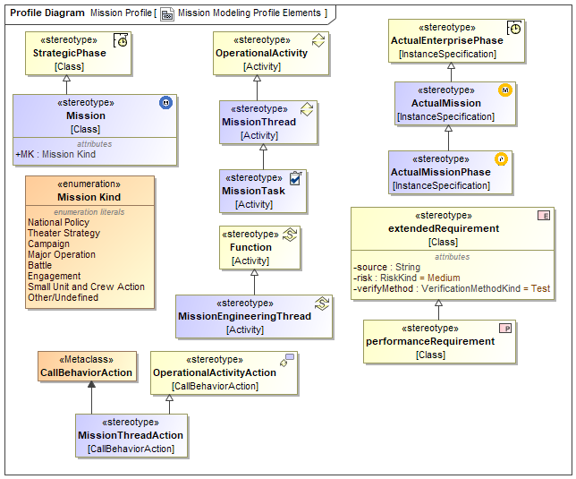
Mission Modeling Profile Elements View
We took a minimalist approach: only add what was necessary
Simple extensions to add some of the concepts to be implemented in UAF 1.3
Mission
Actual Mission
Mission Kind
Actual Mission Phase
Mission Thread
Mission Thread Action
Mission Task
Mission Engineering Thread
Extensions to the UAF diagrams.
Performance requirement is a standard SysML construct
© 2024 SSI, Aerospace, RTX

Slide 31
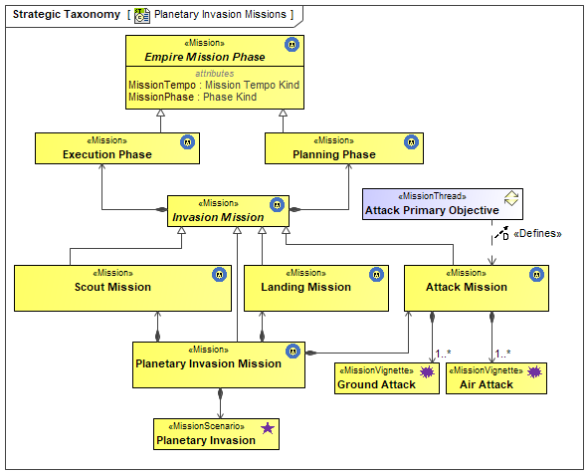
Planetary Invasion Missions for the Evil Empire
The Empire Mission structure shown illustrates the complexity required to model missions
Empire doctrine proscribes that every military mission has two phases to it: Planning and Execution
A Planetary Invasion Mission is comprised of separate Scout, Landing, and Attack Missions, each with their own Planning and Execution Phases
These are all types of Invasion Missions. Each of these have a defined Mission Type
The Execution and Planning Phases both inherit Mission Tempo and Phase attributes
© 2024 SSI, Aerospace, RTX

Slide 32
Vignettes and Scenarios
Scenario – Description of the geographical location and time frame of the overall conflict. It should include information such as threat and friendly politico-military contexts and backgrounds, assumptions, constraints, limitations, strategic objectives, and other planning considerations. (ME Guide)
Vignette – A narrow and specific ordered set of events, and behaviors and interactions for a specific set of systems to include blue capabilities and red threats within the operational environment. Vignettes can represent small, ideally self-contained parts of a scenario (ME Guide)
For the UAF, the actuals are the ones that contain the specific information – Actual Mission Scenario and Actual Mission Vignette
© 2024 SSI, Aerospace, RTX

Slide 33
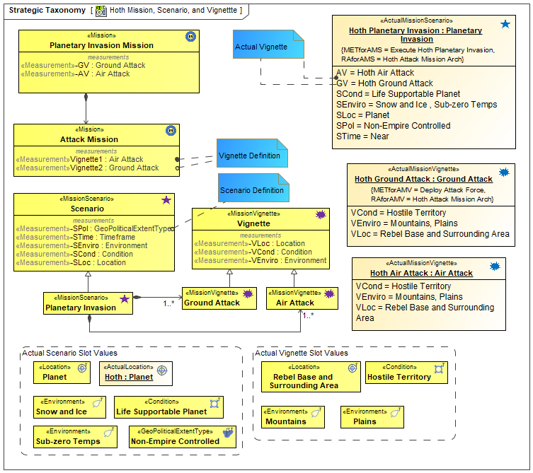
Vignettes and Scenarios Linked to Mission Types & Mission Instances
On the left are a default Mission Scenario and Vignette Definitions. These will be included in the profile as examples
These have been extended for the Hoth Battle
Along the bottom are a set of conditions that can be used throughout the model
These are used by the instances of scenario and vignette on the right.
These are then linked to the Mission definitions so that the Mission actuals can reference the Vignette and Scenario actuals
© 2024 SSI, Aerospace, RTX

Slide 34
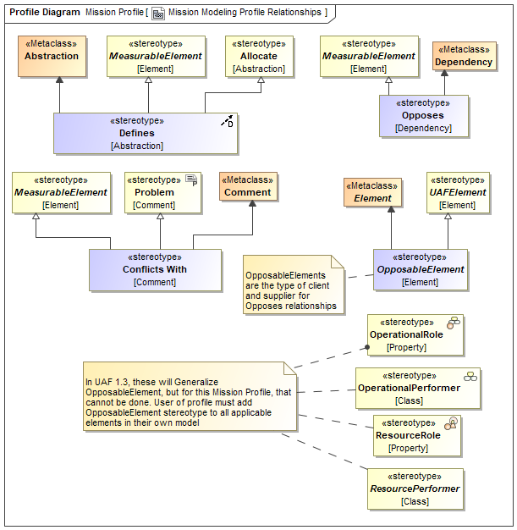
Mission Modeling Profile Relationships
Relationships were added to allow traceability between functional and structural elements
Mission Threads map to Missions via the Process Defines Initiative relationship
Mission Engineering Thread maps to the Actual Mission via the Process Adapts to Actual Initiative
The Opposes Dependency provides a means of indicating elements in the model that conflict with one another such as opposing goals
© 2024 SSI, Aerospace, RTX

Slide 35
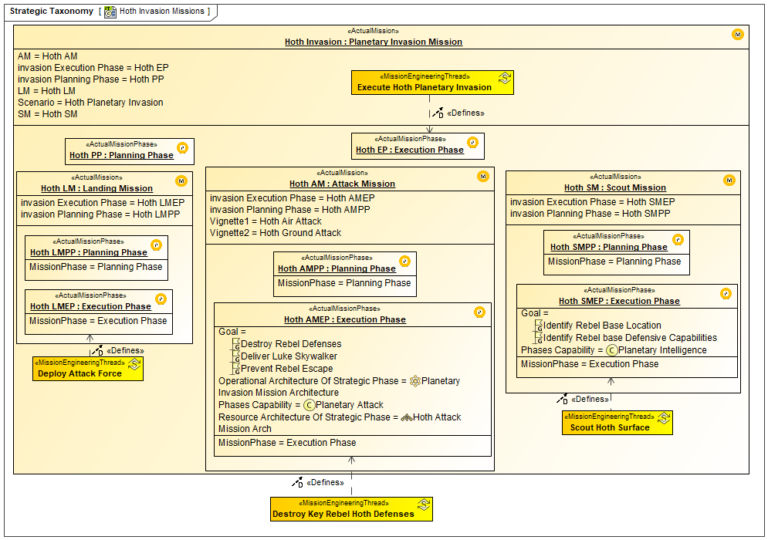
Invasion Missions on the Planet Hoth
The Hoth Invasion is an instance of the Planetary Invasion Mission
This Actual Mission is made up of the Planning and Execution Phase as well as the Landing Mission, Attack Mission, and Scout mission
These Missions each have Planning and Execution Phases
The Execution phases all have Mission Engineering Threads mapped to them
The Hoth AMEP Execution Phase has defined goals as well as Operational and Resource Architecture
© 2024 SSI, Aerospace, RTX

Slide 36
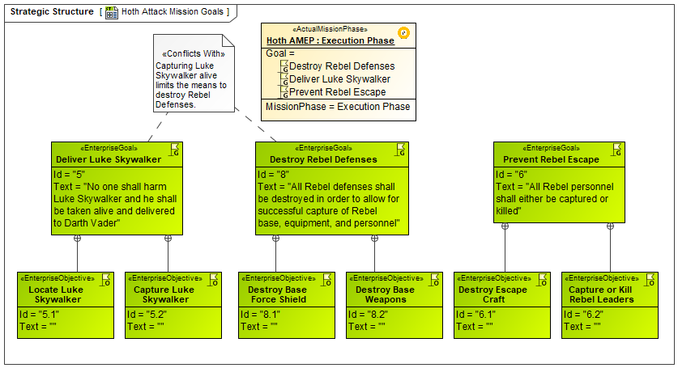
Hoth Battle Execution Phase – Specific Mission Goals
Prior to planning the Mission Thread and Mission Engineering Thread, the Goals of the Mission are defined
These are to Destroy Rebel Defenses, Prevent Rebel Escape, and Capture Luke Skywalker
The constraint imposed by Capturing Luke Skywalker alive and unharmed is one of the causes that lead to Attack Mission failure
The Empire normally executes their missions with extreme violence. This constraint, prevented this hence the “Conflicts With” relationship
Objectives or sub-goals are also defined for each goal using the containment relationship
© 2024 SSI, Aerospace, RTX

Slide 37
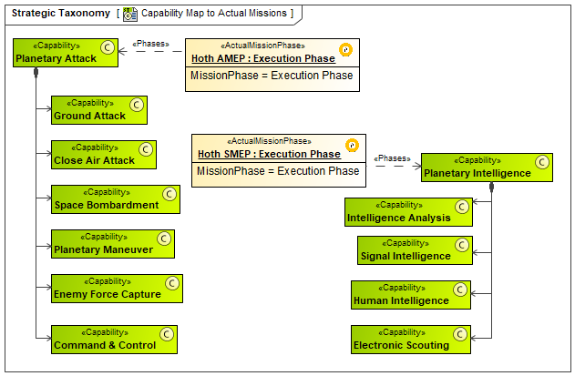
Capability Map to Mission Phases
The Planetary Attack capability hierarchy is shown on the left
This includes Ground Attack, Close Air Attack, etc.
Planetary Intelligence is shown on the right
Linking the mission to the highest-level capability reduces the coupling of the two structures
These capabilities along with the associated metrics will form the basis for trade-off analysis of the candidate architectures and systems
© 2024 SSI, Aerospace, RTX

Slide 38
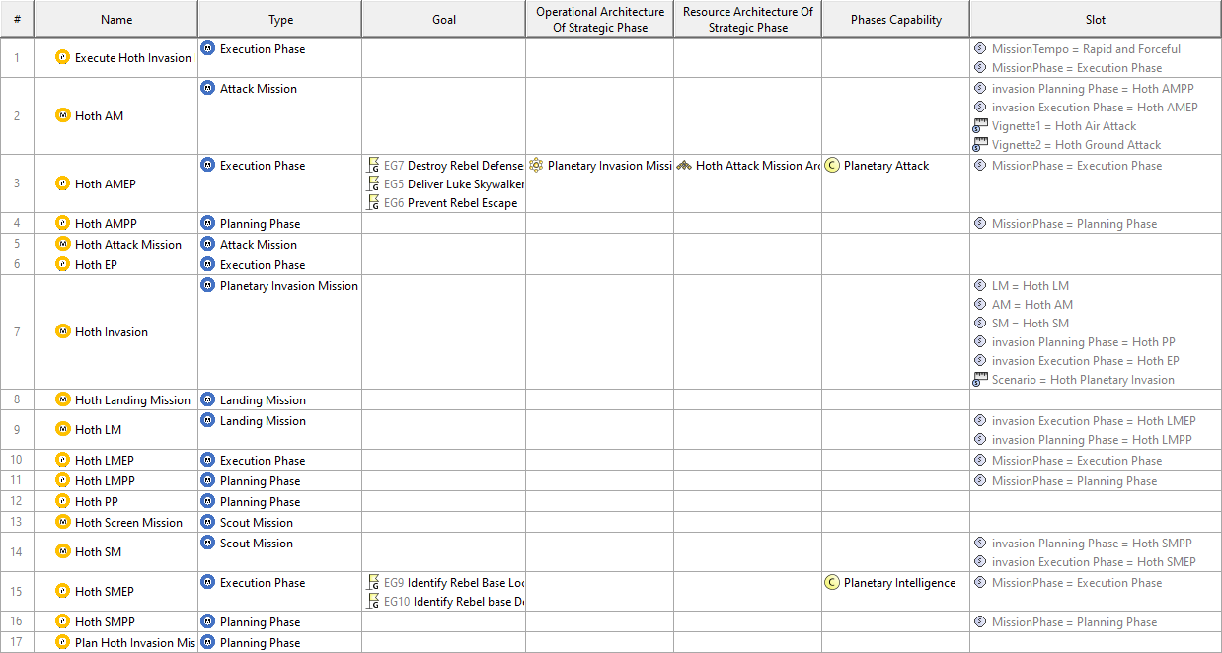
Strategic Actual Enterprise Phase Taxonomy Table
Automatically generated table showing details of the Actual Missions and Phases
© 2024 SSI, Aerospace, RTX

Slide 39
Challenges, Drivers, Opportunities, etc.
Drivers, Challenges, and Opportunities were added to the UAF conceptual schema to allow these concepts to be incorporated into the enterprise architecture model used in the Strategic views. A summary of the key entities and their relationships is as follows:
Concerns define a matter of relevance or importance to a Stakeholder.
Drivers present Challenges to the Enterprise
Challenges are Conditions that can be addressed by Opportunities
Each Opportunity can present the circumstances for new Risks to the Enterprise
Existing or new Capabilities can help the Enterprise pursue these Opportunities
Capabilities can cause the appropriate desired Effects to occur
Operational Activities and related enterprise Services map to the Capabilities
Resources and their functions implement the Operational Activities
Outcomes are the long-term results that are desired.
Effects implemented by Resources will result in desired Outcomes.
© 2024 SSI, Aerospace, RTX

Slide 40
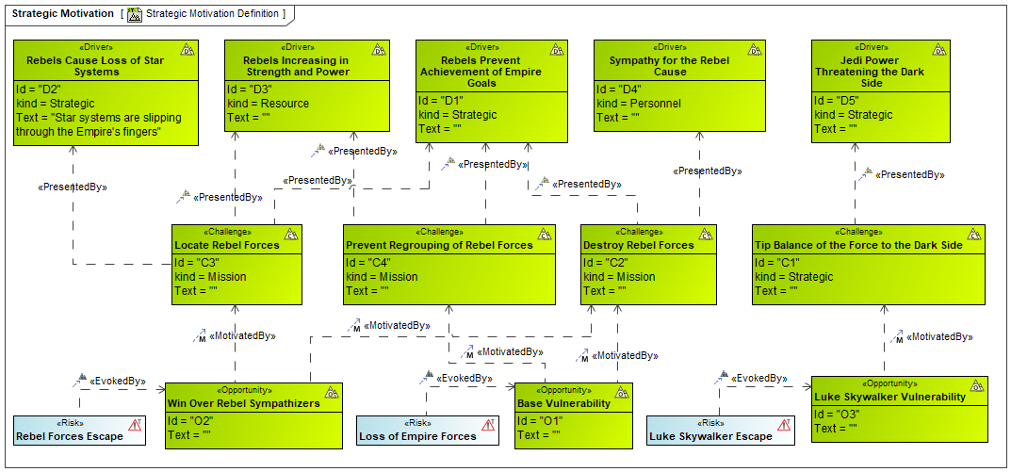
Strategic Motivation Diagram
Drivers present Challenges to the Enterprise
Challenges are conditions that can be addressed by Opportunities
Each Opportunity can present the circumstances for new Risks to the Enterprise
Existing or new Capabilities can help the enterprise pursue these Opportunities
© 2024 SSI, Aerospace, RTX

Slide 41
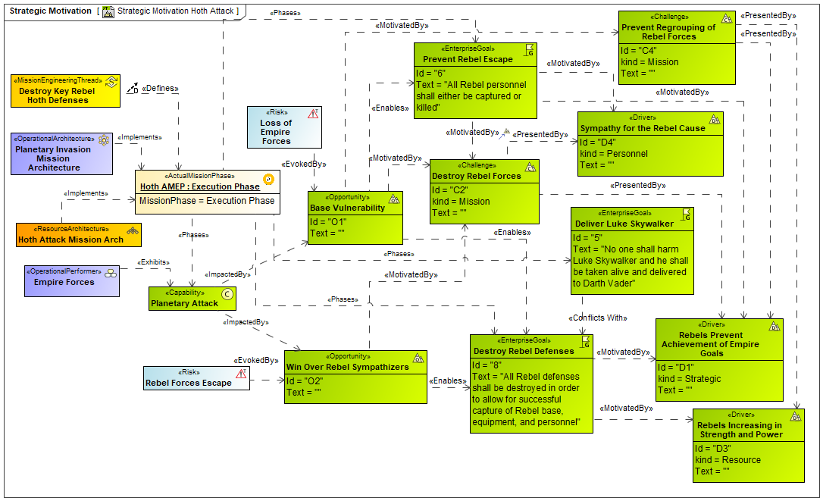
Hoth Battle – Attack Strategy
Key Strategic Relationships for Hoth Attack Mission Execution Phase
Drivers, Challenges, Opportunities, Goals and Risks are all shown here
The Operational and Resource elements are linked to the Capabilities to demonstrate how they will be realized
Several elements are linked to the Actual Mission Phase showing when they will be deployed
© 2024 SSI, Aerospace, RTX

Slide 42
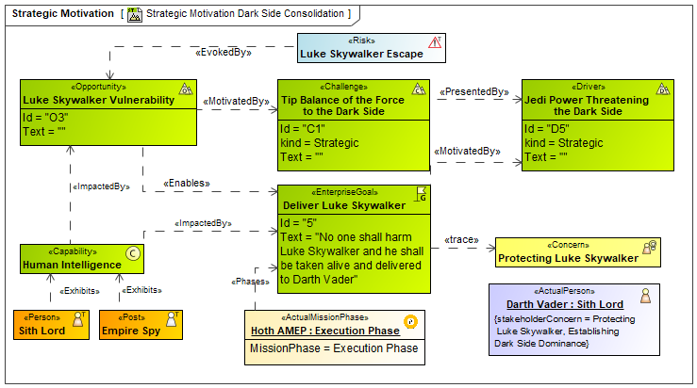
Strategy for the Scouting Phase of the Mission
Key Strategic Relationships Relating to the Goal of Delivering Luke Skywalker
The complete set of elements for a single goal are shown here
Darth Vader has the concern of protecting his son, tracing to the goal of delivering him alive
Luke’s vulnerability enables the goal which is motivated by the challenge to tip the balance of the force
Jedi power threatening the Dark Side is presented by this challenge and motivated by the goal, impacted by the human intelligence capability, realized by spies and the Sith Lords
© 2024 SSI, Aerospace, RTX

Slide 43
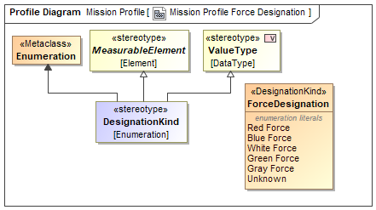
Force Designation Elements
Mission Engineering models require the identification of the different forces such as enemy, friendly, neutral, etc.
This can correspond to organizations, systems, posts, etc.
The tag definition (an enumeration) is defined on the OpposableElement stereotype, which is then inherited when creating new operational or resource elements. This allows for tracking these elements easily within the model, as well as allow for unique formatting (e.g., colors) that clearly identify them in diagrams.
The ME Profile defines 4 Force Designations within the enumeration, with one value being selected for a specific element’s tag.
Modelers can add additional Force Designation values by simply adding a new enumeration literal
© 2024 SSI, Aerospace, RTX

Slide 44
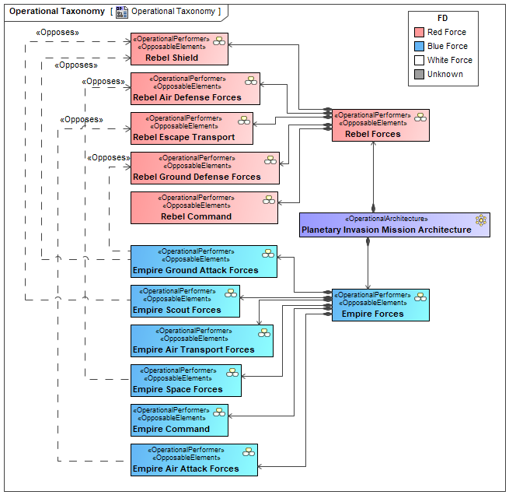
Operational Performer Types (ie, the Actors)
Defines the Operational Architecture hierarchy of the context in which the Empire (Blue Force) and Rebel Forces (Red Forces) will engage
The previously defined Force Designator stereotypes are shown via colors and labels
The Empire forces are those which will be deployed as part of their attack strategy. These are the abstract elements, from which Resources will be chosen to implement them
The Rebel Forces are less clear. They have been discovered by reconnaissance systems. Additional attributes such as provenance, confidence level, etc. can be added as shown later
The Rebel Forces were able to escape as the Empire underestimated the strength of the ground forces cannon which destroyed one of their spaceships
© 2024 SSI, Aerospace, RTX

Slide 45
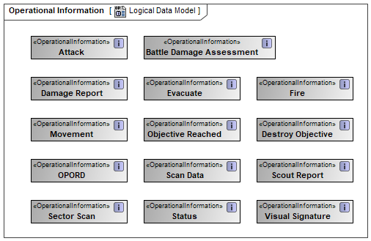
Logical Data Model
Initial data model of the information interactions at the Operational level
These should be expanded to include attributes and other elements
This information is exchanged between activities and Operational Performers
© 2024 SSI, Aerospace, RTX

Slide 46
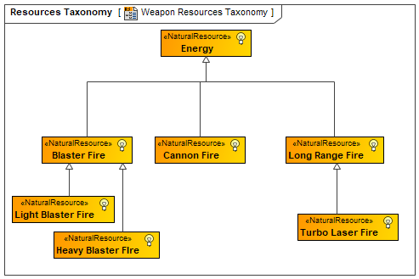
Weapon Resources Taxonomy
Defines the elements for physical interactions that will take place at both the Operational and Resource levels
Blaster weapons are directed energy weapons, so the transmitted elements are types of energy, a natural resource
© 2024 SSI, Aerospace, RTX

Slide 47
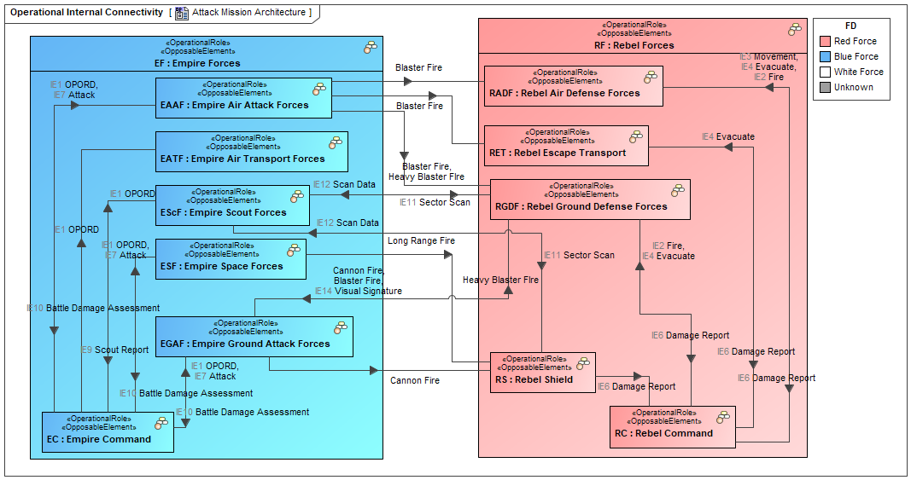
Attack Mission Architecture with Red and Blue Forces
IBD version of the Operational Architecture
An abstract/solution independent expression of the proposed battle
Interactions include Information Exchanges between troops and commanders, weapons fire, sustained damage, scan data, etc.
Red/Blue designations are included, in this case for the Operational Roles
© 2024 SSI, Aerospace, RTX

Slide 48
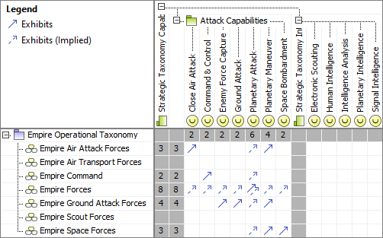
Operational Performers to Capabilities Mapping Matrix
Automatically generated table
Traceability between the required Capabilities and the proposed Operational Performers. The Scout Forces and Air Transport Forces are not included in the Attack context
All required capabilities have been exhibited
© 2024 SSI, Aerospace, RTX

Slide 49
Planetary Invasion Processes – Mission Threads & Tasks Decomposition
This is the functional hierarchy of the Execute Planetary Invasion Mission Thread
It is broken into Mission Threads of Scout Planet, Weaken Planetary Defenses, Attack Primary Objective and Deploy Attack Force
Each of these are further decomposed into Mission Tasks
© 2024 SSI, Aerospace, RTX

Slide 50
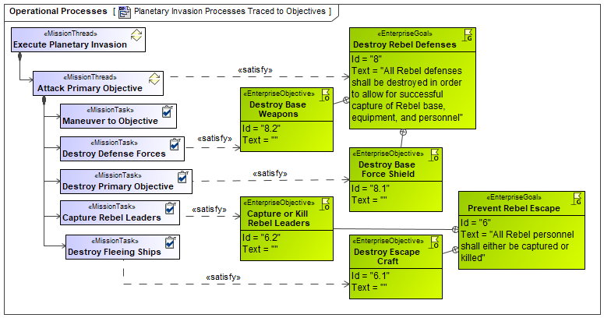
Linking Mission Tasks to Mission Objectives
Not only is it beneficial to show how your structural elements support your Goals/Objectives (via Capabilities), but it also helps to show how your Mission Threads/Tasks support them
Can also be done for Mission Engineering Threads and Functions
© 2024 SSI, Aerospace, RTX

Slide 51
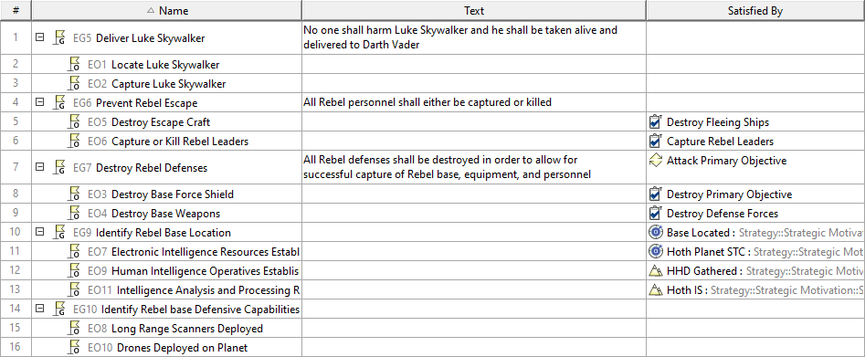
SysML Requirements Traceability Table
Goals and Objectives as well as other UAF elements are types of SysML Requirements
As such, SysML requirements traceability elements can be used
These include functional and structural elements
© 2024 SSI, Aerospace, RTX

Slide 52
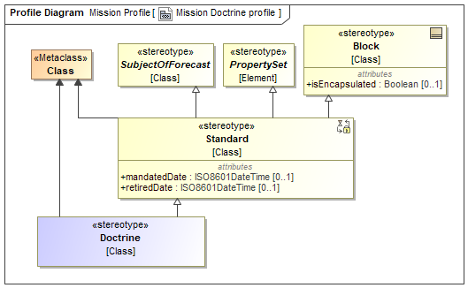
Mission Elements to Support Doctrine
Note that conformance/ compliance to doctrine is an important aspect when modeling mission engineering
At times, each step in a sequence may need to demonstrate which element of doctrine is being supported
This is an extension to the SysML Standard element
© 2024 SSI, Aerospace, RTX

Slide 53
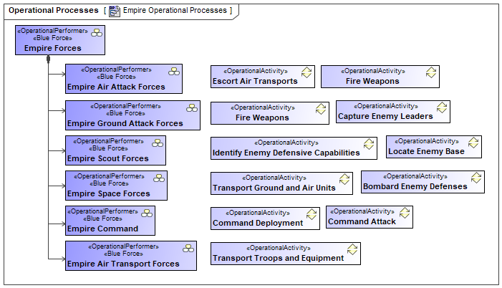
The Empire’s Operational Actors and Behaviors
The Empire forces are those which will be deployed as part of their attack strategy. These are the abstract elements, from which Resources will be chosen to implement them
These are designated as Blue Force
Each has a set of Operational Activities that they can perform
If MBSE is already established in an organization, these would be part of a library and reused
For a new installation, these would form the basis of the library to be populated as further missions are defined
These activities are referenced by the Mission Tasks
© 2024 SSI, Aerospace, RTX

Slide 54
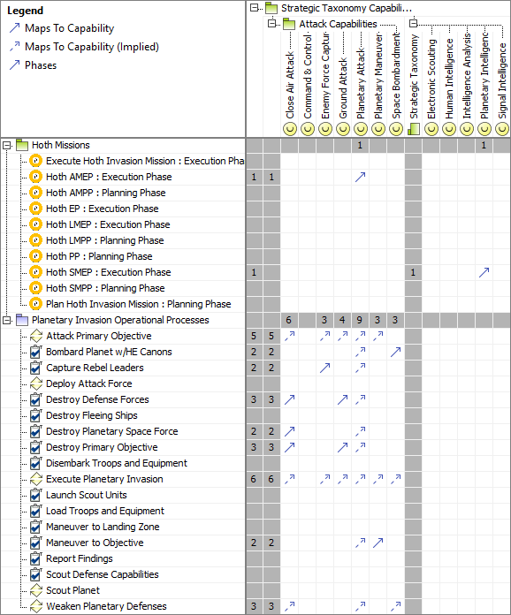
Strategic Traceability
Traceability table showing the Actual Missions, Mission Threads, Mission Tasks and operational activities that exhibit the required capabilities
The scope has been focused on the Planetary Attack capability and its owned capabilities
This helps to validate the Mission thread against the required capabilities
Measurements could be added to determine the required and provided measures for trade-off analysis
© 2024 SSI, Aerospace, RTX

Slide 55
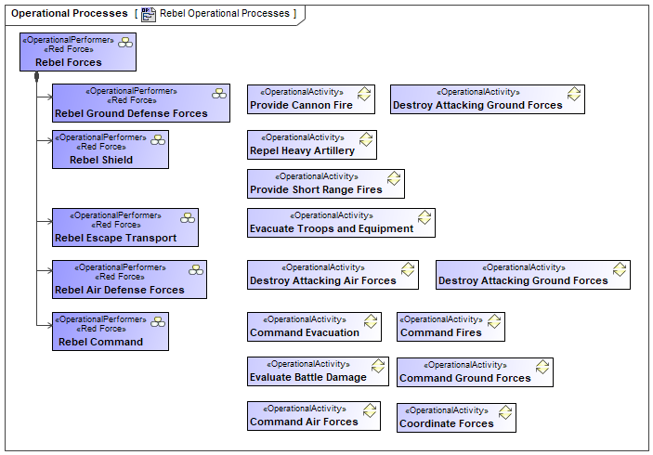
Rebel Force’s Operational Actors and Behaviors
Once again, these are the Rebel Force elements that have been discovered as well as their perceived functionality
The Operational Performers have been designated as Red Force
© 2024 SSI, Aerospace, RTX

Slide 56
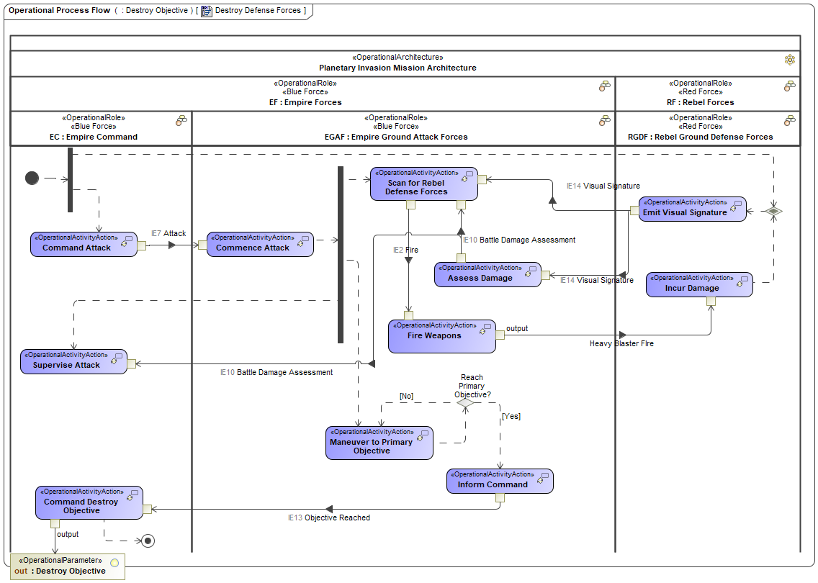
“Destroy Defense Forces” Mission Thread
This is an abbreviated view of the Mission Thread. Details have been excluded to ensure that the diagram is legible
Note the interactions between the rebel and Empire Forces
The Ground Attack Forces Fire Weapons and the Rebel Forces Incur Damage and Emit a Visual Signature. The Signature is detected and analyzed by the Assess Damage and Scan for Rebel Defense Forces activities
Counter attacks as well as other Rebel offensive activities should also be defined
© 2024 SSI, Aerospace, RTX

Slide 57
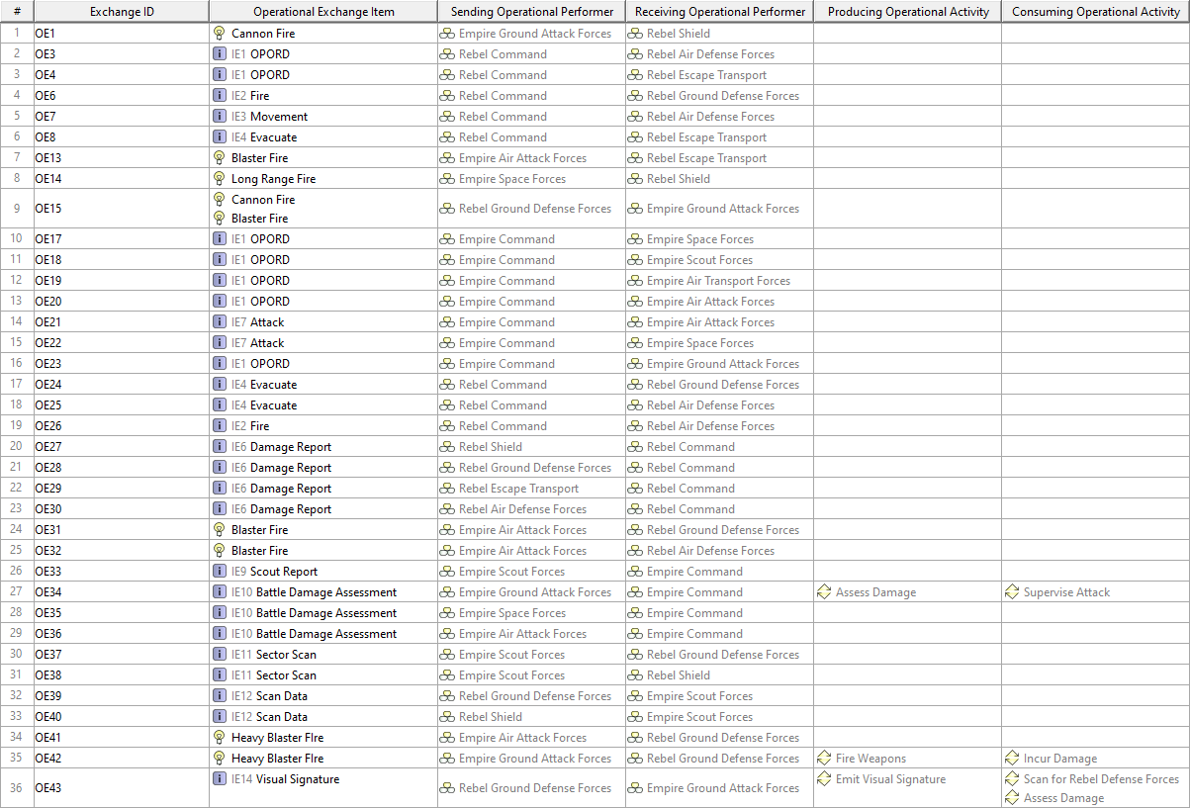
Operational Connectivity Table
© 2024 SSI, Aerospace, RTX

Slide 58
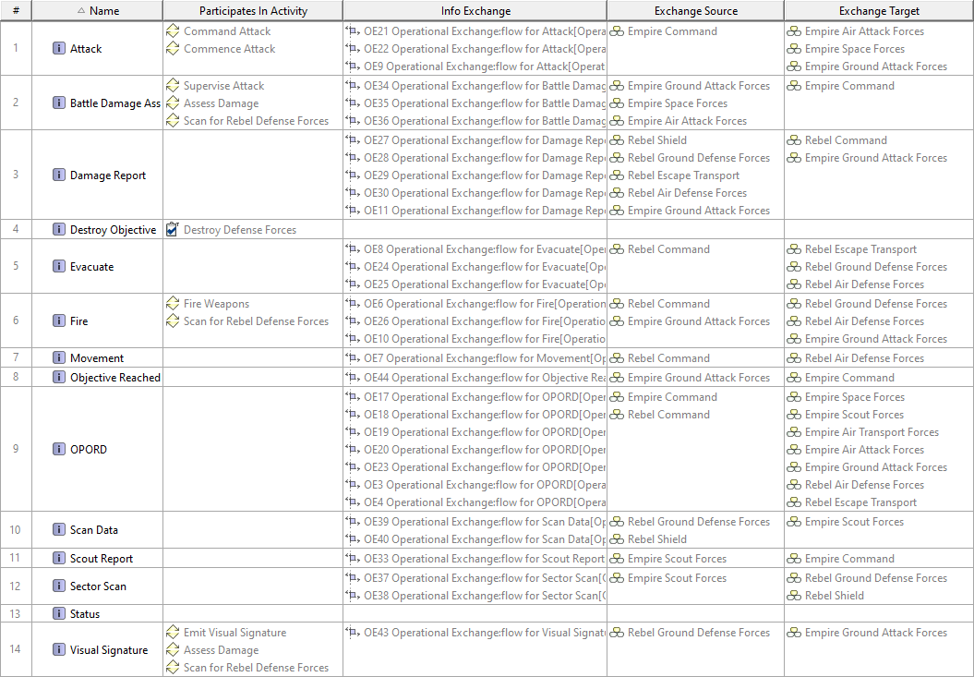
Logical Data Model Usage
The previous table showed a summary of the interactions
This summary table shows the Information Elements and their relationships
Many do not appear on activity diagrams, indicating that the behavioral model is not yet complete
© 2024 SSI, Aerospace, RTX

Slide 59
Strategic Motivation Diagram for Scouting Mission
Defines the goals and motivation behind the mission
Also shows the systems and capabilities linked to the phase
© 2024 SSI, Aerospace, RTX

Slide 60
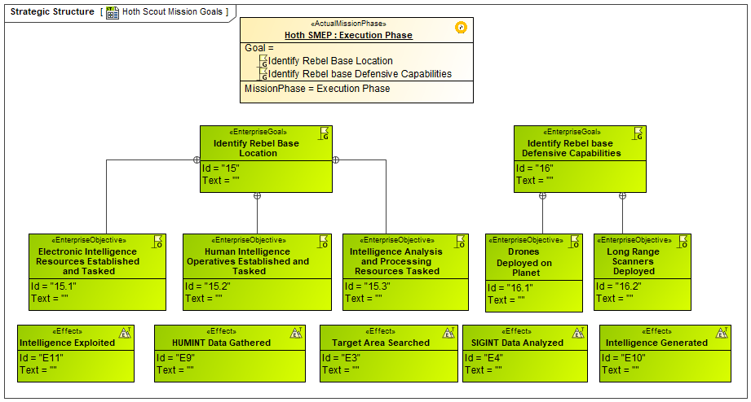
Hoth Scout Mission Goals
The Scout Mission involves finding the Rebel base and determining its defensive capabilities
Like the Attack Mission, the Scout Mission also has its own Goals, and Objectives that support the Goals
Effect definitions are also shown
© 2024 SSI, Aerospace, RTX

Slide 61
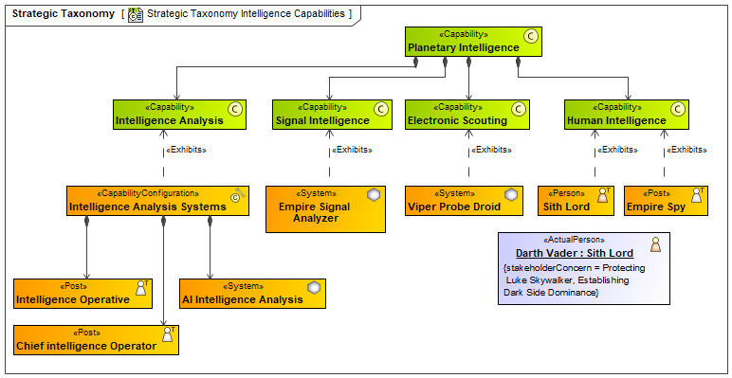
Planetary Intelligence Capabilities
It is important to understand how your Architecture (Operational and Resource) provides the needed Capabilities for the mission
In the example shown here, the elements of the Resource Architecture for the Scout Mission are traced to the Capabilities they provide
Any Capability the Mission requires that is not Exhibited by at least one Resource element would suggest a high risk of Mission failure
© 2024 SSI, Aerospace, RTX

Slide 62
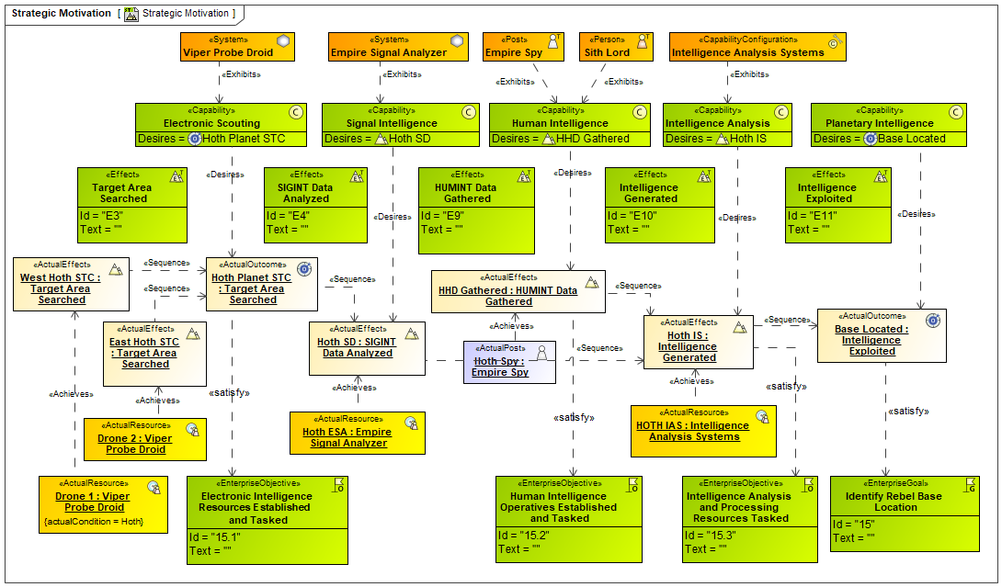
Effects, Goals and Outcomes for Hoth Scout Mission
Shows how the Goals, Objectives, Effects and Outcomes are all linked
Capabilities desire Actual Effects and Outcomes, and Actual Resources achieve them
These Actual Effects and Outcomes satisfy the Goals and Objectives and are shown in a sequence
The final Goal of Identify Rebel Base Location is finally satisfied
© 2024 SSI, Aerospace, RTX

Slide 63
Strategic Capability Table
Traceability tables demonstrate relationships in the model that can be difficult to trace on diagrams
Capabilities trace to desired effects and other model elements
© 2024 SSI, Aerospace, RTX

Slide 64
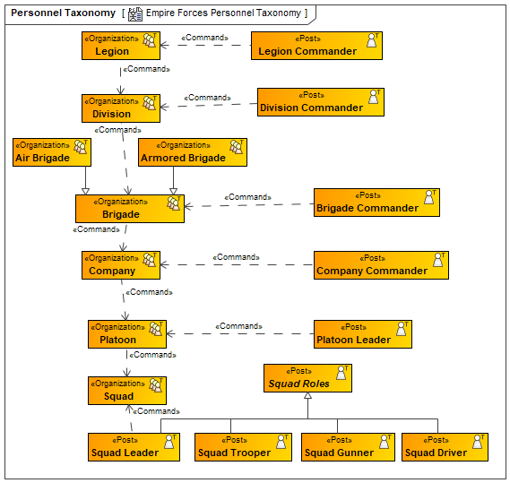
Personnel Taxonomy & Structure
Details the command hierarchy of the generic/standard organizations and posts
These posts and organizations are reused in subsequent diagrams/slides showing different configurations
Instead of showing composition, a Commands relationship is shown. This keeps its elements loosely coupled
These can then be inherited from and reused in other structures without overly constraining them
Competencies, equipment, and executed functions can also be shown
Organizations
© 2024 SSI, Aerospace, RTX

Slide 65
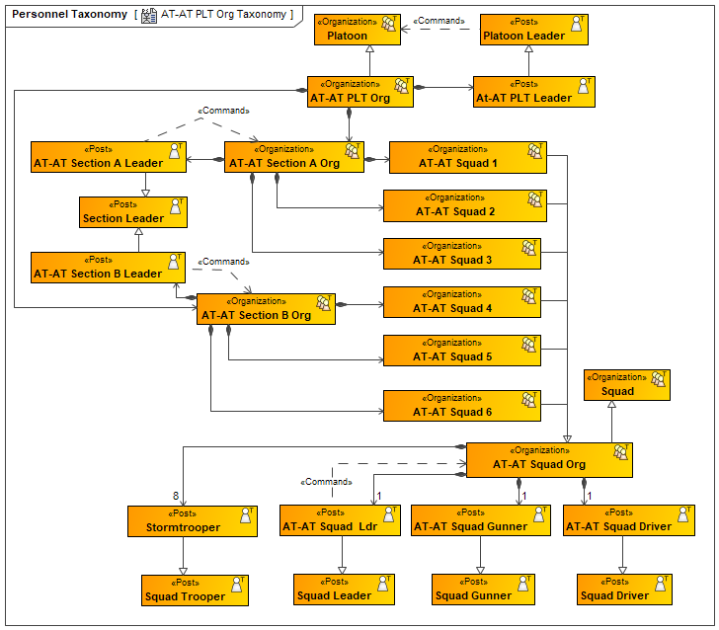
AT-AT PLT Org Taxonomy
Similar structure to the previous slide for the AT-AT platoon reusing the previously defined structure
Specific Posts and Organizations are inherited from the standard/generic ones defined earlier
Elements are inherited to take advantage of equipment and competencies, etc. and ensure uniformity to Empire structures
These will be combined with equipment to form capability configurations
Systems
© 2024 SSI, Aerospace, RTX

Slide 66
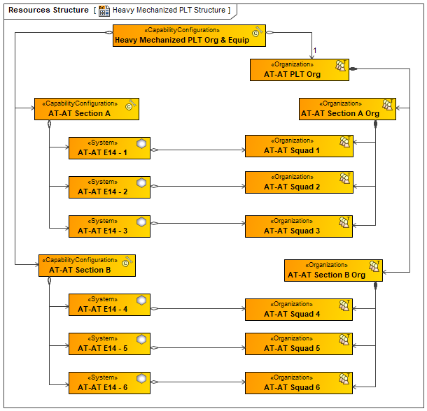
Heavy Mechanized Platoon Structure
Heavy Mechanized Platoon Structure combines the systems on the left with the organizations on the right, which were defined earlier
These can be deployed into battle and the functionality of the capability configurations as well as the organizations can be combined and documented
Organizations
Systems
© 2024 SSI, Aerospace, RTX

Slide 67
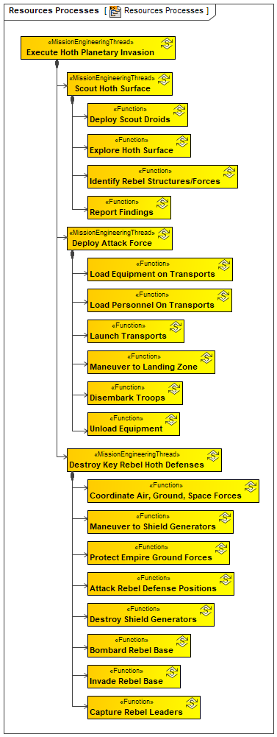
Mission Engineering Thread (System Functions)
The Mission Engineering Thread detailing the various steps of Execute Hoth Planetary Invasion
The functions could either be part of the Mission Engineering Thread, or be Functions performed by the Resources, now that we have identified some of these Resources
© 2024 SSI, Aerospace, RTX

Slide 68
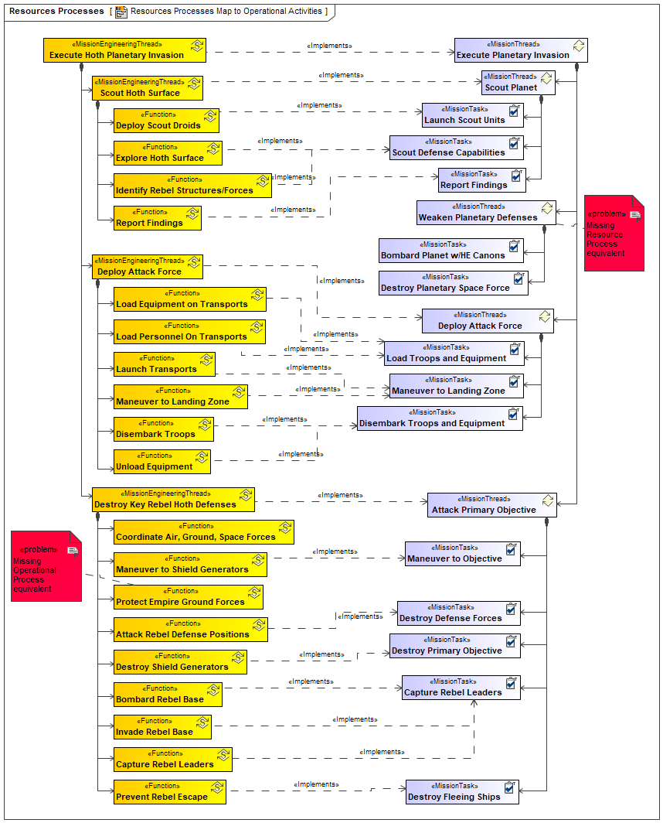
Mapping the Mission Thread to the Missions Engineering Thread
Diagrammatic mapping between the Operational and Resource behaviors of all types
These include the Mission Threads, Mission Tasks and Operational Activities as well as the Mission Engineering Threads and Functions
Weaken Planetary Defenses does NOT have an implementation, which is why the rebels were able to shoot the Spacecraft out of the sky
This mapping is essential to ensure a fully implemented battle plan
Other relationships could also be helpful within each domain. For example:
Offensive Actions and Defensive responses from both sides
Offensive and defensive systems
Etc.
Mission Engineering Threads
Mission Threads
© 2024 SSI, Aerospace, RTX

Slide 69
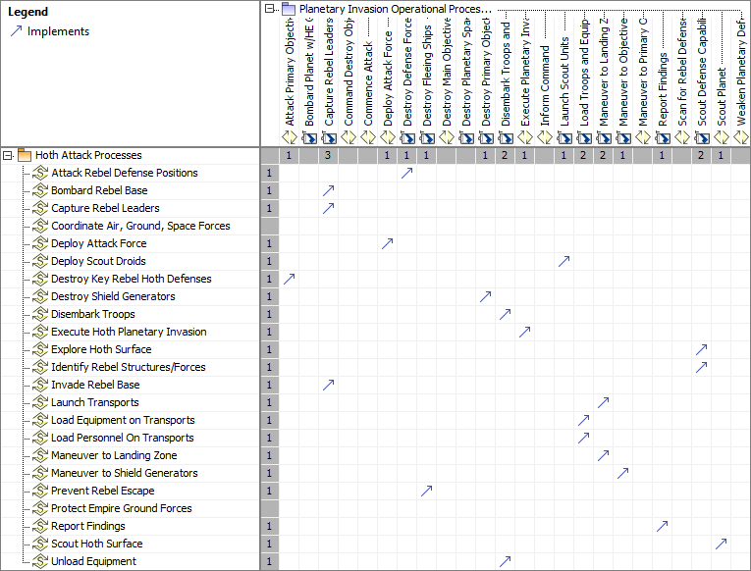
Resources Traceability
Traceability table generated to map the Operational behaviors to the Resource behaviors
Structural tables can also be generated
This matrix could be used to spot holes in the defensive or offensive capabilities
© 2024 SSI, Aerospace, RTX

Slide 70
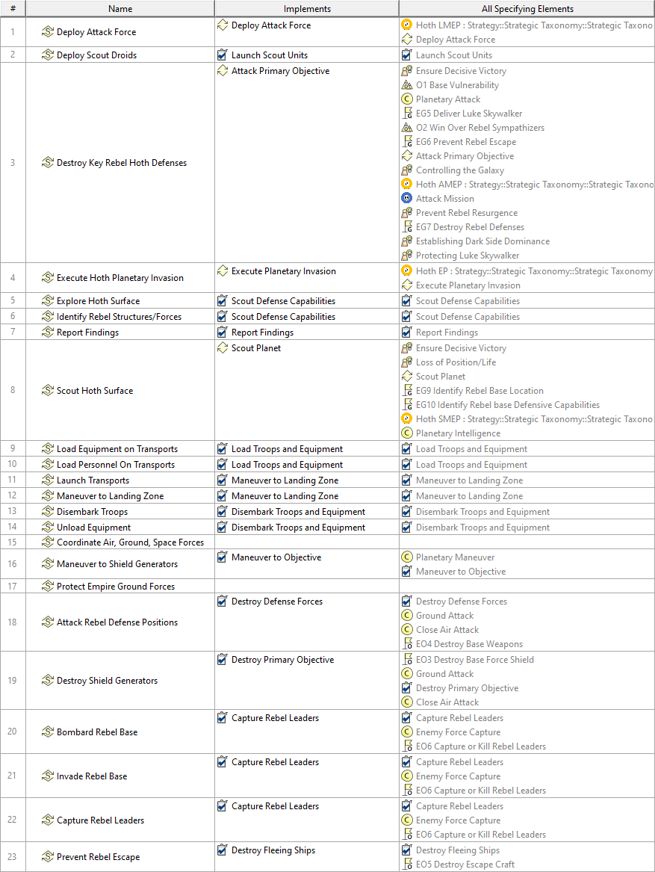
Resource Function Table
Traceability from Resource Functions to Operational Activities, Capabilities, Goals, and other elements
© 2024 SSI, Aerospace, RTX

Slide 71
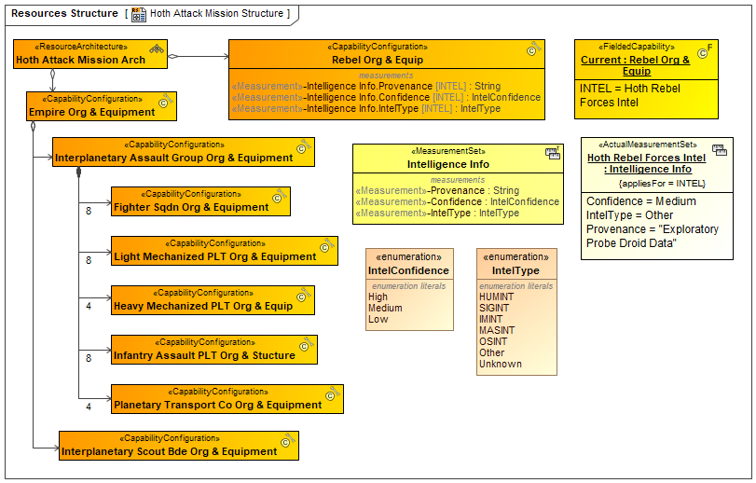
Hoth Attack Mission Structure
Finally, the Structure of the Resource Architecture using the previously defined Organizations and Capability Configurations is created
The Intelligence Info shows information regarding the Rebel Forces
Given the multiplicity of the resources (8 Fighter Squadrons, 8 Light Mechanized Platoons, etc.) as well as all the posts and equipment in each one, this represents a massive scale
This is shown on the following slide
© 2024 SSI, Aerospace, RTX

Slide 72
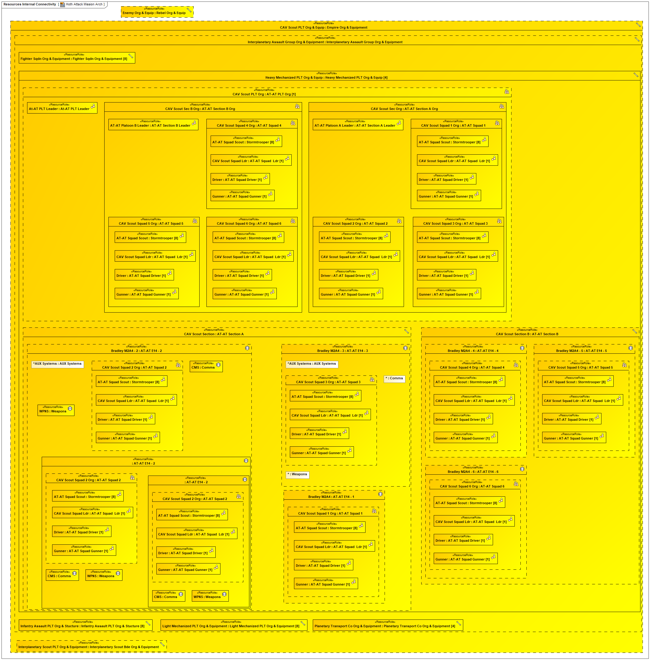
Hoth Attack Mission Architecture
This diagram illustrates the complexity of the structures defined so far
Showing the detailed interactions would quickly lead to quite complex diagrams
It would also be difficult to show interactions between lower-level elements as they are within deep structures
Strategies will need to be devised on the best way to model this
This may involve defining the lower levels together to form the Mission Engineering Threads
© 2024 SSI, Aerospace, RTX

Slide 73
Integrating SysML, Product Line Engineering (PLE), and UAF
© 2024 SSI, Aerospace, RTX

Slide 75
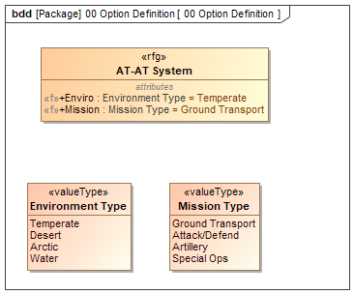
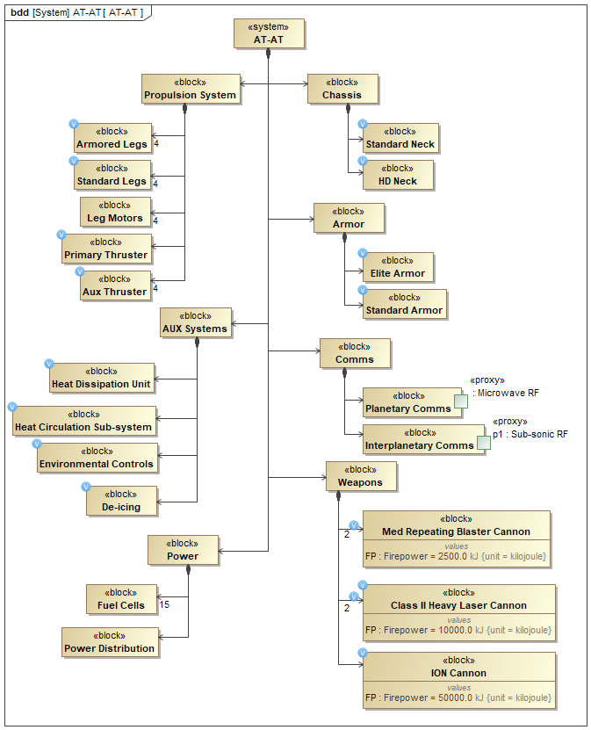
Defining the Product Line Model
Options Definition
System Architecture (150%) with Feature Variation Points
A detailed model Product Line Model (150%) of the AT-AT has been created in SysML with PLE features
It contains a generic AT-AT and other configuration elements for various missions and climates
A Root Feature Group defines what options (attributes) will be used to define different system variants
Note that options can be defined in many ways, but operationally based attributes (e.g. environment) will make the resulting system fit your UAF model better
Variation Points (little blue circles) define what system elements, behaviors, or attributes are valid based on option selection(s)
Note the Heat Dissipation Unit and the De-Icing Blocks for desert and arctic climates respectively
Blue Circles denote variation points of the design that depend on Options selections
© 2024 SSI, Aerospace, RTX

Slide 76
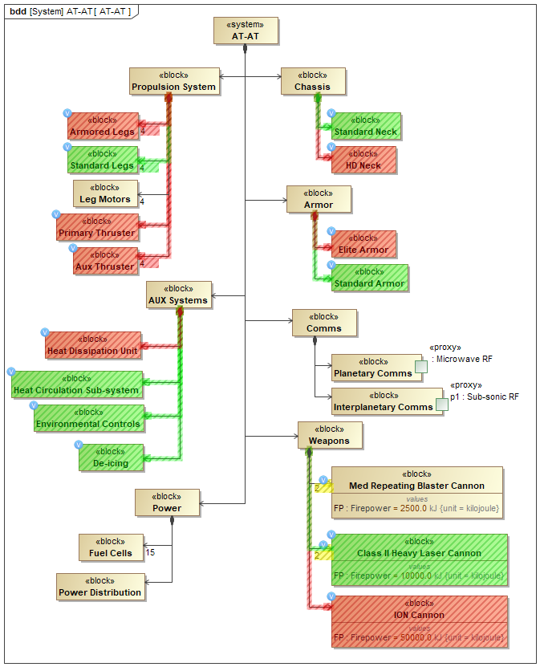
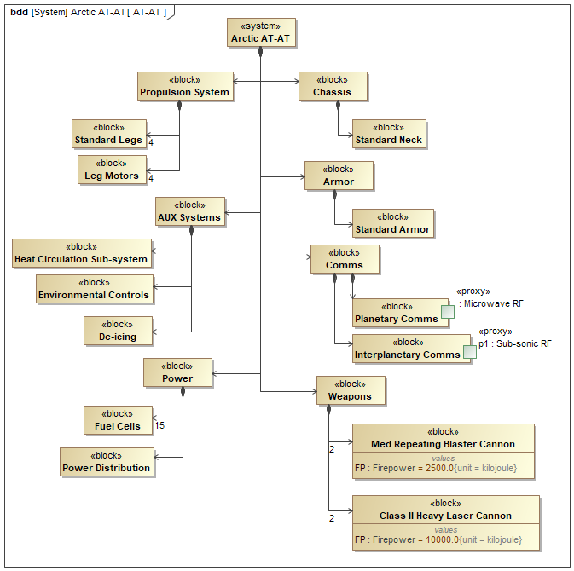
Generating the Model Variant
AT-AT Architecture with Highlighted Choices
Generated Arctic AT-AT Architecture
The figure on the left shows the Product Line model
Elements with variation points are highlighted
Red elements are not valid, based on option selections, green elements are
The right figure shows the resulting generated Arctic AT-AT system with only the valid elements
Different variants can be generated and integrated with the mission model (Next Slide)
© 2023 SSI

Slide 77
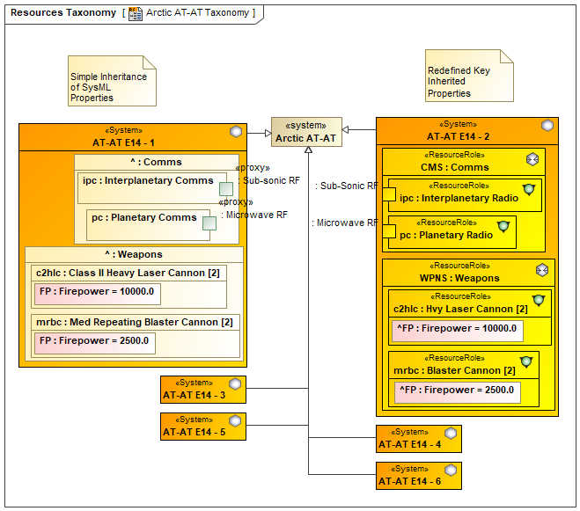
AT-AT Systems and Measures
UAF Mission Level Model of the AT-AT
The figure shows two variations of the reused model: the left where the SysML parts are maintained, and the right where they are redefined to UAF elements
Note that for readability not all elements are shown
Because UAF limits interactions and connection to UAF-UAF elements, ports need to be redefined
SysML can show both UAF and SysML connections
SysML Model of AT-AT Systems
© 2023 SSI

Slide 78
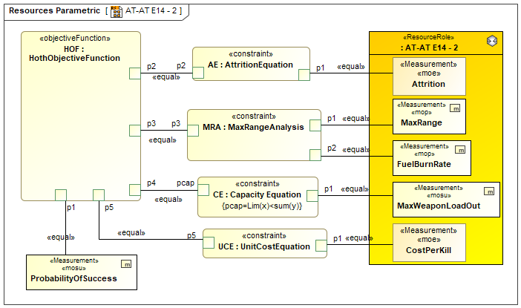
Measuring Mission Success Using UAF Parametrics
The example parametric diagram makes use of both UAF and SysML measurements/ value properties
These include:
Measures of Performance (MOP)
Measures of Success (MOS)
Measures of Suitability (MOSu)
Measure of Effectiveness (MOE)
The measurements are:
Max Range = MOP
Fuel Burn Rate = MOP
Max Weapon Load Out = MOSu
Cost Per Kill = MOE
CostE -> Probability of Success = MOS
Attrition = MOE
The objective function calculates probability of success
Note that the diagram simply illustrates the concept and is not a detailed example
© 2024 SSI, Aerospace, RTX

Slide 80
Conclusions and Future Work (1)
This model was built as a proof of concept for UAF support for Mission Engineering
The current UAF metamodel and future extensions (UAF 1.3/2.0) will address most Mission Engineering concepts
Standardization of MBSE concepts in a profile is beneficial
Reduces learning curve, miscommunication, confusion, etc.
Examples of model-based standardizations
UML was created to standardize SW engineering
SysML to extend UML for systems engineering
UPDM/UAF to extend SysML/UML for DoDAF/MODAF/NAF
RAAML for safety and security in SysML model evaluation
SysML provides many Mission Engineering concepts but needs extensions
The approach taken in this presentation provides these extensions
© 2024 SSI, Aerospace, RTX

Slide 81
Conclusions and Future Work (2)
We will continue to build the model and examine the issues of resource architecture complexity, scale, and detail
We need to build behavioral models at both the detailed and high levels.
Reuse will be an essential part of this effort – libraries, patterns, GRAs, etc.
Add state machines and sequence diagrams
We are socializing the model so that people can build on this to ensure that the UAF Mission Engineering extensions are fit for purpose
We will release these profile extensions to bridge the gap until the next UAF release
Next expected version will be UAF 1.3 specifically to support Mission Engineering
This version will also include a NEW ME Guide for UAF
Finally, we encourage any and all comments to help us achieve our goals
© 2024 SSI, Aerospace, RTX

Slide 82
Questions?

Slide 83
References
Martin James, Kyle Alvarez 2023. “Using the Unified Architecture Framework in Support of Mission Engineering Activities”, INCOSE Symposium
Martin James 2023. “Leveraging UAF for Mission Engineering,” UAF Summit, Mar 22, 2023.
DoD Joint Publication 3-0 (Joint Operations), Available online at https://irp.fas.org/doddir/dod/jp3_0.pdf , Accessed March 2023
Defense Acquisition University, Defense Acquisition Guidebook, Chapter 3, “Systems Engineering,” current edition.
Public Law 114-328, “National Defense Authorization Act for Fiscal Year 2017,” December 23, 2016, Section 855
DoD OSD Mission Engineering Guide (MEG), Available online at https://ac.cto.mil/wp-content/uploads/2020/12/MEG-v40_20201130_shm.pdf Accessed March 2023.
OMG, 2022, Unified Architecture Framework Specification Version 1.1. (2022). Retrieved 31 January 2022, from https://www.omg.org/spec/UAF/1.1/About-UAF/
Object Management Group (OMG), 2019. OMG2012-06-01.OMG Systems Modeling Language (OMG SysML™), V1.6, http://www.omg.org/spec/SysML/1.6/PDF/.
Battle of Hoth, Reference information Available online from https://starwars.fandom.com/wiki/Star_Wars:_Episode_V_The_Empire_Strikes_Back#The_Battle_of_Hoth
Roman & Dahmann, “Applying Mission Engineering to the U.S. Department of Defense Rapid Defense Experimentation Reserve”, Presented at the NDIA Systems & Mission Engineering conference, Orlando, FL, November 2022
Gagliardi, Hause, Martin & Phillips, 2024, Darth Vader's Secret Weapon: Implementing Mission Engineering with UAF, to be presented at the 34th INCOSE International Symposium, Dublin, Ireland, July 2024
© 2024 SSI, Aerospace, RTX

Slide 84
Example Profile Slides
© 2024 SSI, Aerospace, RTX

Slide 85
Mission Engineering Profile Overview
© 2024 SSI, Aerospace, RTX

Slide 86
Mission Elements Examples
© 2024 SSI, Aerospace, RTX

Slide 87
Scenario And Vignette Definitions
© 2024 SSI, Aerospace, RTX

Slide 88
Missions and Measurements
© 2024 SSI, Aerospace, RTX

Slide 89
Missions and Measurements of Success
© 2024 SSI, Aerospace, RTX

Slide 90
Mission Definitions and Actual Missions
© 2024 SSI, Aerospace, RTX

Slide 91
Detailed Mission Structure
© 2024 SSI, Aerospace, RTX

