Slide 1

Chapter 2.3.5.7
Implementation Process

Slide 2
Purpose and Description
Per 15288: Realize a specified system element
Uses technical content from previous technical processes to realize elements of a system
  Concepts, requirements, architecture, design
Follow requirements allocated to element to fabricate, code, or build each individual element
Element requirements are verified and stakeholder requirements are validated
Process is iterative and recursive for resolving discrepancies

Slide 3
Elaboration: Four Forms of System Elements
Hardware – output includes fabricated or adapted physical elements
Software – output includes software code and executable images
Operational resources – output includes procedures and training
Services – output includes specified services. These may be the result of one or more hardware, software, or operational elements resulting in the services
Notes:
Four forms of system elements

Slide 4
Elaboration: Support both Creation or Adaptation
Creation – original design, fabrication and development
Adaptation of System Elements – reuse or acquired (COTS) are adapted to satisfy needs of the System of Interest
  Configuration settings (hardware switches, config tables)
Creation vs Adaptation–
  Creation is custom, therefore increased cost
  Adaptation is reuse, reduce cost
Notes:
Four forms of system elements

Slide 5
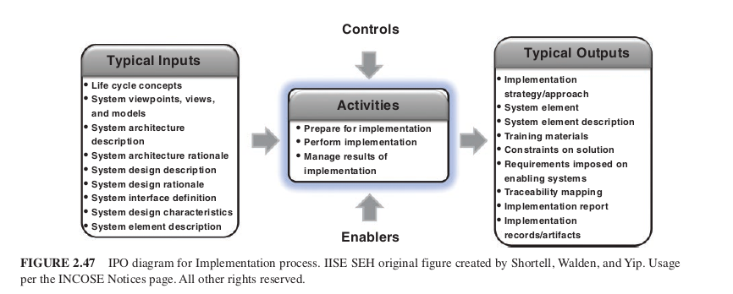
Input / Process / Output
Be aware of mapping of inputs from previous technical processes
Be aware of how outputs feed future technical processes

Slide 6
Prepare for Implementation
Define fab/coding procedures, tools, and equipment
Elicit constraints imposed by technology, strategy or impacted systems
Document plan for acquiring or gaining access to resources
Ensure access to enabling systems, services, materials and support to realize element
Schedule the process (workflow, identify critical path)

Slide 7
Perform Implementation
Realize the elements per specification
Produce evidence of compliance
Complete documentation of product, process, material spec, and configurations (how to reproduce)
Peer review and Test – verify element
Conduct Conformation Audits – Ensure element meets specification and ready for integration
Initial training and draft training documentation – content to enable operation, fault detection and isolation, contingency
Hazardous material log (as applicable)

Slide 8
Manage Implementation Results
Identify and record implementation results
  Baseline information for Config Management
  Records per organizational policy
Record Anomalies and resolve anomalies
  Perform corrective actions as required
Establish and Sustain Traceability
  Ensure traceability to system architecture, design, and interfaces

Slide 9
Chapter 2.3.5.8
Integration Process

Slide 10
Purpose and Description
Per 15288: Synthesize a set of system elements into a realized system that satisfies system requirements
Combine SoI elements (HW, SW, Op Resources)
  Verify Correctness of static and dynamic system aspects
Address integration issues thru modeling, analysis, sim, prototype, testing
Integration process interaction with system definition processes avoids integration issues during realization

Slide 11
Description (cont’d)
This process is Integrated with Verification and Validation
Includes assessment of integration maturity of elements
During Integration, verification is invoked
  Check interfaces, behavior, interactions, boundaries

Slide 12
Elaboration: Occurs Throughout Project and Various Aggregations
Starts at Initial Needs and lasts thru utilization and support
  Focus of integration evolves
  Emphasis shifts as product/system progresses
  Proactive mitigate risks and avoid integration issues
Concept of an “Aggregate”
  Integration based on aggregate of several elements, interfaces, and behaviors
  A Set of Verification actions can be taken for different aggregate configurations
  Take form of simulators, emulators, stubs, harnesses, measuring devices
Notes:
Four forms of system elements

Slide 13
Elaboration: Strategy and Approaches
Integration Strategy Plan:
  Defines actions to be taken to mitigate integration risks and configuration of expected aggregates of evolving system elements
  Defines sequence of aggregates to carry out efficient verification and validation actions
Plan developed in coordination with verification and validation strategy
Approach: dependent on type of system element, delivery time, order of delivery of system elements, risk, constraints
Approach: Should consider context of system of interest
Notes:
Four forms of system elements

Slide 14
Elaboration: Approaches
Global (big bang) integration – bring it all together, all at once. Any issues are difficult to find/resolve
Bottom-up integration – reverse decomposition, find problems at lower levels, system problems not discovered til later
Top-down – intent is to reflect overall system performance with peripheral elements simulated an integrated later. Detect system level issues with external interfaces early
Incremental – small number of system elements are added to an already integrated increment of system elements. Evolutionary/agile development
Subset – assembly by subsets and then subsets are assembled, functional chains or threads to perform specific tasks
Criterion-driven – most critical system elements compared to selected criterion are first integrated. Generally related to risk. Early integration and verification of intensively critical system elements
Integration “with the stream” - delivered system elements are assembled as available
Model based – modeled physically or functionally and integrated in model environment. Actual elements can be inserted as developed.
Notes:
Four forms of system elements

Slide 15
Elaboration: Horizontal and Vertical Integration
Why: Need to address multiple perspectives across lifecycle
Horizontal: activities performed across elements that appear in a common hierarchy level of system
  Structural, behavioral
Vertical: activities performed to help ensure system elements at a given level are consistent with and satisfy expectations of the system or higher-level system elements
Integration viewed as horizontal traceability among parallel elements and vertical traceability between system hierarchy levels

Slide 16
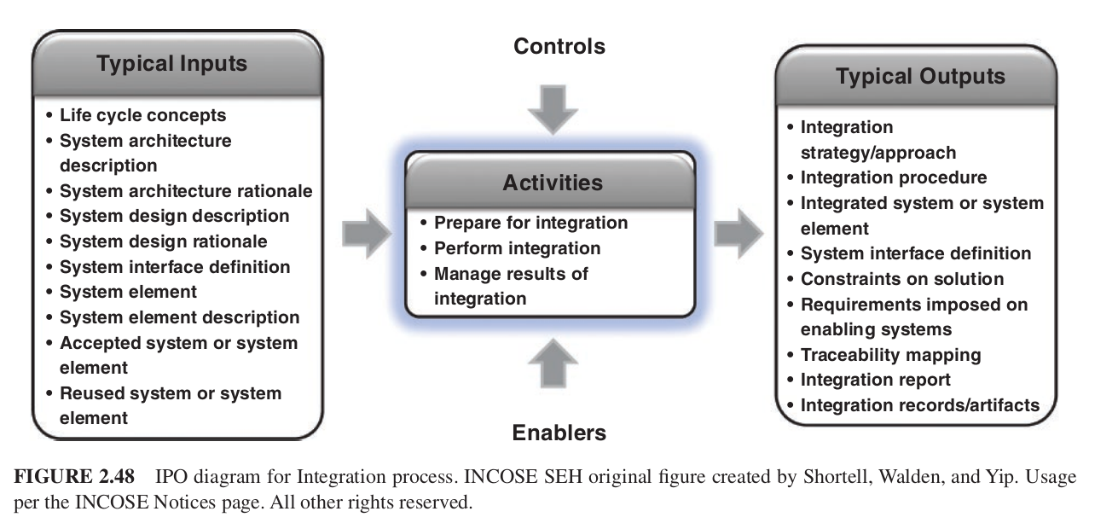
Input / Process / Output
Be aware of mapping of inputs from previous technical processes
Be aware of how outputs feed future technical processes

Slide 17
Prepare for Integration
Establish checkpoints for correct implementation of interfaces
Establish the strategy/approach for integration
Identify risk mitigation approaches and sequences for aggregating elements
Identify system constraints and objectives necessary for successful integration
Plan for necessary enabling systems or services, such as integration facilities, training systems or simulators
Ensure enabling system or service access and materials

Slide 18
Perform Integration
Execute until system is complete
Manage interface availability as scheduled and track conformance
Address conformance or availability issues
Integrate elements IAW sequences
Check interfaces, selected functions, and critical quality characteristics at different integration levels

Slide 19
Manage Integration Results
Capture results, including anomalies
Capture root causes and corrective actions, record any lessons learned
Maintain bidirectional traceability of the integrated system elements and the strategy, plans, and requirements
Give CM information items, work products and artifacts

Slide 20
Chapter 2.3.5.9
Verification Process

Slide 21
Purpose and Description: Was entity built right
Per 15288: provide objective evidence that a system, system element or artifact fulfills its specified requirements and characteristics
Applied to any engineering artifact, entity, or information contributing to realization of SoI
Objective evidence to confirm:
  Artifact/entity is made “right” to characteristics
  No anomalies (error/defect/fault) introduced
  Verification strategy yields appropriate evidence that if anomaly was introduced, it would be detected

Slide 22
Elaboration:
Refer to INCOSE Needs Requirements Manual and GtVV
Verification Planning: Begin when requirements are being defined. Define success criteria, method and strategy
Reduction of Verification Activities and Risk: Use risk-based approach when reducing verification activities due to cost/schedule.
  Try to avoid blindly removing activities
  Keep opportunities available if funding/schedule permits
Notion of a Verification Action: Describes entity to be verified, the requirement/specification, expected result, verification strategy and method, level of integration
Notes:
Four forms of system elements

Slide 23
Elaboration: Example Verification Actions
Verification of stakeholder requirement
  Correctly represents customer need
  Satisfies good requirement characteristics
Verification of a system requirement
  Correctly represents source requirement
  Satisfies good requirement characteristics
Verification of a model or simulation
  Verify model/sim meets requirement with intended purpose
  Verify model/sim against syntactic
  Verify correct application (patterns/heuristics)
Verification of system architecture
  SoI when realized, will pass system verification
  Correct application of patterns and heuristics
Verification of the system design
  SoI design and associated characteristics meets its system requirements
Verification of a realized system
  System or elements meets requirements to an acceptable degree
Notes:
Four forms of systemExample Verification Actions
Verification of stakeholder requirement
Correctly represents customer need
Satisfies good requirement characteristics
Verification of a system requirement
Correctly represents source requirement
Satisfies good requirement characteristics
Verification of a model or simulation
Verify model/sim meets requirement with intended purpose
Verify model/sim against syntactic
Verify correct application (patterns/heuristics)
Verification of system architecture
Verification of the system design
Verification of a realized system
elements

Slide 24
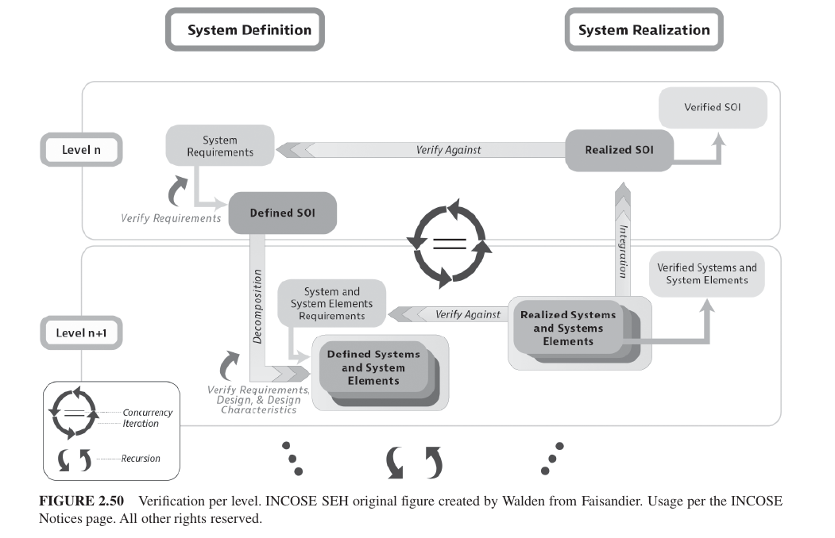
Elaboration: Verification Per Level

Slide 25
Elaboration
Verification Methods: Inspection, Analysis, Demonstration, Test
Early Verification and MBSE:
  Conduct verification earlier in life cycle
  Resist substitute verification of realized system with verification results obtained using models/sims
Managing Projects System Verification Program
  Management of budget and schedule
  Know time, status, anomalies and non-compliances

Slide 26
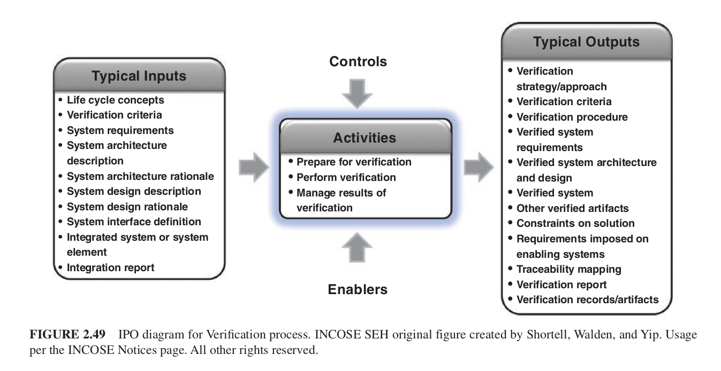
Input / Process / Output
Be aware of mapping of inputs from previous technical processes
Be aware of how outputs feed future technical processes

Slide 27
Prepare for Verification
Define scope and verification actions
  Entities to be verified and stakeholder inputs
  Specified requirements against which entity will be verified
Capture constraints that could impact effectiveness of verification actions
For each verification action, select on or more method and success criteria
Establish the strategy/approach for verification, including trade offs between scope and constraints
  Verification Activities and procedures

Slide 28
Prepare for Verification
Identify constraints and objectives from verification strategy
Plan for the necessary enabling systems or services needed through life cycle for verification
Ensure enabling system or service access needed to support verification

Slide 29
Perform Verification
Define procedures for verification actions
Execution procedures
Schedule execution
Ensure readiness to conduct verification

Slide 30
Manage Verification Results
Record results and defects
Analyze the results against success criteria
Capture operational incidents and problems, track them until closed
Obtain agreement from the approval authority that the verification criteria was satisfied
Establish and sustain traceability
Give CM the information items, work products, or other artifacts needed for baselines.

Slide 31
Extra Material - Content
INCOSE ASEP/CSEP Exam Tutorial - YouTube
INCOSE ASEP Exam Tutorial - Video #8 - Implementation Process - (Chapter 4.7)
INCOSE ASEP Exam Tutorial - Video #9 - Integration Process - (Chapter 4.8)
INCOSE ASEP Exam Tutorial - Video #10 - Verification Process - (Chapter 4.9)

