Slide 1

Systems Engineering Handbook V5.0 Tutorial
Product Number: TBD
INCOSE North Texas Chapter
For more information visit:
https://www.incose.org/certification
© 2025 International Council on Systems Engineering
March 16, 2025
Subject to the restrictions on the copyright pages

Slide 2
INCOSE Copyright Notice (to be updated)
Copyright (c) 2025 by INCOSE, subject to the following restrictions:
This International Council on Systems Engineering (INCOSE) Technical Data was prepared by the INCOSE North Texas Chapter. It has been released by the North Texas Chapter as INCOSE Technical Data. Future releases will be developed by the North Texas Chapter for approval as a Technical Product. Forward comments to TBD
Author Use: Authors have full rights to use their contributions unfettered, with credit to the INCOSE technical source,
except as noted in the following text. Abstraction is permitted with credit to the source.
INCOSE Use: Permission to reproduce and use this document or parts thereof by members of INCOSE and to prepare derivative works from this document for INCOSE use is granted, with attribution to INCOSE and the original author(s) where practical, provided this copyright notice is included with all reproductions and derivative works. Content from ISO/IEC/IEEE 15288 and ISO/IEC/IEEE 24748‐1 is used by permission and is not to be reproduced other than as part of this total document.
External Use: This document may not be shared or distributed to any non‐INCOSE third party. Requests for permission to reproduce this document in whole or in part, or to prepare derivative works of this document for external and/or commercial use, will be denied unless covered by other formal agreements with INCOSE. Copying, scanning, retyping, or any other form of reproduction or use of the content of whole pages or source documents are prohibited, except as approved by the INCOSE Administrative Office, 7670 Opportunity Road, Suite 220, San Diego, CA 92111‐2222, USA.
Electronic Version Use: All electronic versions (e.g., eBook, PDF, PPT) of this document are to be used for personal professional use only and are not to be placed on non‐INCOSE sponsored servers for general use. Any additional use of these materials must have written approval from the INCOSE Administrative Office.
General Citation Guidelines: References to the handbook should be formatted as follows, with appropriate adjustments for formally recognized styles:
INCOSE (2023). Systems Engineering Handbook: A Guide for System Life Cycle Process and Activities (5th ed.).
D. D. Walden, B. A. Delicado, D. Endler, G. J. Roedler, O. Mornas, T. M. Shortell, and Y. Yew-Seng (Eds.). San Diego, CA: International Council on Systems Engineering. Published by John Wiley & Sons, Inc.
Notice: A hardcopy of this Tutorial may not be the most current version. The current approved version is always the version on the INCOSE Training Working Group site.

Slide 3
INCOSE Copyright Notice (cont)
Copyright (c) 2025 by INCOSE, subject to the following restrictions:
In accordance with the following terms and conditions, the figures (the "Product") in this material are licensed to John O. Clark, as an instructor, for instructional use only. Under no circumstances may this Product or any portion thereof be sold, licensed, auctioned, or otherwise redistributed except as may be permitted by the terms herein.
INCOSE provides John O. Clark with this Product for instructional use and review. He and his students may use this Product for instructional use subject to the terms described below. INCOSE has established these use limitations in response to concerns raised by authors, instructors, and other users regarding the problems stemming from unlimited distribution of supplemental material.
INCOSE hereby grants John Clark permission to use the Product for his personal, noncommercial use only. The Product may not be reproduced or distributed, except that portions of the Product may be provided to his students in connection with his classroom instruction. This Product may be made available in the classroom or posted electronically as described herein. Any portion of the Product posted electronically must be through a password-protected website or a learning management system accessible solely by his students. Copy and download functionality by his students is authorized by INCOSE. He may not sell, license, auction, or otherwise redistribute the Product in any form. INCOSE asks that he take reasonable steps to protect the Product from unauthorized use, reproduction, or distribution. His use of the Product indicates his acceptance of the conditions set forth in this Agreement.
All rights (including without limitation, copyrights, patents, and trade secrets) in the Product are and will remain the sole and exclusive property of INCOSE and/or its licensors. The Product is furnished by INCOSE on an "as is" basis without any warranties, express or implied. This Agreement will be governed by and construed pursuant to the laws of the State of California, without regard to such State's conflict of law rules that would require the application of the laws of another jurisdiction.
The following notice should appear on each page of this Product:
© 2023 John Wiley & Sons, Inc. May not be copied, scanned, or duplicated, in whole or in part, except for use as permitted by license on a password-protected website for instructional use.
Thank you for your assistance in helping to safeguard the integrity of the content contained in this Product. We trust you find the Product a useful teaching tool.

Slide 4
Handbook Contents
How to Use This Handbook
Chapter 1 – Systems Engineering Introduction
Chapter 2 – System Life Cycle Terms and Concepts
Chapter 3 – Life Cycle Analyses and Methods
Chapter 4 – Tailoring and Application Considerations
Chapter 5 – Systems Engineering in Practice
Chapter 6 – Case Studies
Appendix A – References
Appendix B – Acronyms
Appendix C – Terms and Definitions
Appendix D – N² Diagram of Systems Engineering Processes
Appendix E – Input/Output Descriptions
Appendix F – Acknowledgements
Appendix G – Comment Form
Index
Not every process will apply universally. Careful selection of the material is recommended. Reliance on process over progress will not deliver a system.

Slide 5
Chapter 3
Lifecycle Analysis and Methods

Slide 6
Chapter 3 Contents
  3.1 Quality Characteristics and Approaches
  3.1.1 Introduction to Quality Characteristics
  3.1.2 Affordability Analysis
  3.1.3 Agility Engineering
  3.1.4 Human Systems Integration
  3.1.5 Interoperability Analysis
  3.1.6 Logistics Engineering
  3.1.7 Manufacturability/Producibility Analysis
  3.1.8 Reliability, Availability, Maintainability Engineering
  3.1.9 Resilience Engineering
  3.1.10 Sustainability Engineering
  3.1.11 System Safety Engineering
  3.1.12 System Security Engineering
  3.1.13 Loss-Driven Systems Engineering

Slide 7
Chapter 3 Contents
3.2 Systems Engineering Analyses and Methods
3.2.1 Modeling, Analysis, and Simulation
3.2.2 Prototyping
3.2.3 Traceability
3.2.4 Interface Management
3.2.5 Architecture Frameworks
3.2.6 Patterns
3.2.7 Design Thinking
3.2.8 Biomimicry

Slide 8
3.2 Systems Engineering Analysis and Methods
This section provides insight into topics, techniques, and methods that cut across the SE life cycle processes, reflecting various aspects of the concurrent, iterative, and recursive nature of SE

Slide 9
3.2.1 Modeling, Analysis and Simulation
“The future of systems engineering is model-based, leveraging next generation modeling, simulation, and visualization environments powered by the global digital transformation, to specify, analyze, design, and verify systems. High fidelity models, advanced visualization, and highly integrated, multidisciplinary simulations will allow SE Practitioners to evaluate and assess an order of magnitude more alternative designs more quickly and thoroughly than can be done on a single design today.”

Slide 10
3.2.1 Modeling, Analysis and Simulation
Modeling is the conception, creation, and refinement of models. Analysis is the process of systematic, reproducible examination to gain insight.
Simulation is the process of using a model to predict and study the behavior or performance of the SoI — for aspects represented in the model.
Two major types of models are distinguished: physical models, and digital models.
Although sometimes the term “simulation” is used in conjunction with a physical model, in this section simulation always involves a digital model, and any examination involving a physical model is always a test.

Slide 11
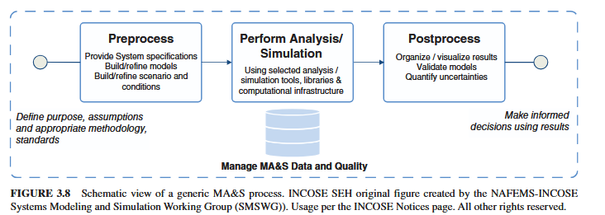
3.2.1 Modeling, Analysis and Simulation

Slide 12
3.2.1 Modeling, Analysis and Simulation
MA&S Related to Life Cycle Processes
    Business or Mission Analysis process, Stakeholder Needs and Requirements Definition process - ensure that the business or mission proposition is understood correctly, the problem is under-stood correctly, is specified at the appropriate level of detail, and is fully shared with the stakeholders
System Requirements Definition process - flowdown the system requirements to system elements. May include models that specify functional, interface, performance, and physical requirements, as well as other nonfunctional requirements (e.g., reliability, maintainability, safety, and security).

Slide 13
3.2.1 Modeling, Analysis and Simulation
System Architecture Definition process concurrently with the Design Definition process - synthesize and define alternative system concepts, compare and evaluate candidate options, and enable discovery of the best architecture and design, including the integration with other systems and unambiguously defining the system’s capabilities and the value it is expected to deliver to its stake-holders (e.g., in the form of MOEs and MOPs).
System Analysis process related system analyses can be used to explore a trade space by modeling alternative system solutions, or even generate many candidate solutions, and assessing the impact of critical properties such as mass, speed, energy consumption, accuracy, reliability, and cost on the overall adequacy and performance.

Slide 14
3.2.1 Modeling, Analysis and Simulation
Implementation process - support definition, understanding and prediction of behavior for various aspects of the enabling production (manufacturing) and supply chain processes for the envisaged SoI. Models that reflect the “as produced” state of the SoI can be used to develop production facilities(factory) and “digital twins.”
Integration process - support integration of the elements into a system
Verification process - support verification that the system satisfies its requirements
Disposal process - used to predict and monitor system disposal

Slide 15
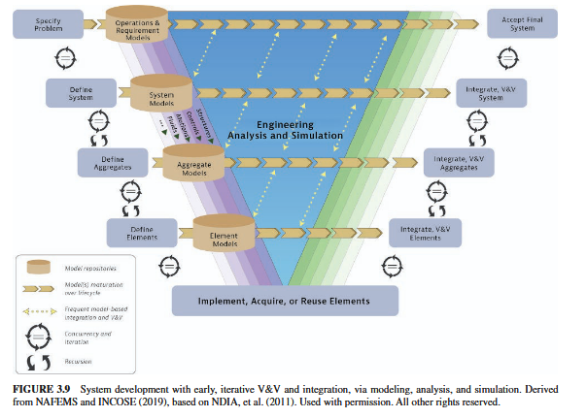
3.2.1 Modeling, Analysis and Simulation

Slide 16
3.2.1 Modeling, Analysis and Simulation
Cross-Cutting MA&S - There are several cross-cutting uses of MA&S that are not tied to a particular life cycle process
                - Characterizing an existing system
              - Knowledge transfer within teams
              - Automated mapping and transformation
              - Knowledge capture and system design evolution

Slide 17
3.2.1 Modeling, Analysis and Simulation
    Benefits of MA&S
        Separation of representation and presentation – authoritative source of truth
        More explicit SE
        Better problem specification
        Rigorous, well-documented design
        Early V&V
        Multi-user collaboration
        Better change impact assessment
        Improved mastering of complexity
        Better team planning and handover
        Enable efficient maintenance and traceability
        Flexible and repeatable querying

Slide 18
3.2.1 Modeling, Analysis and Simulation
Classifying and Characterizing Models - many different kinds of models to address different system aspects and different kinds of systems. Specific types of models focus on some subset of the system characteristics, such as timing, process behavior, measures of performance, interfaces, and connections
Physical model - represents (aspects of) a system with real parts
Digital model - can have many different expressions to represent (e.g., a system, entity, phenomenon, or process), each of which may vary in degrees of formalism
    Formal Models
    Informal Models

Slide 19
3.2.1 Modeling, Analysis and Simulation
Modeling Quality and Metrics - The quality of a model should not be confused with the quality of the design that the model represents

Slide 20
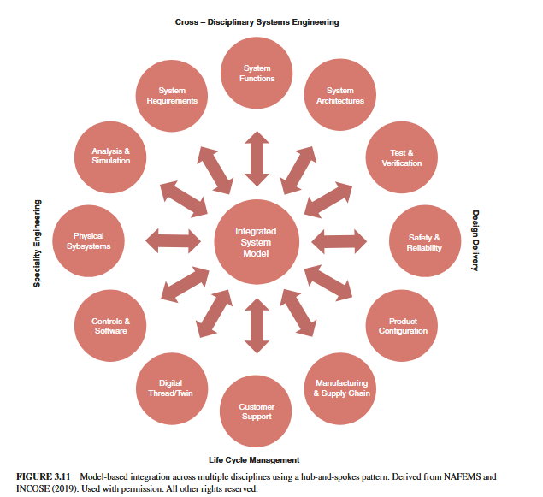
3.2.1 Modeling, Analysis and Simulation

Slide 21
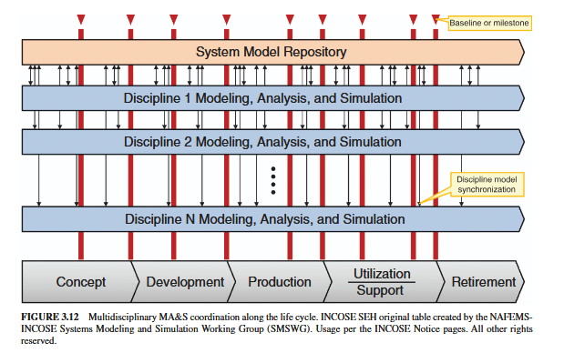
3.2.1 Modeling, Analysis and Simulation

Slide 22
3.2.2 Prototyping
Prototyping is a technique that can significantly enhance the likelihood of providing a system that will meet the user’s need.
A prototype can facilitate both the awareness and understanding of user needs and stakeholder requirements.
Two types of prototyping are commonly used: rapid and traditional.
  – Rapid prototyping is probably the easiest and one of the fastest ways to get user performance data and evaluate alternate concepts.
• A rapid prototype is – an easy and fast way to get system performance data and evaluate alternate concepts
– Traditional prototyping is a tool that can reduce risk or uncertainty.
A partial prototype is used to verify critical elements of the SOI.
A full prototype is a complete representation of the system.
– It must be complete and accurate in the aspects of concern.
– Objective and quantitative data on performance times and error rates can be obtained from these higher‐fidelity interactive prototypes.

Slide 23
3.2.3 Traceability
Traceability for products and systems is defined as “the ability to trace the history, application, or location of an object/entity/item
Bidirectional traceability is the ability to trace an object/entity/item to another object/entity/item while automatically establishing a reverse link back to the initial object/entity/item.
Vertical traceability is most often referred to in context of organization levels or architectural levels of the system or product under development.
Horizontal traceability involves traceability across the elements of a given level of the architectural or system structure and across the life cycle.
Traceability is also a crucial component of the digital thread, enabling the connection between uniquely identified configurations of digital system models, digital twins, and physical assets

Slide 24
3.2.4 Interface Management
Interface Management - facilitate and manage the identification, definition, design, and management of interfaces of the system across the system life cycle
          the behavior of a system is a function of the interaction of its elements and the interaction of the SoI and external systems, it is critical for the project team to identify and define each of the interactions between all system elements that make up the integrated system as well as interactions of the integrated system with external systems and users.
          complex systems projects often develop a separate Interface Management Plan. Useful to have the interfaces managed using an Interface Control Working Group.

Slide 25
3.2.4 Interface Management
Identifying interface boundaries and interactions across boundaries early in the life cycle facilitates definition of the SoI’s boundaries and clarifies the dependencies the SoI has on other systems and dependencies other systems have on the SoI
Major interface boundaries between the SoI and external systems are identified during preliminary life cycle concept definition activities within the Business or Mission Analysis process. Through the application of the Stakeholder Needs and Requirements Definition process the life cycle concepts are further elaborated, interface boundaries between external systems are further refined to include all interface boundaries, and interactions across each of those boundaries are identified.

Slide 26
3.2.4 Interface Management
Recording Interface Boundaries - In a document-centric practice of SE, definitions concerning interface boundaries, the interaction across those boundaries, and the media involved are commonly recorded in some type of interface definition artifact (e.g., Interface Control Document (ICD), Data Dictionary (DD), Interface Definition Document (IDD), Interface Agreement Document (IAD)) or within the project’s integrated dataset from which the associated report may be generated. In a data-centric practice of SE, these are often captured in databases and models.

Slide 27
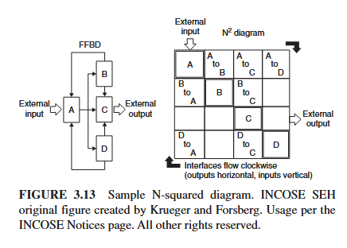
3.2.4 Interface Management
Interface Analysis - Some common diagrams, methods, and tools used for analysis include functional flow block diagrams (FFBD), data flow diagrams (DFD), context diagrams, boundary diagrams, external interface diagrams, input, process, output (IPO) diagrams, N 2 diagrams, and internal interface diagrams, Failure Modes and Effects Analysis (FMEA), System-Theoretic Process Analysis (STPA), language-based models (e.g., SysML diagrams), and simulations.

Slide 28
3.2.5 Architecture Frameworks
A set of “conventions, principles and practices for the description of architectures established within a specific domain of application or community of stakeholders.”
  A method for describing systems in terms of a set of architecture building blocks, and for showing how the
building blocks fit together.
A set of tools and a common vocabulary.
Multiple dimensions with coordinates for relating particular groups of concerns or solutions along the dimensional aspects.
Architecture activities are described in the System Architecture Definition process (see Section 2.3.5.4).

Slide 29
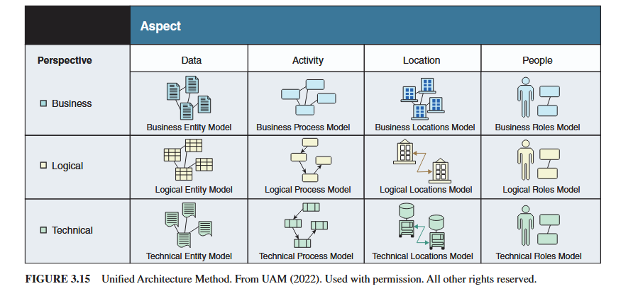
3.2.5 Architecture Frameworks

Slide 30
3.2.6 Patterns
Patterns are recurrences, repeated regularities observed across time, space, or other dimensions
In SE, recurring patterns are observable in engineered system requirements, solution architectures, stakeholder value, missions, fitness and trade spaces, parametric couplings, failure modes and risks, markets, system phenomena, principles, and the socio-technical, systems of engineering and life cycle management

Slide 31
3.2.6 Patterns
Informal Patterns - most informally described patterns are those implicit in the expertise or judgement of individual practitioners and teams (as in tribal knowledge), when subject matter experts recognize new occurrences of past experiences.
Formal Patterns - sciences’ transition from informal prose to formal models powered much of the Science, Technology, Engineering, and Math (STEM) revolution’s transformative impact, where model-based representations of patterns are the heart of the related physical sciences.

Slide 32
3.2.7 Design Thinking
Design Thinking - explores (1) the human needs, (2) the operational and business processes and reasoning by which design concepts are devised and realized, especially those which are creative in nature, together with (3) the systems being realized, (4) its specialization, and (5) their utilities and value provided for the stakeholders.

Slide 33
3.2.8 Biomimicry
Biomimicry - a practice that learns from and mimics the strategies found in nature to solve human design challenges—and find hope”
Nature inspired SE and biomimicry can improve processes, practices, and products through the understanding of how nature is structured, behaves, adapts, interacts, accomplishes functions, and recovers from disturbance.
Over time, natural systems have developed a very close fit to their surroundings and other systems. The result is that they exhibit optimized attributes that often exceed the performance of engineered systems.

Slide 34
Review Question:
Which of the following are enabled by digital engineering? (Choose three)
Digital artifacts
Digital authorities
Digital threads
Digital twins
example

Slide 35
Review Question:
Which of the following are enabled by digital engineering? (Choose three)
Digital artifacts
Digital authorities
Digital threads
Digital twins
example
X
X
X

